Slide 1

Ancient Egypt - Homes

Slide 2
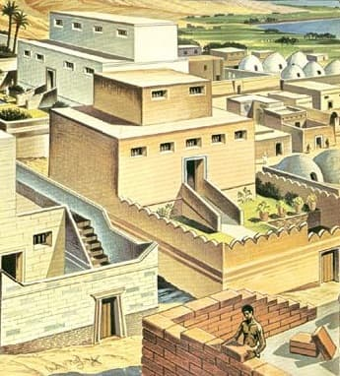
Ancient Egyptian Homes:
Average family lived in sun baked mud homes.
Usually one-floor & small.
Had a basement & four rooms.
Had little furniture & few windows.
Had flat roofs - could be slept on when it was too hot inside.
Rich homes were made from brick & wood.
Had many rooms including walled garden.
Often had a room that was a shrine to their favourite God.

Slide 3
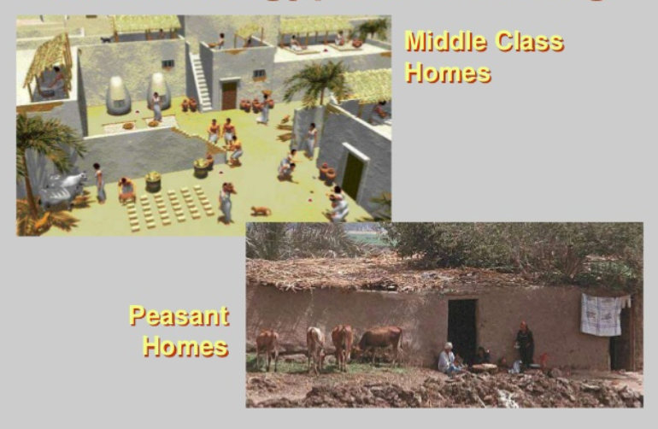

Slide 4
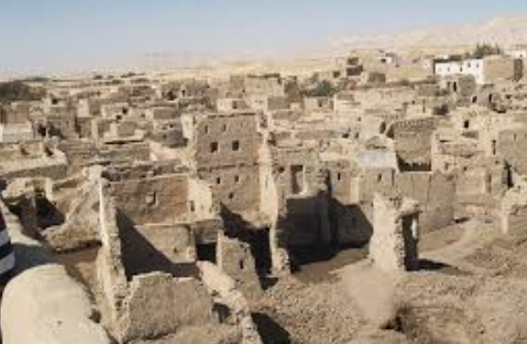
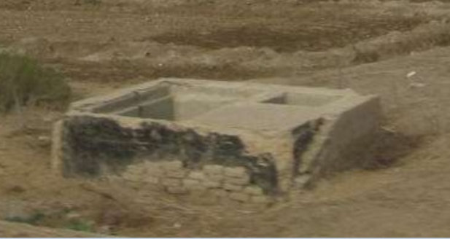
What can we tell from these pictures?

Slide 5
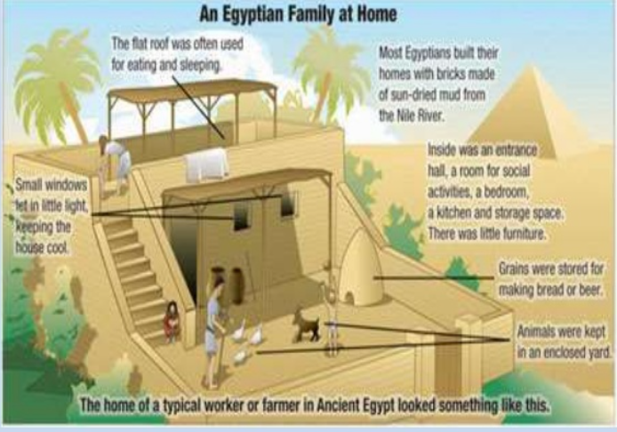

Slide 6
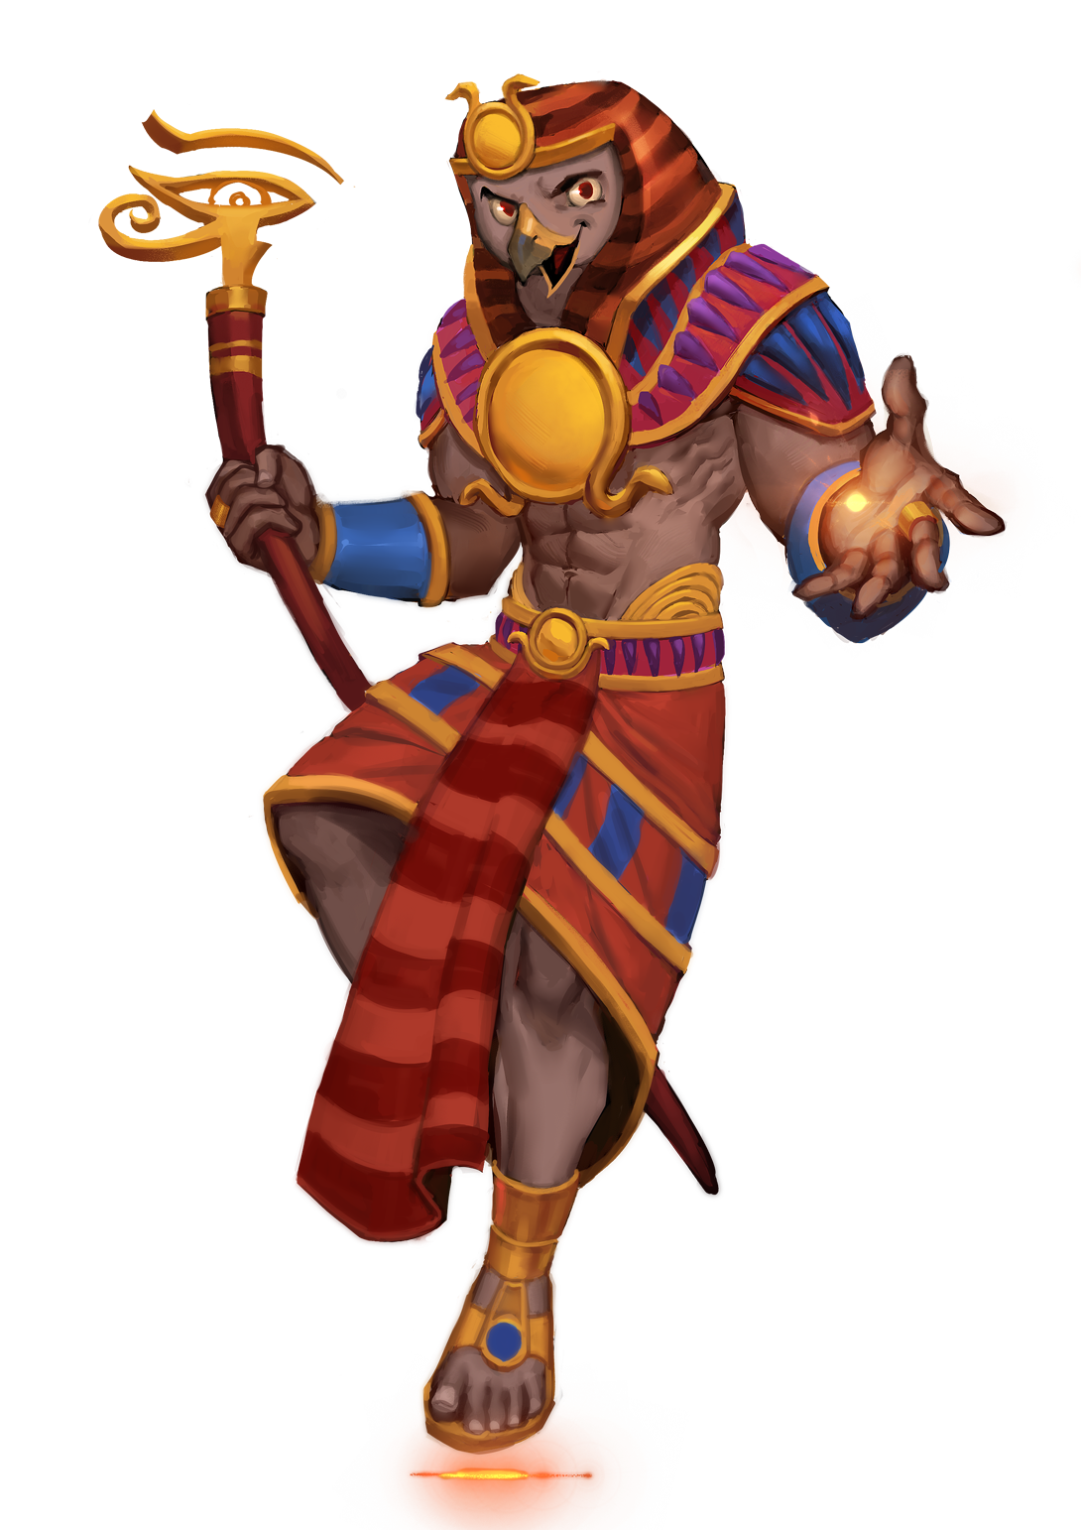
Your task:
You need to design, make or draw an Egyptian house using the facts we have learnt.
You can use anything to make it: a box, lego, other construction material or you can simply draw and label one.
Remember:
-a flat roof
Small windows
a walled garden
If you are making an inside, remember it was very basic with only maybe four rooms and little furniture.
Have fun, wecan’t wait to see them.

