Slide 1
Ancient Egyptian gods

Slide 2
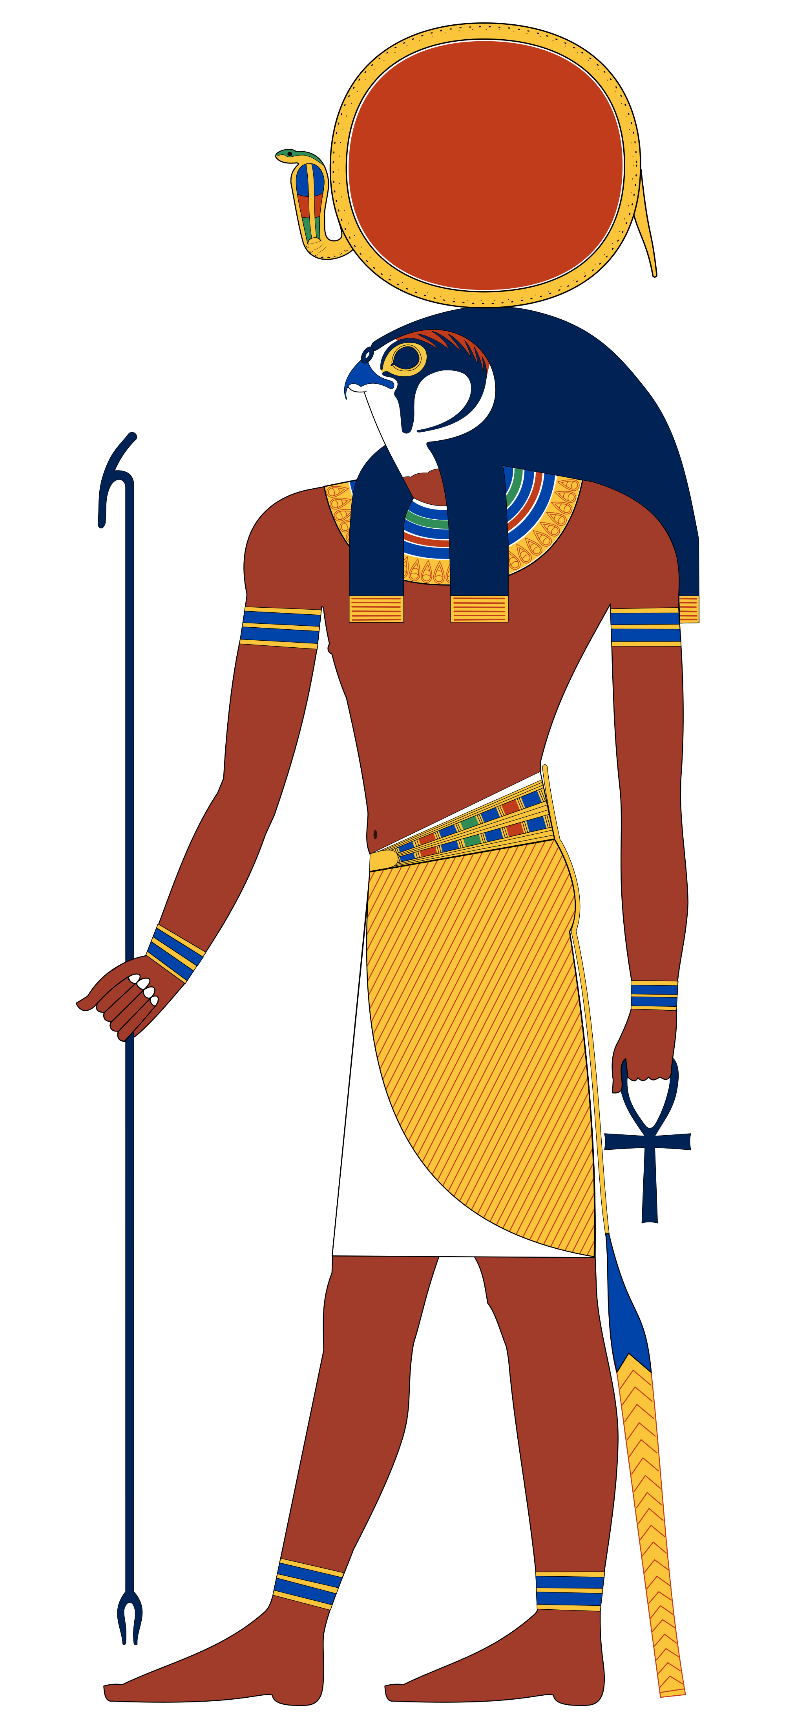
amun
I am Amun.
I am the god of the air, sun and the sky. During the New Kingdom, I became the national god of Egypt and merged with Ra, the sun god as Amun-Ra. I have blue skin and a double plume crown.

Slide 3
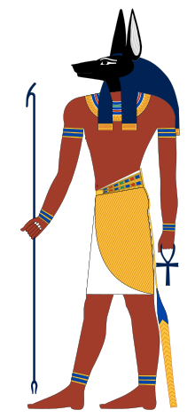
anubis
I am Anubis.
I am linked to the mummification process. According to the Book of the Dead, after a person dies, I weigh the heart against the Feather of Truth. Only if the heart weighed less than the feather, the person would enter the afterlife. If not, you would be eaten by a god which was part lion, part crocodile and part hippopotamus. I have the head of a jackal.

Slide 4
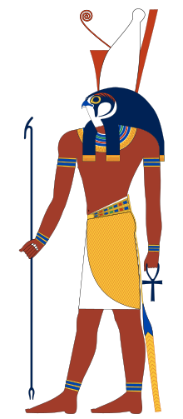
horus
I am Horus.
I am the god of the sky and the son of Isis and Osiris. I fought my uncle Seth to become the King of Egypt. In the process, I lost an eye. The Eye of Horus has become one of the most famous symbols of Ancient Egypt. It has become an amulet which is believed to help fight off evil, danger and disease. I have the head of a falcon.

Slide 5
ra
I am Ra, also known as Amun-Ra.
I am the sun god but I also have a falcon head, although I have a circle to represent the sun on top of my head. The sun has a sacred cobra around it. I look like lots of other gods because I am ‘the father of the gods.’

Slide 6
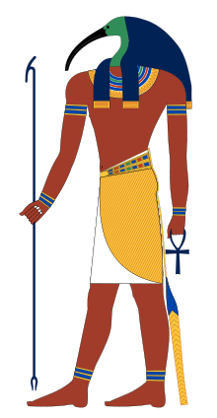
thoth
I am Thoth.
I am the god of knowledge, truth and hieroglyphics. I don’t have any parents because I created myself. I have many jobs including looking after the universe, settling arguments and judging people when they die. I have the head of an ibis, which is a long and slim bird with a curved beak.

Slide 7
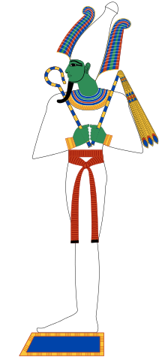
osiris
I am Osiris.
I am god of death, the underworld and rebirth. I was murdered by my jealous brother Seth. It was believed that I died by the powers of evil and therefore, I became a very important god. I have green skin and wear a white headdress which looks like a cone. I also carry a flail and a crook which were symbols of power and kingship linked to the pharaohs.

Slide 8
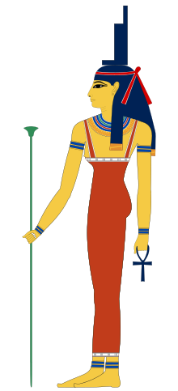
isis
I am Isis.
I am a very important god who is in charge of protection, children, nature, motherhood and healing. I wear a long dress and a crown which is the hieroglyph for a throne. More importantly, I am pictured wearing an Ankh. This is the symbol for immortality or eternal life and it looks like a key.

Slide 9
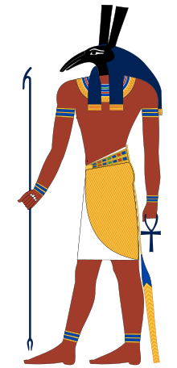
seth
I am Seth.
I am known as the god of chaos. At first, I was a very valuable god. Over time, I became very unpopular and had lots of enemies, especially from supporters of Horus. I murdered my brother Osiris and became the god of darkness. I have the head of what the Egyptians called the Seth Animal. I have a pointed snout and tall rectangular ears. I have a thin body with a forked tail.

Slide 10
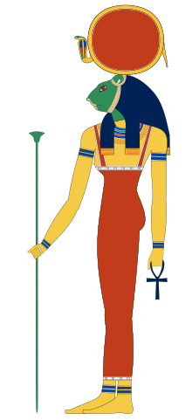
sekhmet
I am Sekhmet.
I am ‘The Great Lady, the holy one, the powerful one.’ I am a goddess of war and always use weapons such as arrows, darts and the fiery heat of my own body, which came from the sun. I have the body of a woman but the head of a lion. Like Ra, I have a headdress with a sun disk encircled with the sacred cobra.

Slide 11
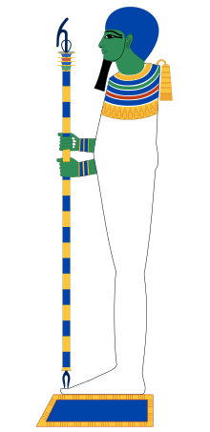
ptah
I am Ptah.
According to the Book of the Dead, I was a master architect and was responsible for building the structure of the universe. I made a great metal plate which was the floor of Heaven but the roof of the sky. I also have green skin and am a bald headed man. I have a beard and wear tight-fitted clothing so I look a bit like a mummy.

Slide 12
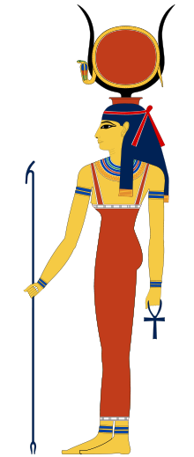
hathor
I am Hathor.
I am the goddess of love, beauty, music and laughter. My name means ‘House of Horus.’ There was an ancient myth which told the story of Hathor being a cow standing on the earth. Horus would fly into my mouth every evening. I am shown as being a cow or having horns like a cow.

Slide 13
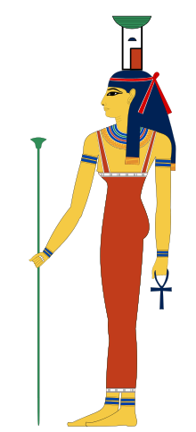
Nephthys
I am Nephthys.
I am the goddess of mourning as well as the goddess of night and sleep. I am a friend and protector of the dead. I am the sister of Isis and Osiris and the wife of Seth. I found my brother’s body when he died and helped rebuild him to come back to life. I am always shown as a woman with a basket and house on my head.

Slide 14
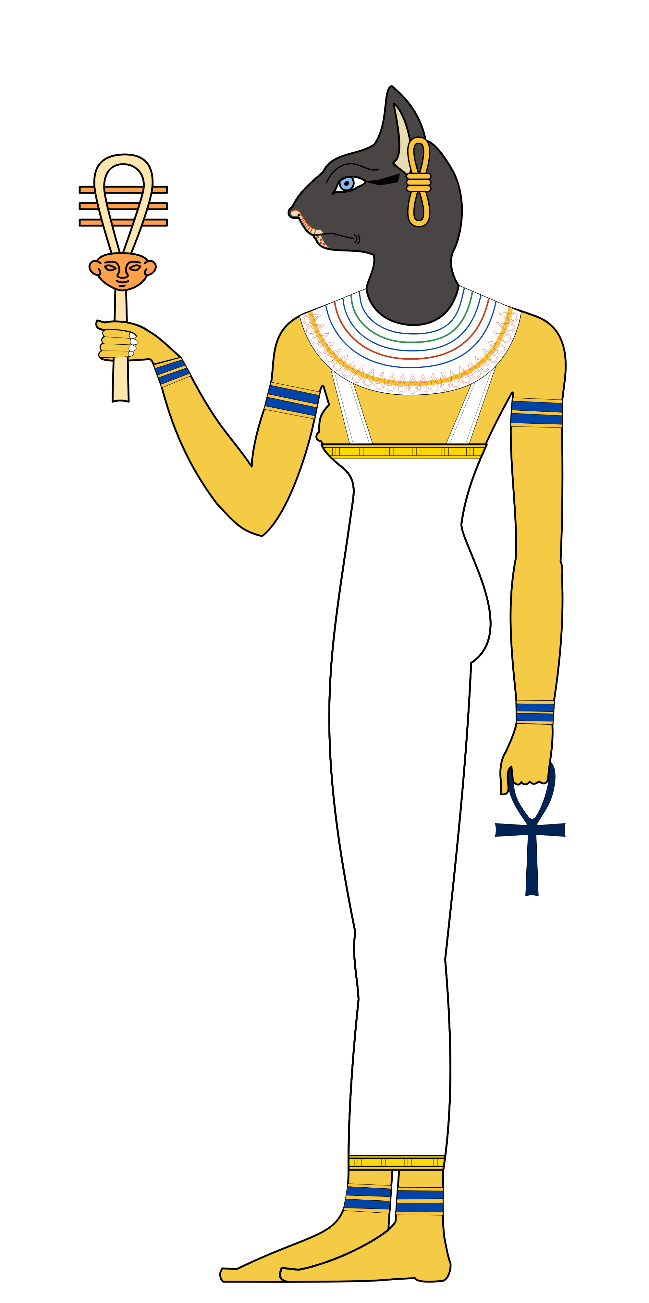
bastet
I am Bastet.
I am the goddess of Ancient Egyptian religion as well as the home. I protect homes from evil spirits and disease. I was a helper and guide to people in the afterlife, although this was not my main role. At first, I was shown as being a woman with the head of a lioness but over time, this changed to a black cat instead.

