Slide 1
Ancient Egyptian Pharaohs

Slide 2
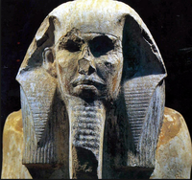
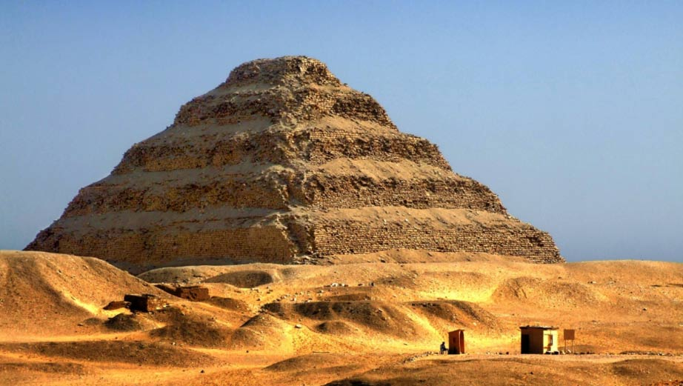
Djoser
Reigned 2686 BC – 2649 BC
Famous for overseeing the building of a step pyramid. This was the first of its kind!

Slide 3
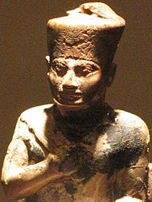
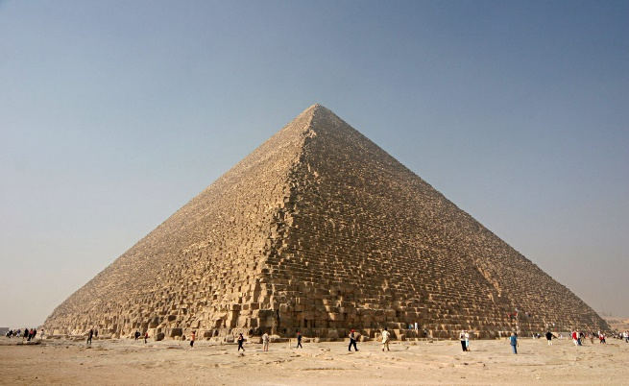
Khufu
Reigned 2589 BC – 2566 BC
Famous for building the Great Pyramid of Giza. This was the tallest man-made building for almost 4000 years!

Slide 4
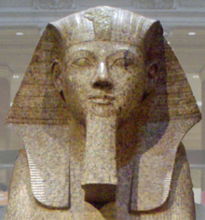
Hatshepsut
Reigned 1478 BC – 1458 BC
The second woman to rule in Egypt. She put important trade routes in place.

Slide 5
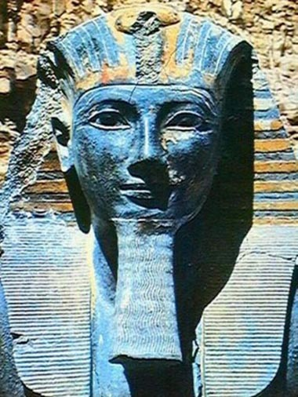
Thutmose III
Reigned 1458 BC – 1425 BC
He was an expert in the military and never lost a battle whilst he reigned as pharaoh.

Slide 6
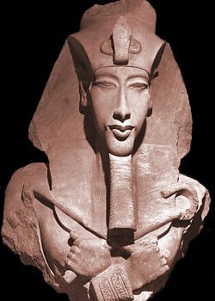
Akhenaten
Reigned 1351 BC – 1334 BC
He made the people believe in one true god: Aten, the Sun God.
After he died, Egypt turned back to believing in many gods.

Slide 7
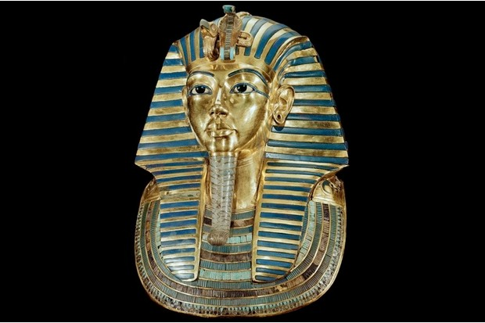
Tutankhamun
Reigned 1332 BC – 1323 BC
The youngest pharaoh in Egyptian history. He became pharaoh at nine or ten years old.
He reigned for only ten years and died aged 20.
His tomb was discovered in 1922 by Howard Carter and Lord Carnarvon.

Slide 8
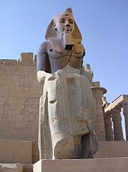
Ramses II
Reigned 1279 BC – 1213 BC
He had 96 children and ruled for 67 years.

Slide 9
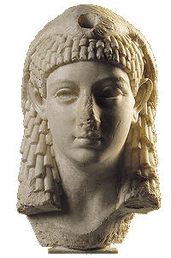
Cleopatra VII
Reigned 51 BC – 30 BC
She was the last ruler of the Egyptian Empire.
Cleopatra was very attractive but was an outstanding ruler too.

