Slide 1
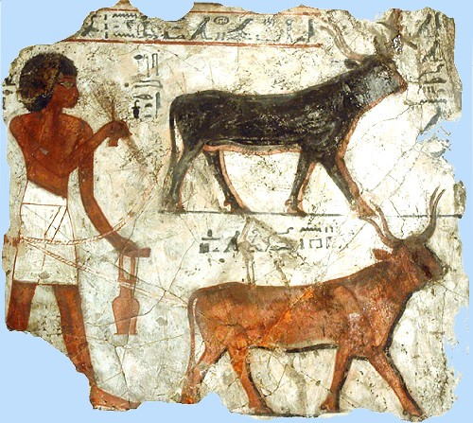
Farming in Ancient Egypt

Slide 2
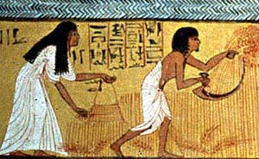
Who were the farmers in Ancient Egypt?
The pharaoh employed rich peasants to do farm work on the land.
Most villagers were farmers.
Farmers also lived in the towns.

Slide 3
Growing crops in Ancient Egypt
Egyptians grew crops such a wheat, barley, vegetables, figs, melons, pomegranates and vines.
The most important crop to grow was grain. The Egyptians used grain to make bread and porridge. This was the first crop to be planted after the flooding season. They then could plant vegetables such as onions, leeks, cabbages and cucumber.
Farmers planted fruit trees and vines along the paths to not only provide fruit but shade as well.
Farmers used the banks of the River Nile to plant crops and farm because of the rich black soil from the yearly floods. The fertile soils helps grow healthy crops and plants.

Slide 4
Farming Seasons
Egyptian farmers spilt the year into three seasons based on cycles of the River Nile.
Ahket – the inundation (June-September): The Flooding Season. No farming was done during this period, as all the fields were flooded. Instead many farmers worked for the pharaoh, building temples and pyramids. Some of the time was spent mending tools and tending to animals.
Peret (October-February): The Growing Season. In October, the flood waters receded, leaving a layer of rich, black soil. This fertile soil was then ploughed and seeded.
Shemu (March- May): The Harvesting Season. The fully grown crops had to be cut down and removed before the Nile flooded again. It was also time to repair canals before the flooding started.

Slide 5
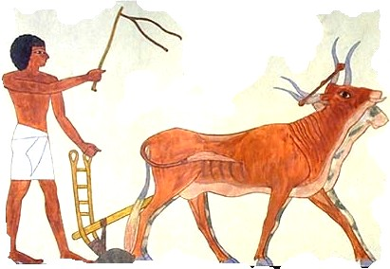
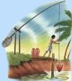
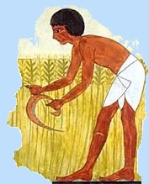
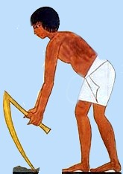
Farming Tools
Farmers used flint-bladed sickles, rakes, hoes and ploughs to plant and harvest the crops. They could also use a shaduf to water the plants.

