Slide 1
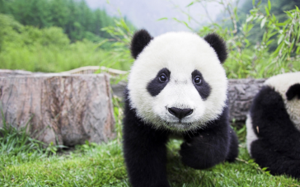
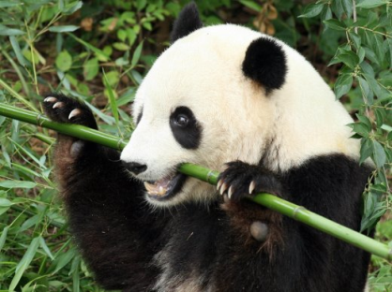
Pandas
Pandas are the national animal of China. They are related to bears and have black eye patches.
What do pandas look like?
There are two different types of panda. The giant panda is the most well known but the red panda also lives in the mountains in China. The red panda has a long tail and is the same size as a cat. The giant panda is much bigger and has black and white fur. Both the red and giant pandas are have long, sharp claws that they use to climb trees and strip bamboo.
What do pandas eat?
Pandas are very fussy eaters. Most pandas only eat bamboo, a type of grass. A giant panda will eat half their own weight in bamboo every day.
Did you know?
Pandas are endangered and if they are not looked after could become extinct.
What do pandas do?
Pandas spend most of their time eating or sleeping. Young pandas like to play with each other and can be very naughty!
What does the future look like for pandas?
There are not many pandas left in the world. They are a symbol for animal conservation. This means that people are doing their best to save the pandas.
A giant panda eating bamboo.

Slide 2
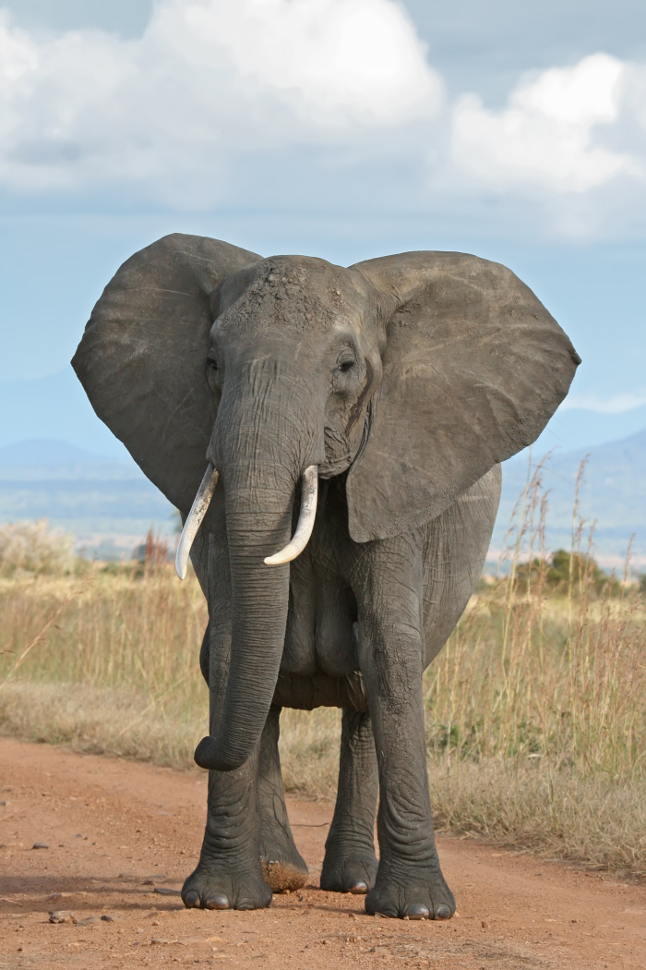
Elephants
Elephants live in Africa and India and are the largest animals that live on land.
What do elephants look like?
Elephants have tough grey skin and large ears. They have a long nose called a trunk that they use to drink water. African elephants have bigger ears than Indian elephants. Elephants have tusks to protect them from other animals.
What do elephants eat?
Elephants are herbivores and eat bark and leaves from trees.
What do elephants do?
Elephants are usually very gentle but can get quite cross. Elephants are very clever and know how to find water even when it is far away. When they find water they like to swim.
A bull elephant
Did you know?
A mother elephant is called a cow. The dad is a bull and a baby is called a calf!

Slide 3
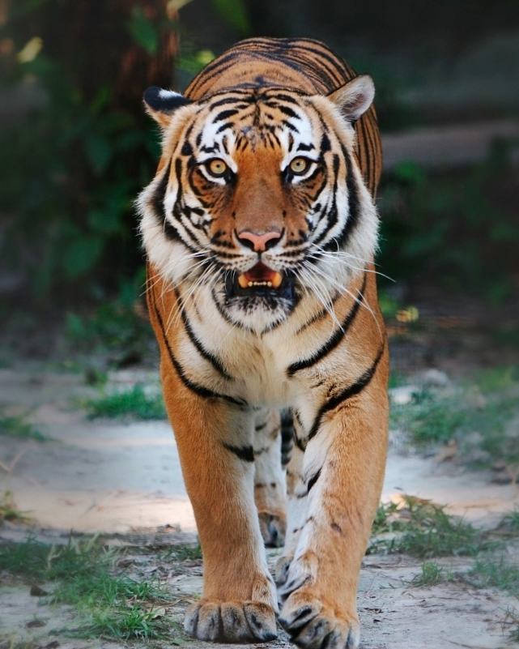
Tigers
Tigers are a type of big cat that live in India and are very dangerous.
What do tigers look like?
Tigers have orange fur with black stripes so they can hide in tall grass.
What do tigers eat?
Tigers are carnivores. They hunt for their food.
What do tigers do?
Tigers live on their own. They like to hunt and are the only big cat who likes to swim.
A male tiger
Did you know?
Tigers are an endangered species. That means there are not many left in the wild.

