Slide 1
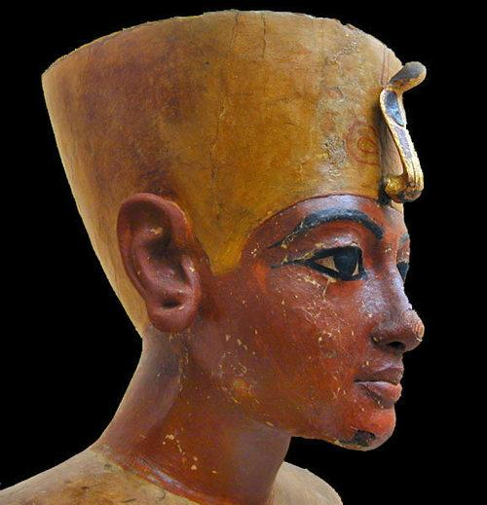
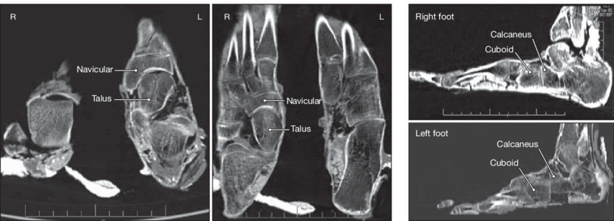
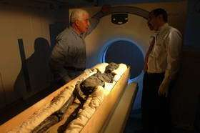
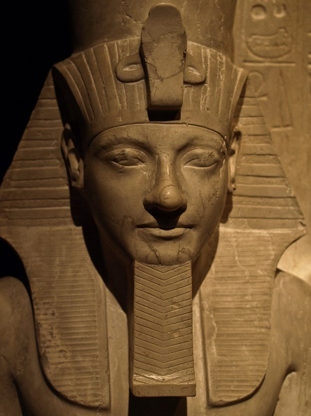
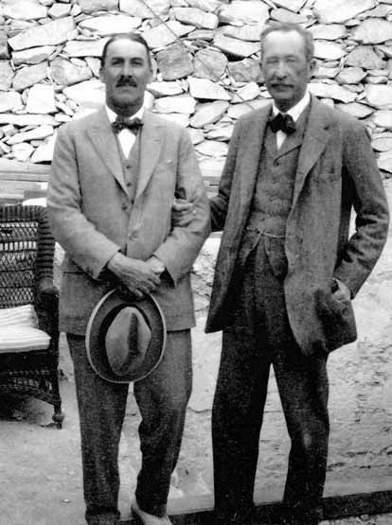
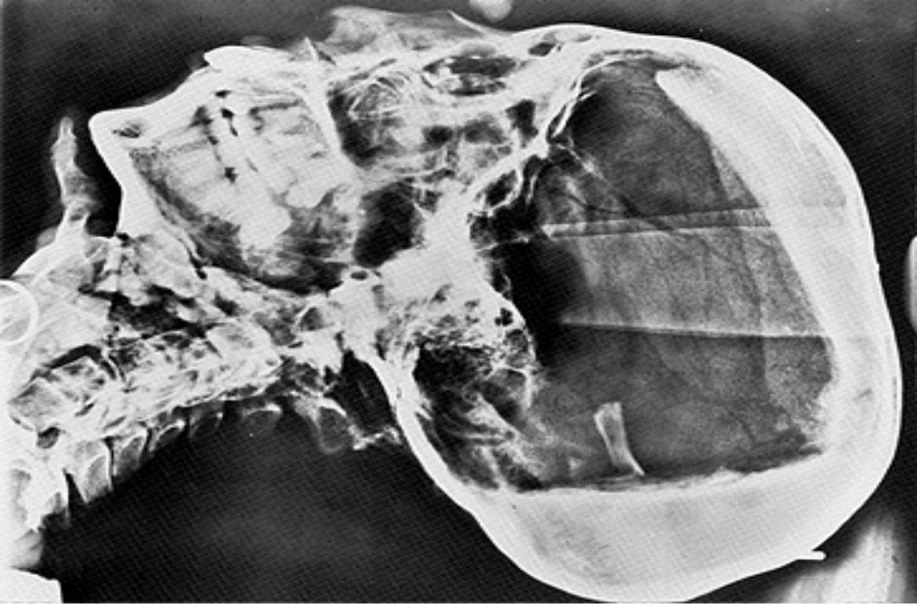
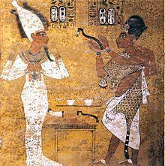
Was
Tutankhamun Killed?

Slide 2
Background Information
Akhenaten was pharaoh of Egypt and father to Ankhesenamun and Tutankhamun.
Ahkenaten wanted everyone to believe in one god Aten. They had previously believed in lots of gods. He upset a lot of people, especially the priests. This led to his downfall.
Tutankhamun was born at a time of change. Ahkenaten was not a popular pharaoh because he turned a once rich and powerful country into one which almost lost everything.
Tutankhamun restored Egypt’s religious beliefs. The Egyptians were allowed to believe in many gods again, just like they had done before Ahkenaten reigned.

Slide 3
Victim - Tutankhamun
Tutankhamun was a pharaoh of Egypt. He became pharaoh at nine years of age after his father Akhenaten died.
Due to Tutankhamun’s age, it was decided that Ay would become his adviser and be in charge of making important decisions.
Tutankhamun was married to his half-sister Ankhesenamun.
Tutankhamun did not take part in any military campaigns himself, possibly because of his poor health. Despite his poor health, no one was prepared for the sudden shock of his death.
Records suggest that Tutankhamun was just 18 or 19 years old when he died.
Tutankhamun was buried hurriedly in a tomb built for someone else. It wasn’t discovered for many thousands of years. Perhaps this burial was to hide his death for as long as possible.

Slide 4
The Excavation of Tutankhamun’s Tomb
Howard Carter worked with a man called Theodore Davis. Davis held the concession for the Valley of the Kings. Howard desperately wanted to find Tutankhamun’s tomb.
In 1914, Davis was very old and ill and he finally gave up his concession and a man called Lord Carnarvon was able to buy it. Carter worked for ten years and had nothing to show for it.
On Carter’s last dig at the Valley of the Kings (4th November 1922), a waterboy found the first step of the entrance of Tutankhamun’s tomb. Inside were ‘wonderful things.’

Slide 5
Suspects – Ay and Horemheb
Ay was Tutankhamun’s great-uncle but also an adviser to the young pharaoh.
Horemheb was the general of the Egyptian army.
The burial was not hidden from Ay as he oversaw the burial. However, it may have been his idea to hide the death from Horemheb, to give Ay time to be crowned as pharaoh.
Ay and Horemheb wanted to become pharaohs. When Horehem became pharaoh, he started to destroy everything to do with Tutankhamun.
After Tutankhamun’s rule, both Ay and Horemheb would go on to become pharaohs.

Slide 6
Motive
Both Ay and Horemheb had something to gain if Tutankhamun was out of the way. Both of them wanted power and the title of being ruler of Egypt.
Horemheb was away with the army at the time of Tutankhamun’s death. This would have given Ay time to bury Tutankhamun and quickly claim the title of pharaoh before Horemheb found out.
After Tutankhamun died, his wife Ankhesenamun was left without a husband. She asked the king of the Hittites to send her a son to marry. A son was sent but on the way back to her, he was ambushed and killed.
It is possible that Ay married Ankhesenamun. She wouldn’t have been very happy about this as he was a lot older than her. She was probably forced into marriage with Ay.
Perhaps it was Horemheb that was supposed to marry Ankhesenamun. It may have been him who intercepted her letters and had the Hittite prince killed. Horemheb could not marry Ankhesenamun because he was a commoner.

Slide 7
Important Evidence – Part 1
One painting was discovered in the Burial Chamber of Tutankhamun’s tomb. It showed Ay performing the ‘Opening of the Mouth’ ceremony. The Ancient Egyptians believed that a dead body needed food and water to survive in the afterlife. The soul needed food and water so they could eat and drink again in the afterlife.
The painting was unusual because Ay was wearing a crown when he performing the ‘Opening of the Mouth’ ceremony. Traditionally, the new king could not be crowned until the last one was sealed in his tomb.
During the excavation of Tutankhamun’s tomb, Carter noticed that the paintings covering the walls of the tombs had been rushed and finished quickly. He looked for more clues and find more evidence that Tutankhamun had been buried very quickly too.
The sarcophagus lid had been broken and hastily repaird before the burial. This did not look like the carefully planned tomb of a king.
When a new pharaoh started his or her reign, they would start to build and decorate their tomb in preparation for a royal and expensive burial.

Slide 8
Important Evidence – Part 2
Inside the sarcophagus were three decorated human-shaped coffins. Each one showed a painted death mask. The second mask did not look the same as the other two. If they were all made for Tutankhamun, they would have probably matched.
Inside the third coffin, it appeared that a quantity of thick, black liquid had been poured into this coffin and it had done a considerable amount of damage. Was this a sign that the mummification had been rushed.
There were lots of shabtis in Tutankhamun’s tomb. A shabti was buried with a person to act as their servant in the afterlife. Usually one or two were buried but Tutankhamun had 413 found in his tomb. It was strange because lots of the shabtis didn’t have Tutankhamun’s name on them.
Tutankhamun was buried in a private, but not a royal tomb. It is unknown who was supposed to be buried them instead.
130 walking sticks were found in Tutankhamun’s tomb as well as lots of paintings on the wall depicting Tutankhamun walking with them.

Slide 9
Scientific Evidence – Part 1
Scientists now know from recent research that Tutankhamun had malaria at the time of his death.
Howard Carter was disappointed to find that the first examinations of Tutankhamun’s mummy were unable to confirm a cause of death.
In 1968, a series of x-rays showed there was a small piece of bone within the skull, possibly from a blow to the head.
The bone found inside his skull had been broken during mummification.

Slide 10
Scientific Evidence – Part 2
Studies have been made since 1922 in forensic archaeology and genetics which have helped to some of the mysteries surrounding Tutankhamun’s death.
A CT scan revealed that Tutankhamun had not been murdered, nor had he died from a blow to the head.
Bone conditions would have been very painful but not killed Tutankhamun. They could have weakened him so that he became ill with a strain of malaria.
A later investigation showed that Tutankhamun had a bone disease which had destroyed the bone of one of his toes and part of his foot. He also had an unhealed break in his leg and a club foot. This meant he would have found it difficult to walk, so he must have needed a walking stick to move around.

