Slide 1

My Nanny
By Bella Hammond
When my nanny was little she did not have a Christmas tree.
My nanny would lay a pillow case at the bottom of her bed and Santa would put her presents in the pillow case on Christmas Eve.
The pillow case would be full of apples,oranges,nuts and a nutcracker to open the nuts.
My nanny made her own decorations.
She made them with sticky coloured paper and rolled them into loops to make streamers.
They did not have baubles because they did not have a tree.
For Christmas dinner they had chicken.
At night time they would visit their family.
There would be so many people in one house. About 50!
Nanny’s aunty would play Christmas carols on the piano and they would all sing songs.
I want to learn to play the piano so we can all sing songs.

Slide 2
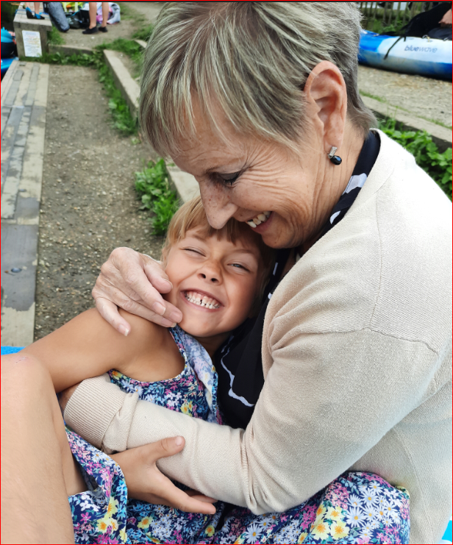
My Nanny
By Bella Hammond

