Slide 1
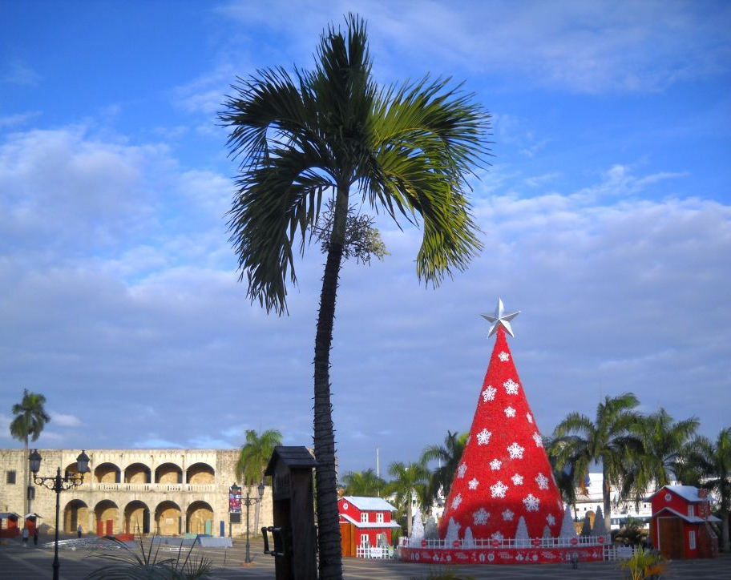
Christmas in the Dominican Republic (DR) Aunty Vee By Charlotte Freestone
Notes:
Welcome to my presentation.
Today I’m going to tell you about Christmas in the Dominican Republic
<number>

Slide 2
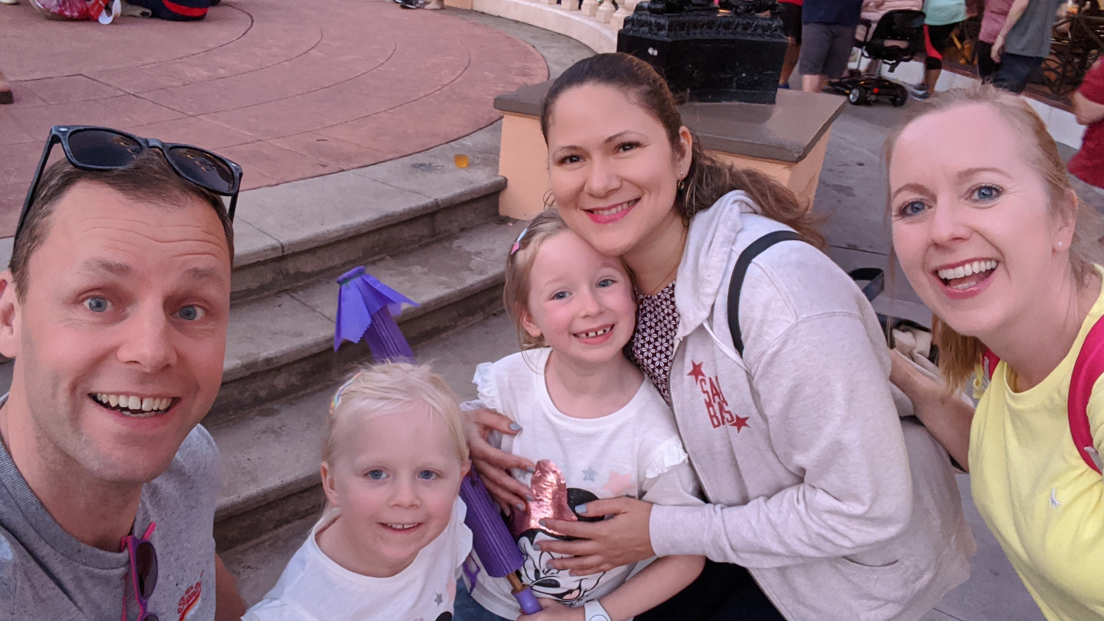
My Aunty Vee
Born and grew up in DR
Notes:
This is my Aunty Vee
She was born and grew up in DR
<number>

Slide 3
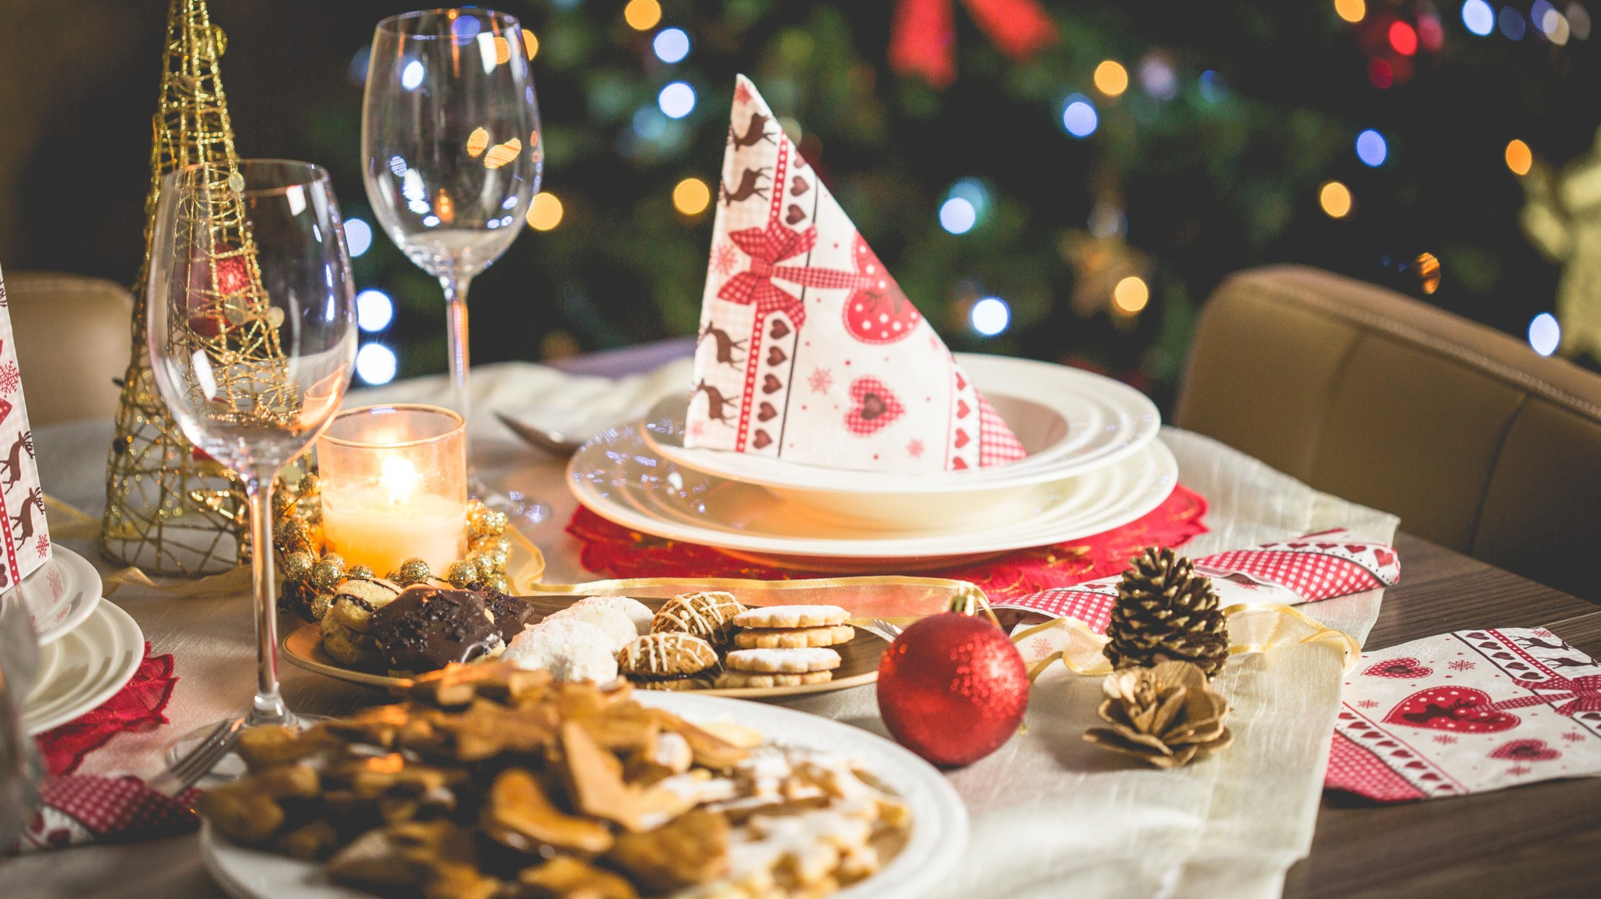
Dinner
Dinner is on the 24th, the day before Christmas, instead of 25th
Notes:
In DR dinner is on the 24th, the day before we have our dinner
<number>

Slide 4
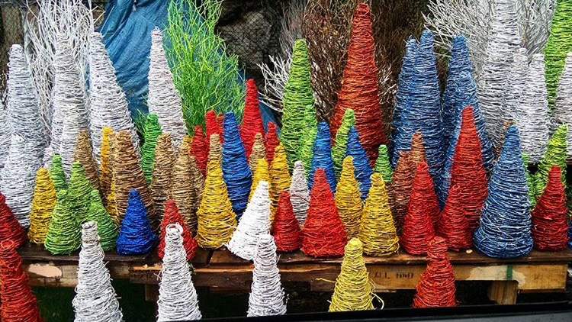
Christmas Tree
These are the DR Christmas trees
They are made of wood
Notes:
These are the DR Christmas trees
They are made of wood
<number>

Slide 5
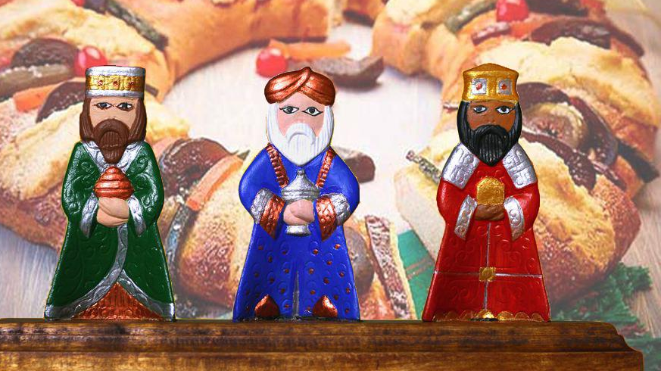
No gifts on Christmas Day
No gifts until the day of the kings
Day of the kings is 5th January
Notes:
In DR they do not have gifts on Christmas Day like we do, they have them on the day of the kings
The day of the kings is on the 5th January
<number>

Slide 6
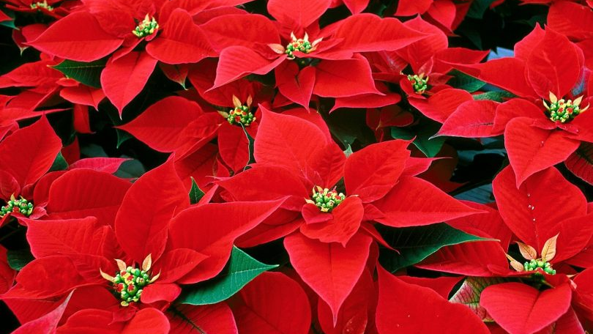
Christmas Flowers
Christmas flowers are the star of the birth of Jesus
Notes:
These are the DR Christmas flowers, they are red and star shaped, and they mean the star of the birth of Jesus
<number>

Slide 7
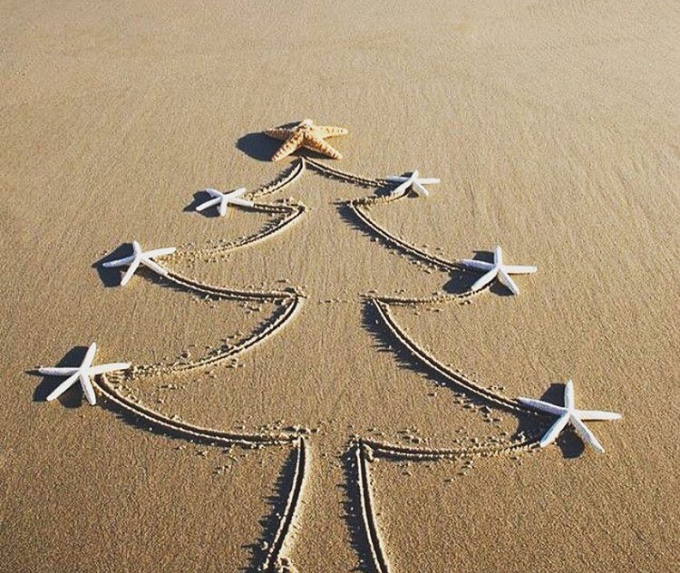
Thank you
Notes:
Thank you, I hope you liked my presentation

