Slide 1
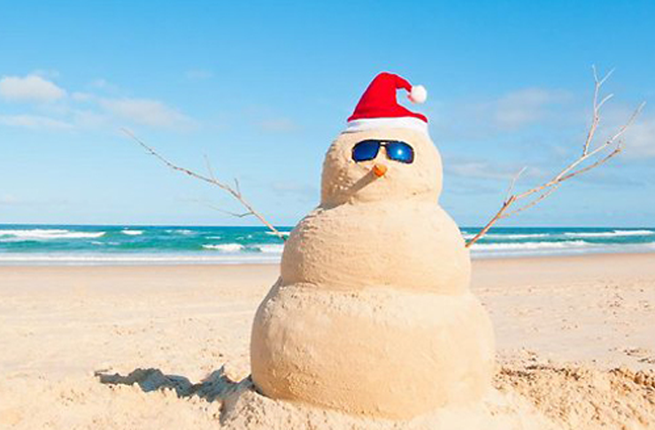
Christmas in Australia

Slide 2
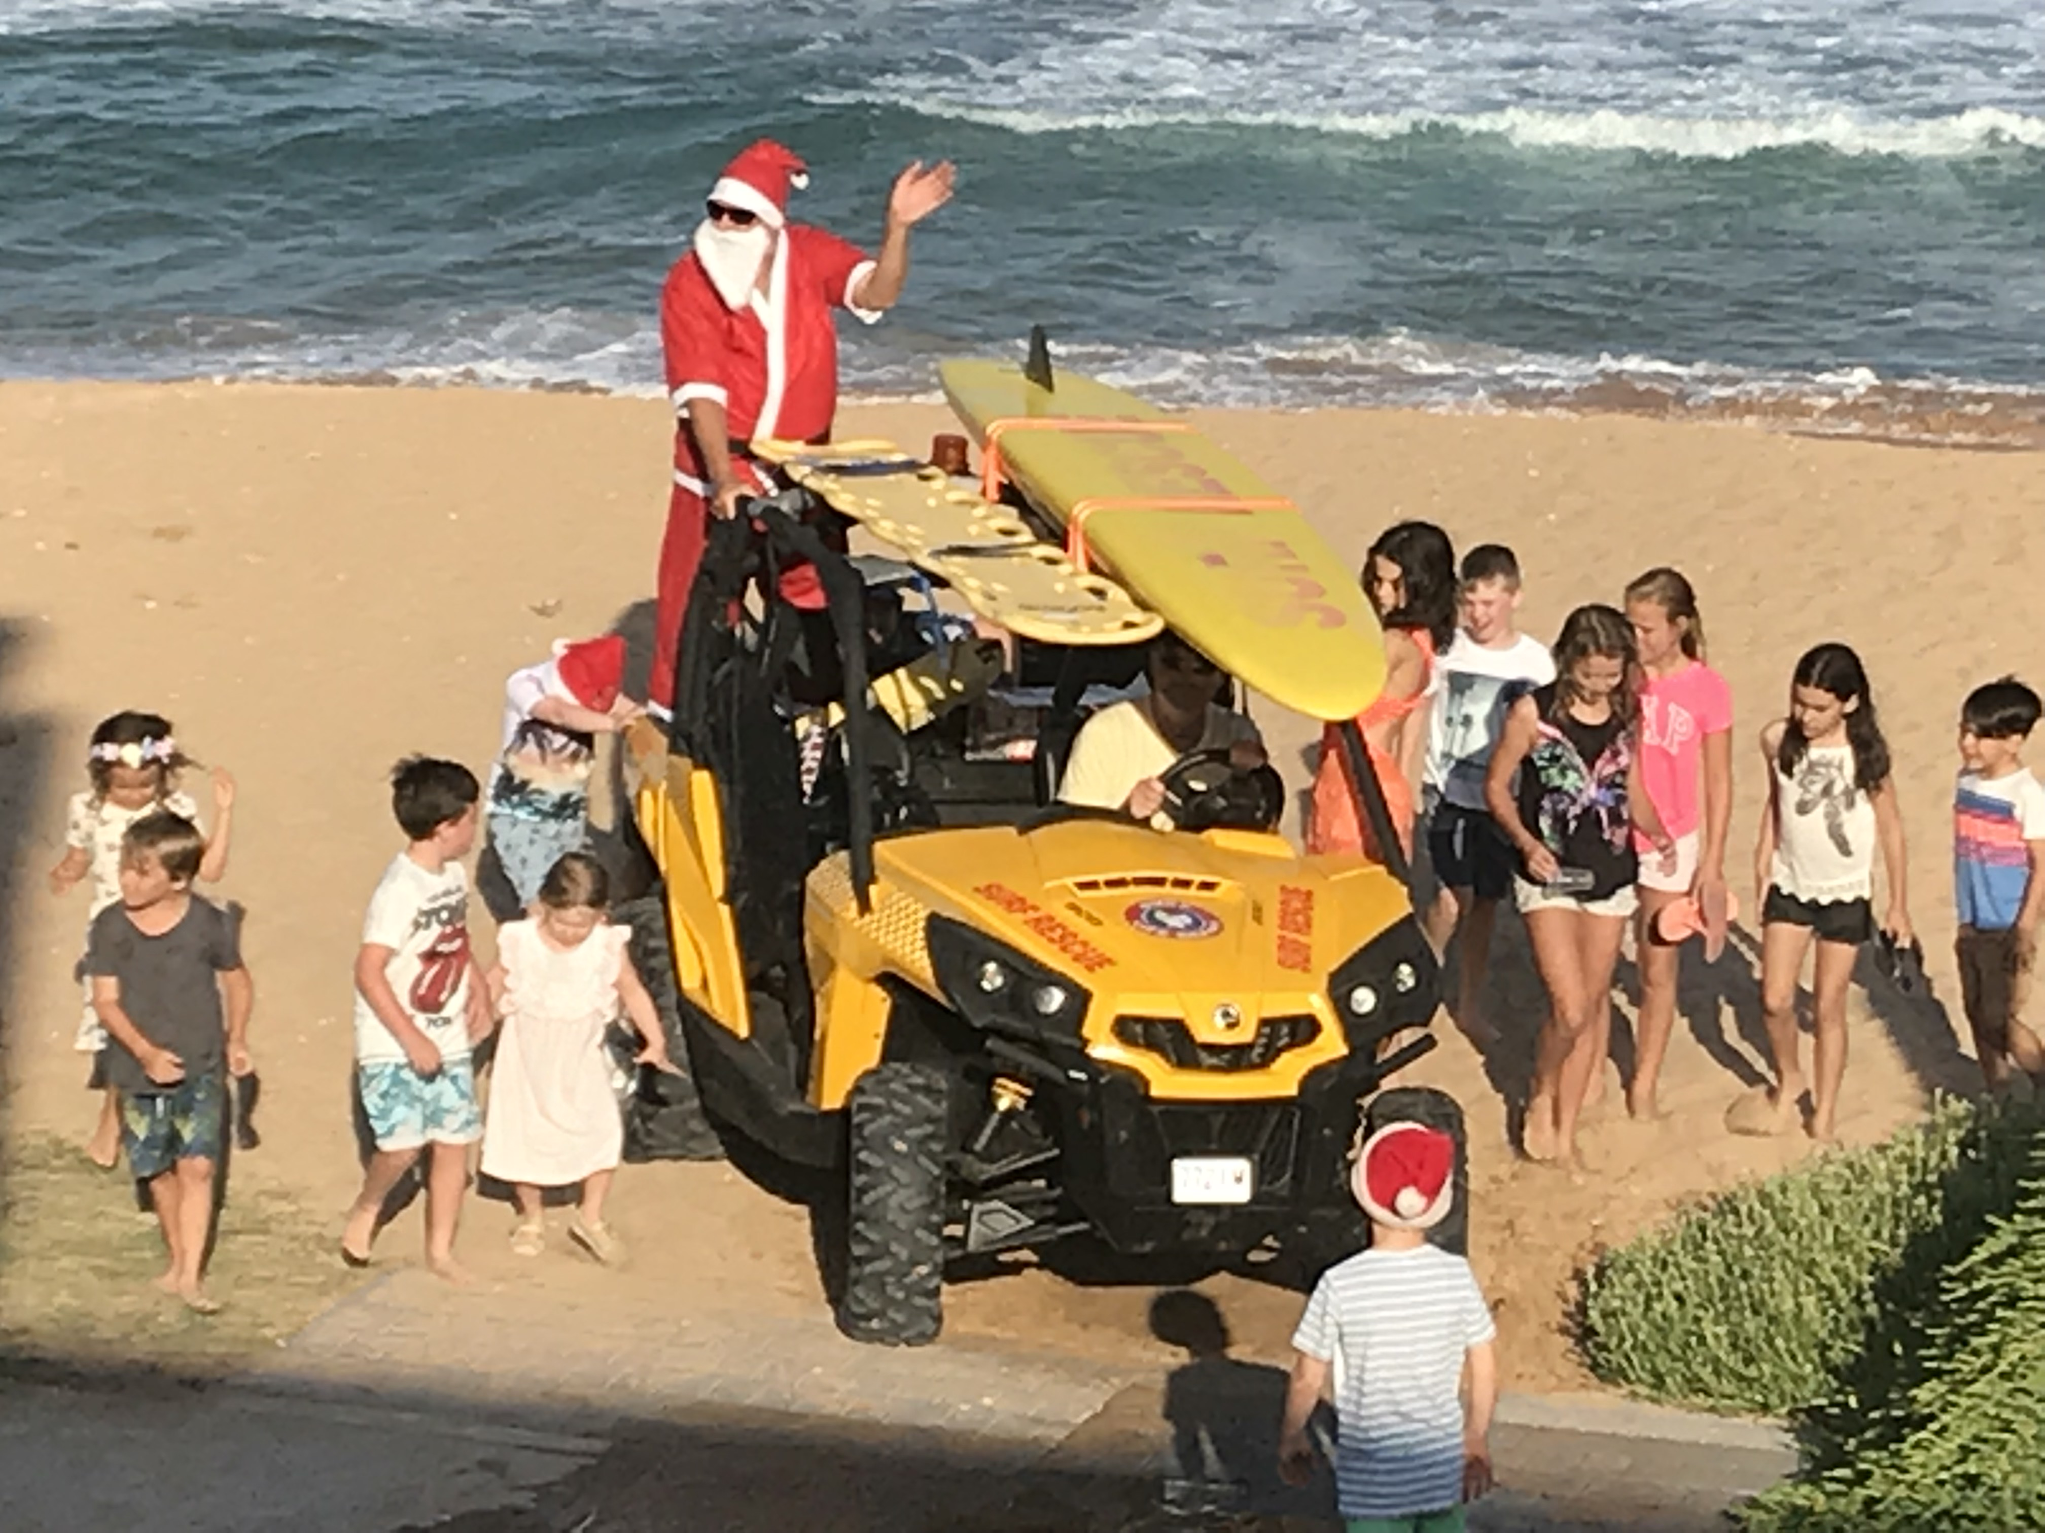
Christmas in Australia is similar to England but
Christmas in Australia is in Summer (still 25th of December).
We often start Christmas with a swim at the beach before breakfast

Slide 3
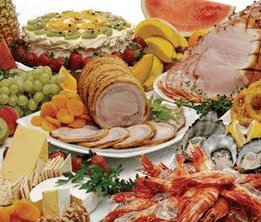
Because the weather is hot, Australians often eat salads, seafood and cold meat on Christmas Day.

Slide 4
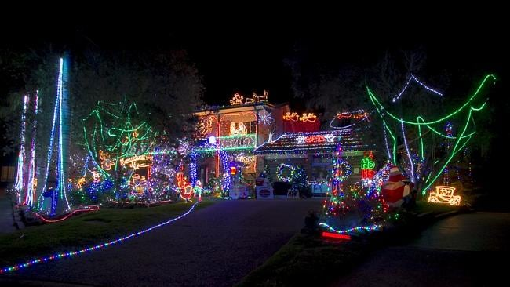
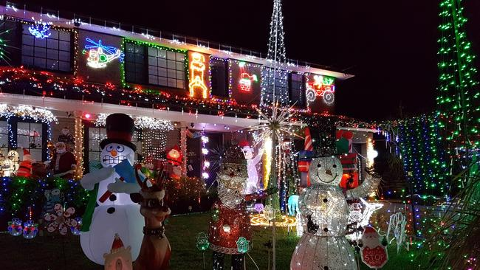
People decorate their houses with lights and go for walks to see them.

Slide 5
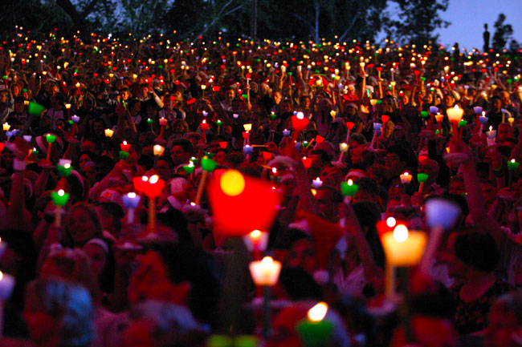
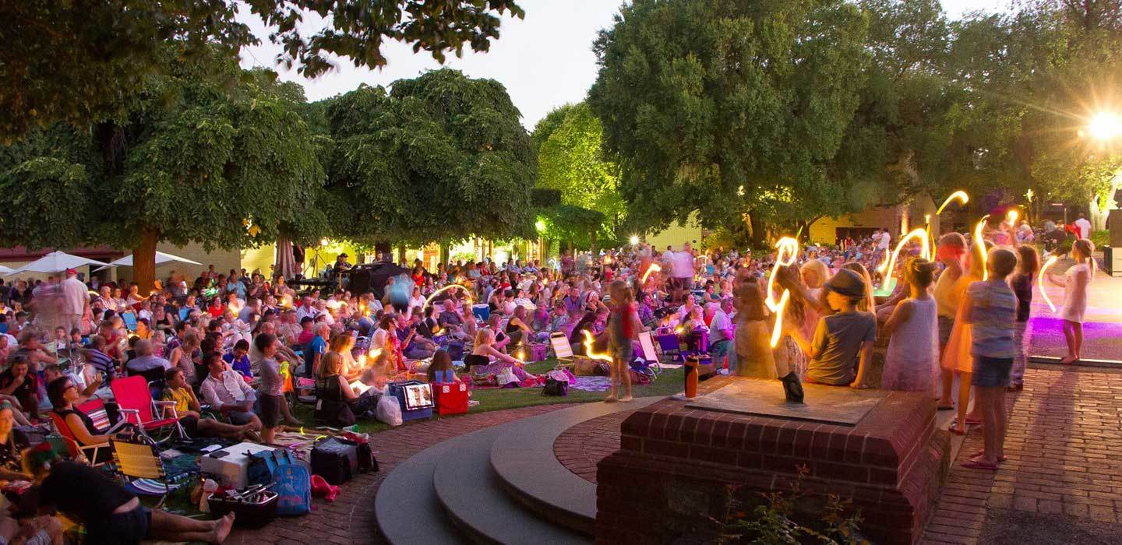
Christmas carols are sung in parks at night. People have candles and torches.

