Slide 1
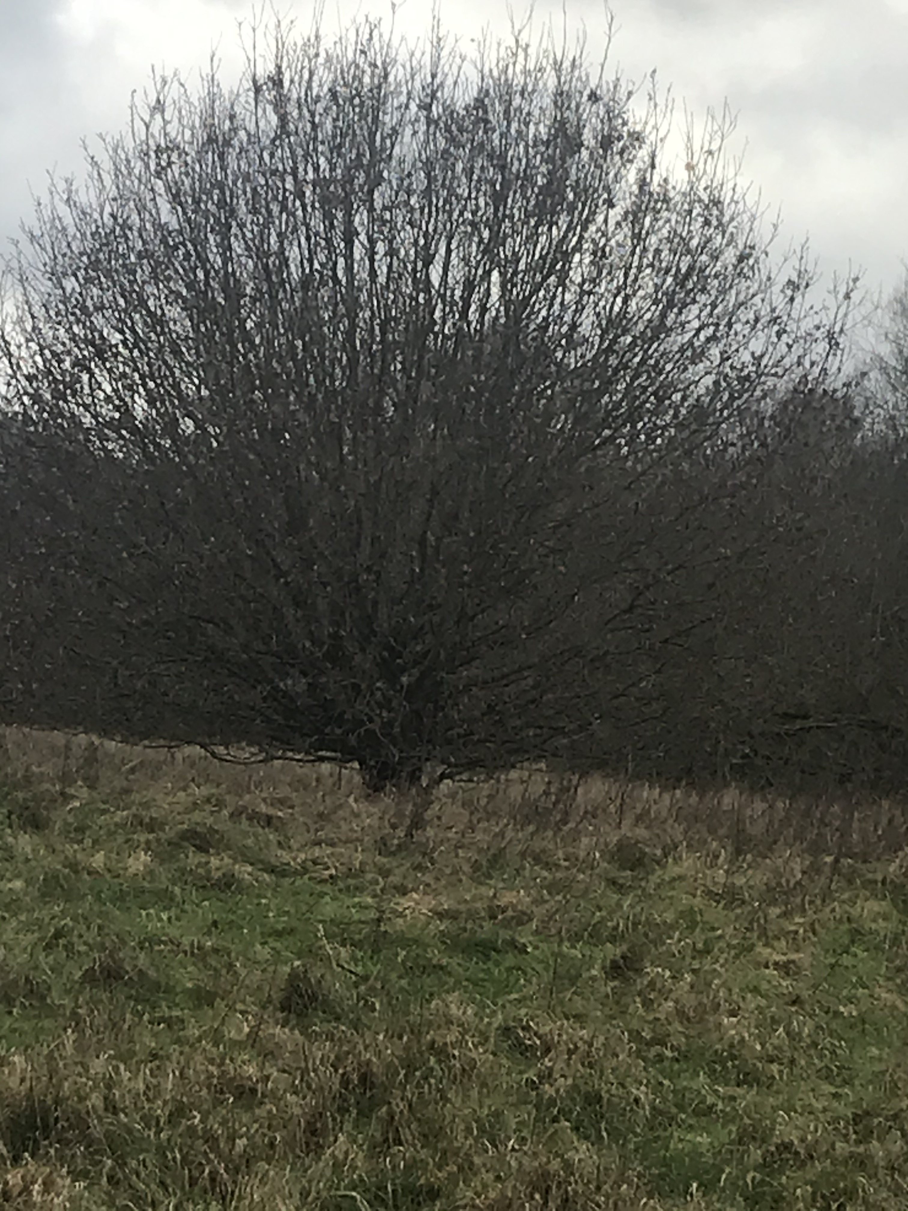
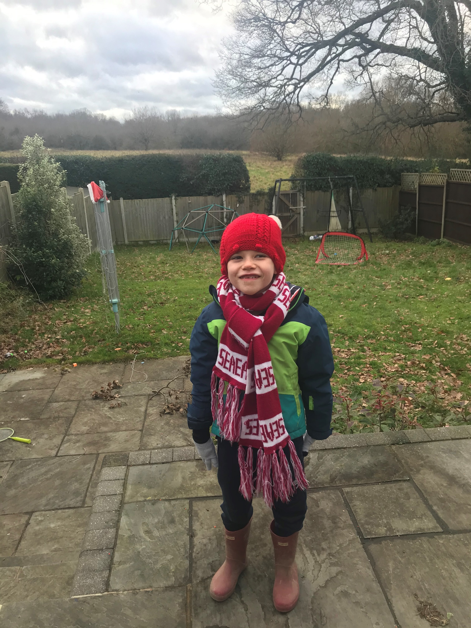
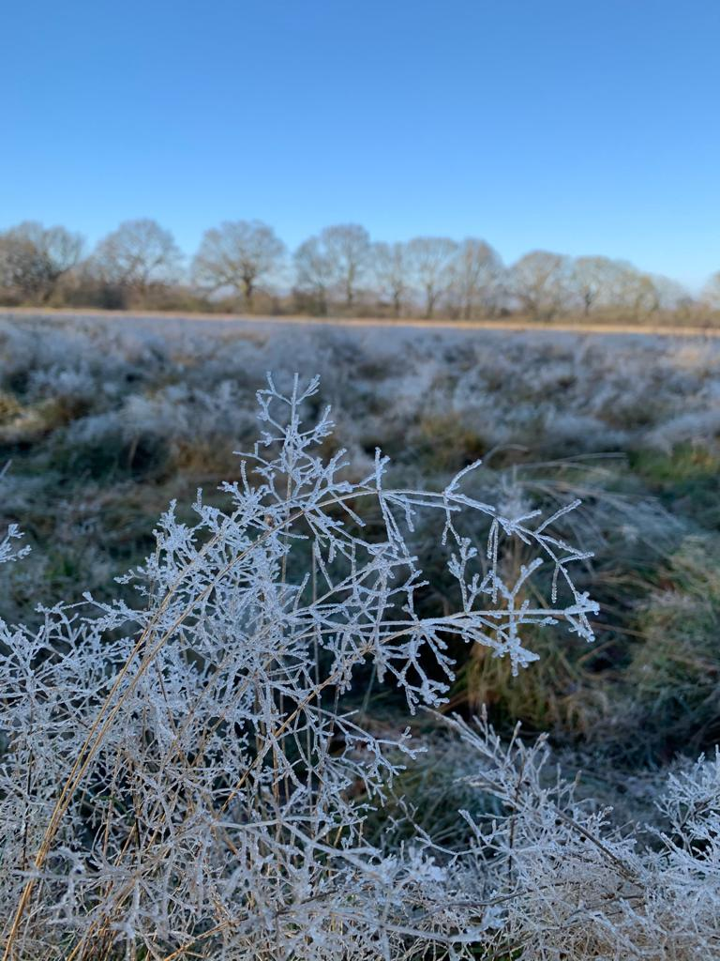
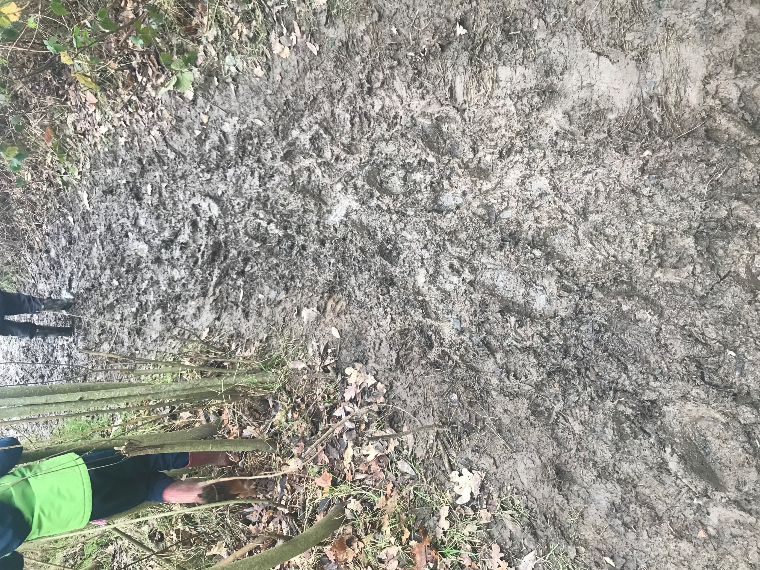
Winter Walk
On my winter walk I wore:
A beanie
A scarf
Gloves
A warm coat
Boots
There were no leaves on trees and I didn’t see any animals but I heard a bird. There was lots of slippery mud. It smelt bad.
The weather was cold and the plants had frost on them. There was ice on the stream. My hands were chilly.

