Slide 1
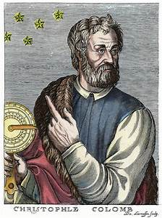
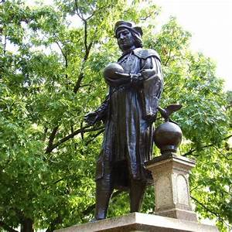
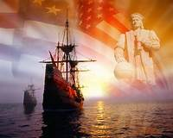
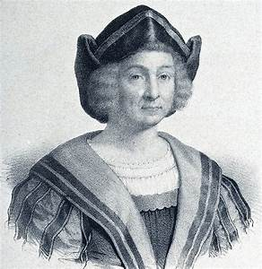
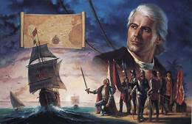
Christopher Columbus

Slide 2
Christopher Columbus
Christopher Columbus was a sailor. His first voyage nearly ended in disaster as his ship was attacked and set on fire by pirates! Columbus only survived by swimming to land.
He became famous as the explorer who found new lands called ‘The Americas’. But actually, many people already lived there.
He found the Americas by accident! He was actually looking for a new way to get to China and India.

Slide 3
Did you know?
Christopher Columbus is his name in English but he was born in Italy in 1451, so his real name in Italian is Cristoforo Colombo.
Columbus wasn’t popular with his crew. They left him on the island of Jamaica. He nearly starved as the people on the island didn’t give him food.
He brought back pineapples and turkeys from America.

Slide 4
Quiz
Q.
What job did Christopher Columbus have?
Explorer
Sailor
Pirate

Slide 5
A
It was B!
Christopher Columbus was a sailor!

Slide 6
Q.
Who attacked Christopher Columbus?
Pirates
Penguins
Sea gulls

Slide 7
A.
It was A!
Those pesky pirates set his ship on fire but the seagulls stole his sandwich!

Slide 8
Q.
How did Christopher survive?
Did he ride dolphins
Did he not survive
Did he swim to shore

Slide 9
A.
It was C!
Although it was tough he swam back to shore.

Slide 10
Q.
Which country did Christopher Columbus find?
England
Spain
The Americas

Slide 11
A.
It was C!
Christopher Columbus claimed he was the first person to go to America!

Slide 12
Thank You for watching!
☺☺☺☺☺☺☺☺

