Slide 1
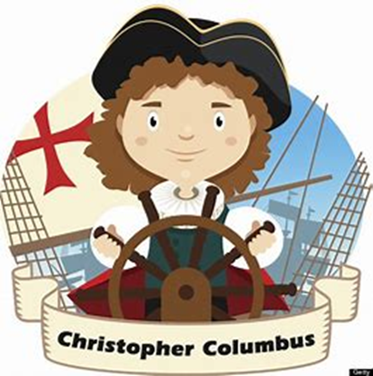
Isabella’s Explorer Project

Slide 2
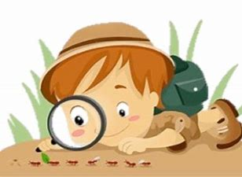
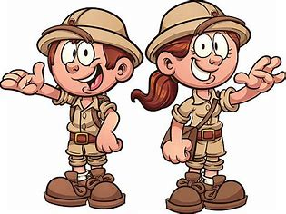
What is an explorer?
They discover new things
They go to unknown places to find out what they are like
They look for new things that have not been found yet

Slide 3
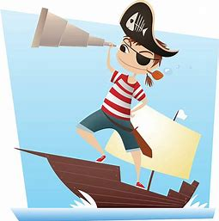
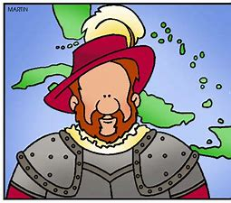
Christopher Columbus
Christopher Columbus was a sailor
He was born in Italy over 500 years ago
He discovered new lands
On his first expedition, his ship was attacked by pirates!
He managed to escape and swim to land
The crew on his ship didn’t like him!

Slide 4


What did he find?
He found new lands called “The Americas”

Slide 5
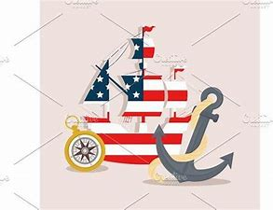

How he found the Americas
The King of Spain paid for 3 ships
Columbus was trying to find a better way to get to China and India
He travelled East hoping it would be quicker
After a few months the crew spotted land
It wasn’t China or India but the Americas!
People were already living there

