Slide 1


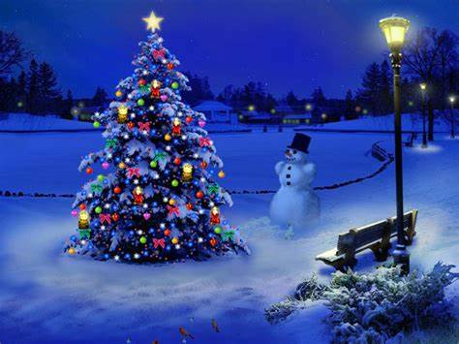
Christmas in the UK and Christmas in Italy

Slide 2
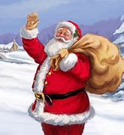
In the UK people say
“Father Christmas”.
In Italy people say
“Babbo Natale”.

Slide 3
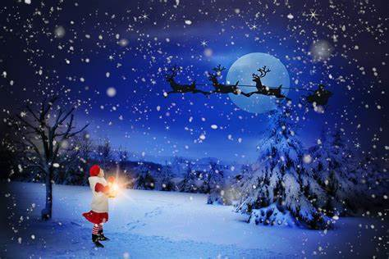
In the UK and Italy, Father Christmas travels by sleigh pulled by reindeer.

Slide 4
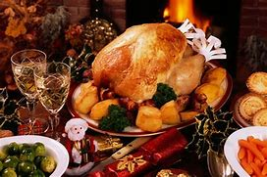
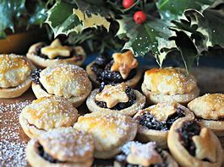
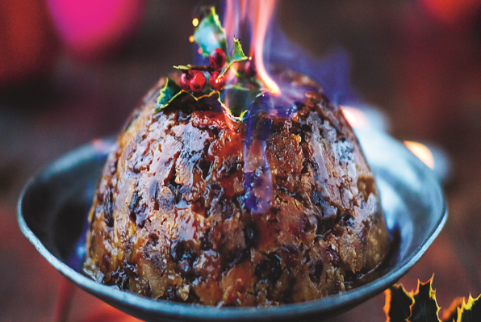
In the UK we eat Turkey, Stuffing and Cranberry Sauce on Christmas Day. We also eat mince pies and Christmas pudding at Christmas.

Slide 5
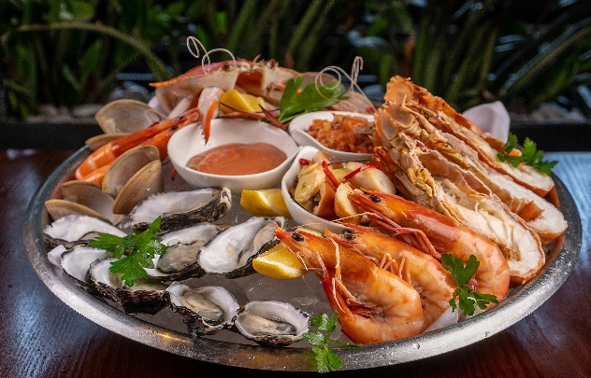
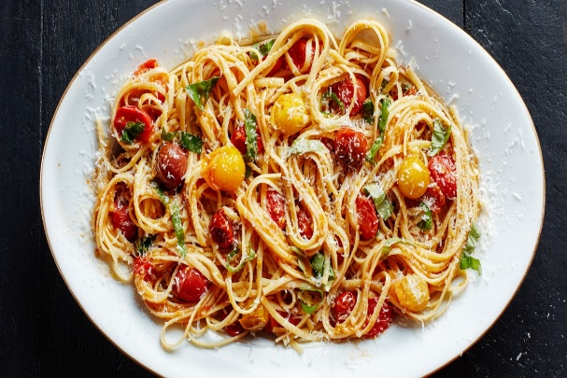
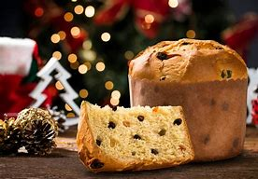
In Italy, they don’t eat Turkey, Christmas pudding or mince pies. They eat seafood on Christmas Eve – they are not allowed to eat meat due to religion. On Christmas Day they have a 6 course meal with soup, pasta, lamb and Pannetone for dessert.

Slide 6
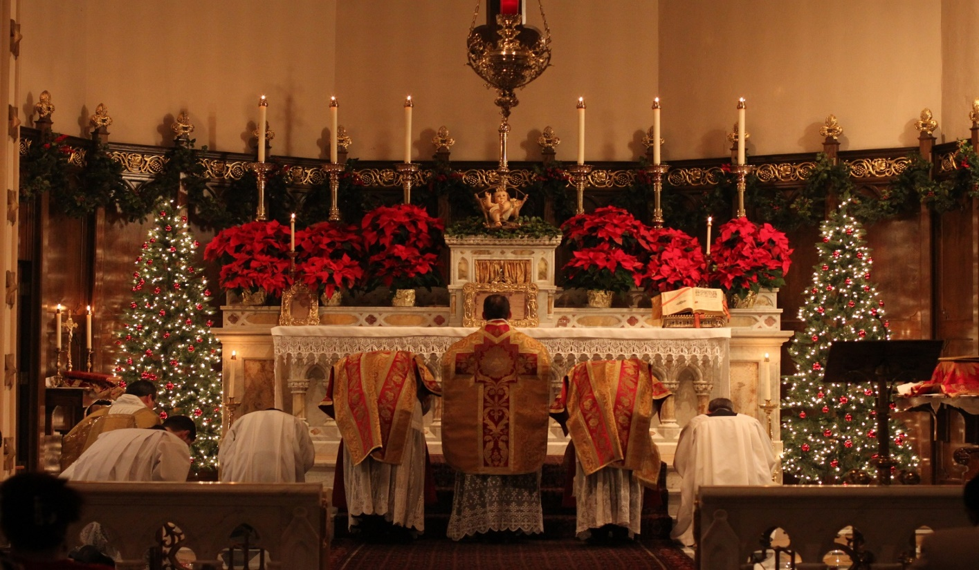
In both the UK and Italy, lots of people go to Church for
Midnight Mass on Christmas Eve.

Slide 7

“Merry Christmas”
“Bun Natale”

