Slide 1
Lewis and Clark Expedition
Luke Morris

Slide 2
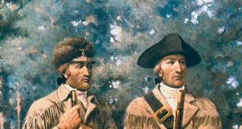
Who?
Meriwether Lewis was born in Virginia, USA, in 1774 and was secretary to President Thomas Jefferson, having previously served in the Army.
William Clark was also born in Virginia in 1770 and served with Lewis in the Army.

Slide 3
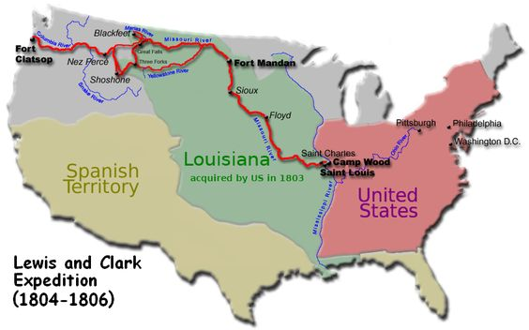
What did they do?
Meriwether Lewis and William Clark were the first people to explore what became the United States of America
President Thomas Jefferson – only the third ever President – asked them to travel to the new mid and western lands he had bought from France

Slide 4
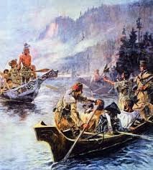
Was it difficult?
Yes! Nobody had ever travelled from east to west coast before.
There were no maps and they had to cross mountains and rivers in very hot and very cold temperatures

Slide 5
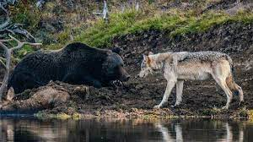
What did they find?
Lewis and Clark discovered many animals that had never been seen before such as grizzly bears and coyotes
They documented all the animals and new land that they discovered for the President

