Slide 1
Fearne Murphy

Slide 2
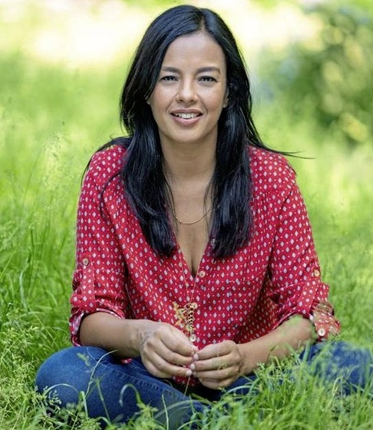
This is Liz Bonnin

Slide 3
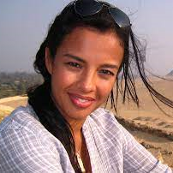
She is a girl explorer

Slide 4

She was born in France

Slide 5

But she now lives in Ireland

Slide 6

She is a scientist

Slide 7
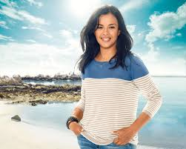
Liz is 44 years old

Slide 8
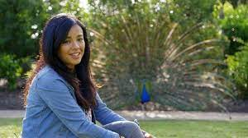
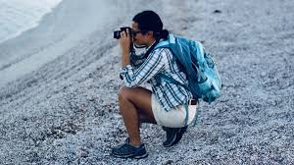
She makes television shows about animals and nature.

Slide 9
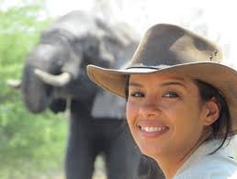
She loves to tell people new things about the planet.

Slide 10
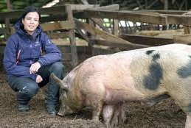
She has made more than 40 television shows.

Slide 11
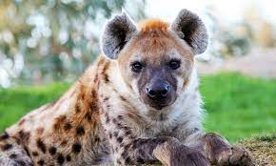
Here is a video showing Liz Bonnin finding out about hyenas.
Man plays with Hyena - Animal Odd Couples: Episode 2 Preview - BBC One - YouTube

Slide 12
The End

Slide 13
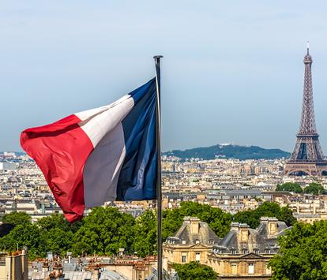


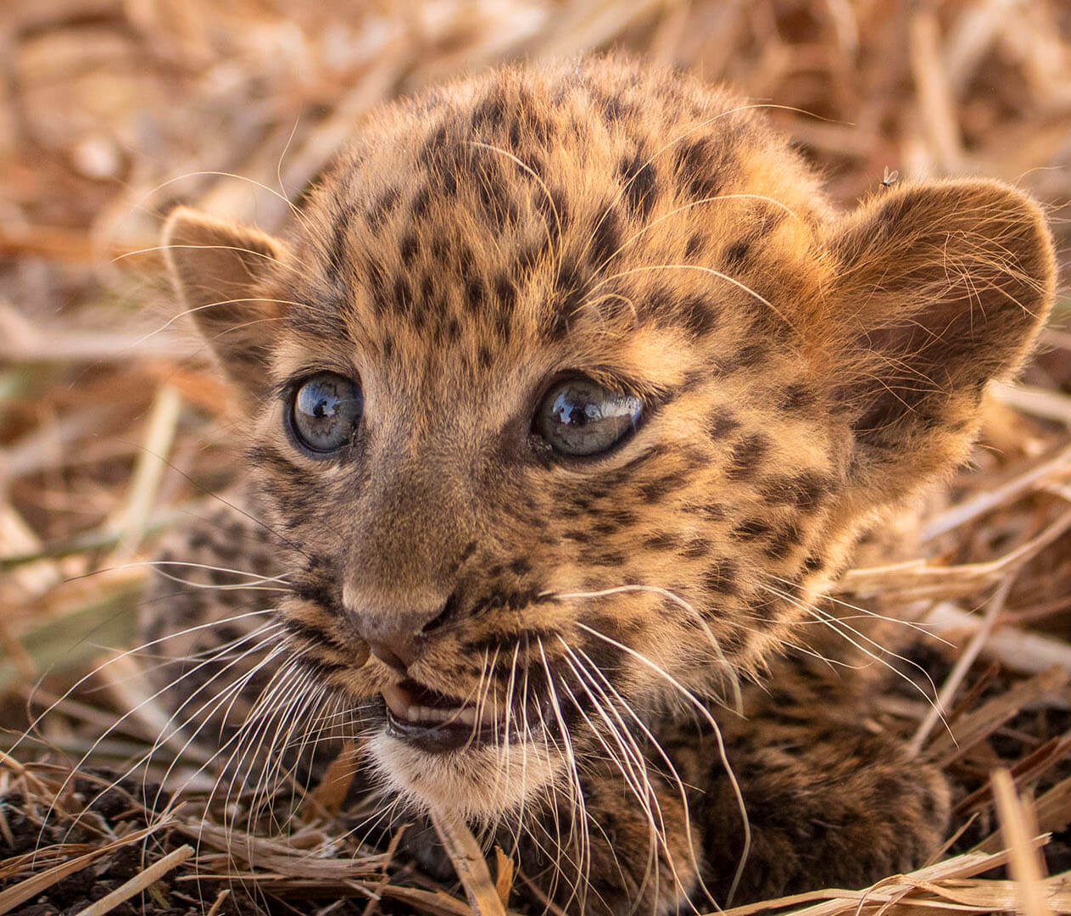
So why did I pick Liz Bonnin?
She is a Girl explorer
She is from France
She is a Scientist
She is 45 years old
She is a Wildlife TV
Presenter

