Slide 1
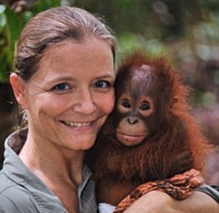
Lone Drøscher Nielsen
The Orangutan Hero

Slide 2
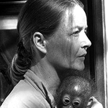
Lone Drøscher Nielsen was born in Denmark in 1964.
She is a Danish wildlife conservationist who set up the Orangutan Reintroduction Project in Borneo in 1998.
She met her first orangutan when she volunteered at a zoo when she was 14.
Later, when she was working as an air hostess, she volunteered for a month-long project in Borneo, and there she fell in love with orangutans again.

Slide 3
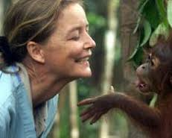
She met some orphaned orangutans when she was volunteering in Borneo and she decided to move there in 1996 to help save them from extinction.
Orangutans are close to being extinct as they are loosing their homes because they are being cut down for palm oil plantations.

Slide 4
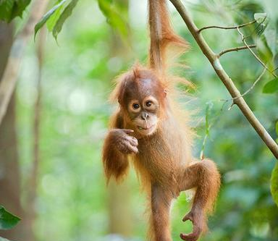
With the help of the Borneo Orangutan Survival (BOS) Foundation and money from the Gibbon Foundation she was able to open the sanctuary so orangutans would have a chance to live in the wild where they belong.
The sanctuary was designed to hold up to 100 orphaned orangutans while they go through rehabilitation. It has a large area of forest where the orangutans can learn the skills they need to live in the wild.
It quickly became the largest primate rescue project in the world, with over 600 orphaned orangutans in its care in 2009.

Slide 5
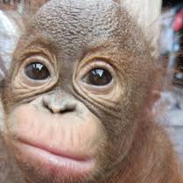
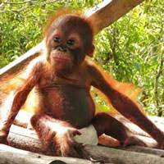
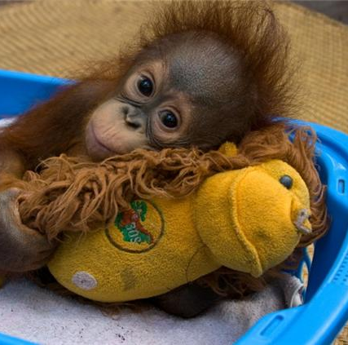

Many of these orangutans are only weeks old when they arrive, and all of them are scared and some hurt. The sanctuary saves the orphaned baby orangutans from the local farmers and from being sold illegally as pets. It has also come up with ways to
put them back into the rainforest that is left.

Slide 6
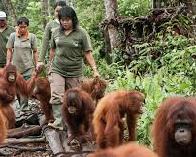
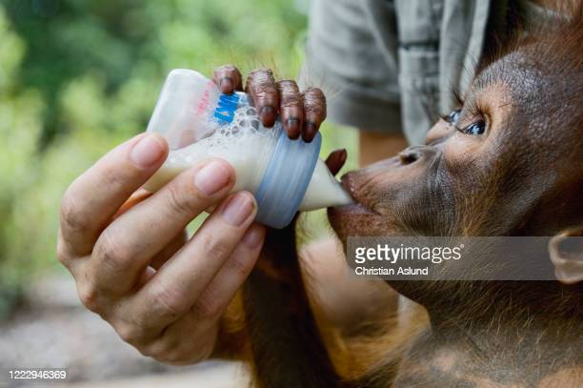
Babies and young orangutans are brought to the centre and are cared for 24 hours a day by a team of "babysitters".
As they get bigger they are taken to "forest school" where they learn to climb trees and survive in the forest.
At about eight years old, they are moved in groups of 25 to a nearby island for the first stage of their release.
Finally they are released into the wild to live their lives where they belong.

Slide 7
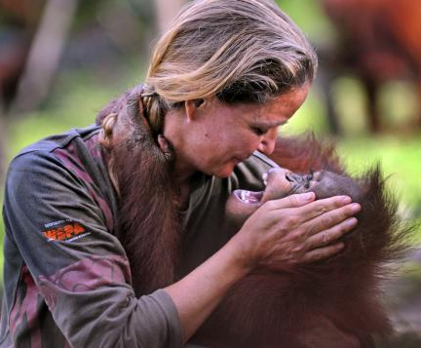
Lone lived near the centre until 2010 when unfortunately she had to return to Europe because she was very ill. She still works with Save the Orangutan from her home in Wales.

Slide 8
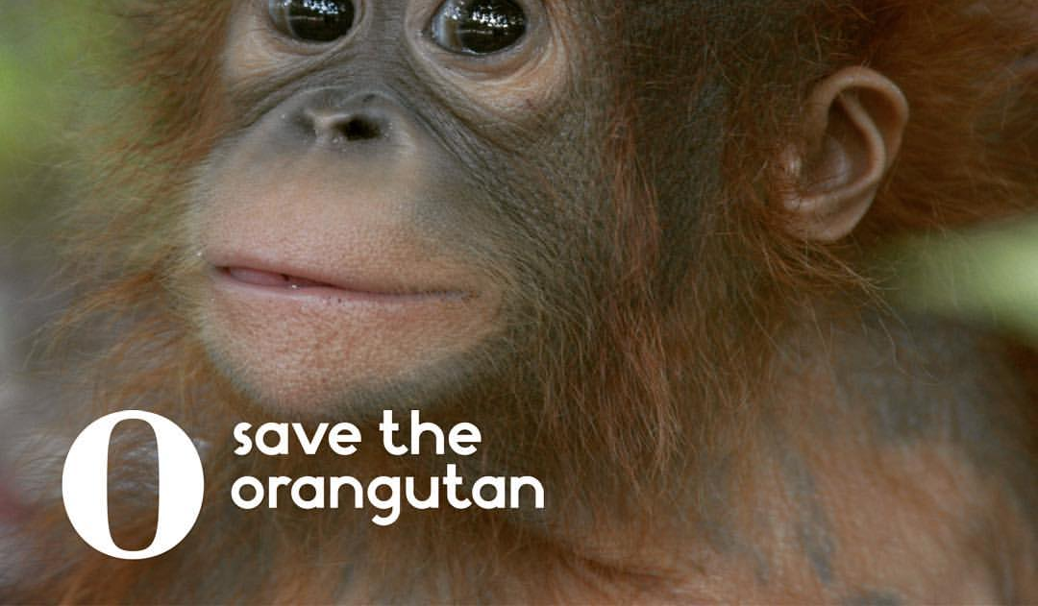
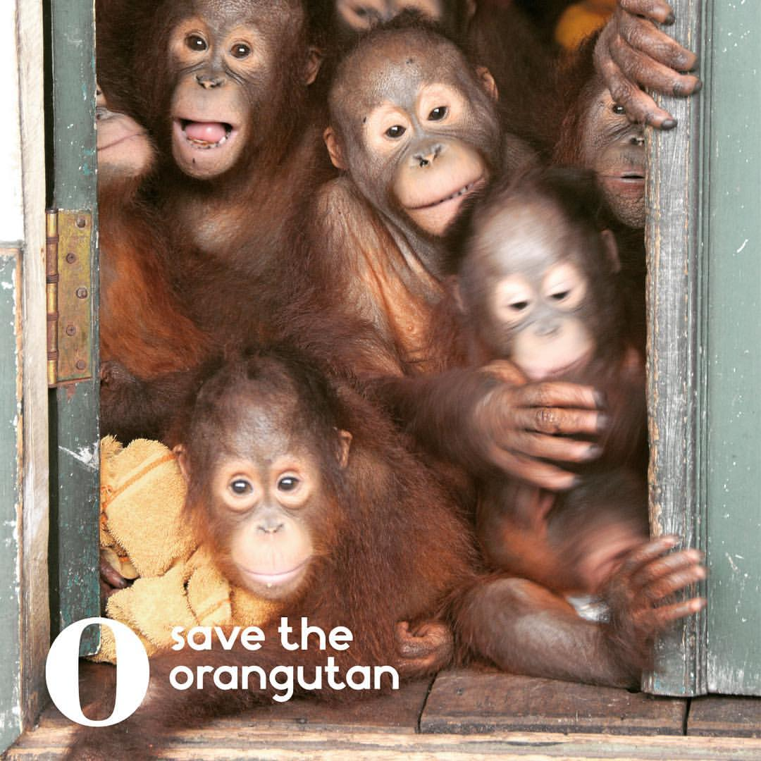
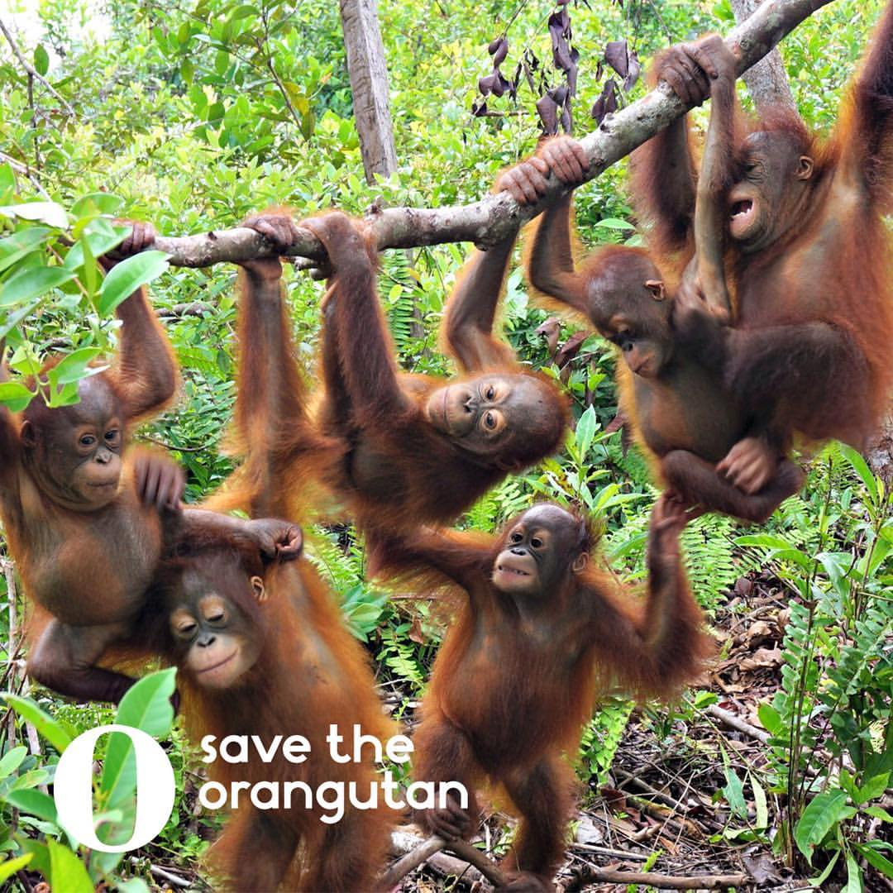
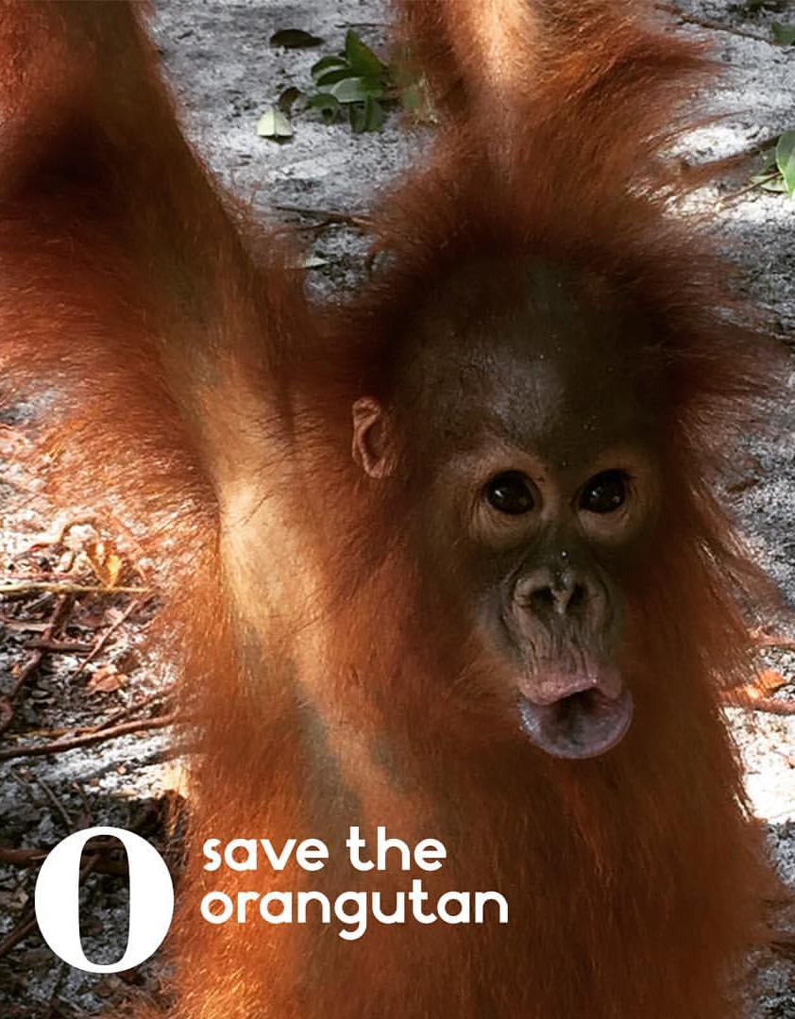
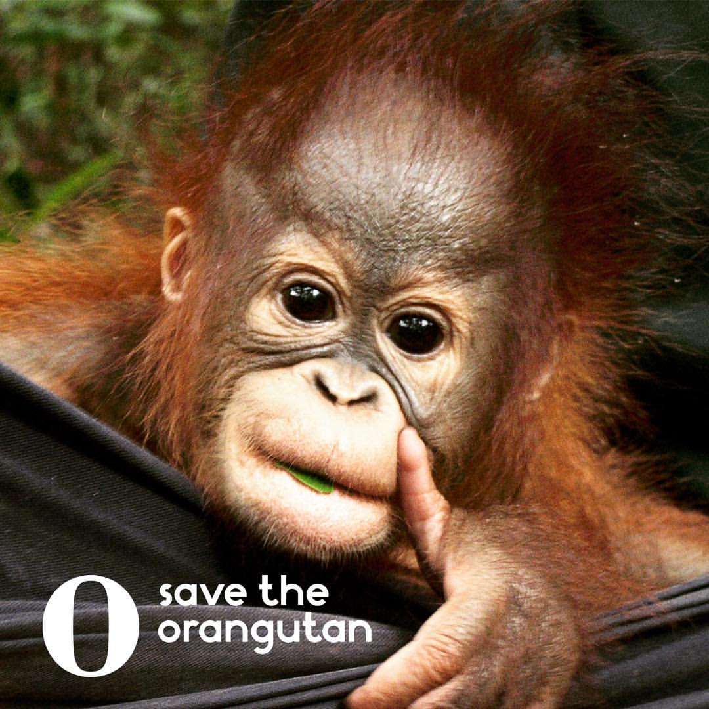
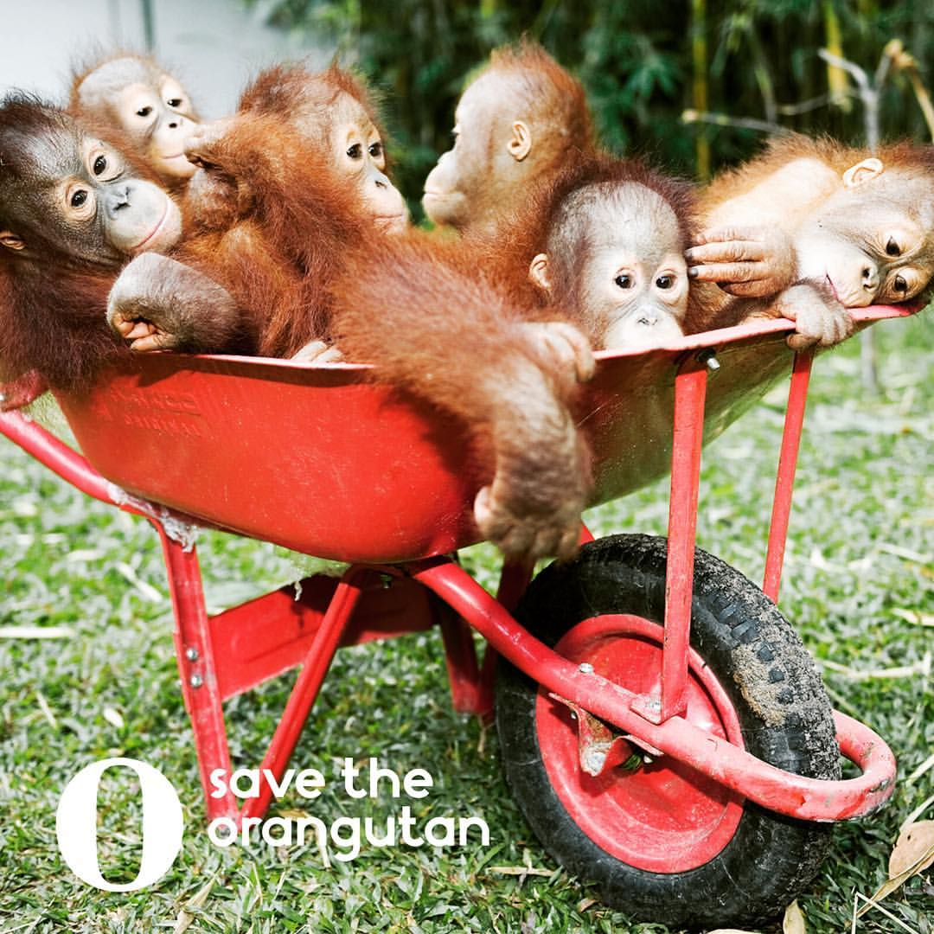
Lone is my hero and I hope to do good like her one day.

