Slide 1
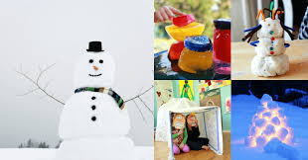
Winter
By Luke Morris

Slide 2
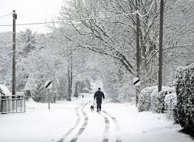
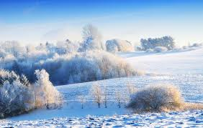
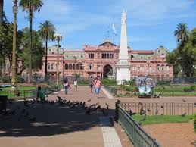
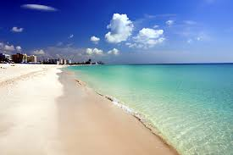
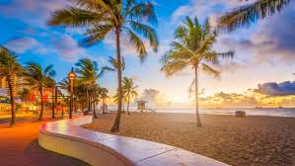
Winter in different cities
Winter can be cold or warm depending on location
It can snow in some cities
You can enjoy going to the beach if you are in Miami!

Slide 3
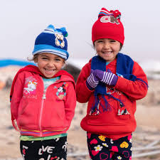
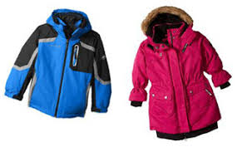
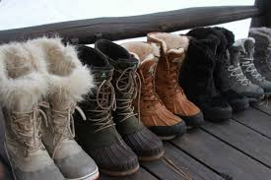
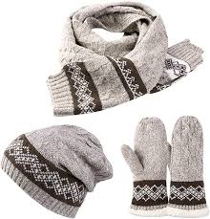
Clothing for winter

Slide 4
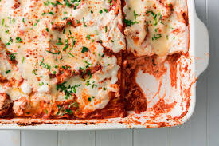
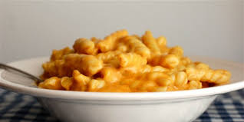
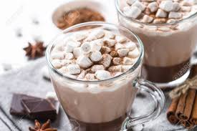
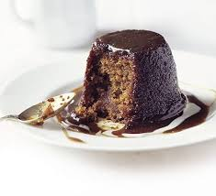
Food I like to eat in winter

Slide 5
Some facts I learnt about winter
Days are shorter
It is the coldest season of the year
The sun looks bigger because Earth is closest to the sun in Winter
Plants and trees don’t grow in the Winter
Some animals hibernate
Animals that live in very cold weather: polar bear, snowy owl, snow leopard, artic hare, artic ground squireels, penguins, and beluga whales.

