Slide 1
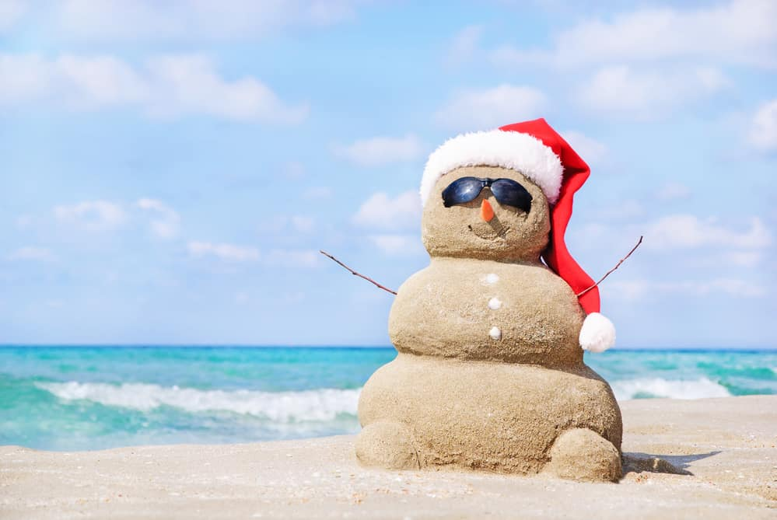
Sebastian Budzynski
Christmas in Australia

Slide 2
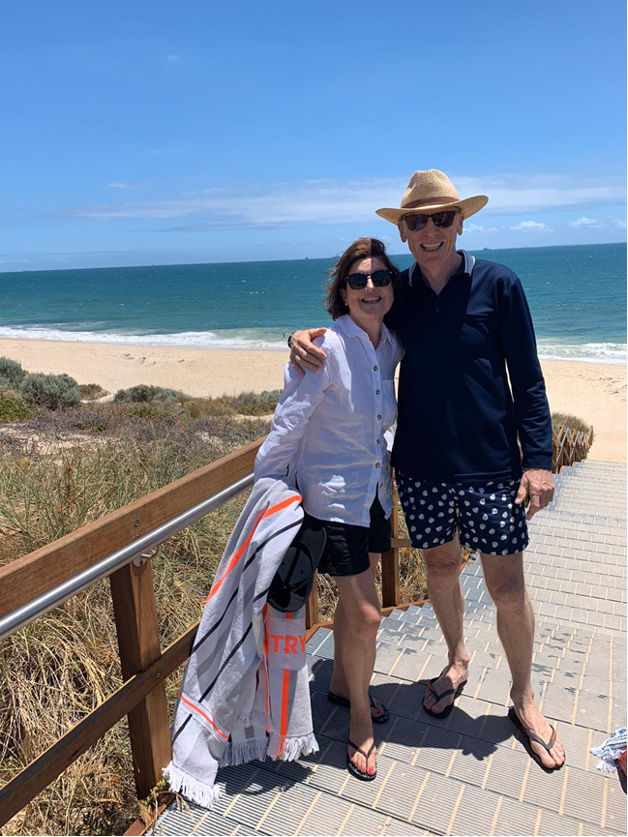
My Grandad lives in Australia. This is a picture of my Nana and Grandad at the beach on Christmas Day.

Slide 3
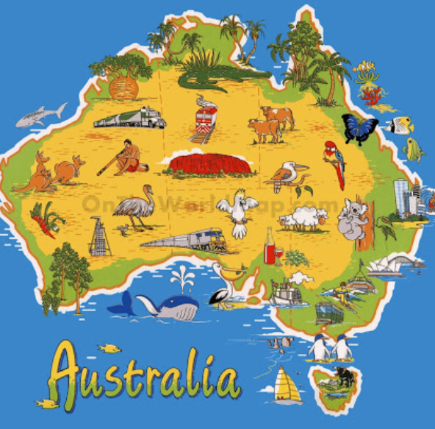
This is a map of Australia.

Slide 4

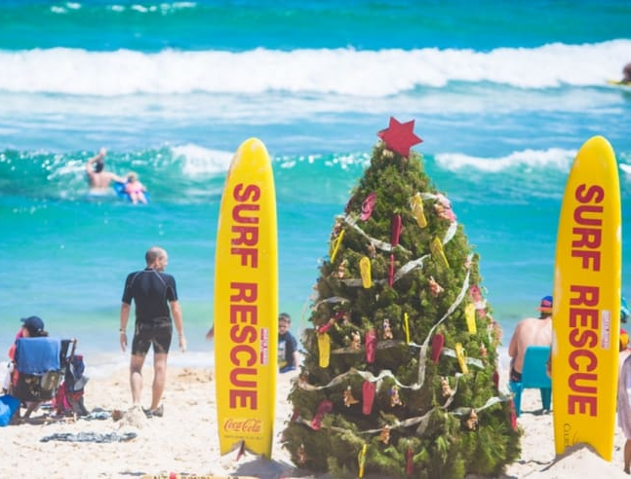
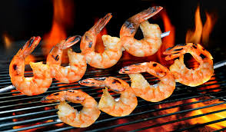
Australia is near the equator so it is hot and sunny.
Before they open their presents my Grandad goes for a swim at the beach.
Then they open presents and have a BBQ for lunch.

Slide 5
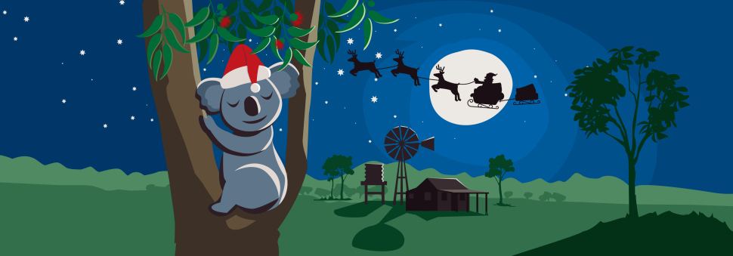

HO HO HO Merry Christmas

