Slide 1
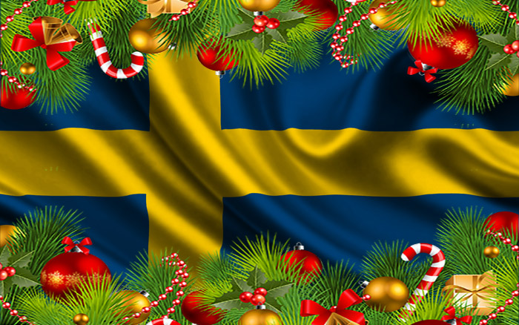
Christmas in Sweden

Slide 2

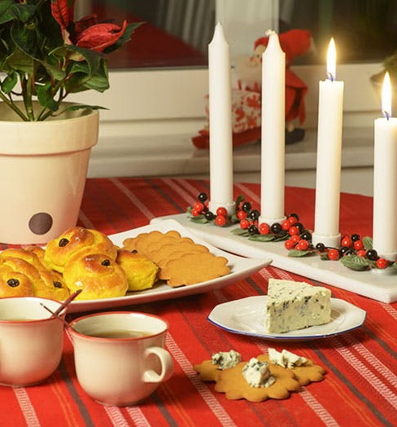
Christmas in Sweden is called ‘Jul’.
To say Happy Christmas in Swedish you say ‘God Jul’.
Swedish people love Christmas and start celebrating on Advent Sunday which is 4 Sundays before Christmas.
On this day they light the first of 4 candles. Every Sunday they light 1 more candle until Christmas. They celebrate by eating saffron buns and gingerbread biscuits and drink fruit juice or mulled wine

Slide 3
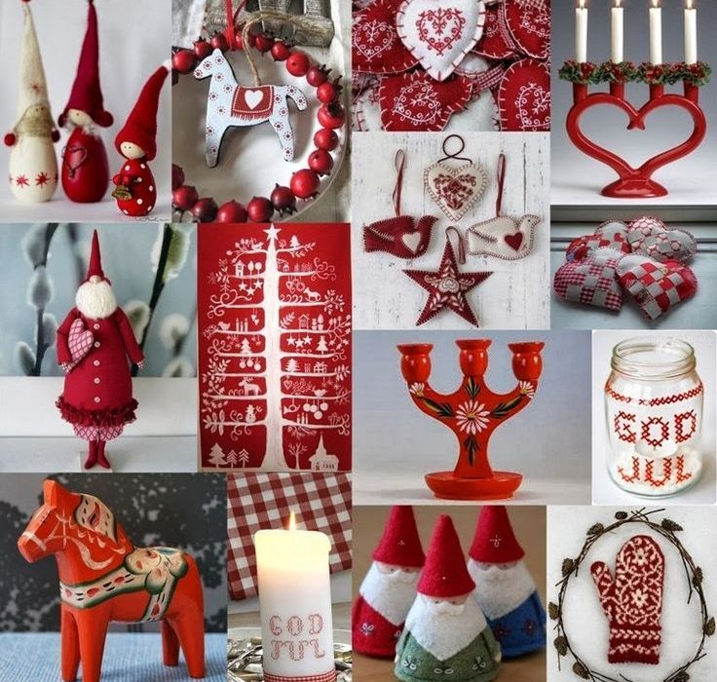
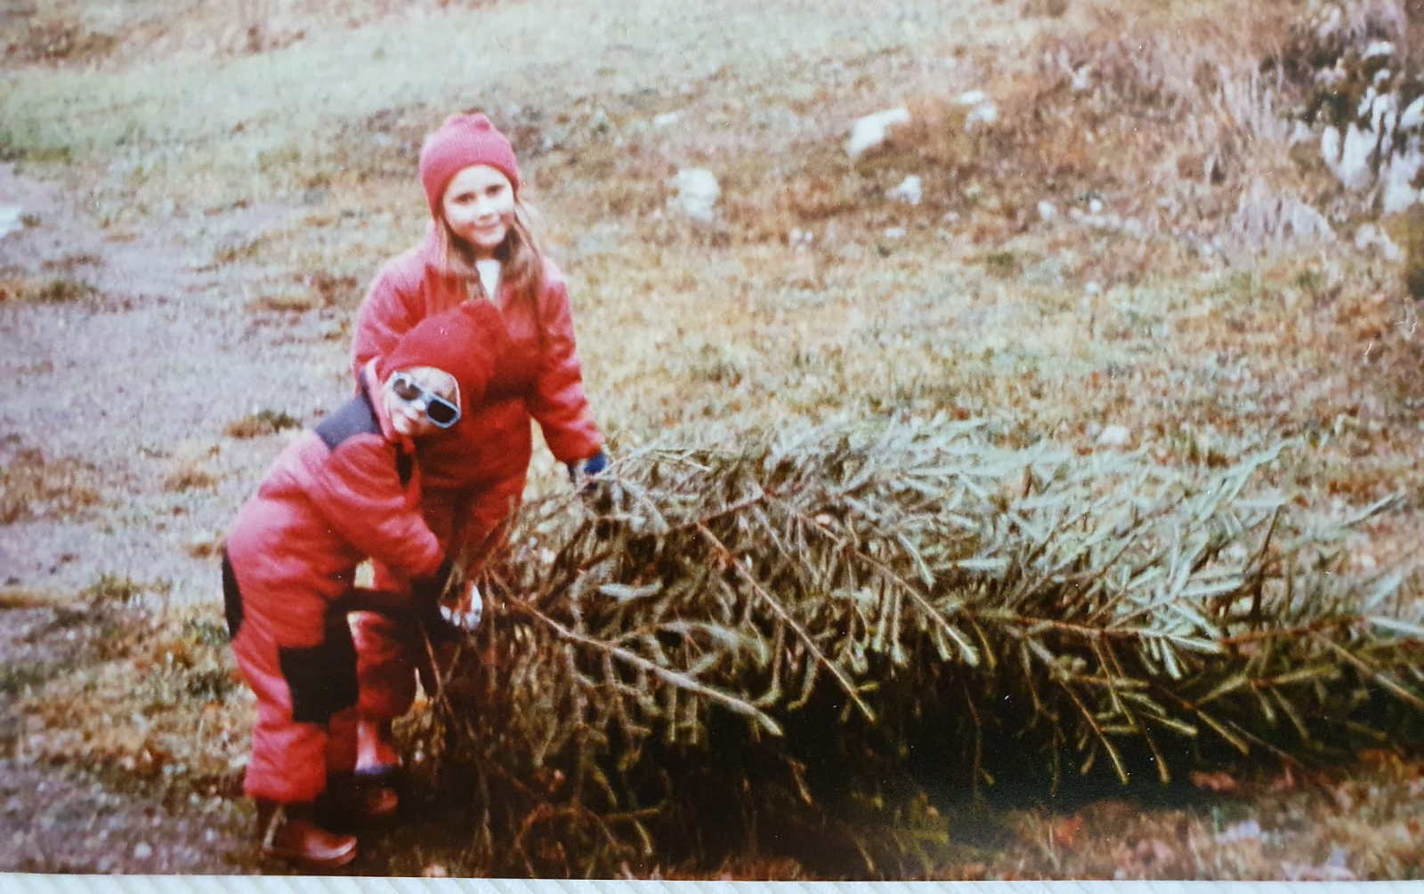

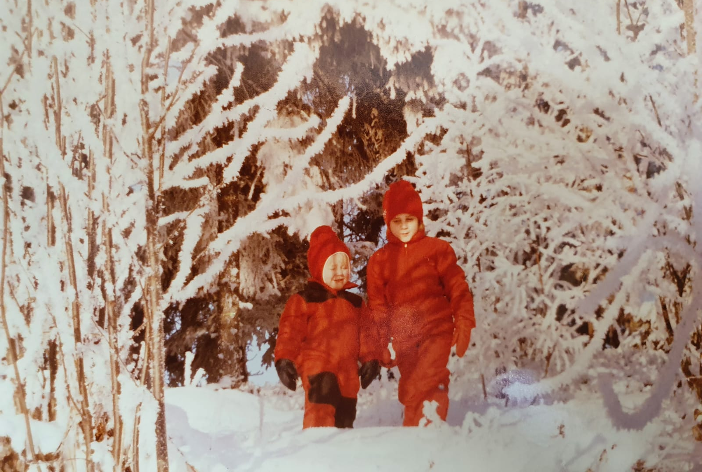
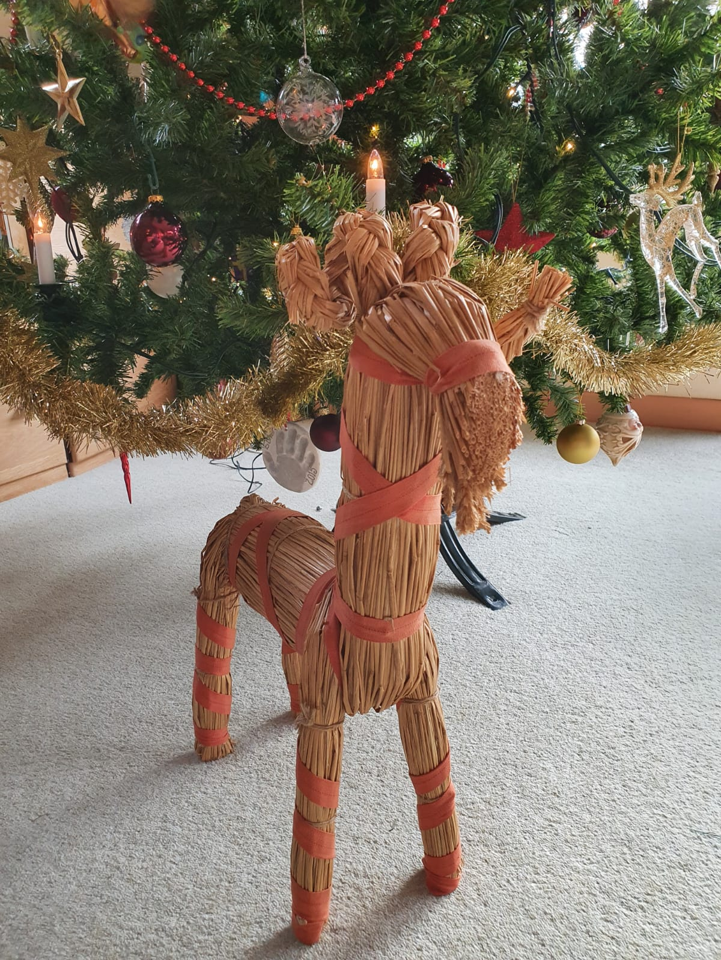
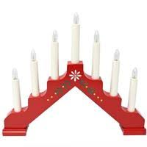
People who live in the country usually chop down their own Christmas trees and decorate their homes with lucia candles in their windows, lots of hearts and candles.
They put a straw goat under the tree, called the ‘Julbok'. Today they think it guards the house and tree.

Slide 4
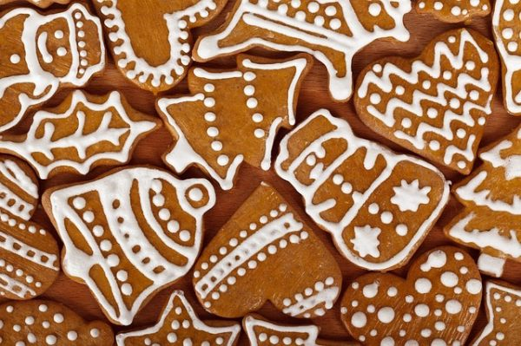
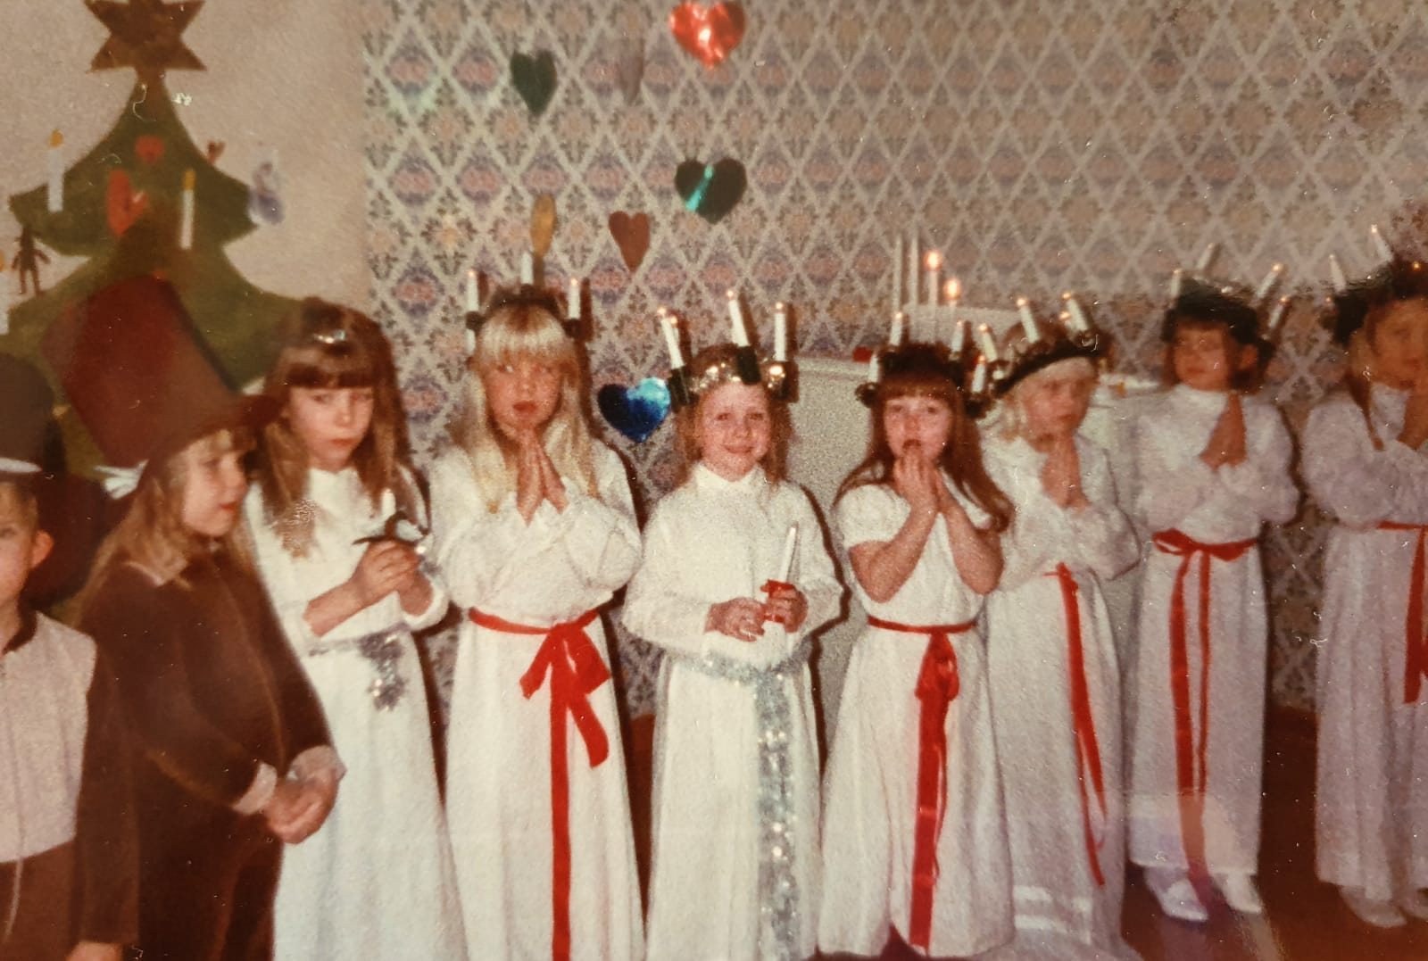
St Lucia’s Day – 13th December
The 13th of December is St Lucia's day. Young girls dress in white and carry a white candle in their hands while singing Carols in a parade or in schools, work places and nursing homes. One girl is chosen to be Lucia and has a red sash and a crown of candles in her hair. The other girls and boys are stars.
Early in the morning at home the oldest daughter dresses as Lucia and serves buns and pepperkakor with coffee to their Mummy and Daddy.

Slide 5
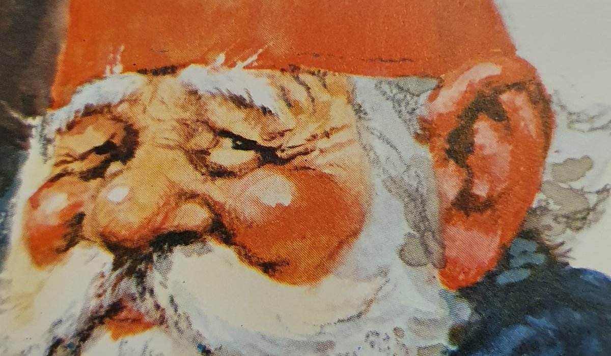
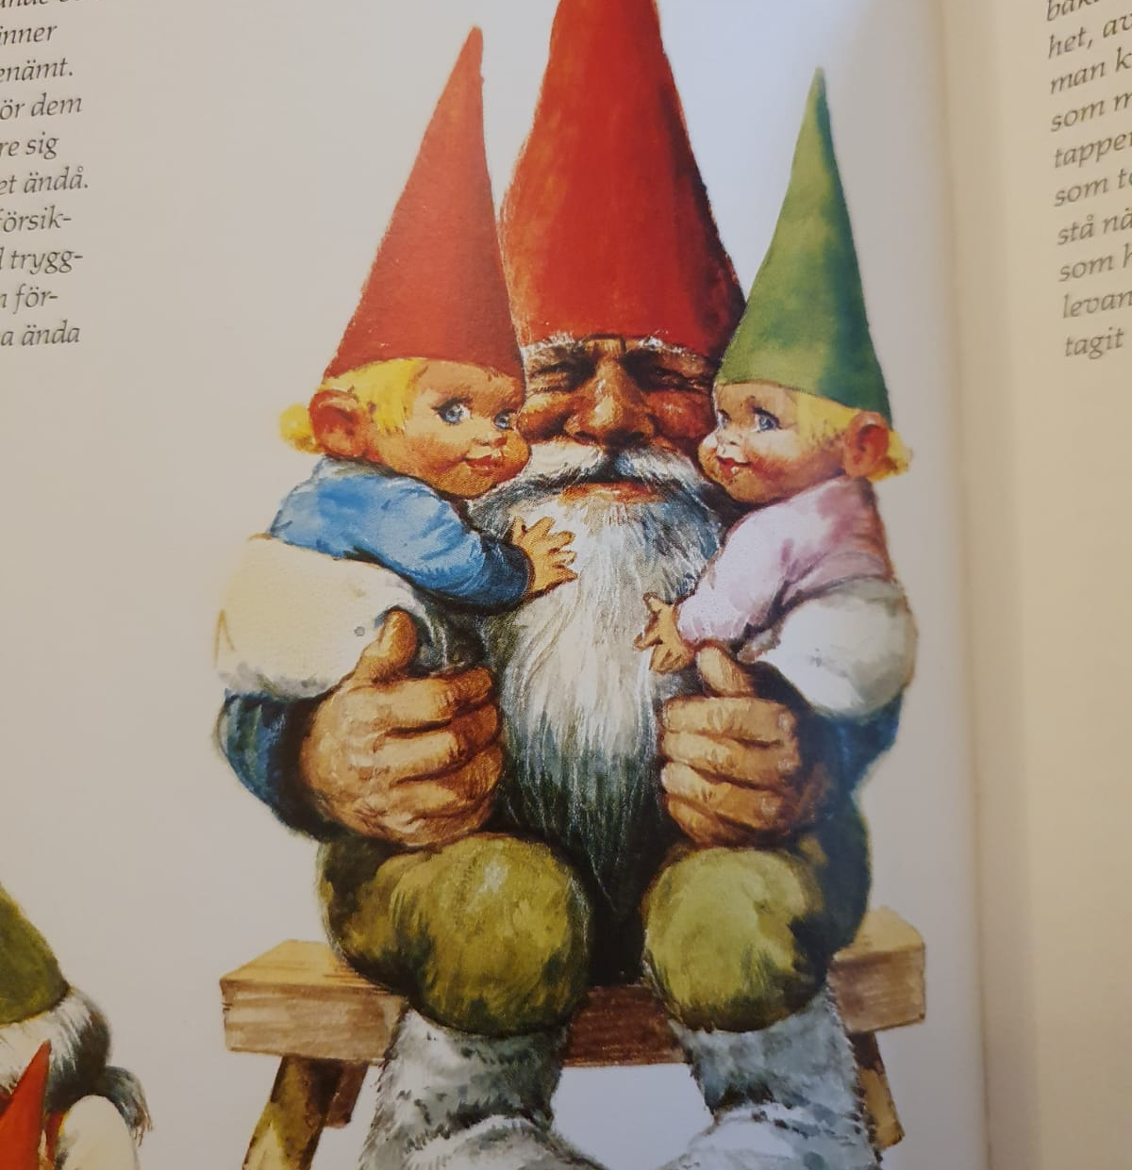
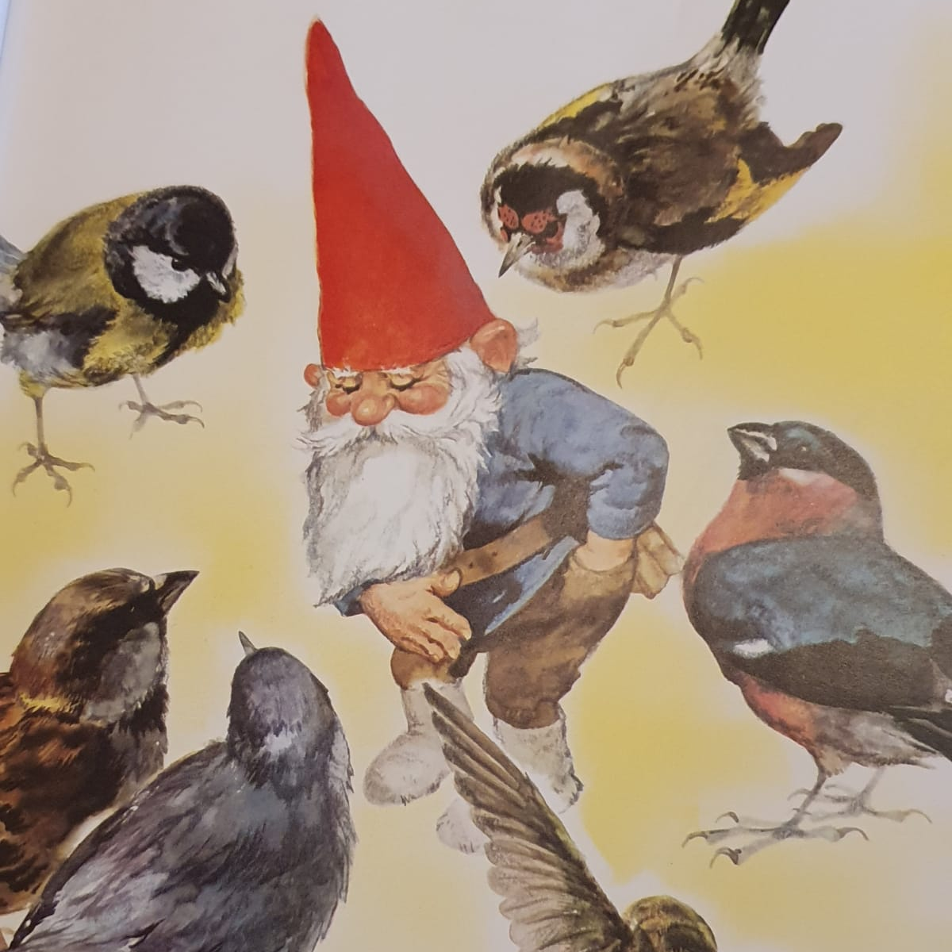
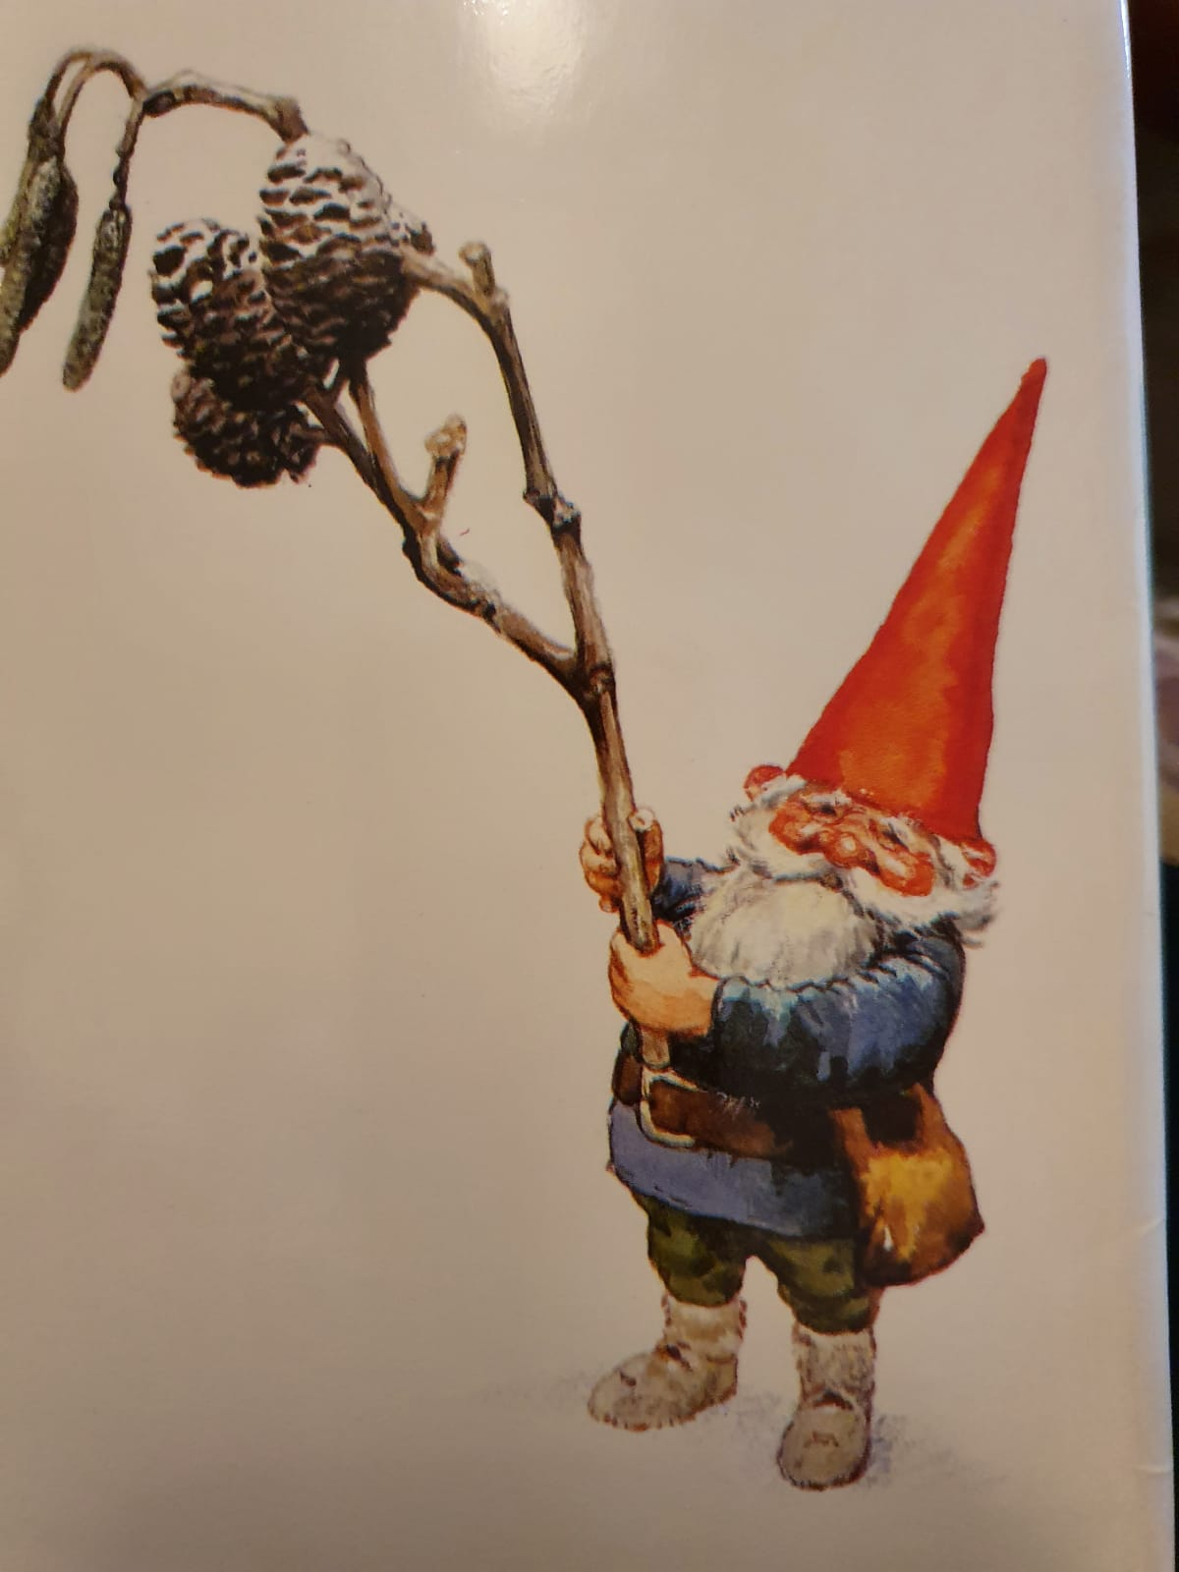
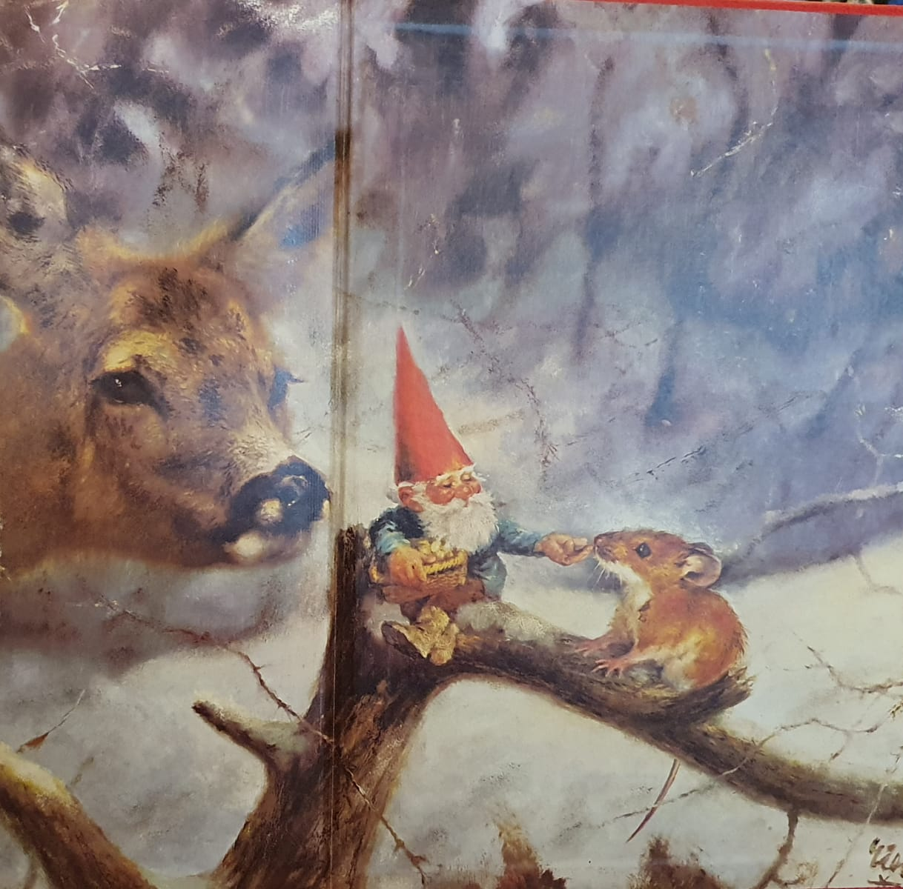
Father Christmas is called ‘Tomten' and his helpers are called ‘Tomtar’. He visits peoples houses in the afternoon on Christmas Eve to give gifts to children.

Slide 6

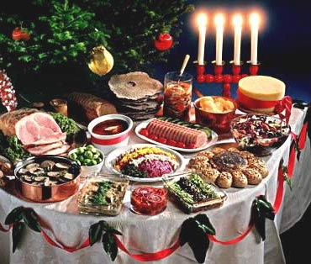
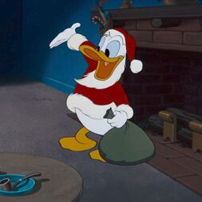

In Sweden they celebrate Christmas on Christmas Eve.
They have a buffet dinner for their Christmas dinner which is called a ‘smorgasbord’
In the afternoon they watch Disney classics with Donald Duck on TV. This is a tradition that started in the 1950s!
In the afternoon Tomten visits and they then open all their presents.
The Christmas holidays finish on the thirteenth day, the 6th of January, and the tree is taken down on the 13th of January.

