Slide 1
Tabitha’s presentation
Christmas traditions

Slide 2
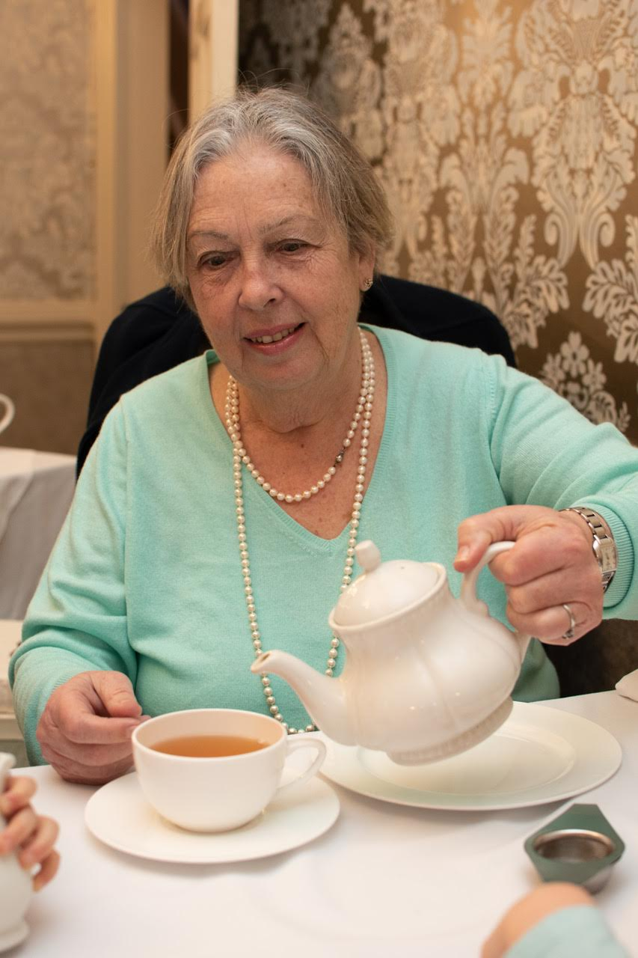
My Nana

Slide 3
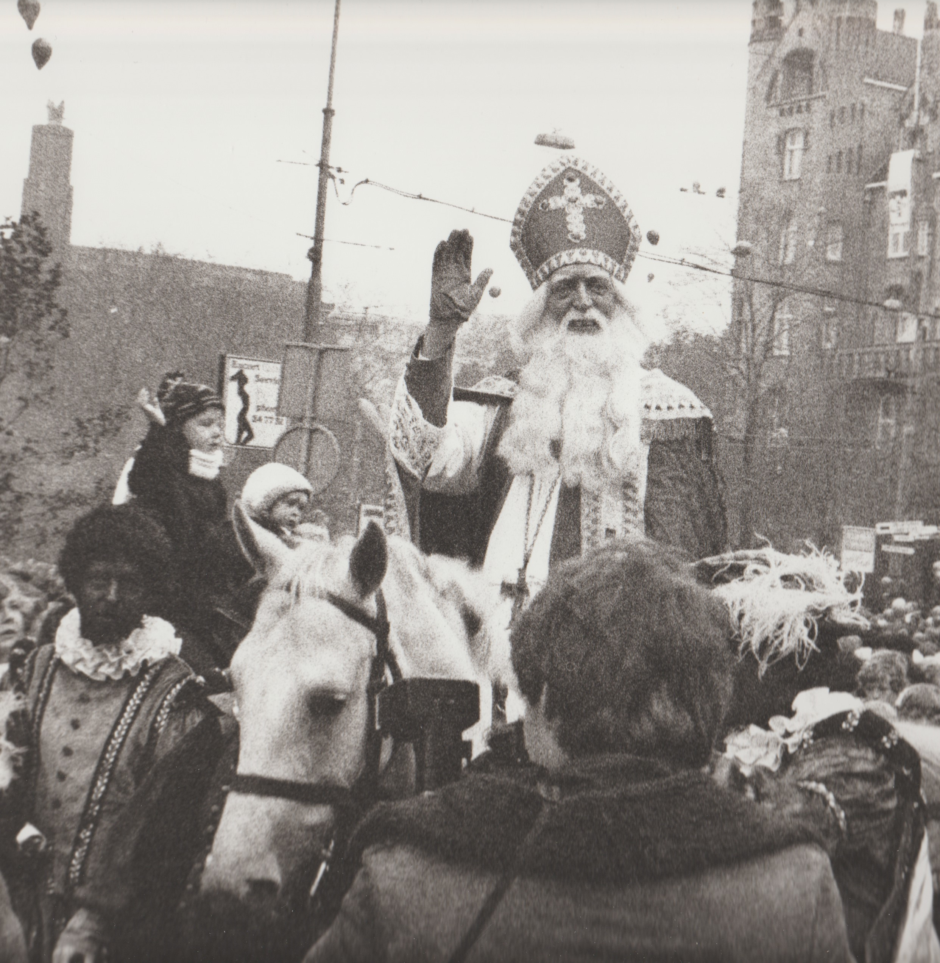
Nana
Nana lived in Holland with Daddy and Auntie Sharon
Saint Nicholas arrives in November
On a boat from Spain
He rides in to town with presents
And goes home on the 6th December

Slide 4
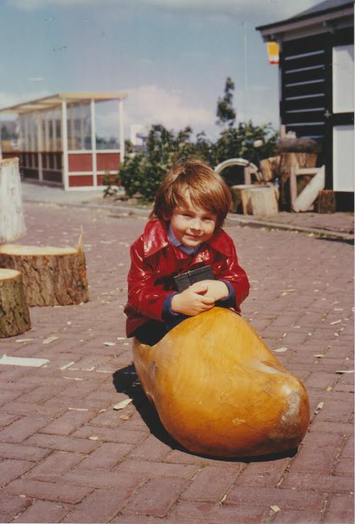
What is different?
No Christmas tree
No Christmas pudding but yummy cake
Leave a shoe outside your door or window
There were 21 days to get presents
Toy in the shoe if you were good.
If bad a lump of coal.
One day Daddy got a lump of coal

Slide 5
Thank you

