Slide 1
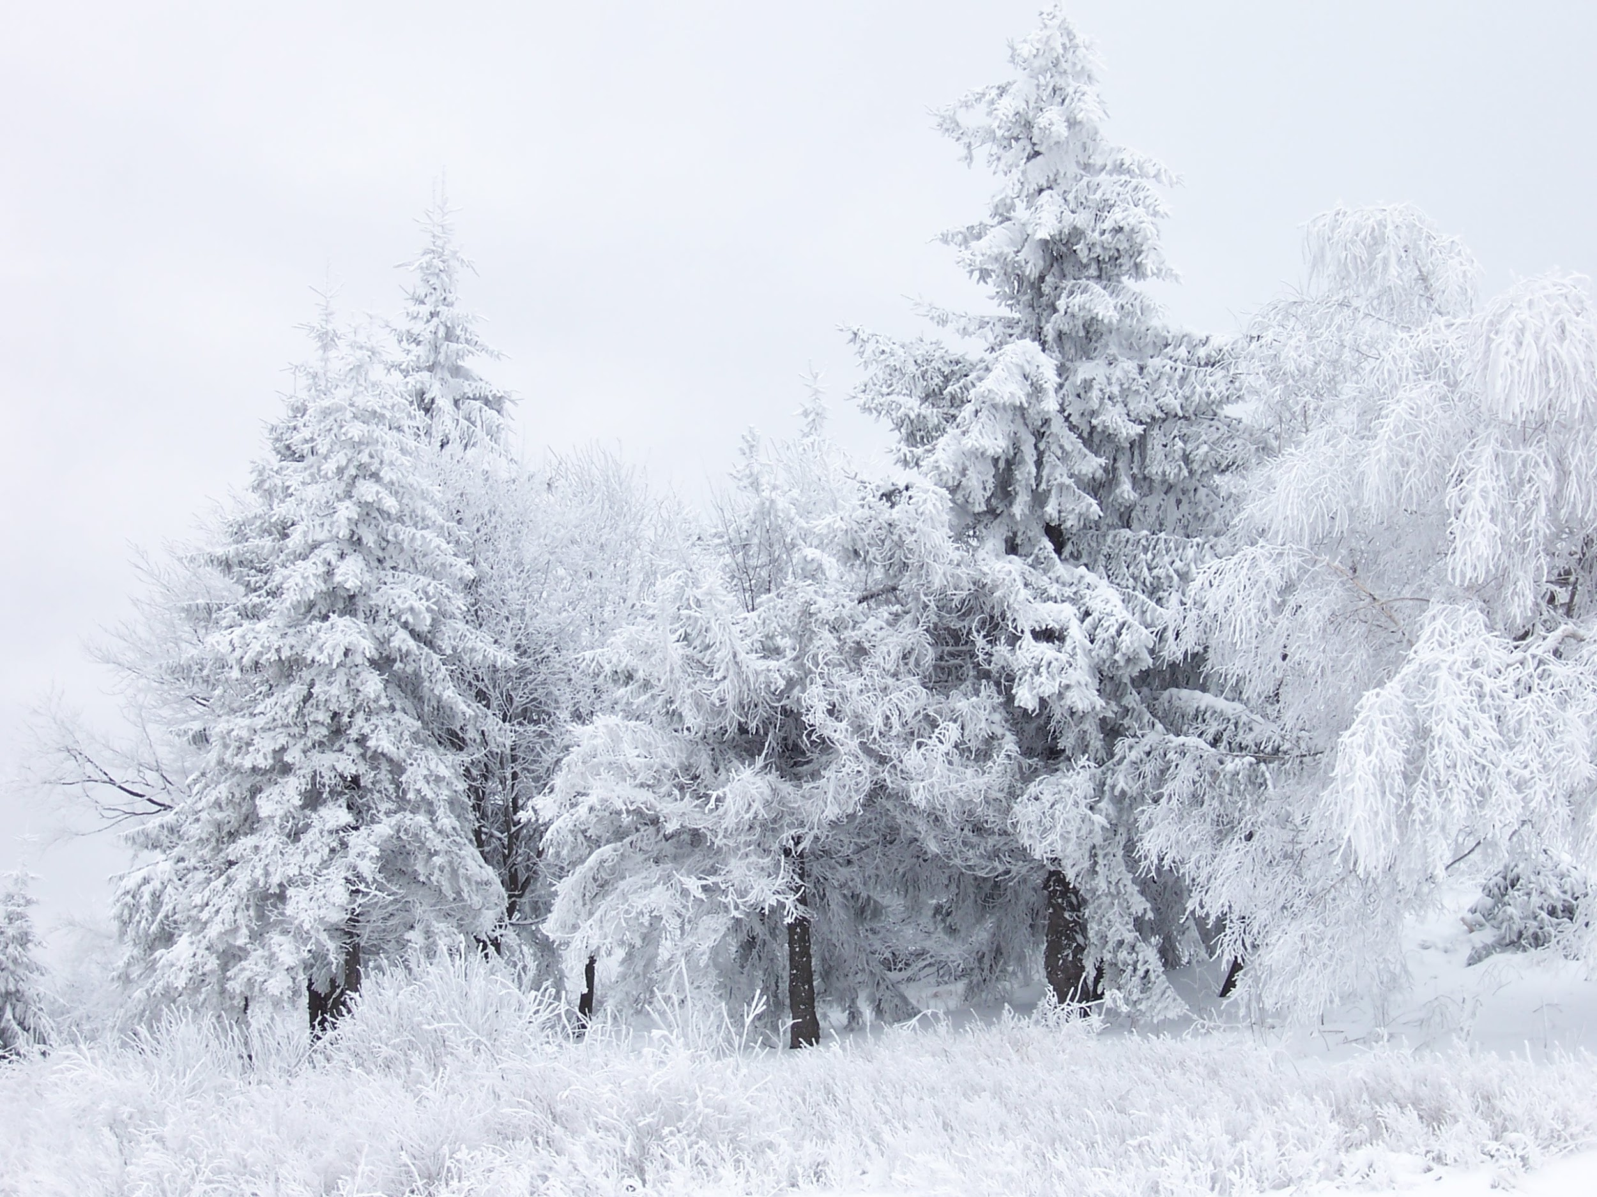
Season changes in Winter
Season changes in Winter.

Slide 2
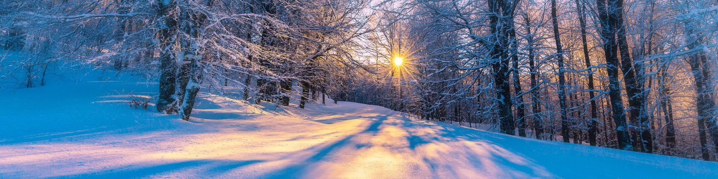
Winter
Winter.
In winter it cold. The leaves fall off the trees. All the flowers die and the leaves fall off of them.
In winter it gets cold. The leaves fall off the trees. All the flowers die and the leaves fall off them..Some plants stay green through winter these plants are called evergreen.

Slide 3
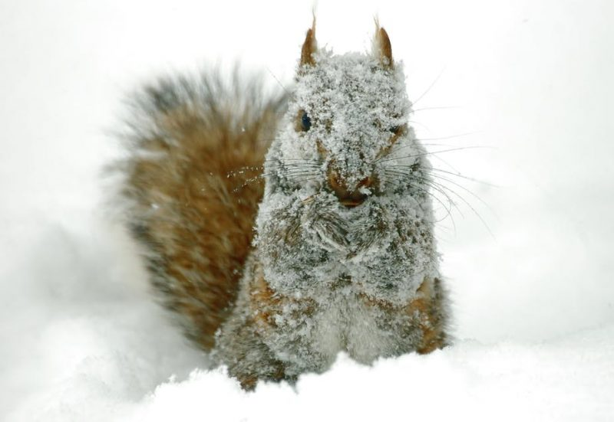
Winter.
Some animals go to sleep until spring. This is called hibernating. Some birds fly to warmer countries and some sea creatures swim to a warmer part of the sea. Animals that hibernate include hedgehogs, bears and chipmunks.

Slide 4
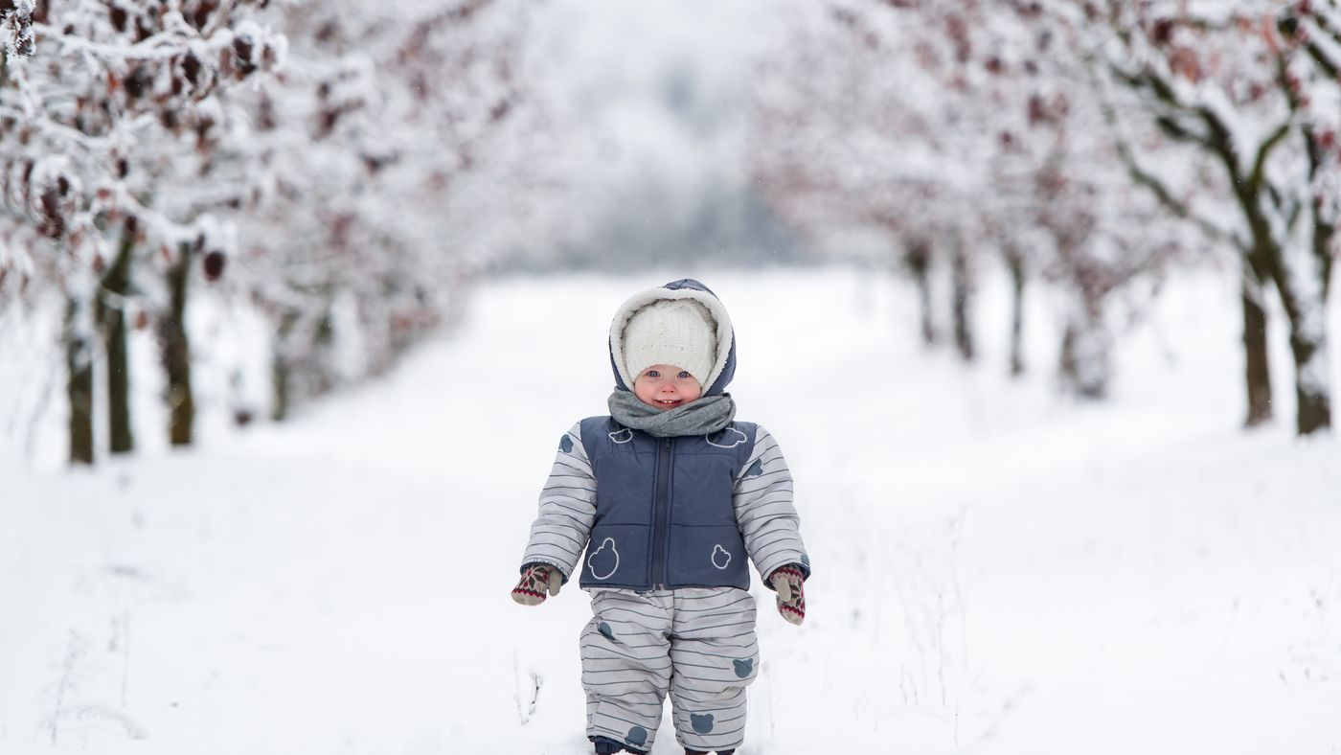
Winter.
In winter you have to wear thick, cosy clothes to keep you warm. Clothes you could wear to keep you warm are: a scarf, a hat, gloves or mittens and a fluffy coat.

Slide 5
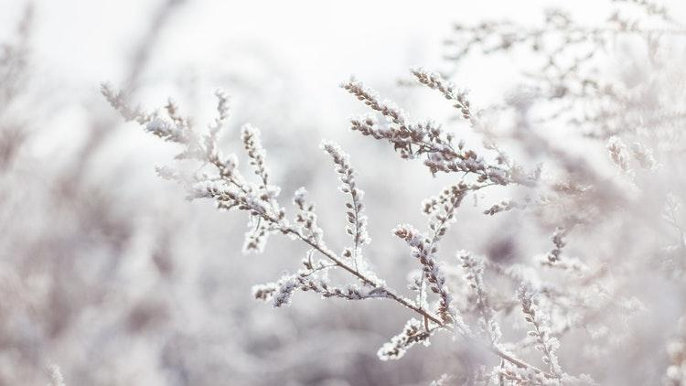
Winter.
In winter it's windy and rainy and it sometimes snows and hails. Sometimes the wind is so powerful it blows down trees and when it rains it makes puddles. When the rain gets so cold it makes ice.

