Slide 1


Slide 3
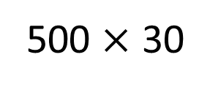
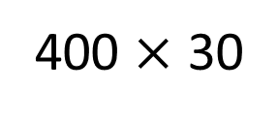
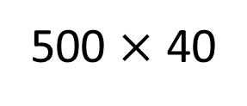

1) Which is the best estimate to use to check the
answer to 488 $×$ 32?
2) 12 $×$ 6 $=$
3) 1,200 $×$ 6 $=$
4) 12 $×$ 600 $=$
500 $×$ 40
400 $×$ 30
500 $×$ 30

Slide 4
1) Which is the best estimate to use to check the
answer to 488 $×$ 32?
2) 12 $×$ 6 $=$
3) 1,200 $×$ 6 $=$
4) 12 $×$ 600 $=$
500 $×$ 40
400 $×$ 30
500 $×$ 30
72
7,200
7,200

Slide 6

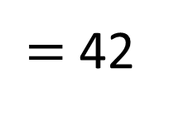
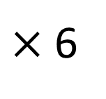
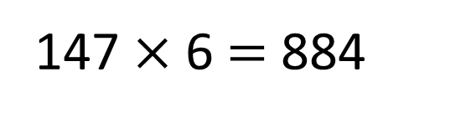

7
$×$ 6
$=$ 42
147 $×$ 6 $=$ 884
Th | H | T | O
 | 1 | 4 | 7
 |  |  | 6
$$×$$
8
8
2
2
4

Slide 7

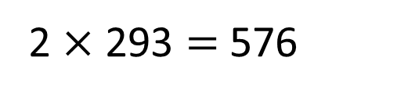
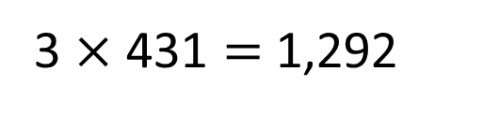
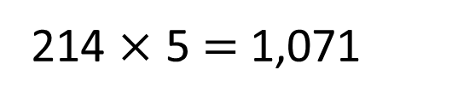
Have a think
Could these calculations be correct?
214 $×$ 5 $=$ 1,071
2 $×$ 293 $=$ 576
3 $×$ 431 $=$ 1,292
Could be correct | Definitely incorrect

Slide 8


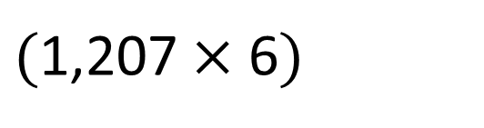
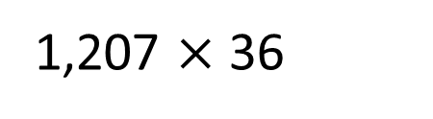
1,207 $×$ 36
TTh | Th | H | T | O
 | 1 | 2 | 0 | 7
 |  |  | 3 | 6
$$×$$
7
2
4
2
$($1,207 $×$ 6$)$
1
4
$$+$$

Slide 9
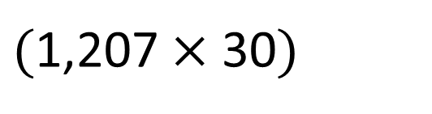
1,207 $×$ 36
TTh | Th | H | T | O
 | 1 | 2 | 0 | 7
 |  |  | 3 | 6
$$×$$
7
2
4
2
$($1,207 $×$ 6$)$
1
4
$$+$$
3
6
2
1
0
$($1,207 $×$ 30$)$
2
4
3
4
5
2
1

Slide 10
Have a go at the questions 1 - 5 on the worksheet

Slide 11



Tommy gets a pack of 12 football stickers every day for 9 weeks.
Whitney gets a pack of 21 football stickers every day in August.
Who gets the most stickers and by how many?

Slide 12
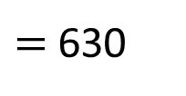
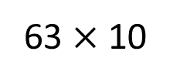
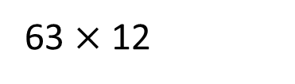
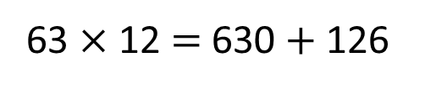
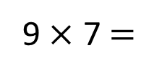
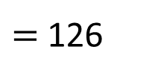
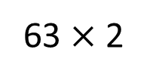
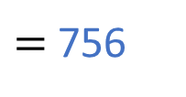
Tommy gets a pack of 12 football stickers every day for 9 weeks.
9 $×$ 7 $=$
63 days
63 $×$ 12
63 $×$ 10
$=$ 630
63 $×$ 2
$=$ 126
63 $×$ 12 $=$ 630 $+$ 126
$=$ 756

Slide 13
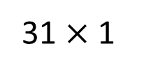
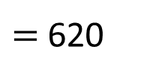
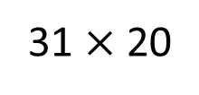
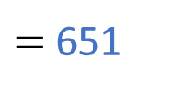
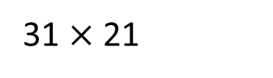
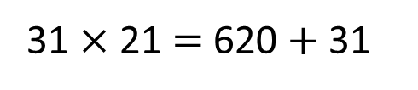
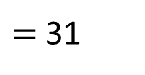
Tommy gets a pack of 12 football stickers every day for 9 weeks.
756
Whitney gets a pack of 21 football stickers every day in August.
31 $×$ 21
31 $×$ 20
$=$ 620
31 $×$ 1
$=$ 31
31 $×$ 21 $=$ 620 $+$ 31
$=$ 651

Slide 14
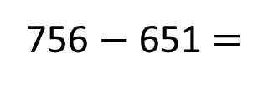
Tommy gets a pack of 12 football stickers every day for 9 weeks.
756
Whitney gets a pack of 21 football stickers every day in August.
651
Who gets the most stickers and by how many?
Tommy gets the most stickers.
756 $−$ 651 $=$
105

Slide 15





What is the smallest product you can make that’s also an odd number?
5
2
7
3
6
Th | H | T | O
odd$×$ odd $=$ odd
3
6
odd$×$ even $=$ even
2
7
$$×$$
5
even$×$ even $=$ even
$$+$$
Have a think

Slide 16
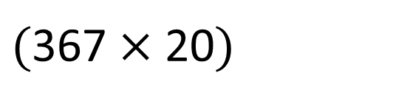
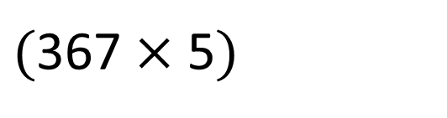
What is the smallest product you can make that’s also an odd number?
5
2
7
3
6
Th | H | T | O
3
6
7
$$×$$
2
5
1
8
3
5
$($367 $×$ 5$)$
$$+$$
7
3
4
0
$($367 $×$ 20$)$
9
1
7
5
Have a think

Slide 17
Have a go at the questions on the worksheet

