Slide 1
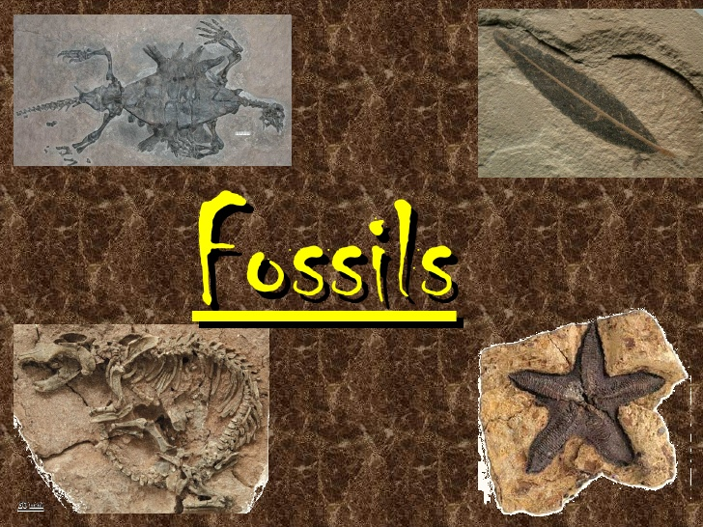
What do we know about
?

Slide 2
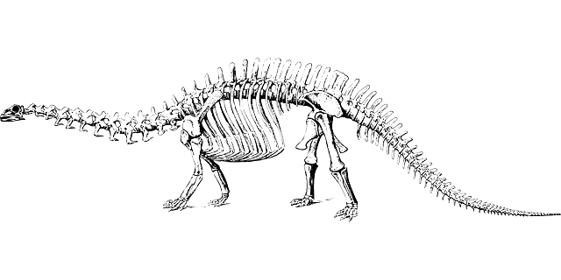
LO: To understand and explain how fossils are made
I know what a fossil is
I know how fossils are made
I can explain the steps needed to create a fossil

Slide 3
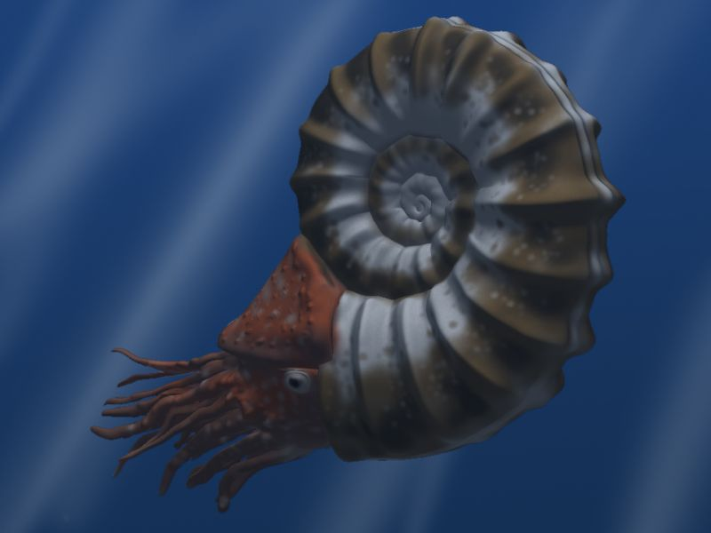
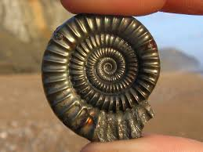
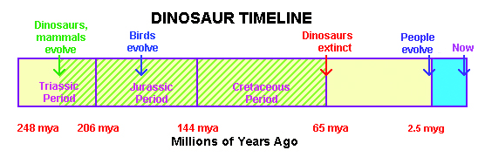
What is a fossil?
Fossils are the stone remains of animals or plants that were once living. Fossils are at least 10,000 years old. The dinosaurs became extinct 65 million years ago.
My ammonite is 165 millions years old.

Slide 4
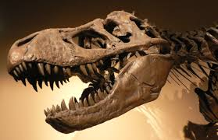
What is a fossil?
They are rare, as most animals and plants that die rot away into the soil.
The conditions have to be perfect for a fossil to form.
There are different ways that a fossil can be created, but the most common is the ‘mould and cast’.

Slide 5
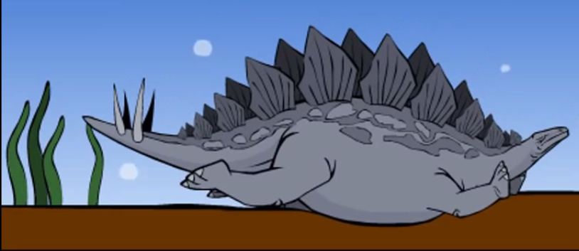
Step 1: An animal (such as a dinosaur, ammonite or fish) dies and falls to the bottom of the ocean

Slide 6
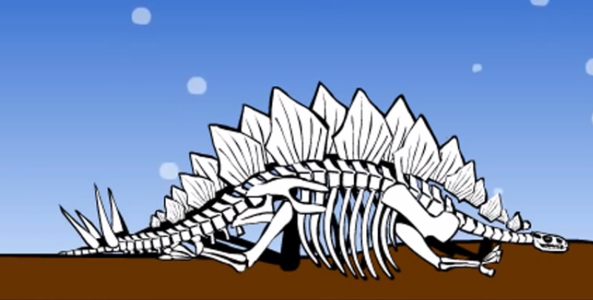
Step 2: The animal rots away leaving just the hardest parts – bones or shell

Slide 7
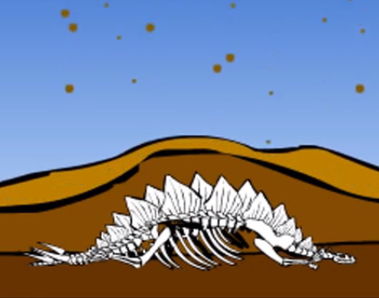
Step 3: Sediment falls and covers the remains

Slide 8
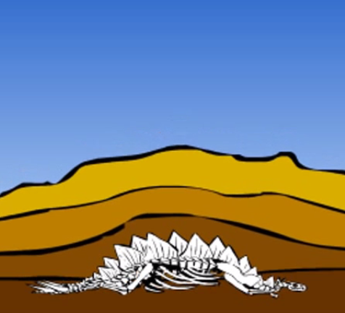
Step 4: Pressure forces the sediment layers together, turning them into sedimentary rock.

Slide 9
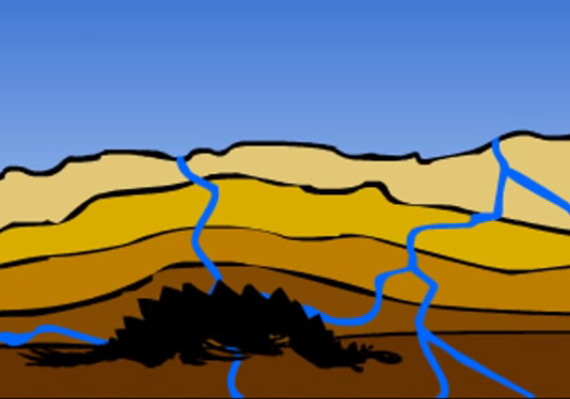
Step 5: Small amounts of water come through the permeable rock and the remains are slowly washed away.

Slide 10
Step 6: Left behind is an open space in the exact size and shape of the skeleton, this is called a mould.

Slide 11
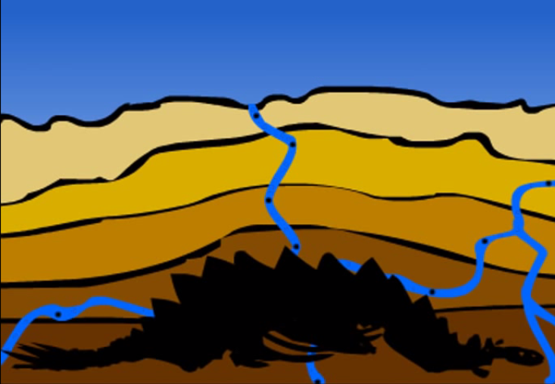
Step 7: The water transports tiny pieces of impermeable rock, which are left inside the mould.
Pieces of rock

Slide 12
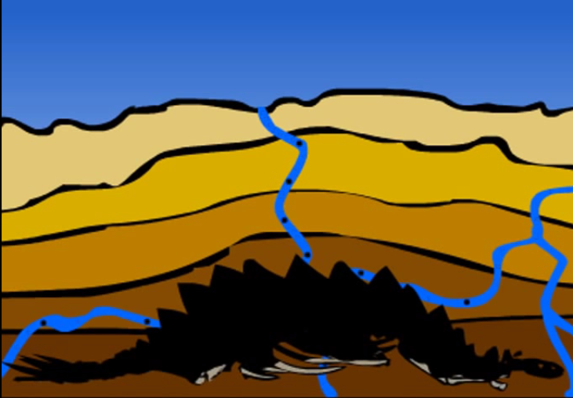
Step 8: The mould starts to fill up with these pieces of rock, in the shape of the skeleton.
Pieces of rock

Slide 13
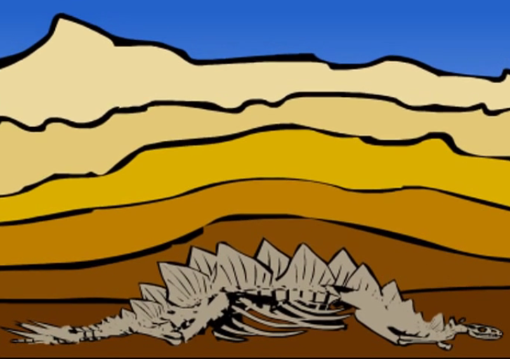
Step 9: Over time the whole skeleton, or remains, will become solid rock, called a cast.

Slide 14
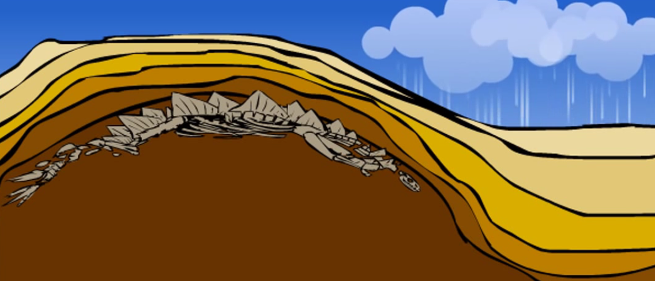
Step 10: After millions of years the ground underneath the cast will rise up, and weathering will wear away the rock from above.

Slide 15
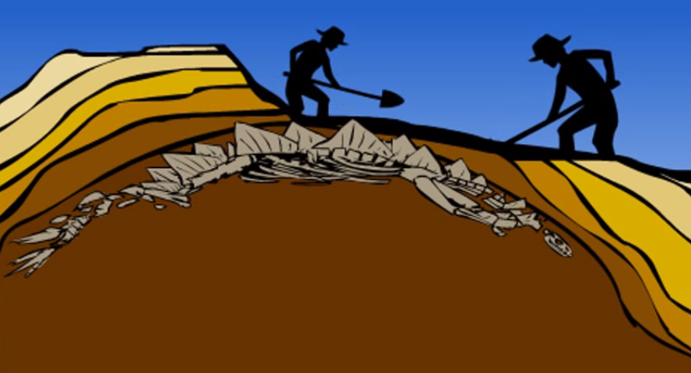
Step 11: This brings the stone cast near the surface, and people dig them up.

Slide 16
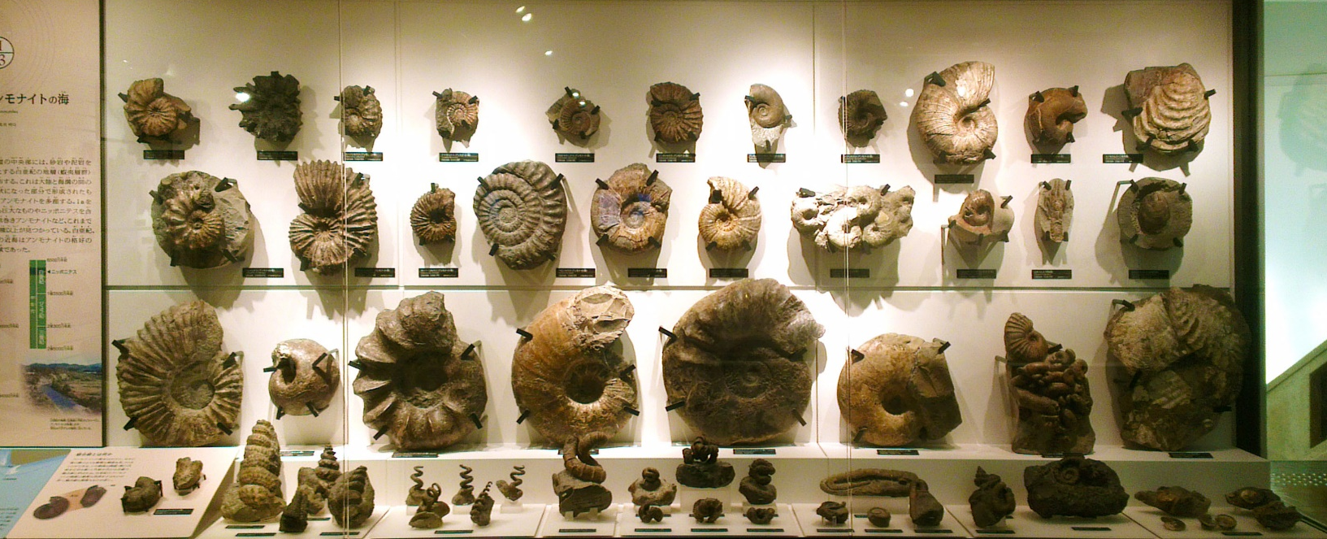
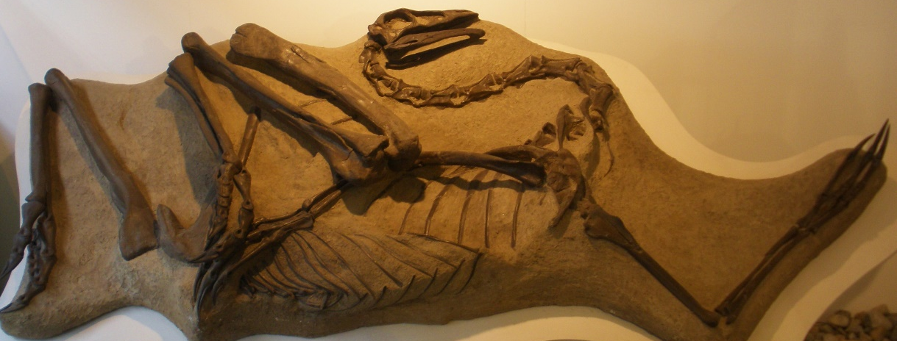
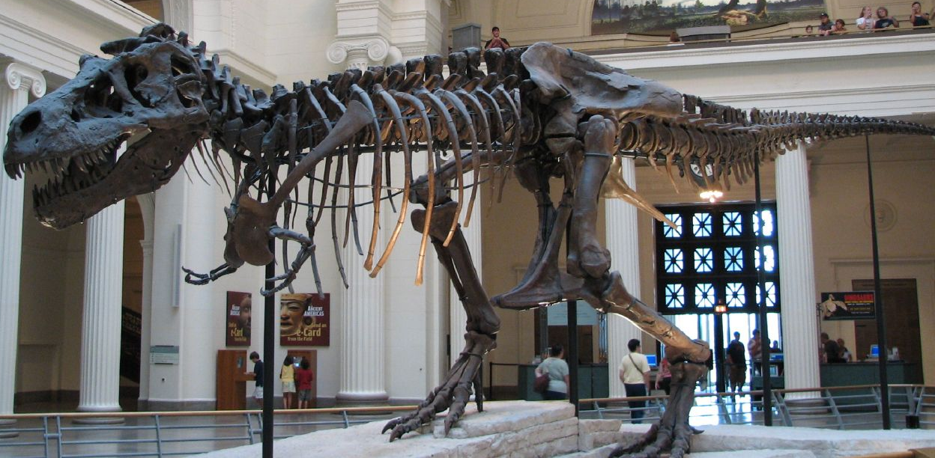
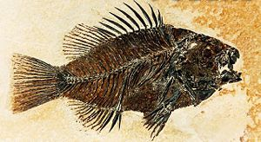
Now we see these fossils in museums

