Slide 1
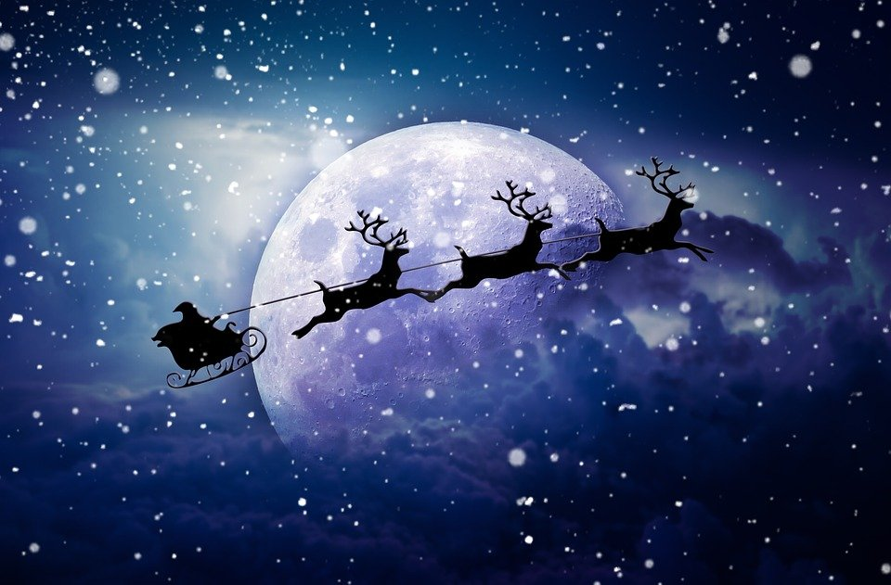
Australian Christmas!
By Ella Fry

Slide 2
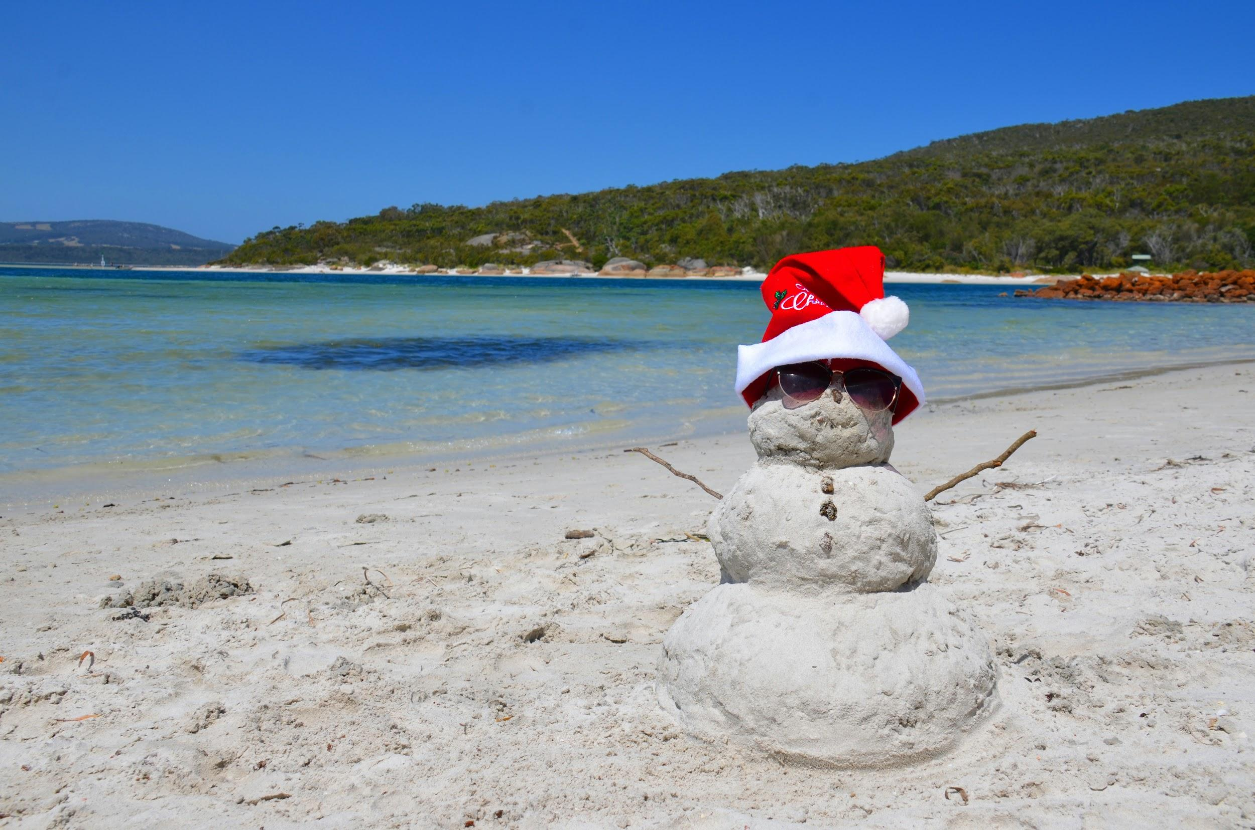
How do you celebrate Christmas?
Australians don’t send christmas cards.
They go to the beach and wear swimsuits.

Slide 3
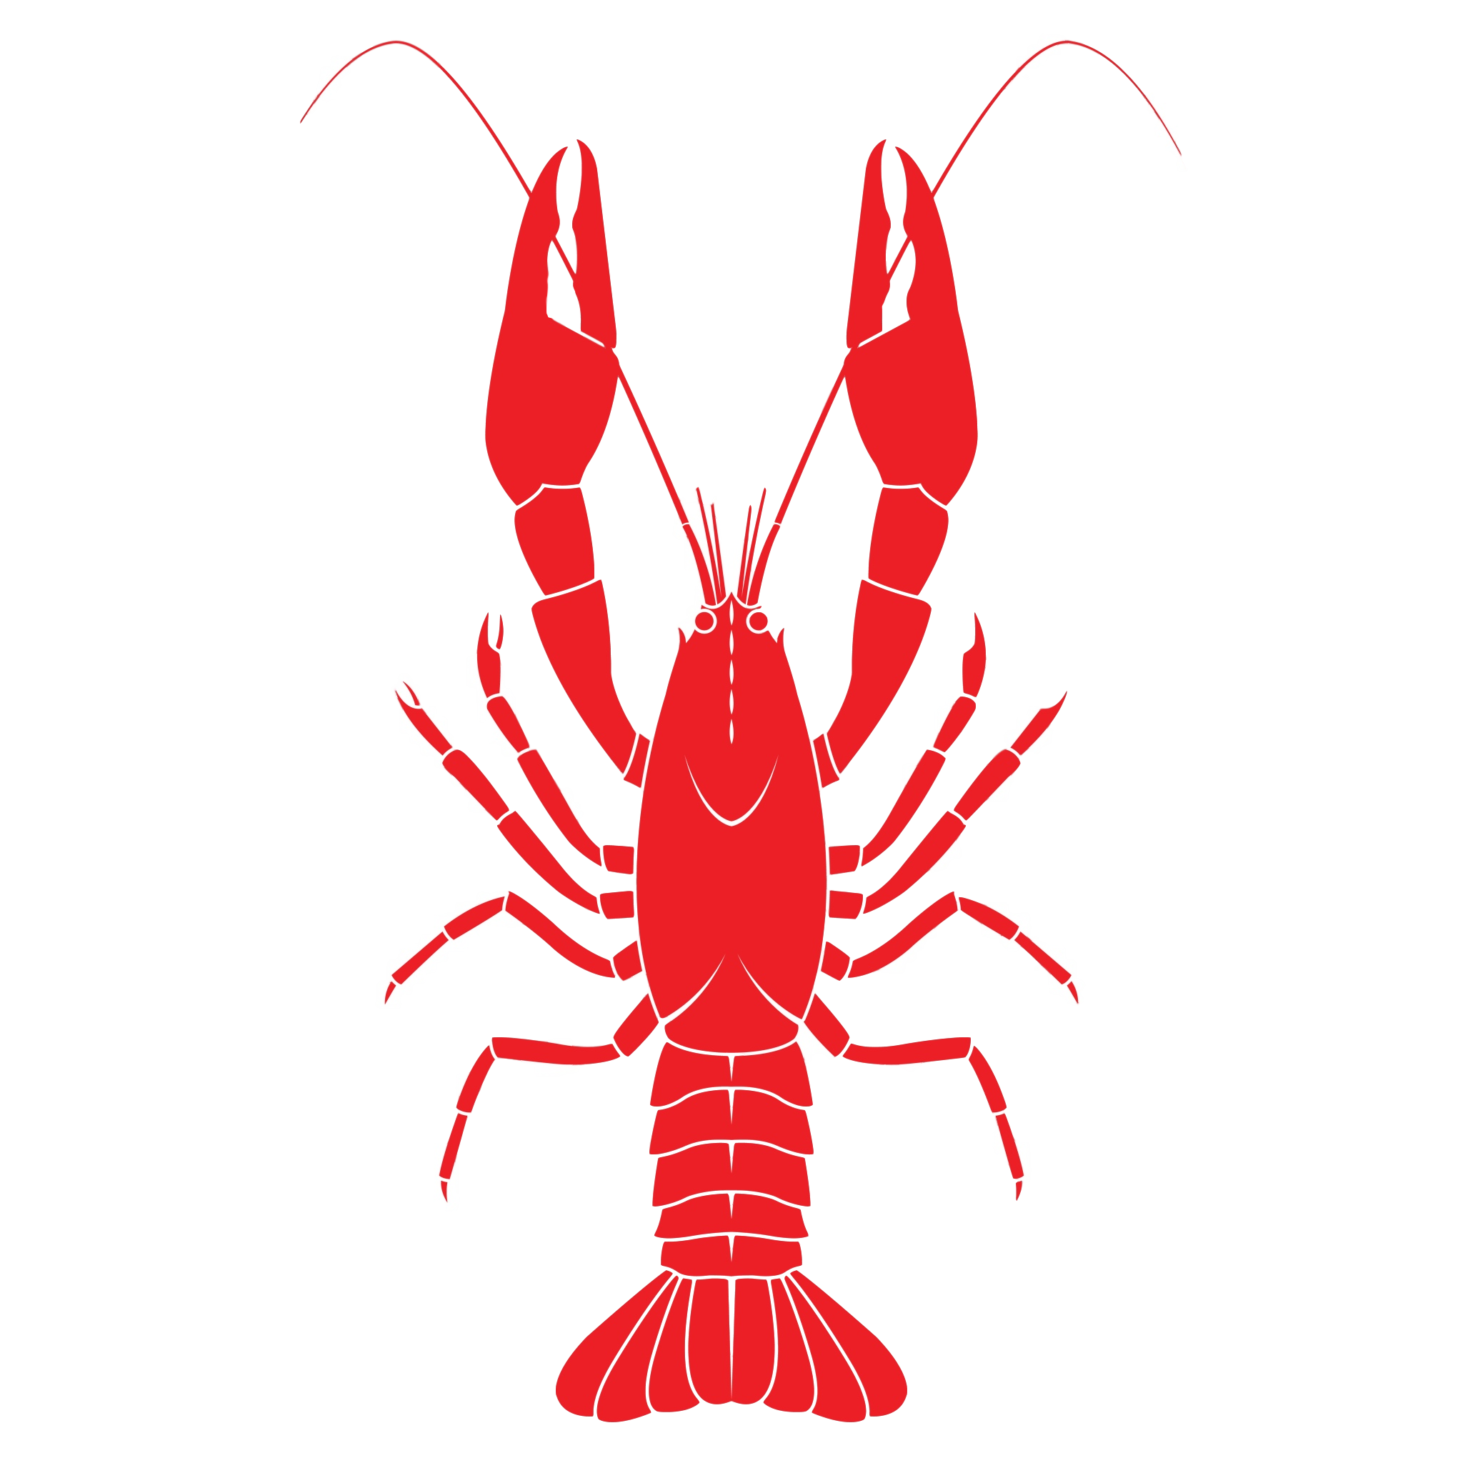
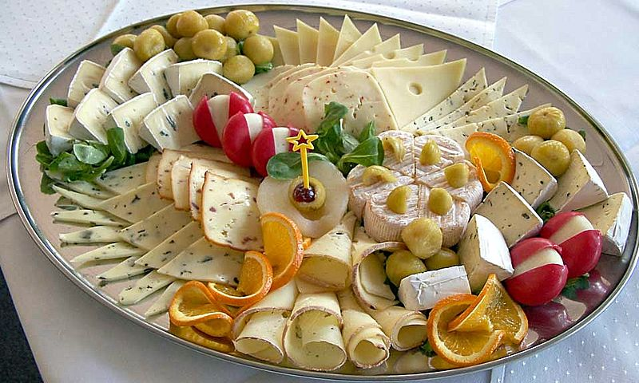
What do you have for Christmas dinner?
The starter is lots of fish, prawns, oysters and lobsters. They share a cheese platter as a special starter. Turkey, chicken and ham on the same plate all at the same time! Vegetables and roast potatoes are also eaten.

Slide 4

Does Father Christmas still come?
He comes to Australia first because they are 11 whole hours ahead. His name in Australia is Santa!

Slide 5
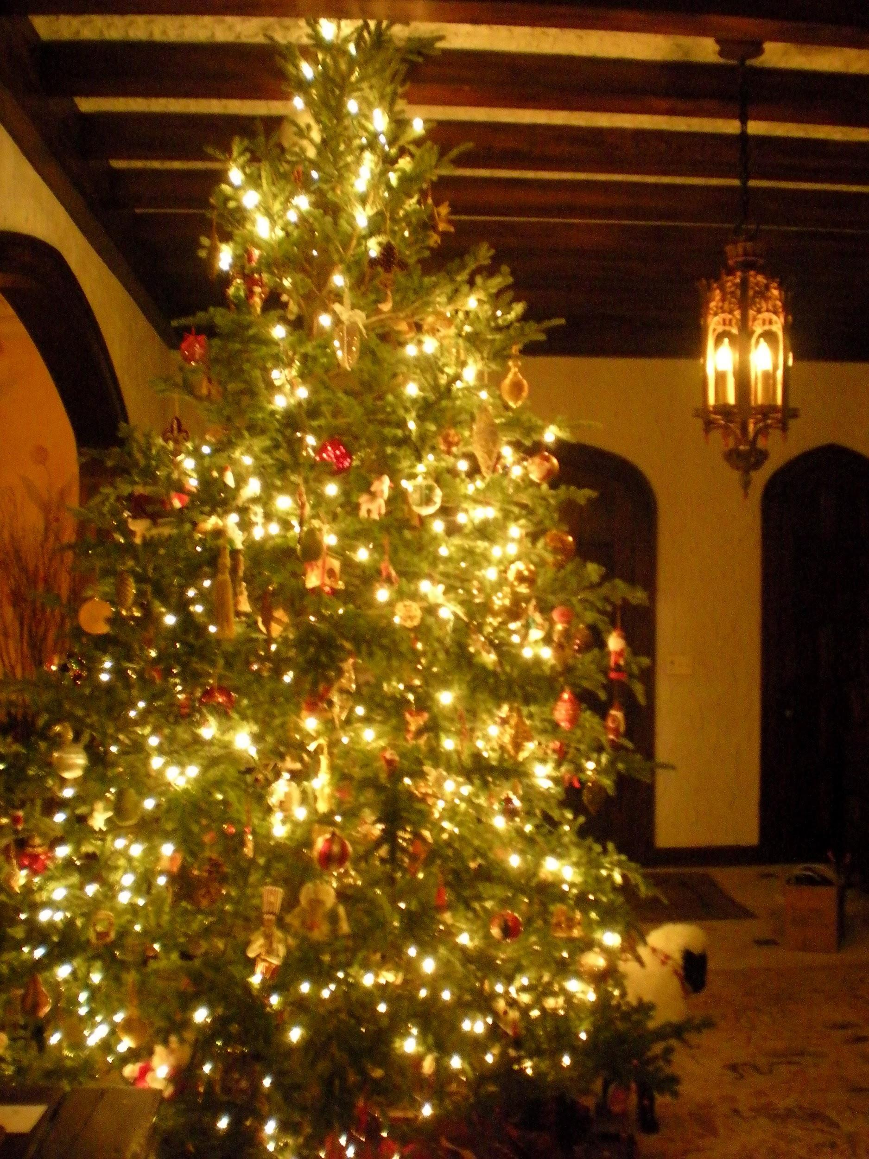
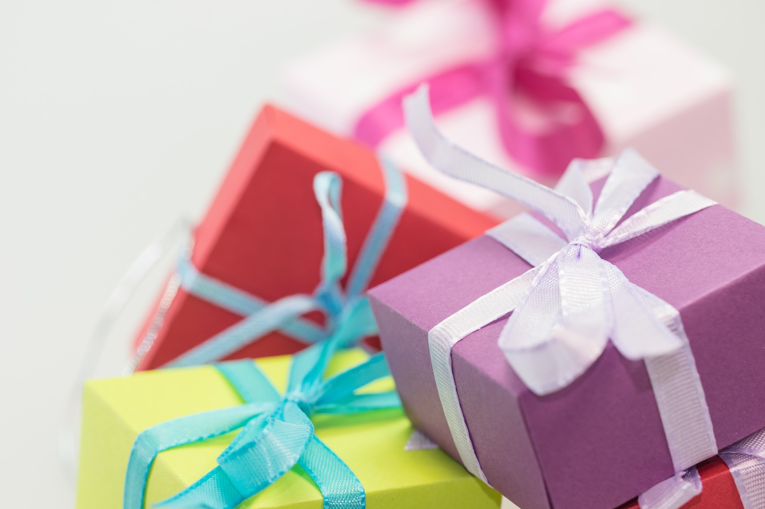
Do you still decorate a christmas shiny tree?
Yes and they also give presents!
Does it snow in australia?
No it does not! This is because their christmas is in summer!

Slide 6

Thanks for watching!!!!!!

