Slide 1
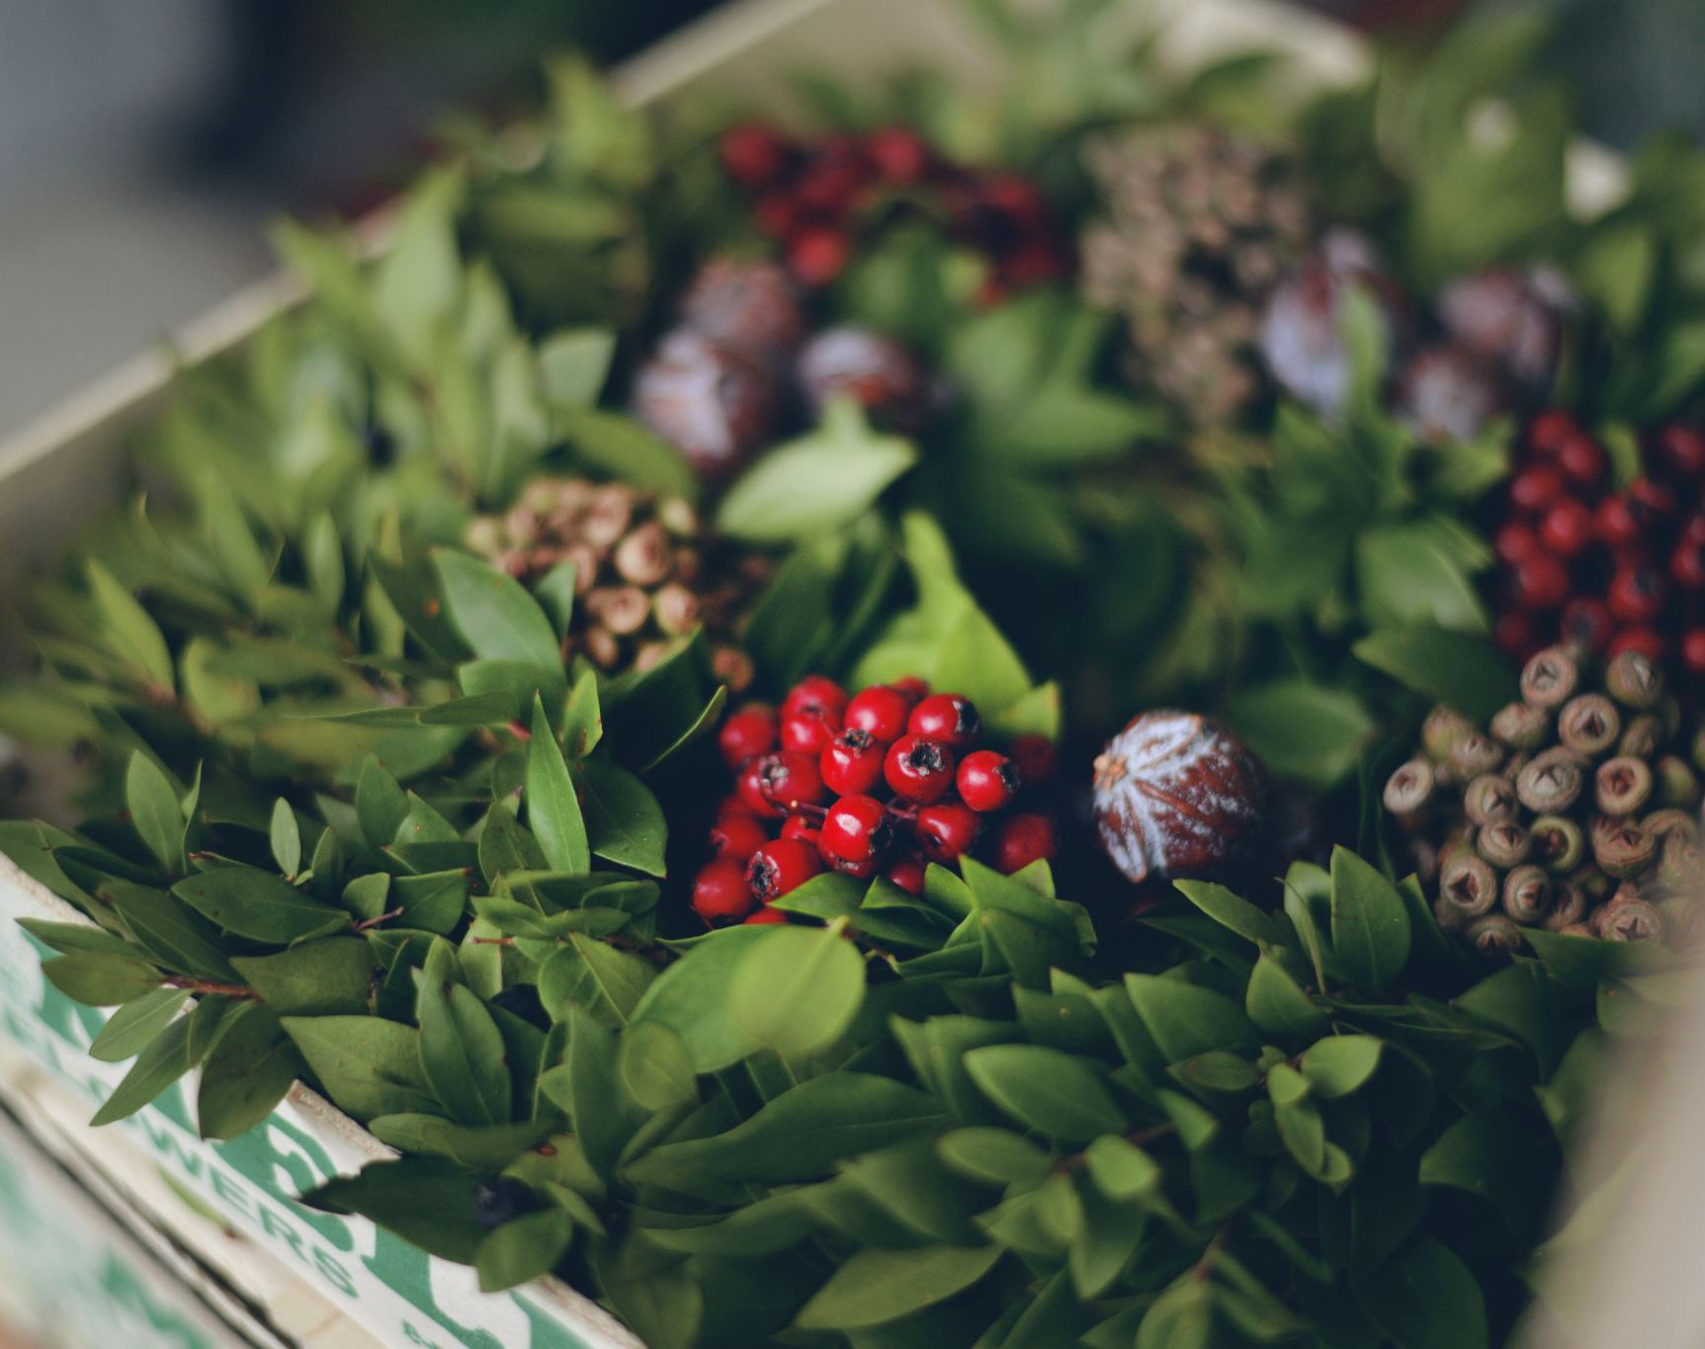
Vesele Vanoce !
Merry Christmas !
Christmas in the Czech Republic

Slide 2

Christmas Tree
In Czech Republic (also known as Czechia) Christmas Trees are decorated on 24 December.

Slide 3
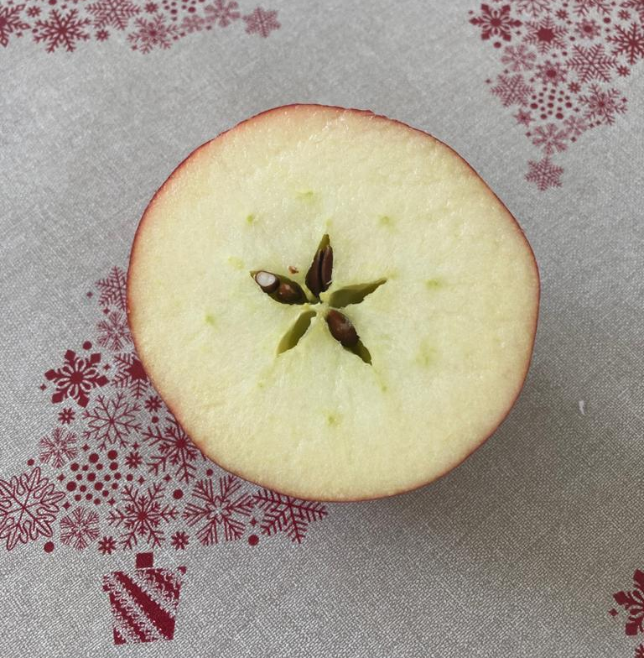
Apple Star
Czech people cut apples to show the star in the core of the apple as a sign of happy and healthy New Year.

Slide 4
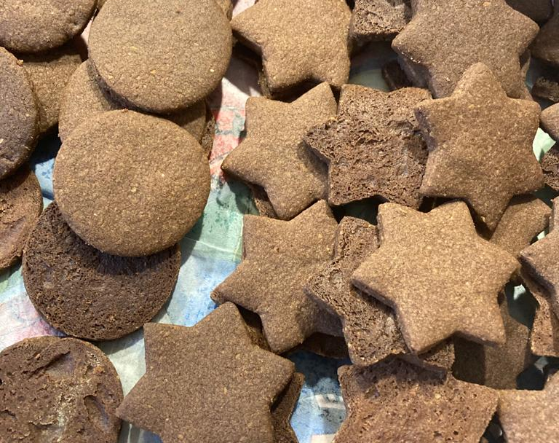
Baking
Czech people will bake lots of different biscuits for Christmas, such as chocolate stars.

Slide 5
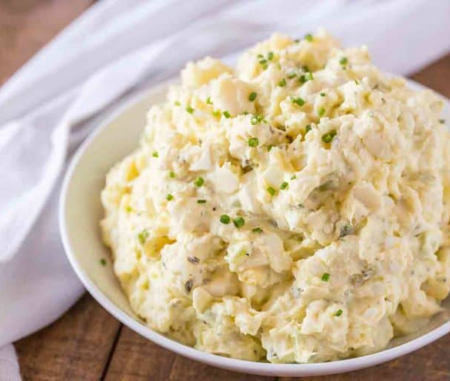
Christmas Dinner
Christmas dinner is traditionally potato salad with carp fish.

Slide 6

Presents !
In Czech Republic, gifts are opened in the evening of 24 December, one day earlier than in United Kingdom.

