Slide 1
Christmas in Holland
Phoebe Bywater’s interview with Nana
Hedgehog Class

Slide 2
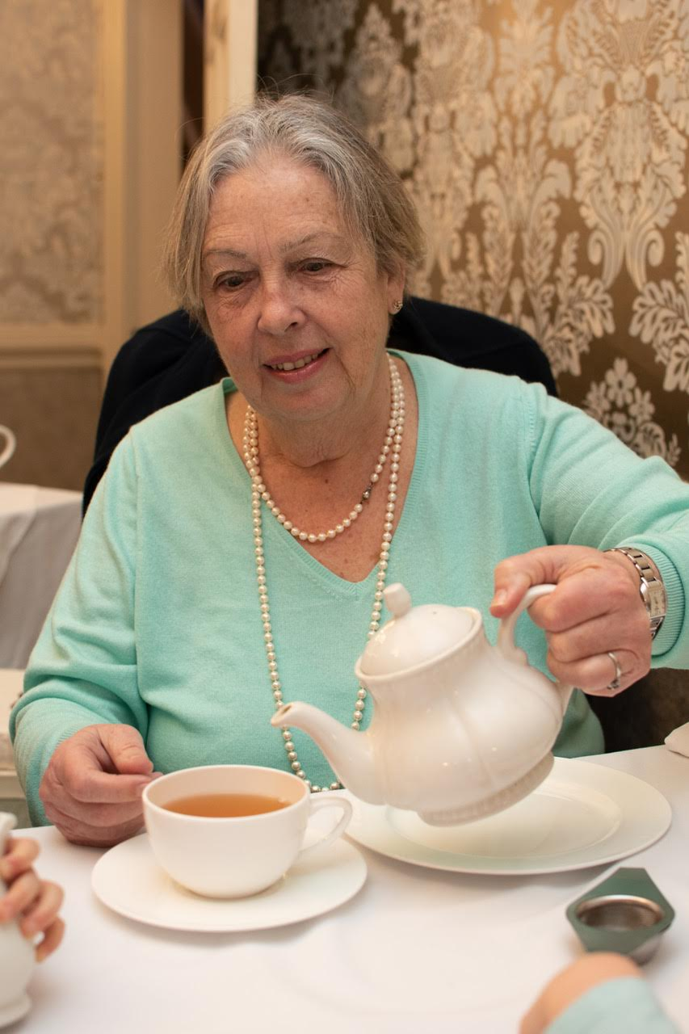
This is my Nana.

Slide 3
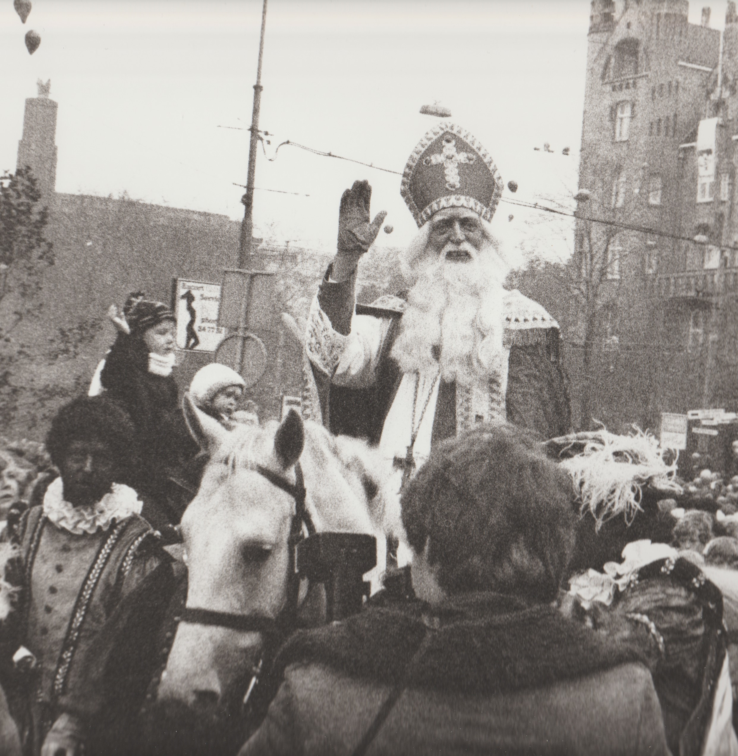
Nana lived in Holland when my Daddy was little.
In Holland they celebrate St. Nicholas’ Day.
He comes from Spain on a boat.
He goes home on the 6th December.

Slide 4
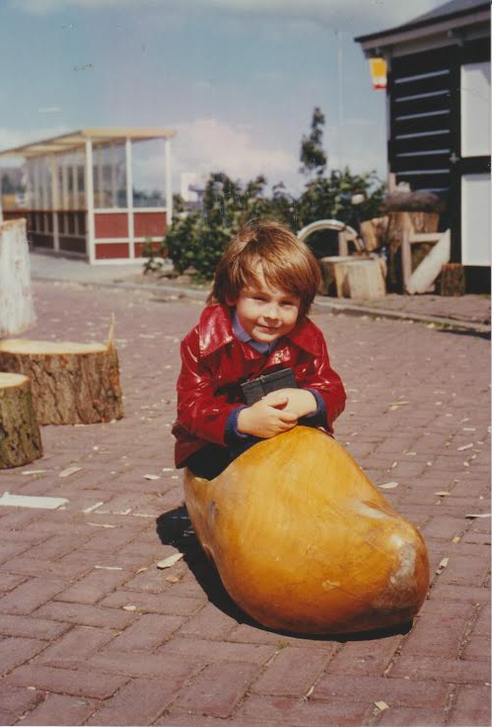
Children leave a shoe outside the door or window for 21 days.
If they are good they get a present.
If they are naughty they get a piece of coal.
One day Daddy got a piece of coal.

Slide 5
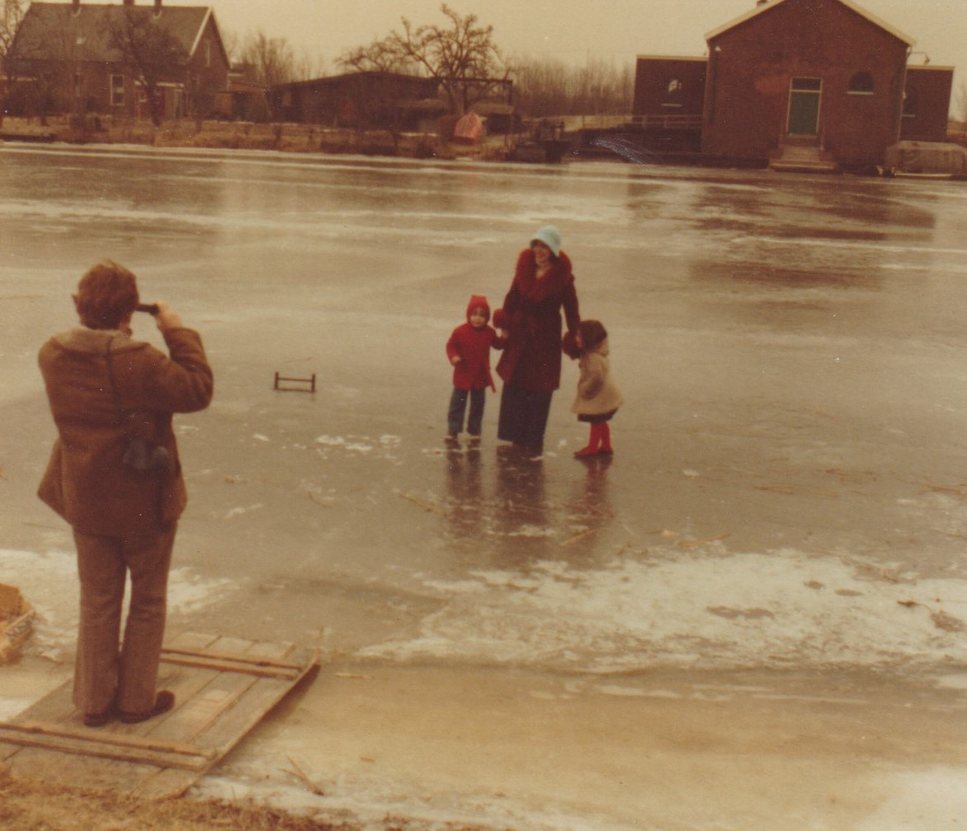
There was no Christmas tree or pudding, but there was cake!
It is cold and the canals freeze.
This is a picture of Daddy walking on
the frozen water.
They do not celebrate Baby Jesus!

Slide 6
Thank you

