Slide 1
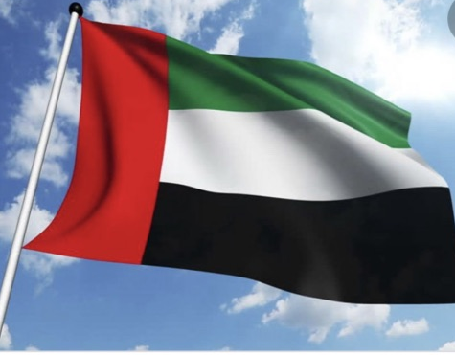
Christmas in another Country - Dubai

Slide 2
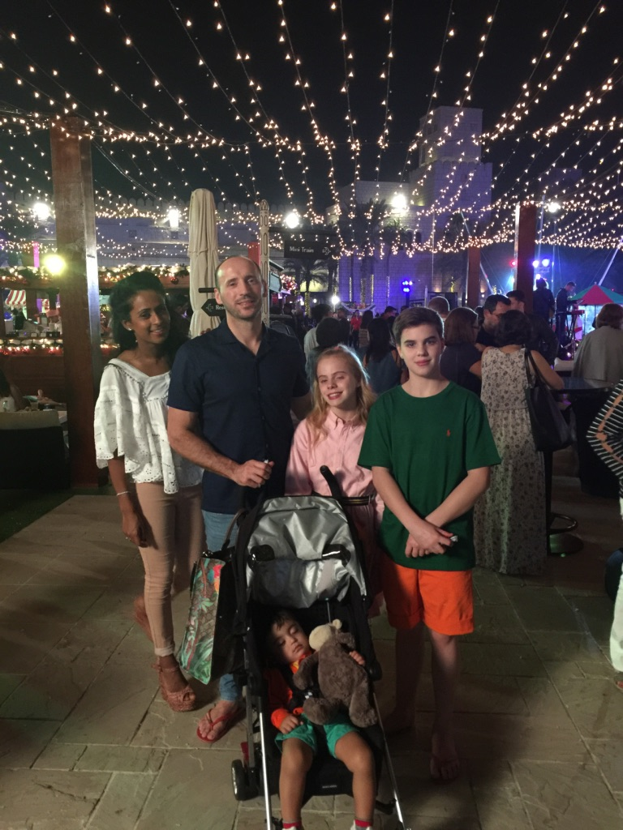
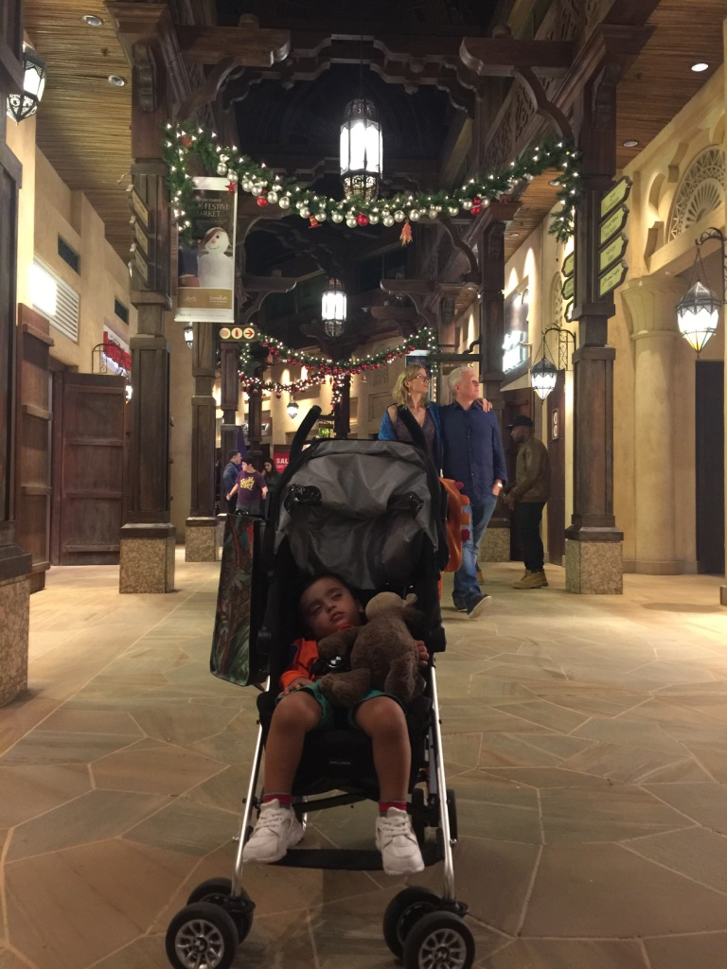
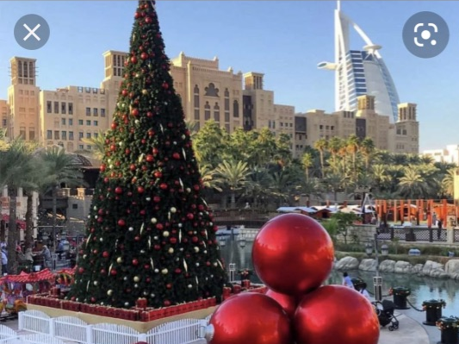
In December 2016, I spent Christmas with my family in Dubai
I was very little, so don’t remember much but I love the photos of my family holiday

Slide 3
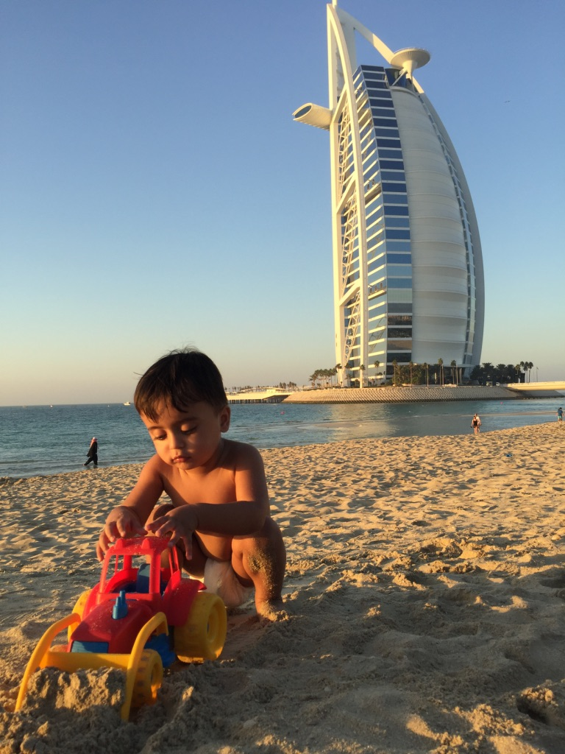
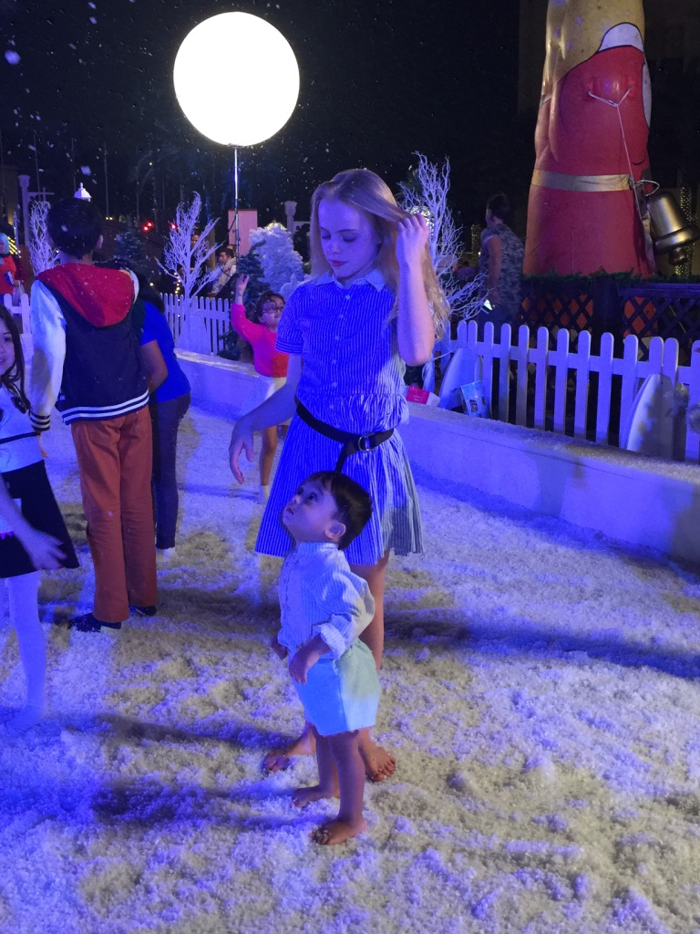
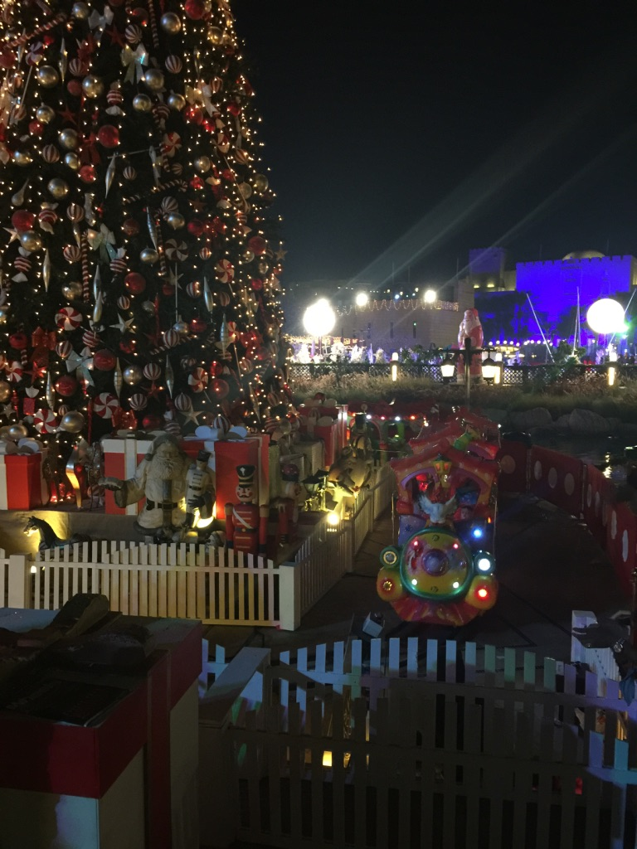
It was very hot in Dubai
There were lots of Christmas decorations every where
I played on the beach and then went to the Christmas market where there was fake snow

Slide 4
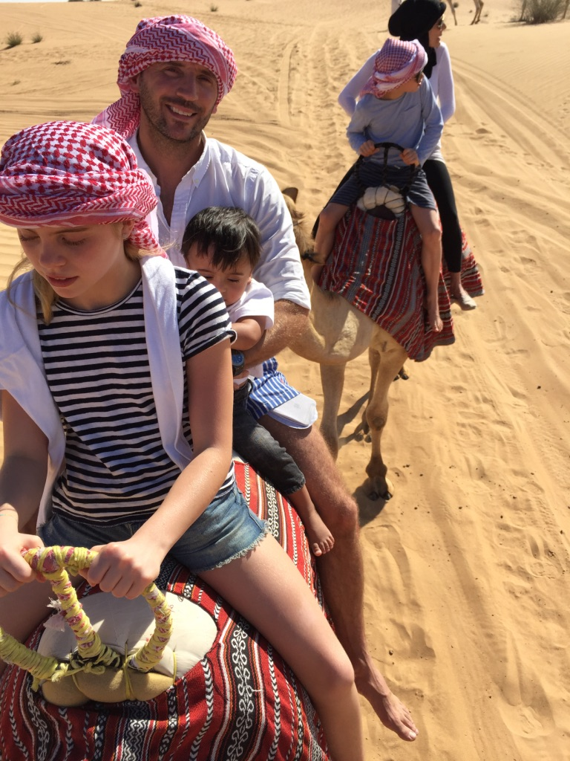
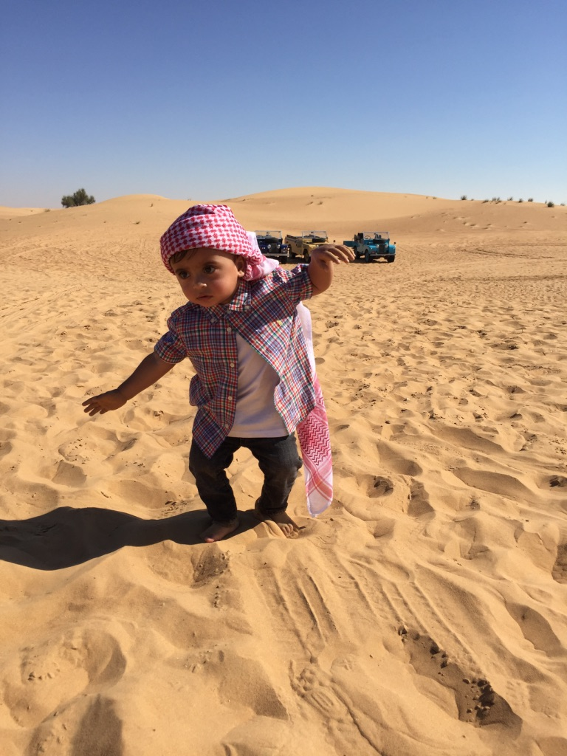
I even went for a camel ride with my family on Christmas Day

Slide 5
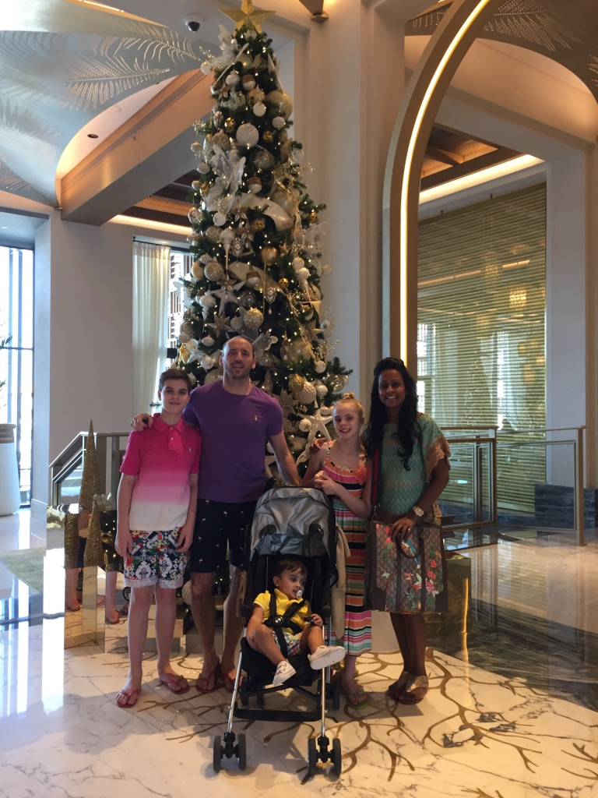
Here I am with my family at our hotel

