Slide 1
My nannas christmas story
By poppy coquard

Slide 2
My nanna is 1 of 7 children! Her name is Ann.
She is the middle child. The names of her brothers and sisters, from oldest to youngest, are:
Barbara
Bryan
David
Ann – my nanna
Sandra
Jane
Paul

Slide 3
Christmas stockings
They had real ladies stockings at the end of their beds!
They were filled with:
A tangerine
Nuts
Colouring pencils and book

Slide 4
Christmas morning
They used to come downstairs from their bedrooms from smallest to biggest.
They each had a small pile of presents. They always had new clothes which they put on after breakfast.
They would play with their toys until lunch time. Nanna got a teddy bear that she still has now. It burps!

Slide 5
Christmas afternoon
After lunch they all would visit their nanna and grandad – my great, great nanna and grandad.
Christmas decorations
They always had a real christmas tree and they used balloons to decorate the house.

Slide 6
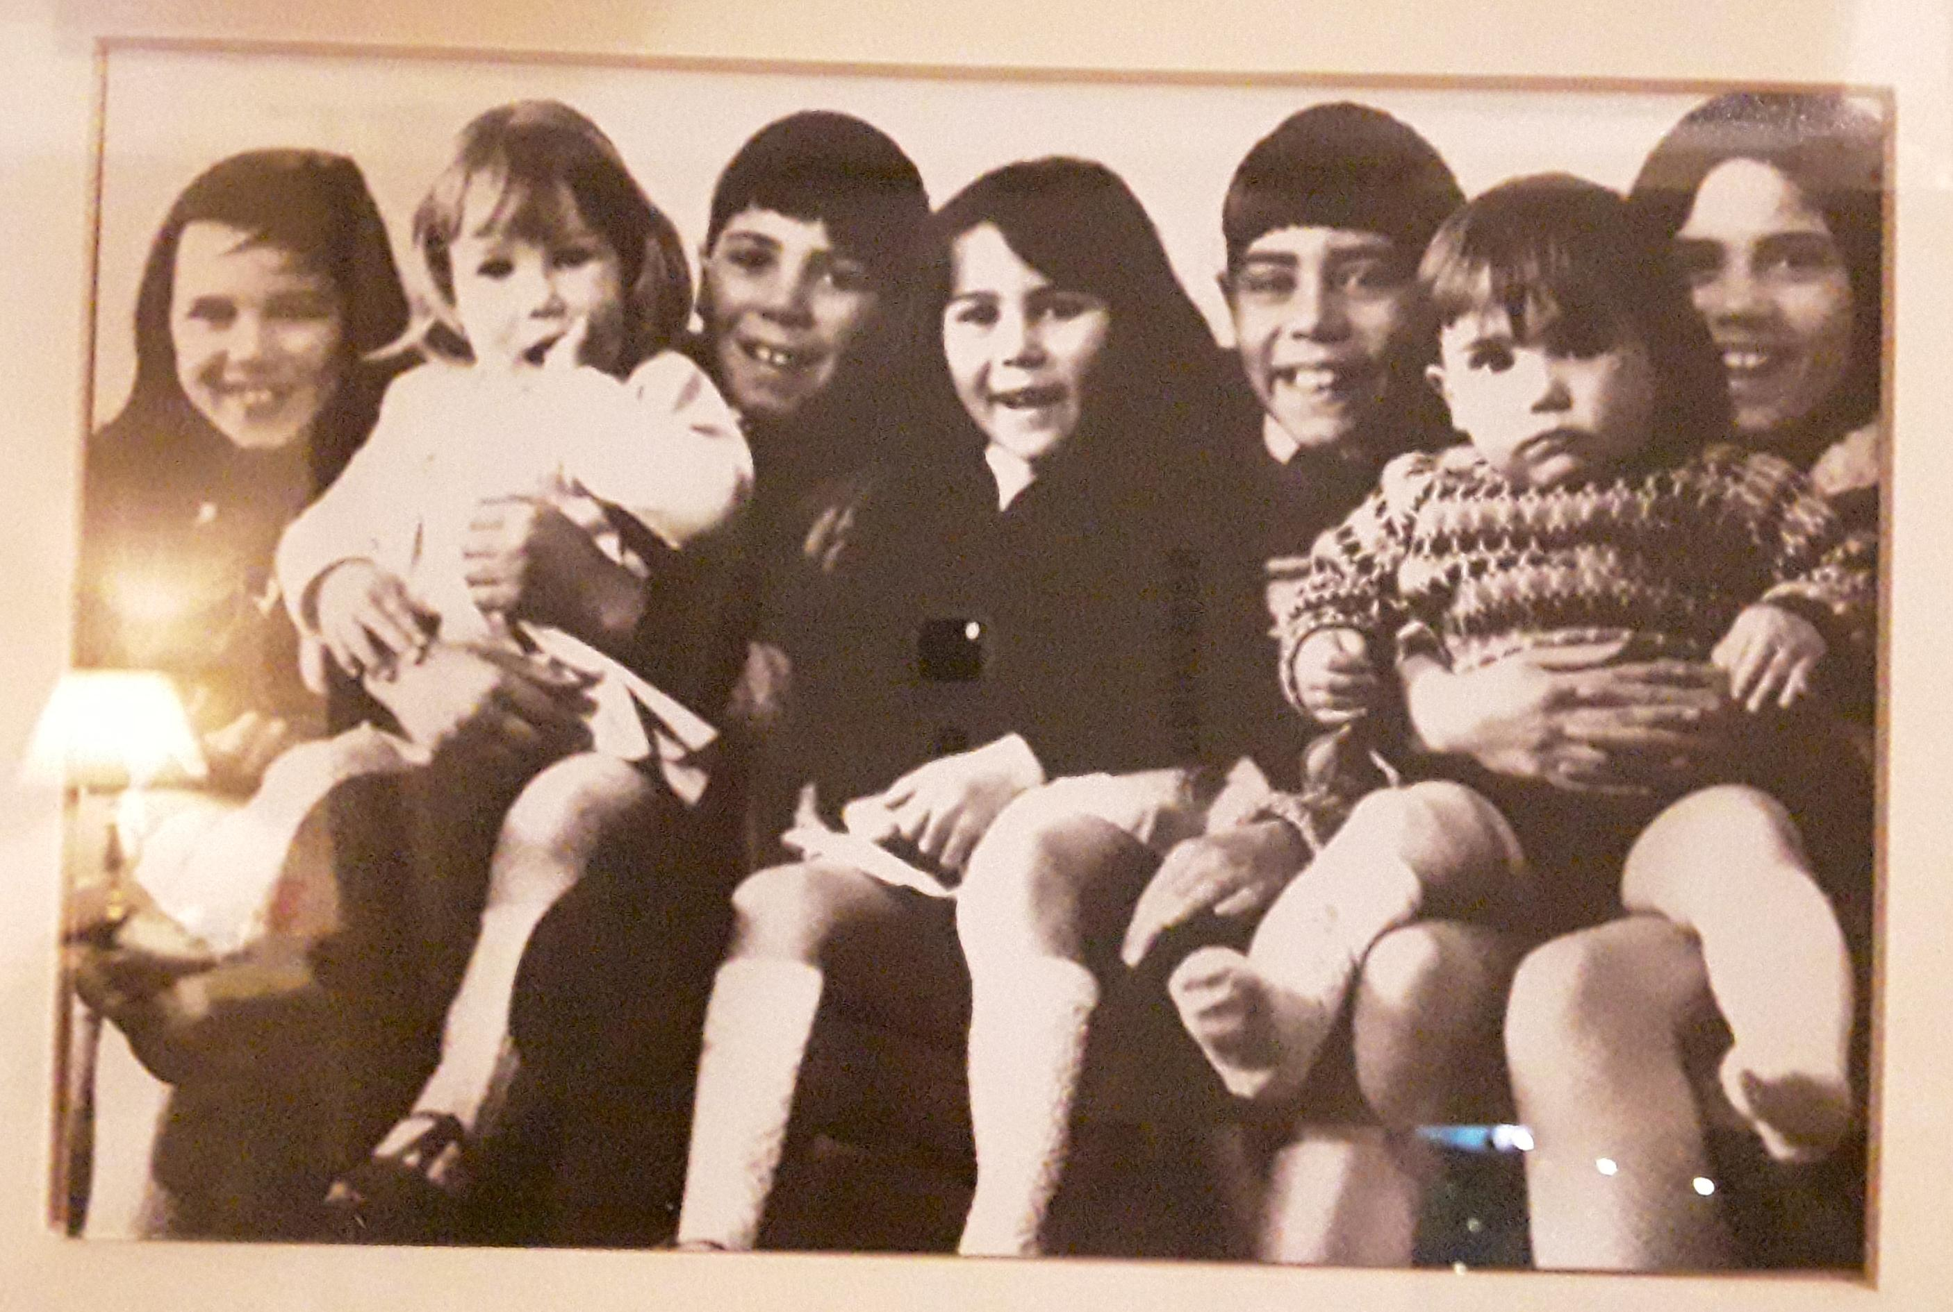
My nanna and her brothers and sisters

