Slide 1
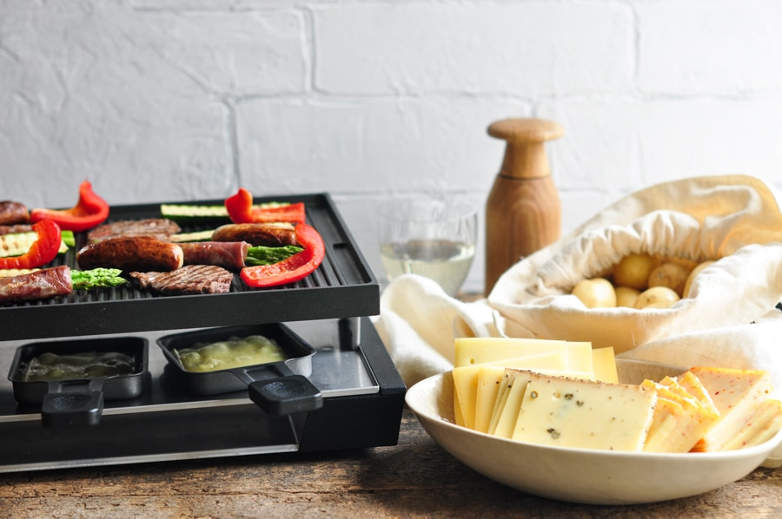
Raclette – a traditional Swiss Christmas Meal
I am half Swiss and our traditional Christmas meal is Racelette.

Slide 2
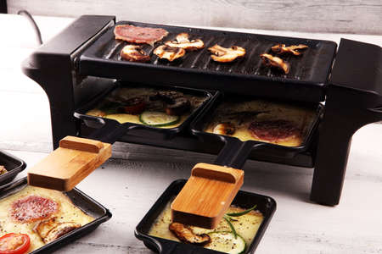
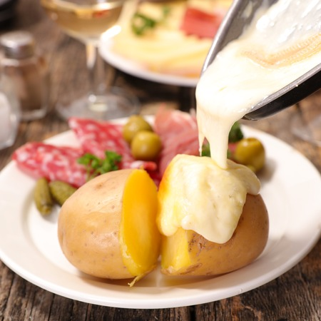
  Raclette is a cheese.
  You put the cheese in a little tray under the oven to melt.
  Then you tip the cheese over your potatoes.
  If you want you can then put some special Raclette spices on top.

Slide 3
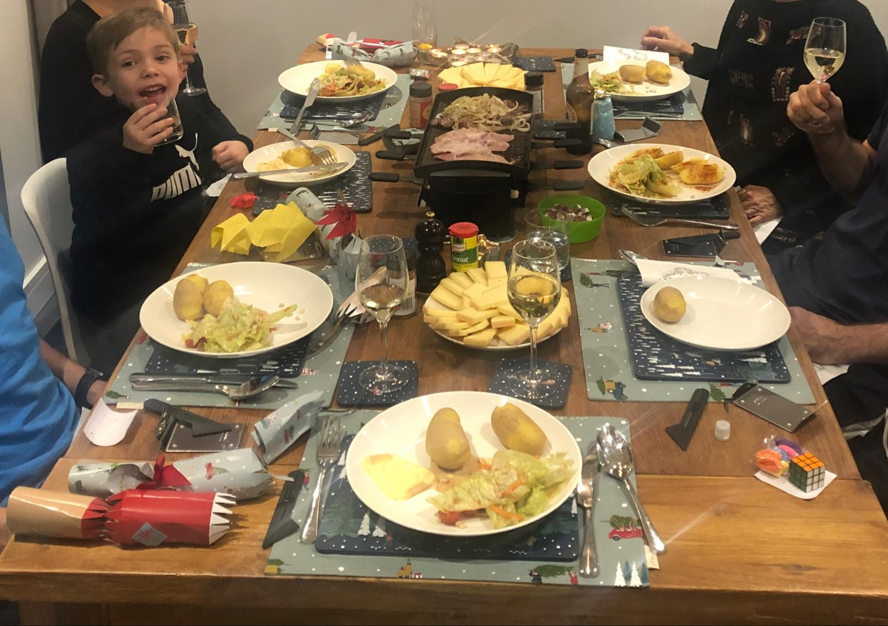
This is me last year on Christmas Eve.
I love Raclette, but the house gets a bit stinky from the smell of the cheese.

