Slide 1
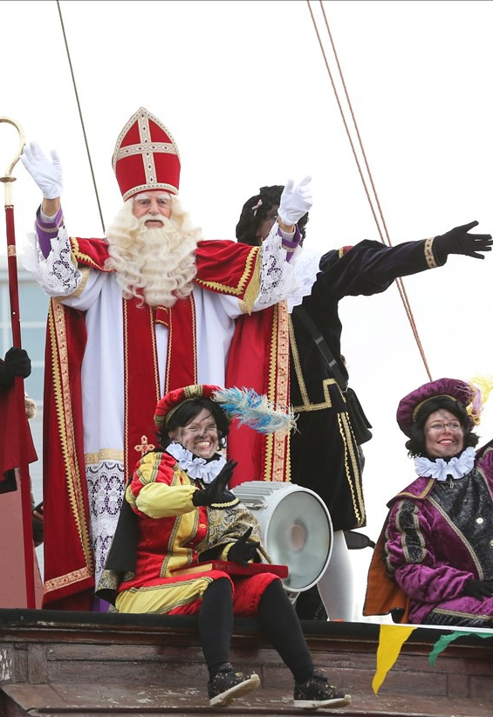
SINTERKLAAS
Dutch Christmas

Slide 2
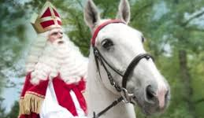
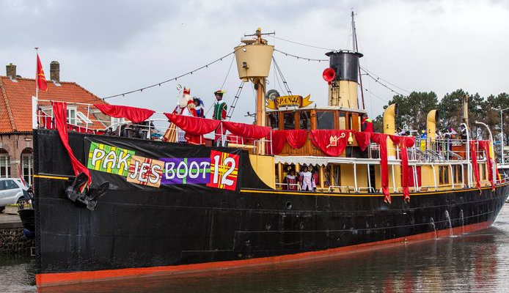
In Holland Sinterklaas comes and gives you presents.
Sinterklaas comes from Spain on a boat.
He is on a horse called Americo.

Slide 3
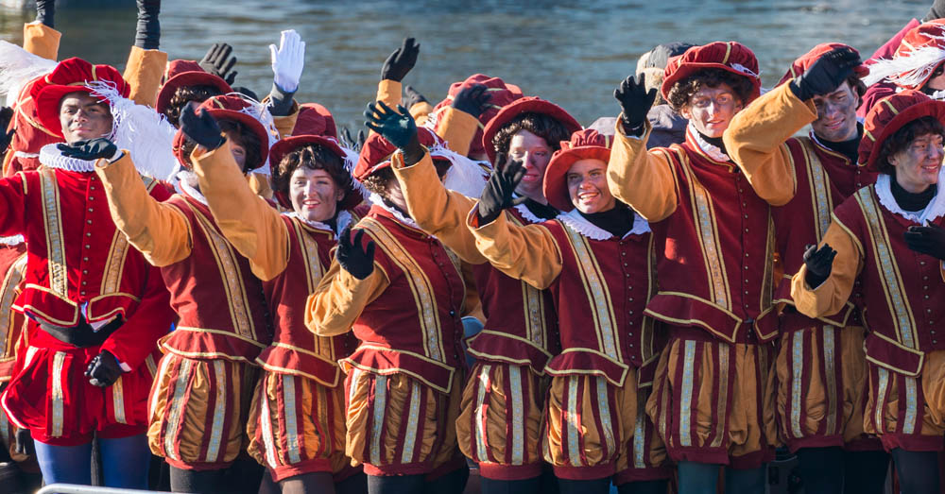
Piet
Sinterklaas his helpers are called Piet.
Piet makes presents and sweets
Piet puts them in your shoe at night if you sing a song.

Slide 4
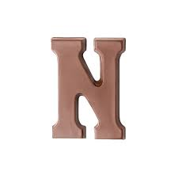
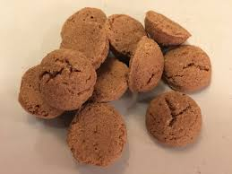
Sweets
Sinterklaas and Piet gives you sweets.
He gives you a chocolate letter
And he gives you pepernoten (little cookies)

