Slide 1
Year 6 pgl trip to bawdsey manor
Monday 16th May – Friday 20th May

Slide 2
Welcome
Apologies that it is quite a long way into the school year and we are only just holding this meeting. We were obviously waiting to see how the Covid situation panned out. We are absolutely thrilled that this trip can go ahead; it’s such a massive part of the children’s growth and the memories they make genuinely will last a life-time.

Slide 3
WHAT’S IT ALL ABOUT?
This is a short promotional film that’s aimed at parents to explain the benefits of PGL.

Slide 4
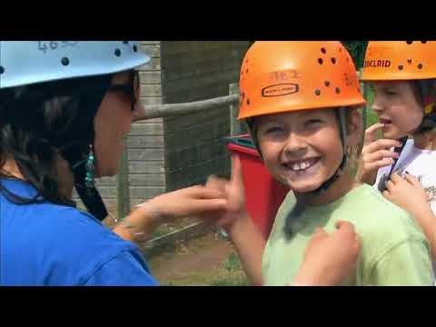

Slide 5
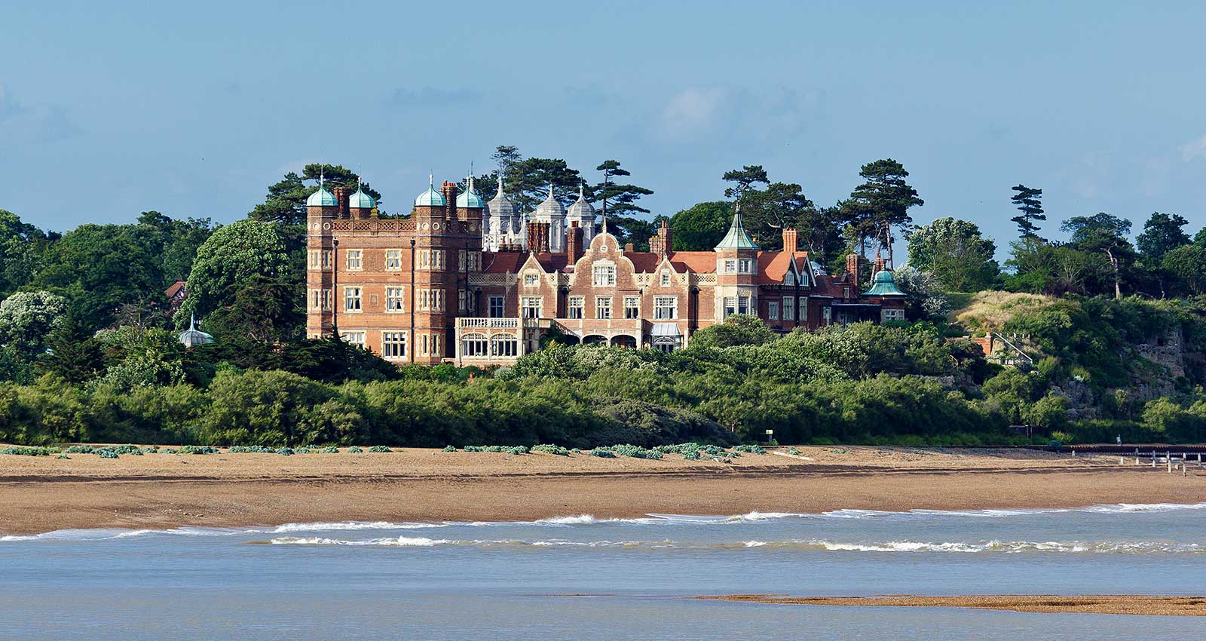
Bawdsey Manor in Suffolk is a very special place for children to visit. There's comfortable accommodation, a range of thrilling adventure activities and a fantastic on-centre team to support the children throughout their stay.

Slide 6
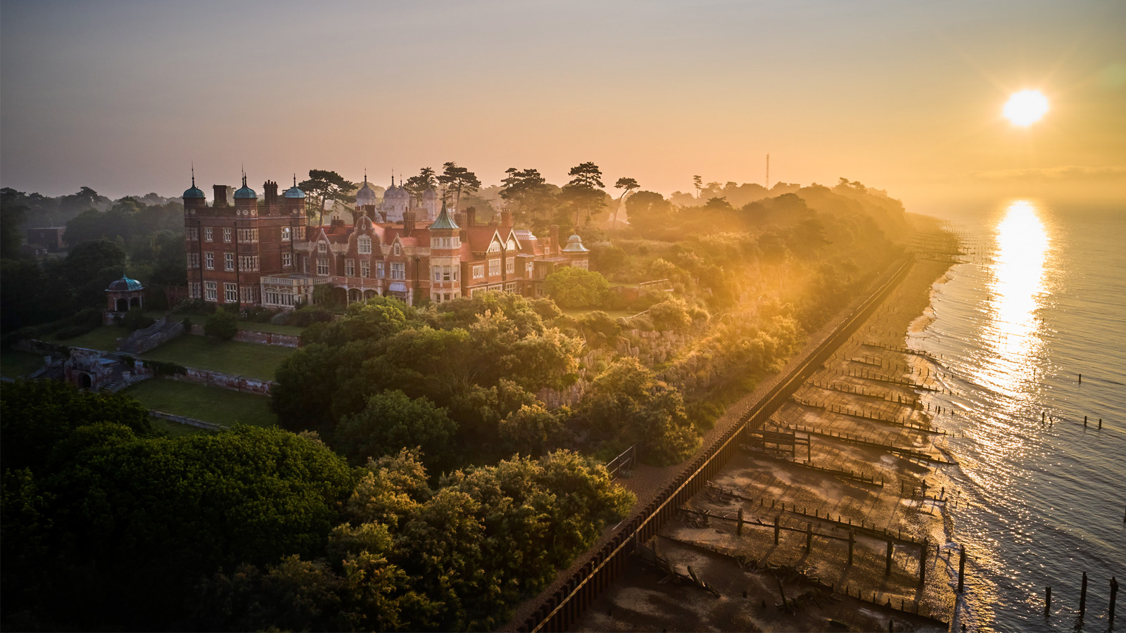
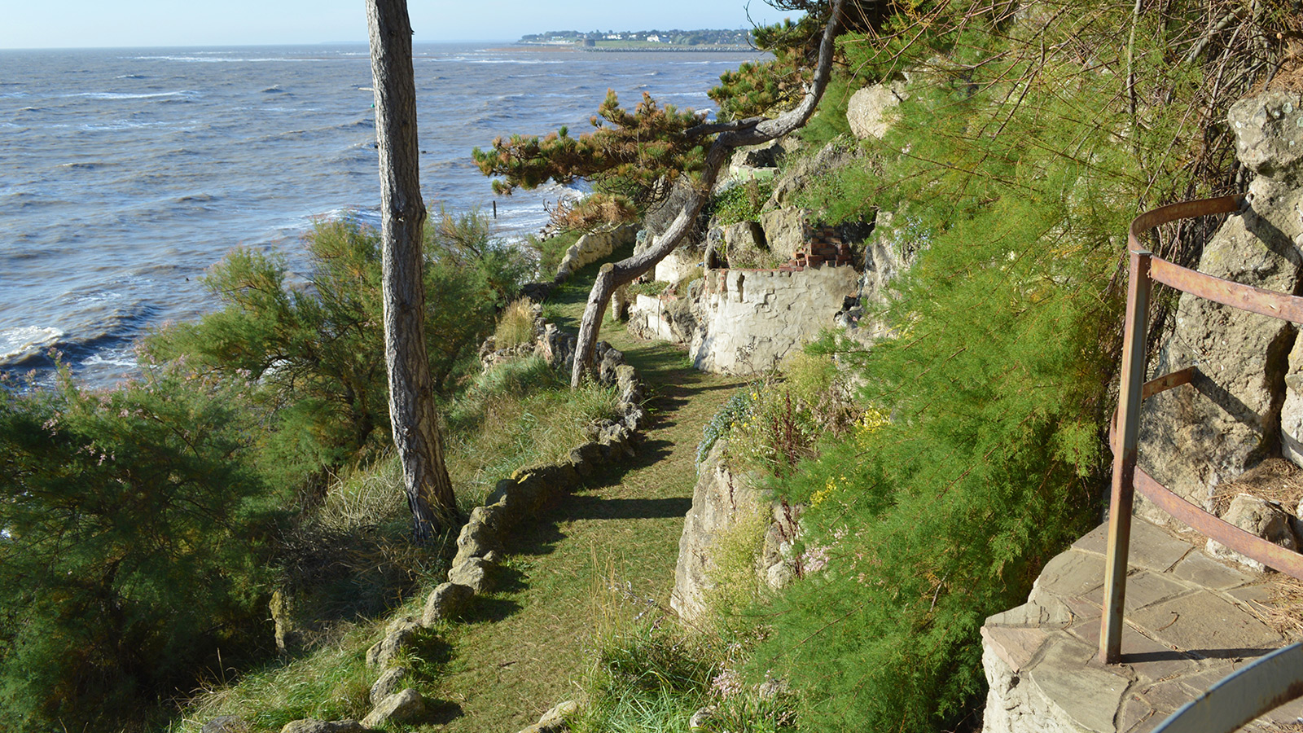
With its panoramic views, it really is quite something. The centre is set in absolutely stunning grounds and best of all, it’s not too far away.

Slide 7
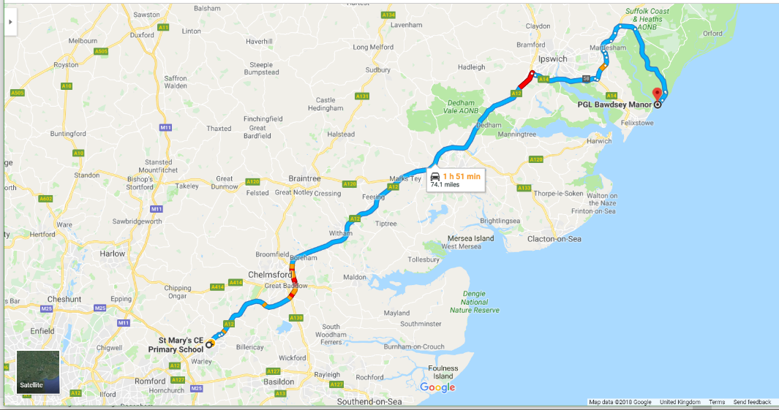
Bawdsey Manor is just under two hours drive away. It is a former boarding school and RAF base that was developed into an exciting adventure centre relatively recently. We visited it for the first time in 2019 after many, many, many years of travelling all the way to Shropshire with Year 6 children for a similar experience.

Slide 8
Accommodation
The centre can accommodate up to 550 guests and employs over 110 staff.
Although there is the option of staying in the Manor House or accommodation blocks in dormitory-style rooms, we choose to stay in the tent village. We stay in chalet-style tents that you can stand up in. Plus, they have proper beds!

Slide 9
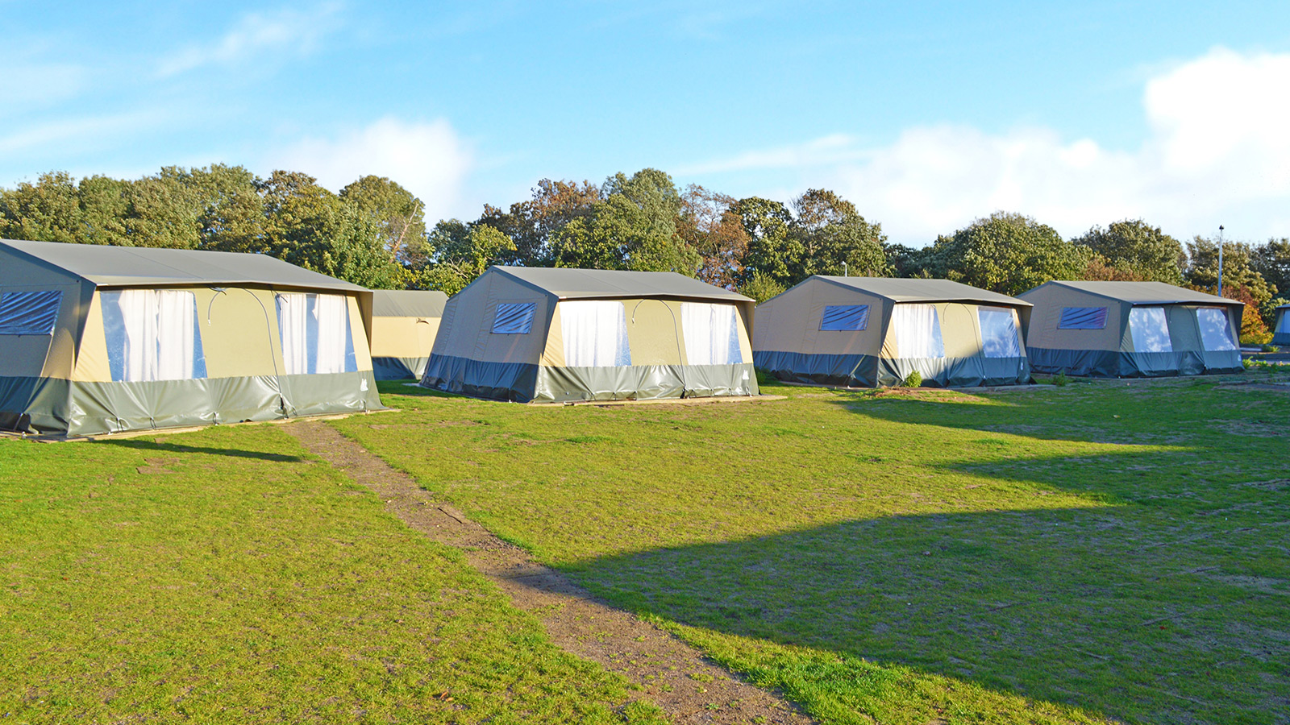

Slide 10
ACCOMMODATION
Typically a tent sleeps 4 or 5 pupils. Pupils’ tents are interspersed with teachers’ tents.
Showers and toilets are located close by with separate facilities for teachers.

Slide 11
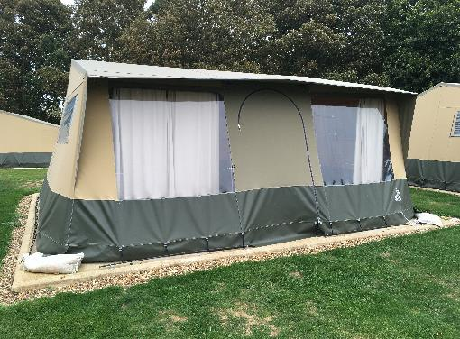
ACCOMMODATION
Tent groupings will be organised around three weeks before we leave and the details sent to PGL. The children will have a choice of who they share with, but sometimes compromises have to be made.
The tents are new and made from PVC covered canvas on a concrete base. Each child has their own metal framed bed with a rubber covered mattress.
Their belongings are unpacked into large, plastic storage boxes underneath their beds and dirty clothes placed in their bags - ready to be taken home.

Slide 12
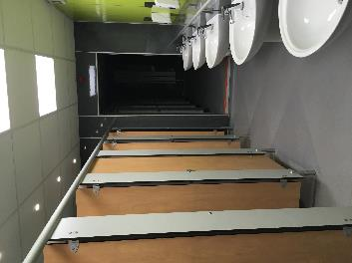
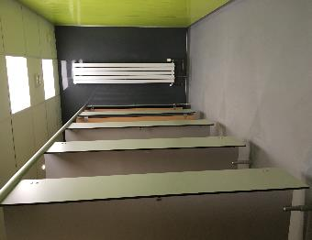
Although facilities are basic, they are clean and they do the job. Our school will be designated a shower block to use for the week. There are a number of toilet blocks around the centre. The children will very quickly get to know their way around.

Slide 13
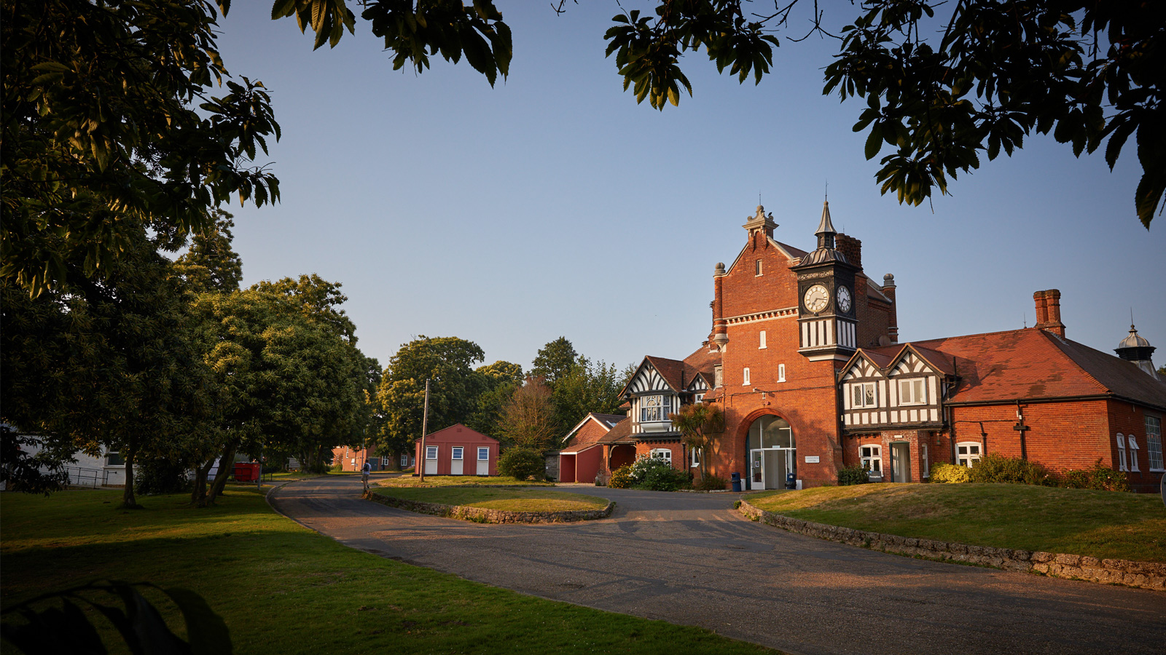
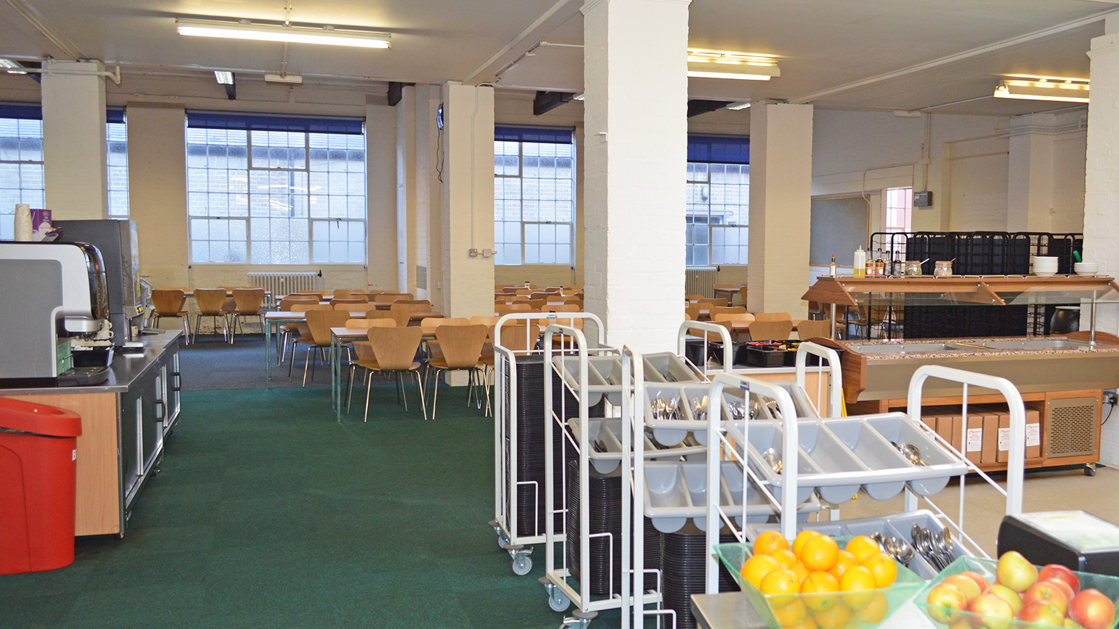
MEAL TIMES AT PGL
Outside the Dining Hall
Inside the Dining Hall

Slide 14
What’s on the menu?
PGL centres are able to deliver catering provision for many dietary requirements as specified by culture, religion and medical concerns. They regularly provide meals for a wide variety of needs including coeliac, diabetic, food allergies and vegetarian/vegan.
There are freshly-prepared hot or cold options available at every mealtime and a self-service salad bar for children to help themselves to as much salad as they like at lunch and dinner. Homemade soup is available most days and there is plenty of bread and fresh fruit available, as well as hot and cold drinks.

Slide 15
What’s on the menu?
Fussy Eaters
PGL realise that some children are very particular about what they eat and if the menu doesn't suit, they can provide alternatives to ensure no-one leaves the dining room hungry. However, we often find that children are more likely to try new things at PGL that they wouldn't normally eat at home - it's all part of the PGL experience!

Slide 16
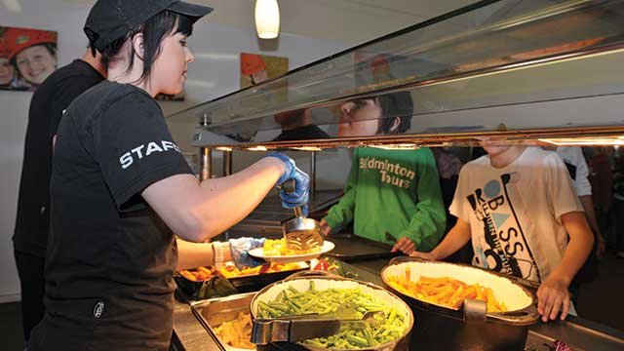
Meal Times at PGL
The school has allocated meal times and allocated tables, so the children always sit with their friends within the dining hall.

Slide 17
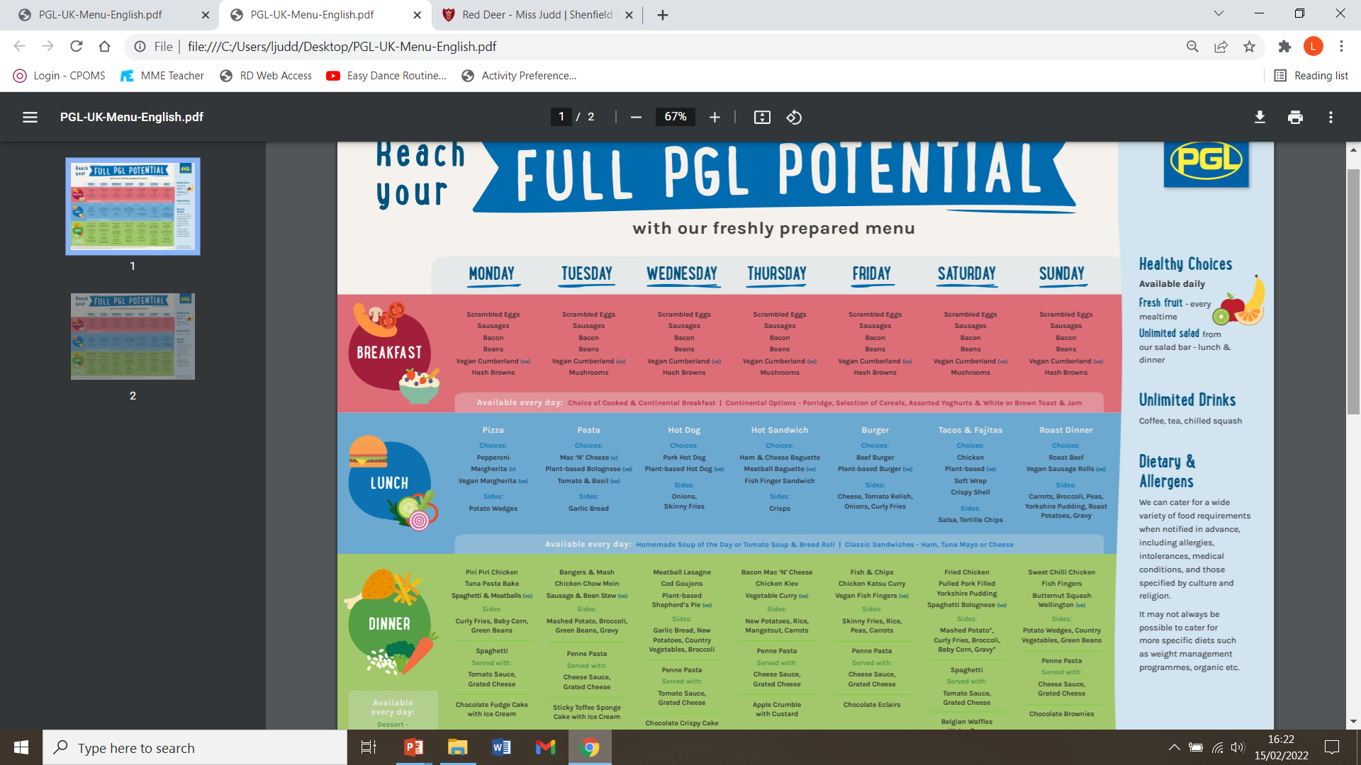

Slide 18
ACTIVITIES
The children have morning, afternoon and evening activities. We are not provided with the proposed timetable until a few days before we go, but it is likely that we will be offered at least one water activity (eg. canoeing, raft-building, kayaking).

Slide 19
ACTIVITIES
Other possible activities include: abseiling, aeroball, archery, buggy building, challenge course, climbing, fencing, Giant Swing, Jacob’s Ladder, orienteering, problem-solving, rifle shooting, sensory trail, survivor, trapeze and zip-wire.

Slide 20
ACTIVITIES
All activity sessions are led by well trained, enthusiastic instructors and are specially designed to motivate, build confidence and encourage development in pupils.
Every child has the opportunity to do all of the activities that we have been allocated, but they will not be forced to take part in any activity that they are uncomfortable with.

Slide 21
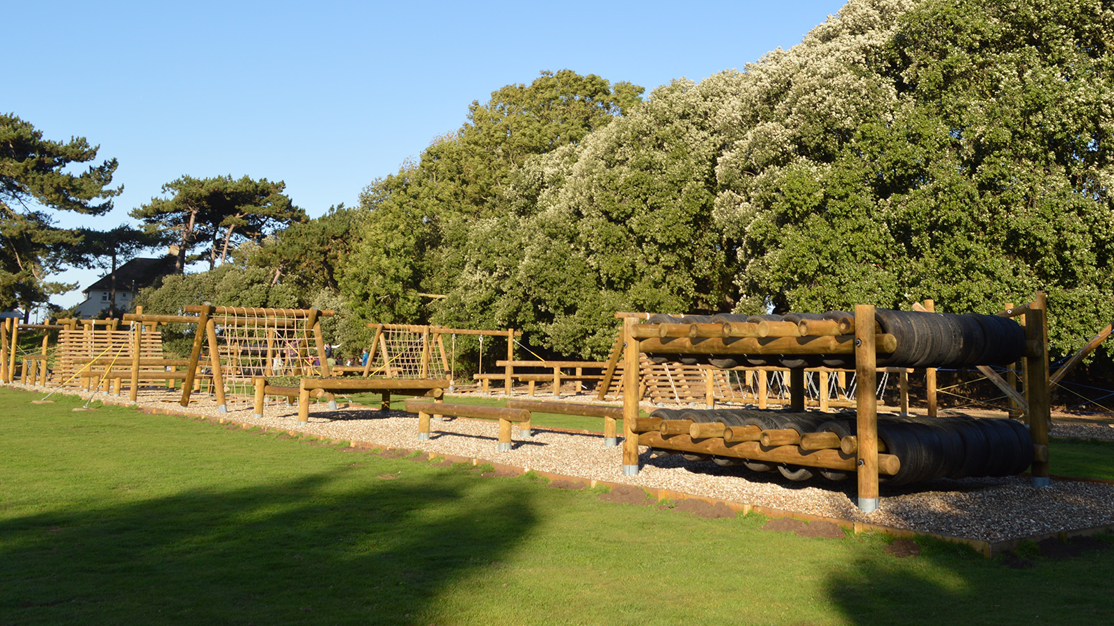

Slide 22
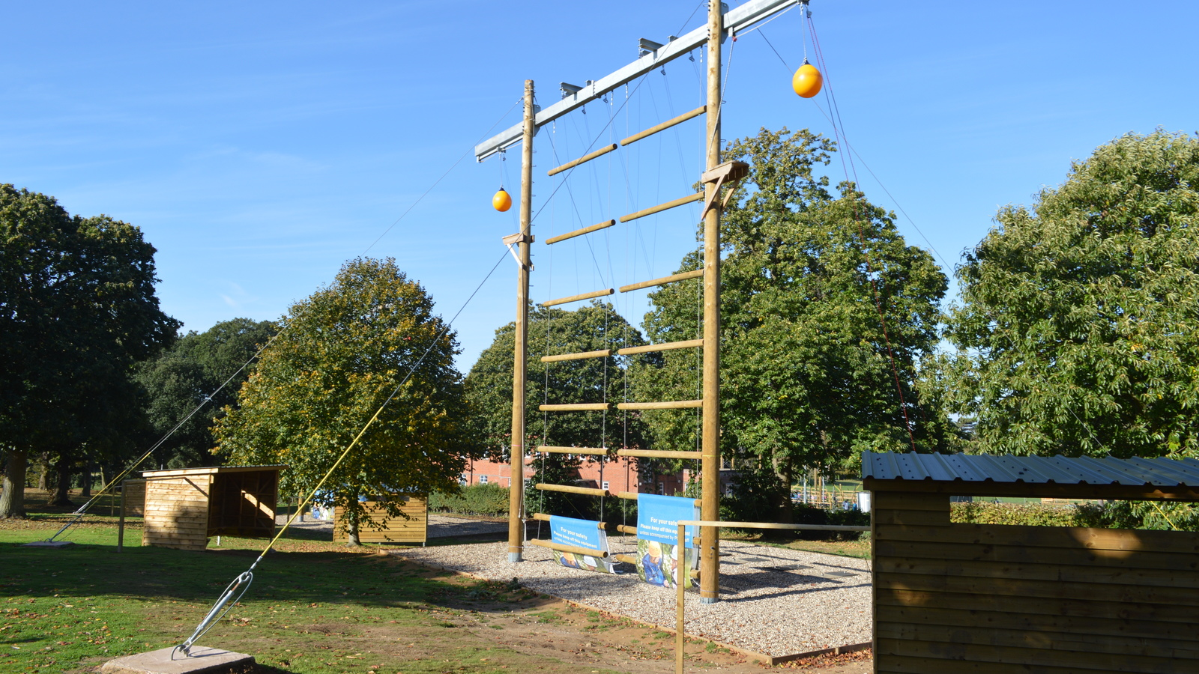

Slide 23
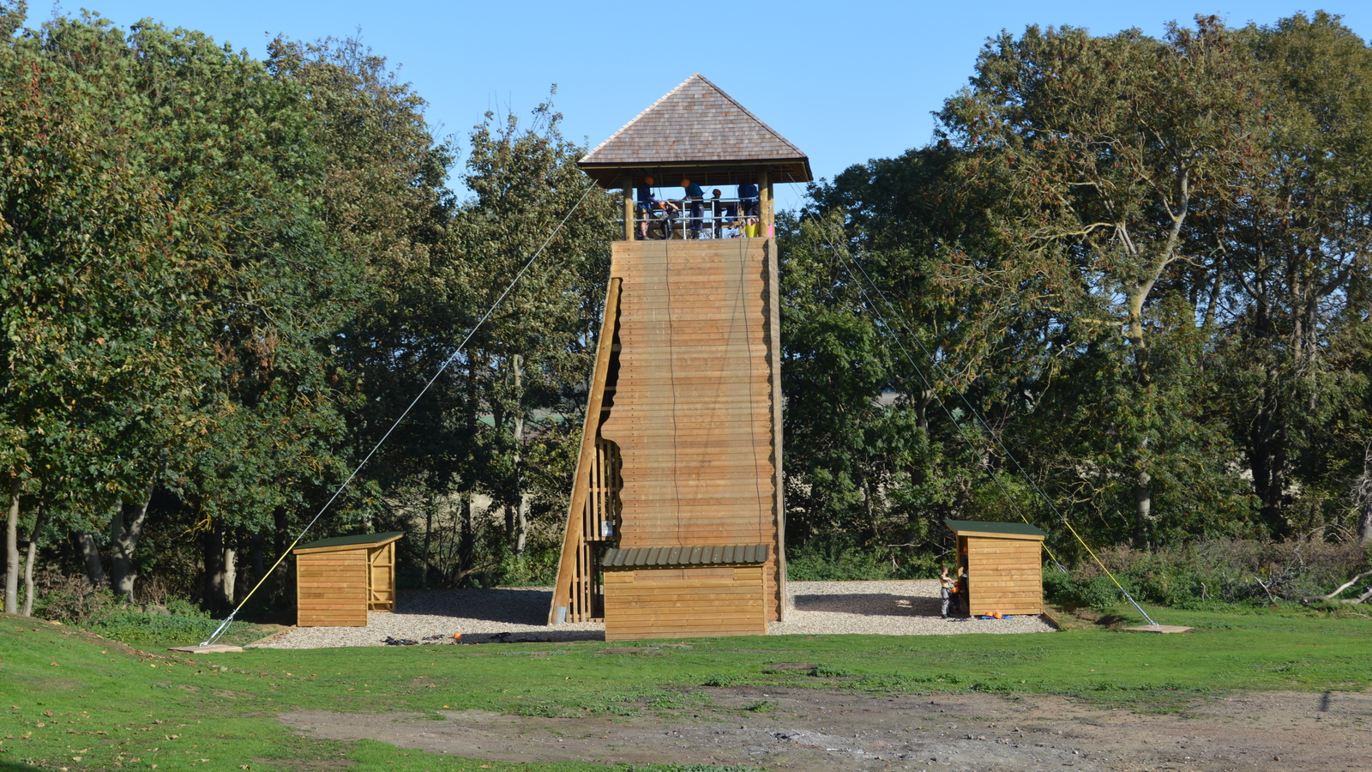

Slide 24
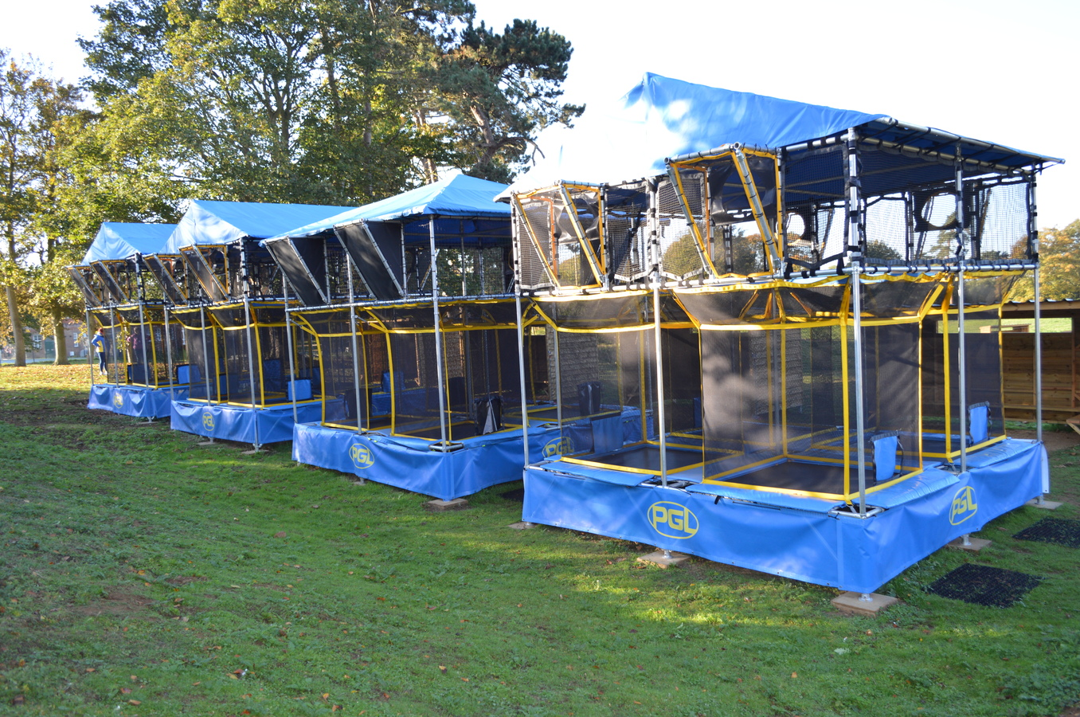

Slide 25
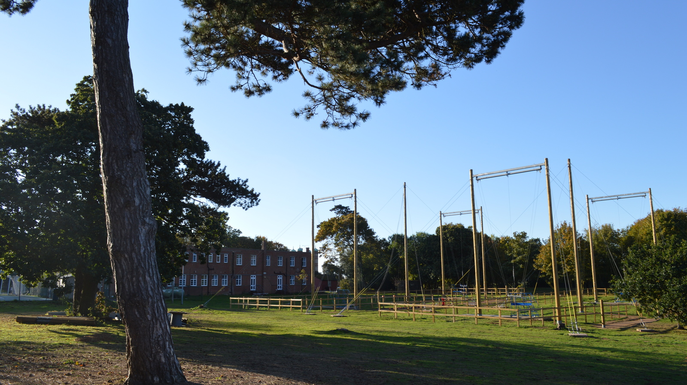

Slide 26
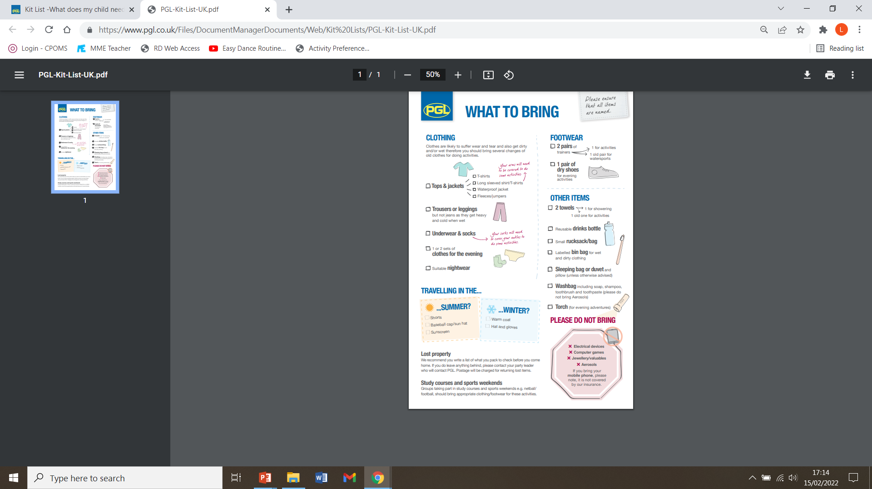
KIT LIST
On Thursday evening, the children have to pack up and clean out their tent. If they packed their own bag in the first place and have a list to follow, there is a better chance that they will return home with all their belongings.
We leave after lunch on Friday, at roughly 1pm. The aim is to get back around 3pm.

Slide 27
Thank you for listening….
You will shortly be required to complete a form that asks about your child’s dietary requirements, medication needs, emergency contact numbers etc. This information is sent to PGL and needs to be with them a few weeks in advance of our trip, so look out for that.
Nearer the departure date, we will run a further meeting to outline the final instructions and provide a more detailed kit list. Hopefully, that meeting will be able to go ahead face to face.

Slide 28
(continued)
In the past, we have always finished this meeting with a question and answer session. Over Zoom, that’s not ideal. Hence, please feel free to get in touch (via email) should you want to ask anything privately that we have not covered.

