Slide 1
The Holy Island of Lindesfarne
Complete the questions

Slide 2
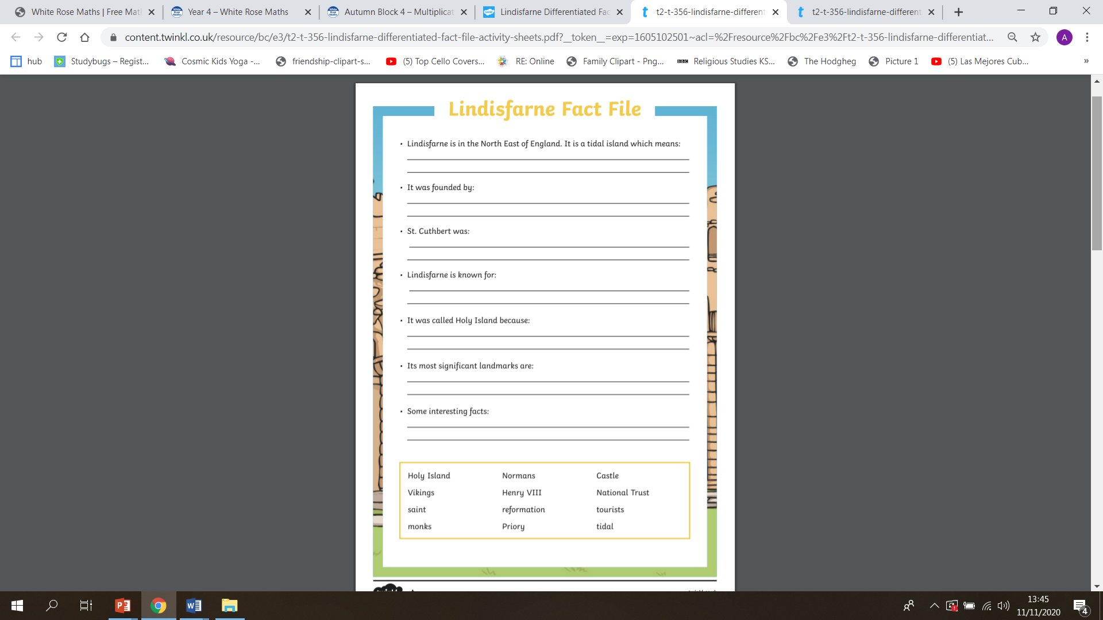

Slide 3
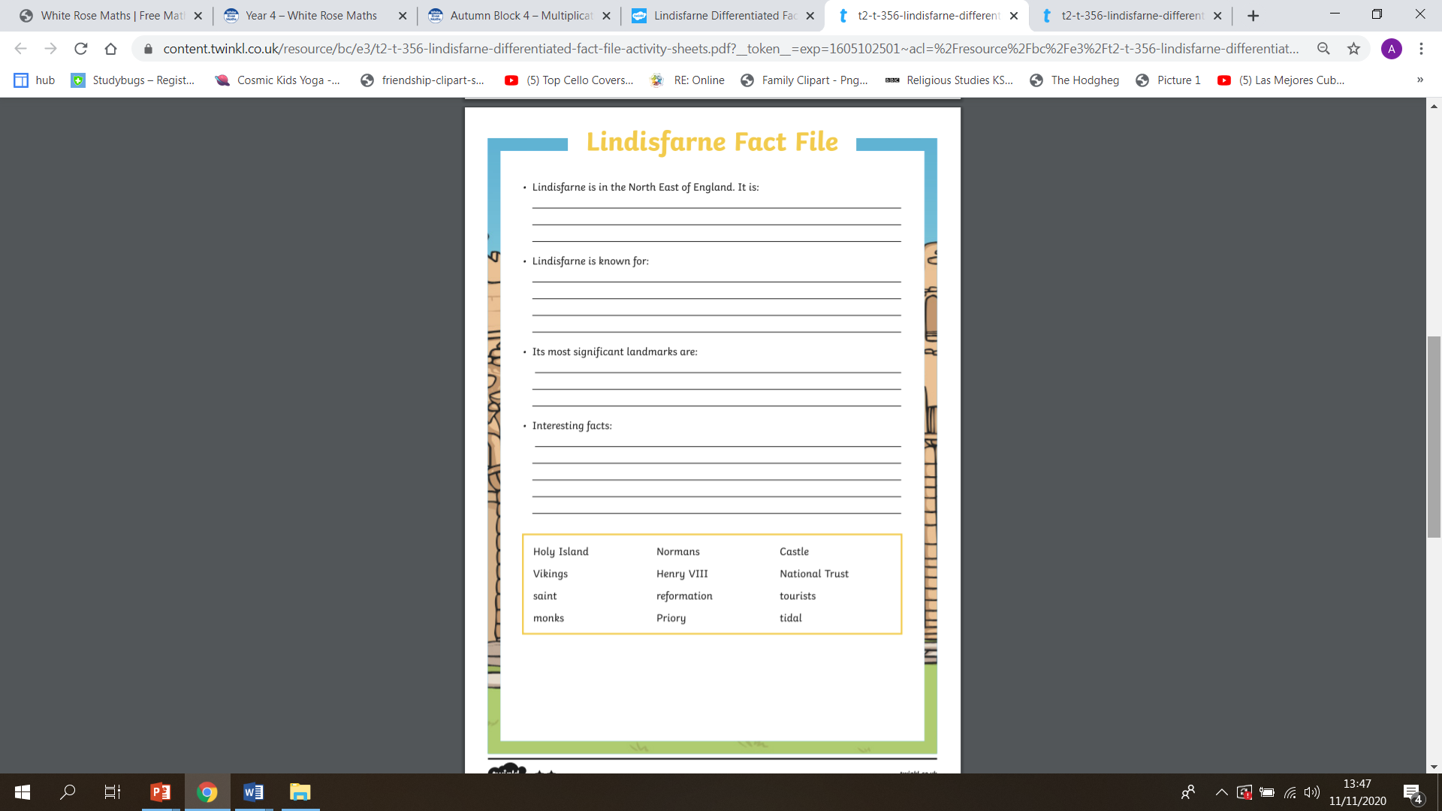

Slide 4
