Slide 2
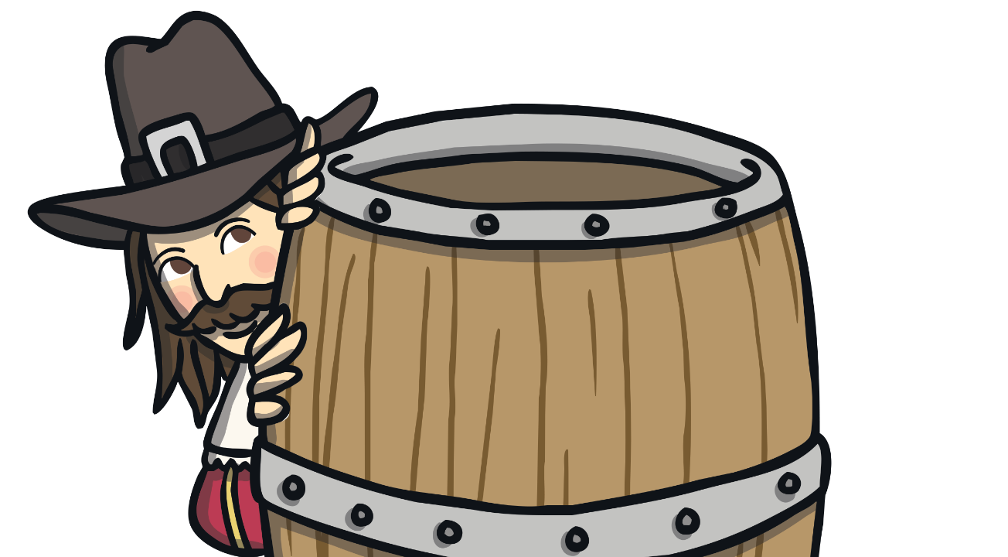
What is Bonfire Night?
Bonfire Night is celebrated on the 5th November of every year.
We celebrate it because in 1605, a man called Guy Fawkes and his friends from York decided to try and blow up the English government, along with King James I.

Slide 3


Why Celebrate?
King James wanted to celebrate the fact that he had lived through such a treacherous plot and therefore ordered that November 5th should be an official celebration for everyone in Great Britain!
How do you celebrate Bonfire Night?

Slide 4





We celebrate with…
Fireworks!

Slide 5
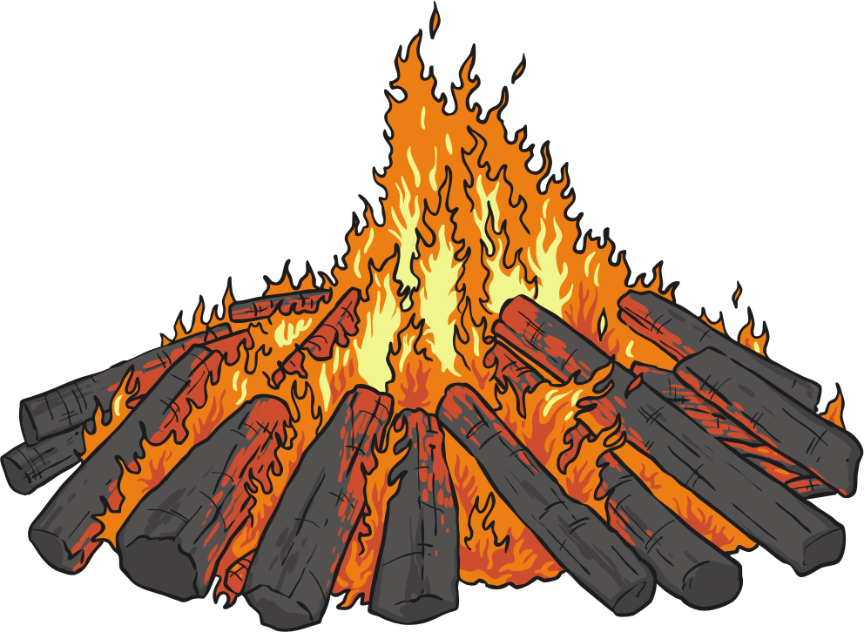
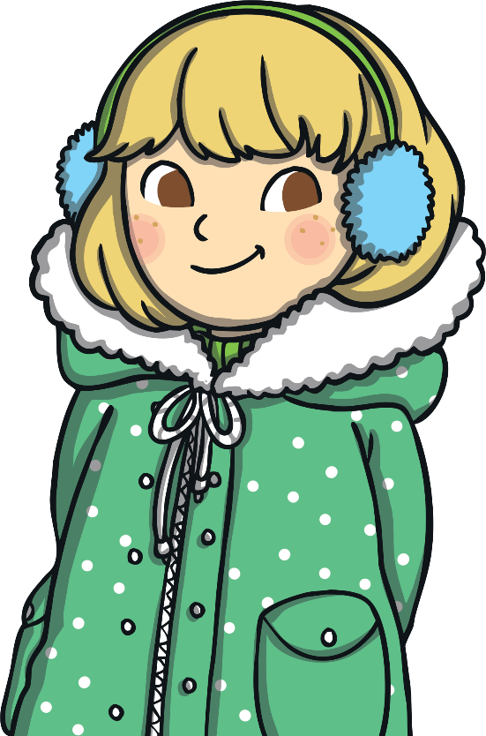
We celebrate with…
A bonfire!

Slide 6
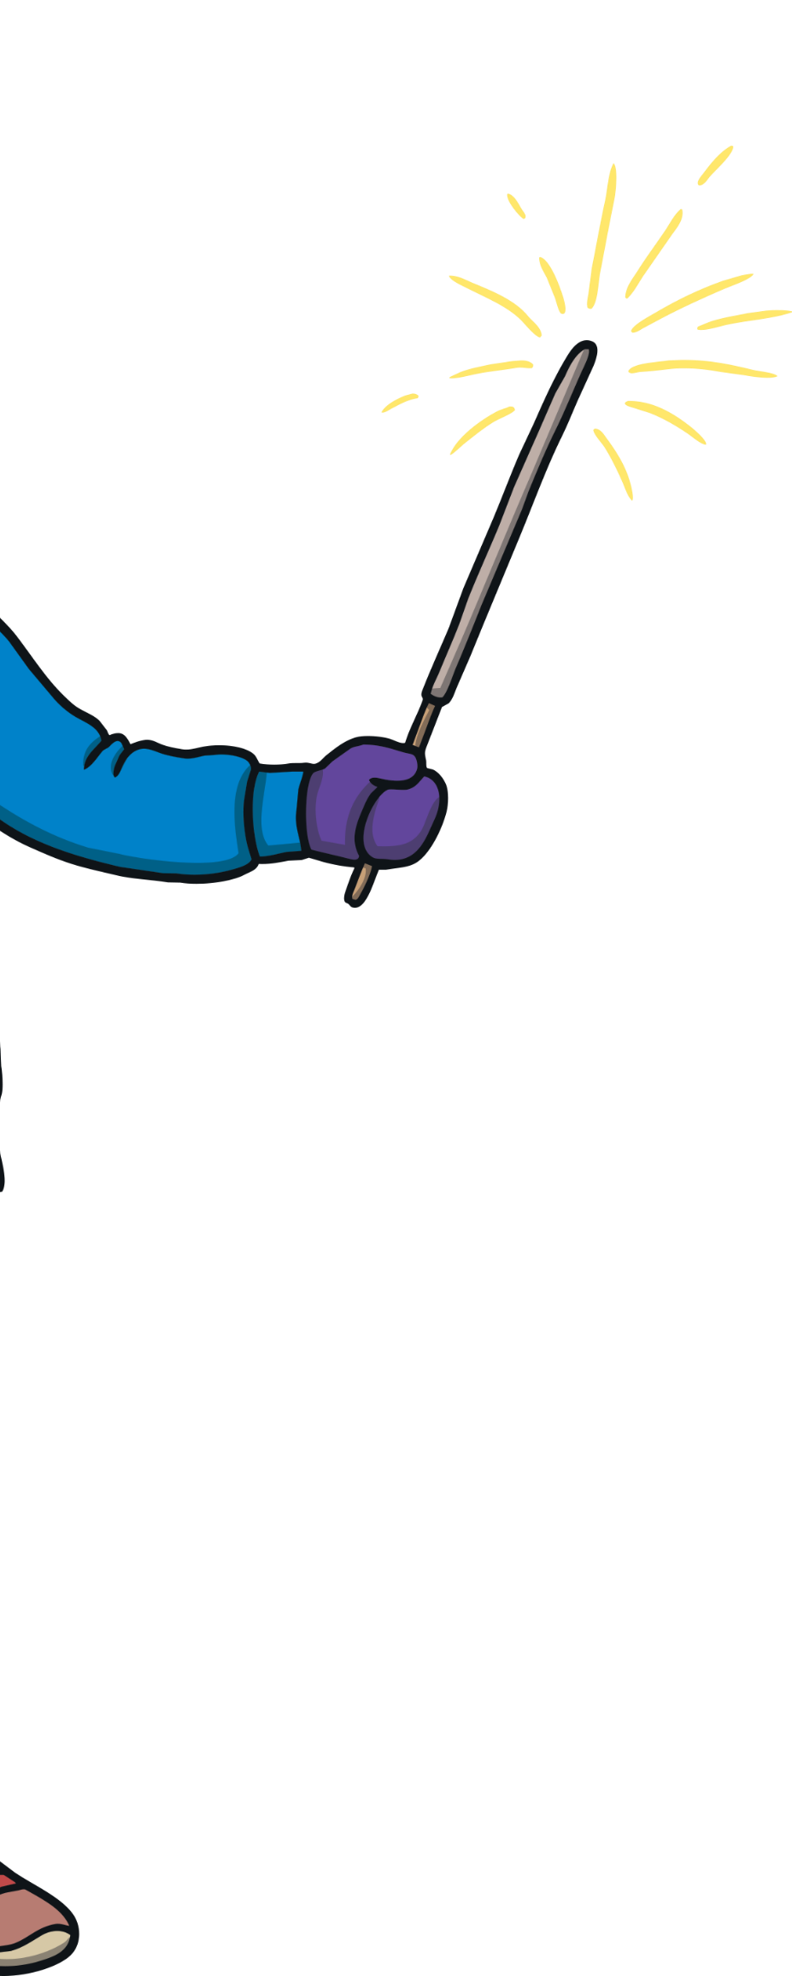
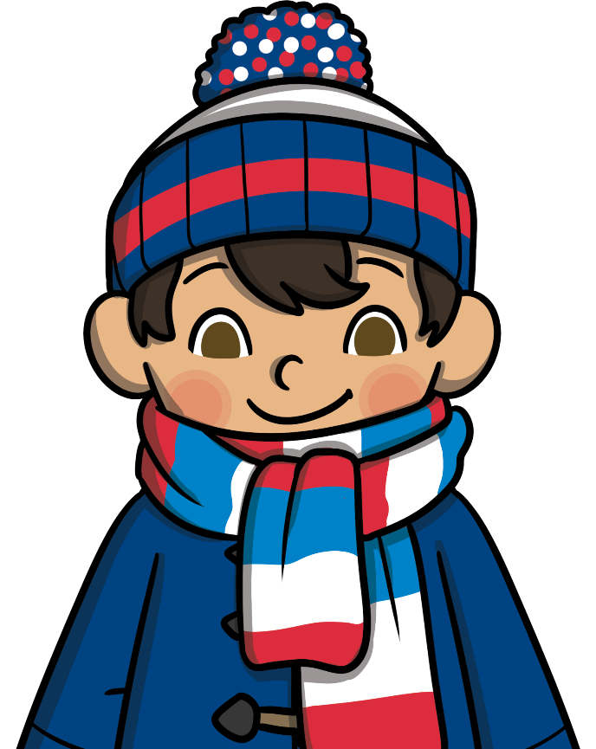
We celebrate with…
Using sparklers!

Slide 7

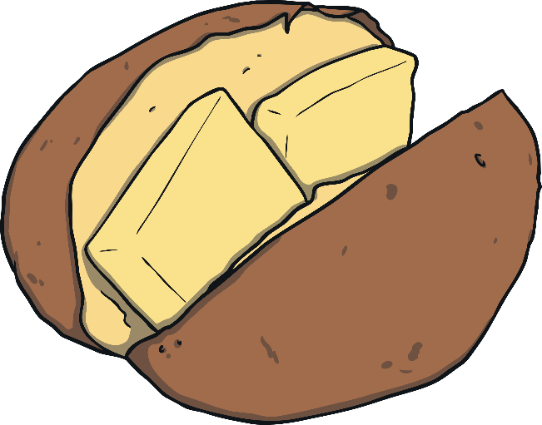
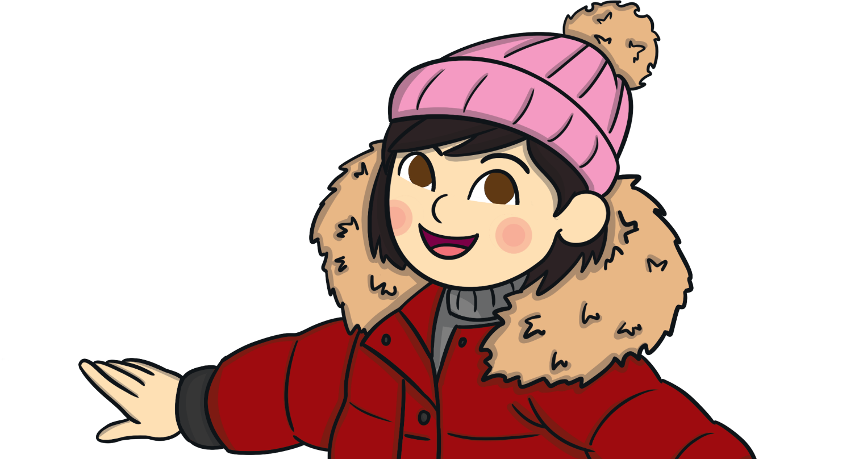

We celebrate with…
Eating toffee apples, jacket potatoes and bonfire toffee!

Slide 8

How to Remember…
Remember, remember the fifth of November,
Gunpowder treason and plot,
I know of no reason,
Why gunpowder treason,
Should ever be forgot!

Slide 9
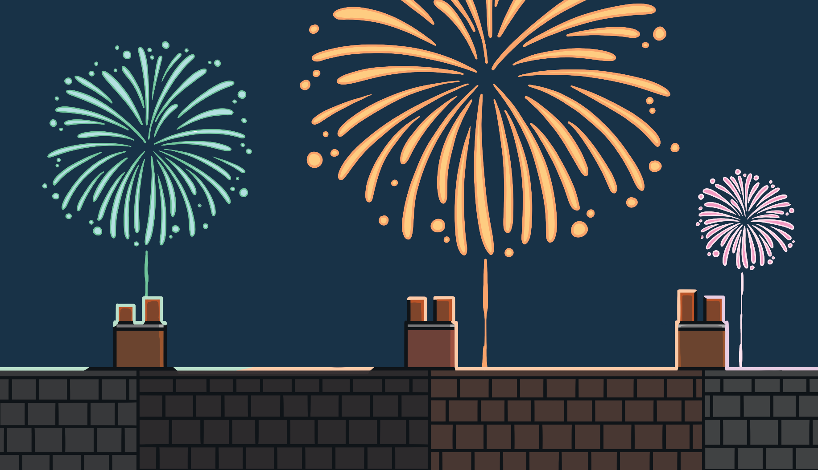

Happy Bonfire Night!

