Slide 1
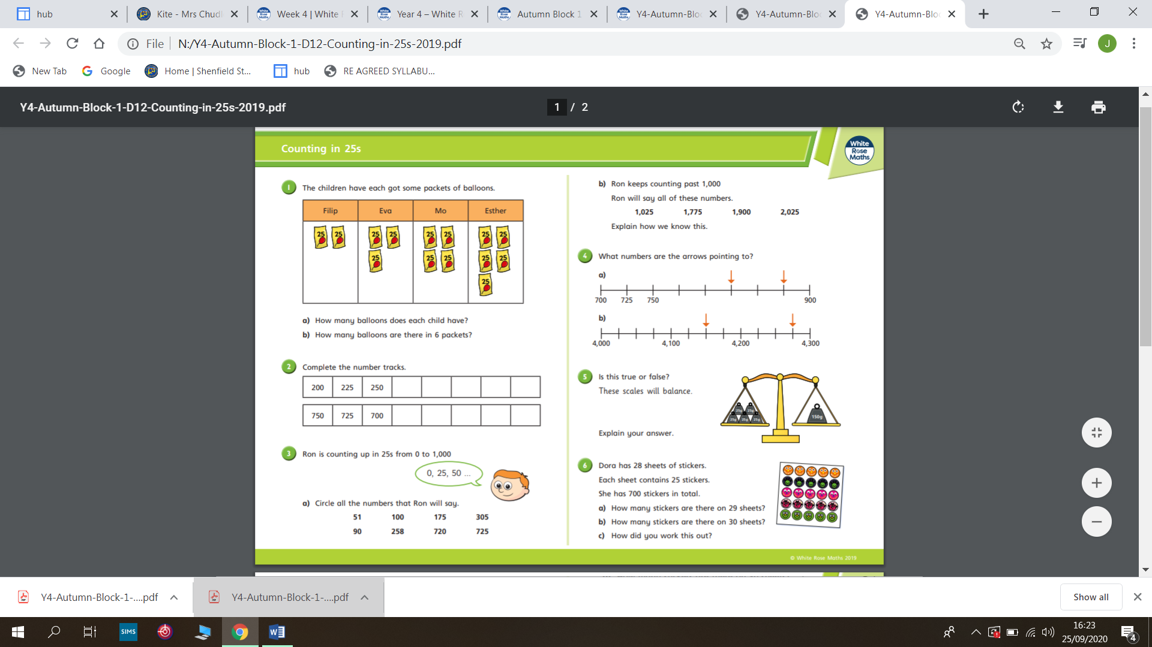
Monday

Slide 2
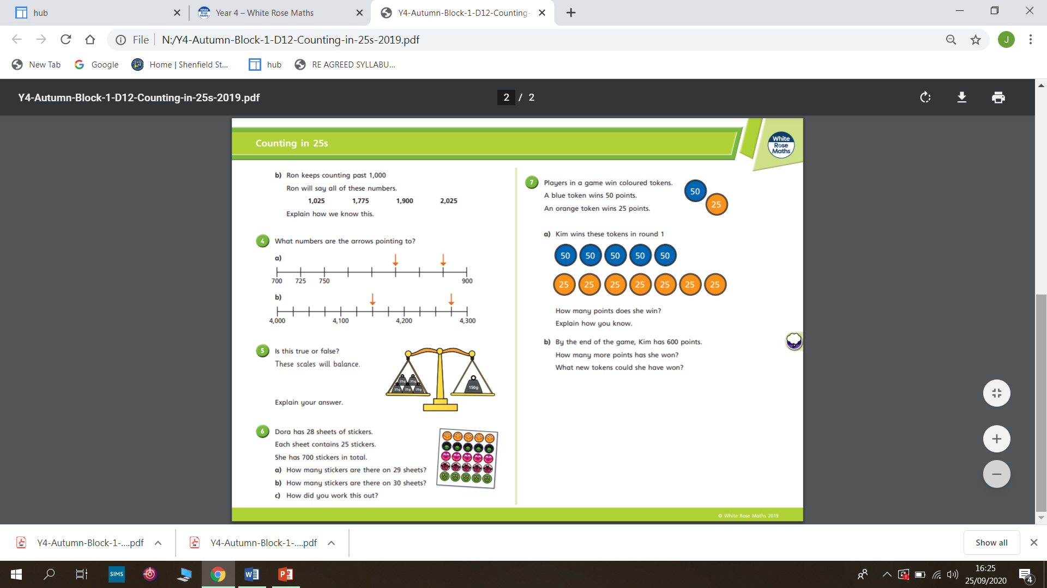

Slide 3
Tuesday/Wednesday – See separate PPT
Introducing Negative Numbers

Slide 4
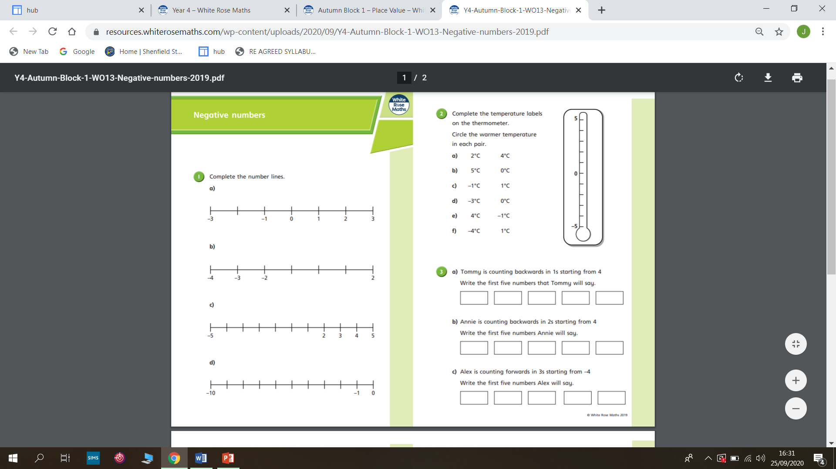
Thursday

Slide 5
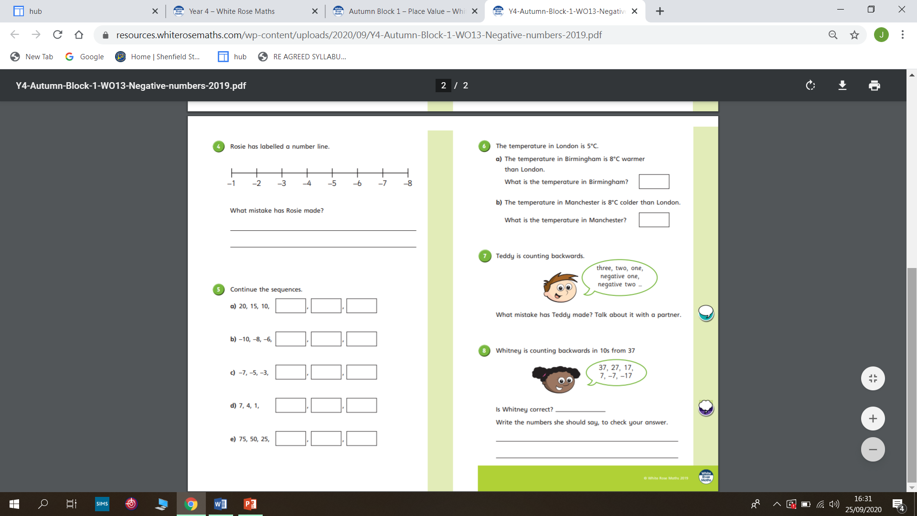

Slide 6
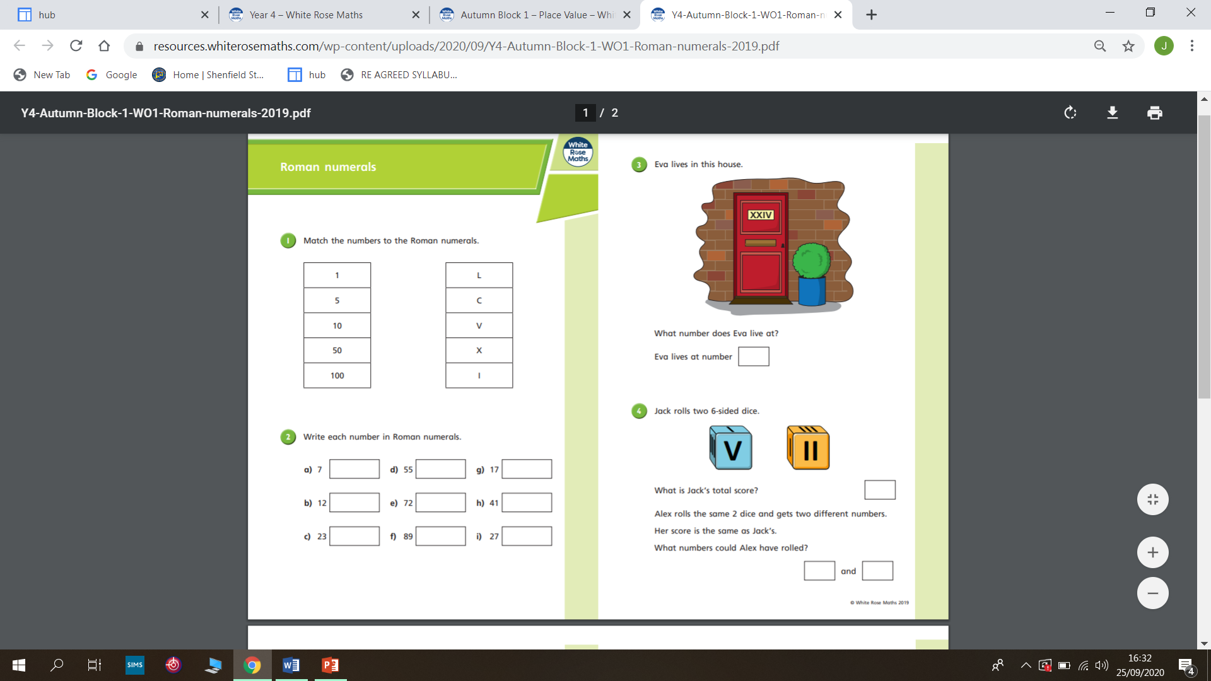
Friday

Slide 7
