Slide 1
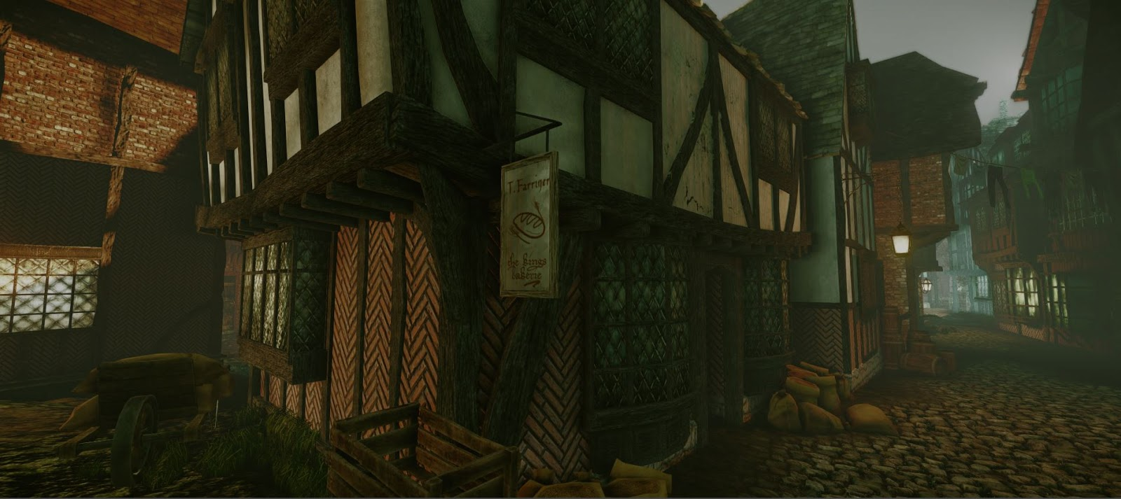
The Hopcroft News
Monday 3 September 1666
Fire starts in bakery
The fire started early Sunday in Thomas Farriners bakery on Pudding Lane in London.
King told of fire
Samuel Pepys told King of fire and to pull houses down.

Slide 2
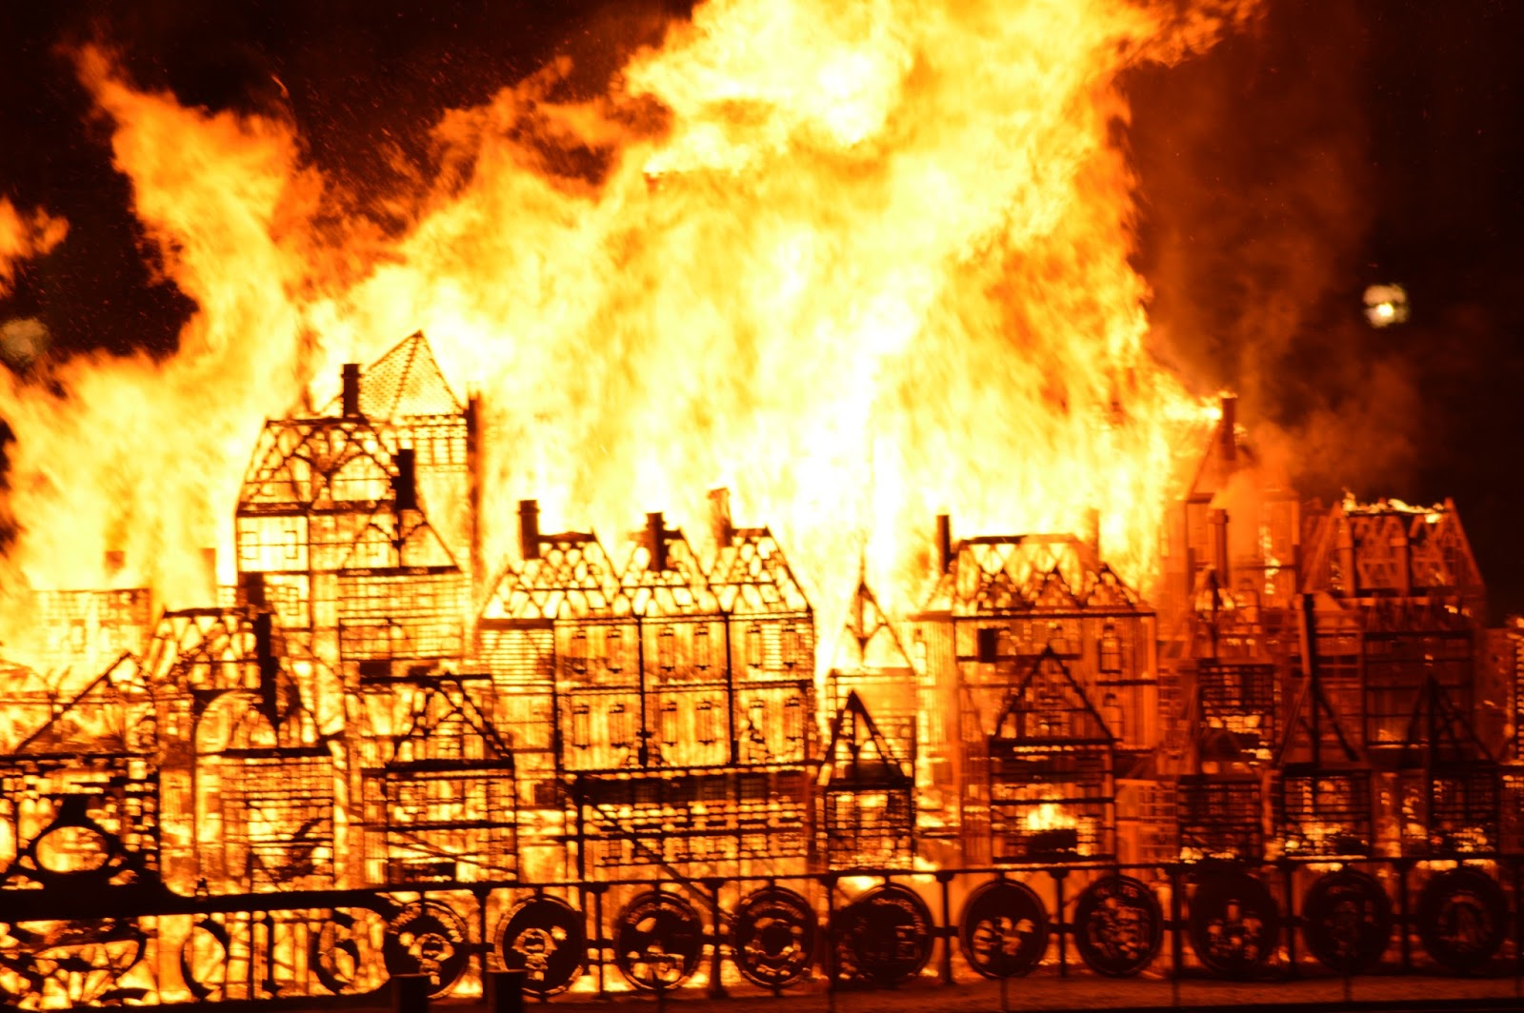
The Hopcroft News
Tuesday 4 September 1666
Samuel Pepys on the move
He dug a hole for his chees and wine and left his howse.

Slide 3
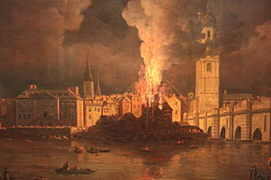
The Hopcroft News
Wednesday 5 September 1666
St Pauls on fire
Yesterday St Pauls cort fire and bernt down.

Slide 4
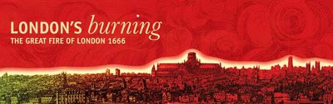
The Hopcroft News
Thursday 6 September 1666
Fire out
The fire was finale under contraol and put out but most of London was bernt down and lots of people died.
The End

