Slide 2
What Is an Acrostic Poem?
Acrostic poems are written by choosing a word to go vertically down a page. Like this…
P
O
E
M

Slide 3
What Is an Acrostic Poem?
Then, you think of words or phrases beginning with each letter. Like this…
P
O
E
M
ersonal thoughts
n each line
xpress your feelings
ake people happy

Slide 4
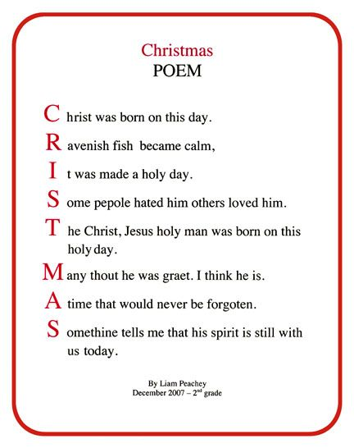

Slide 5
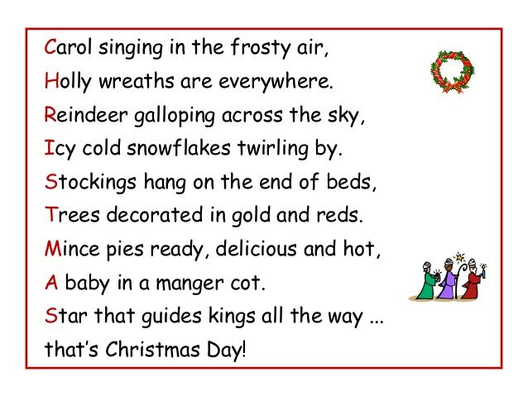

Slide 6
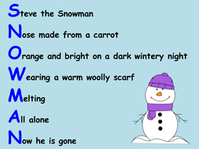

Slide 7


Slide 8
Now it’s your turn…

Slide 9


C
H
R
I
S
T
M
A
S

Slide 10

S
T
O
C
K
I
N
G

Slide 11


B
E
L
L
S

Slide 12

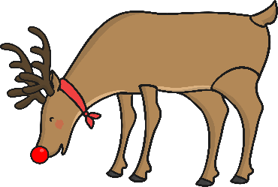
S
A
N
T
A

Slide 13


B
A
U
B
L
E

Slide 14

S
N
O
W
M
A
N

Slide 15


G
I
F
T
S

