Slide 1

Poetry Writing
Complete one poetry
activity per day.

Slide 2

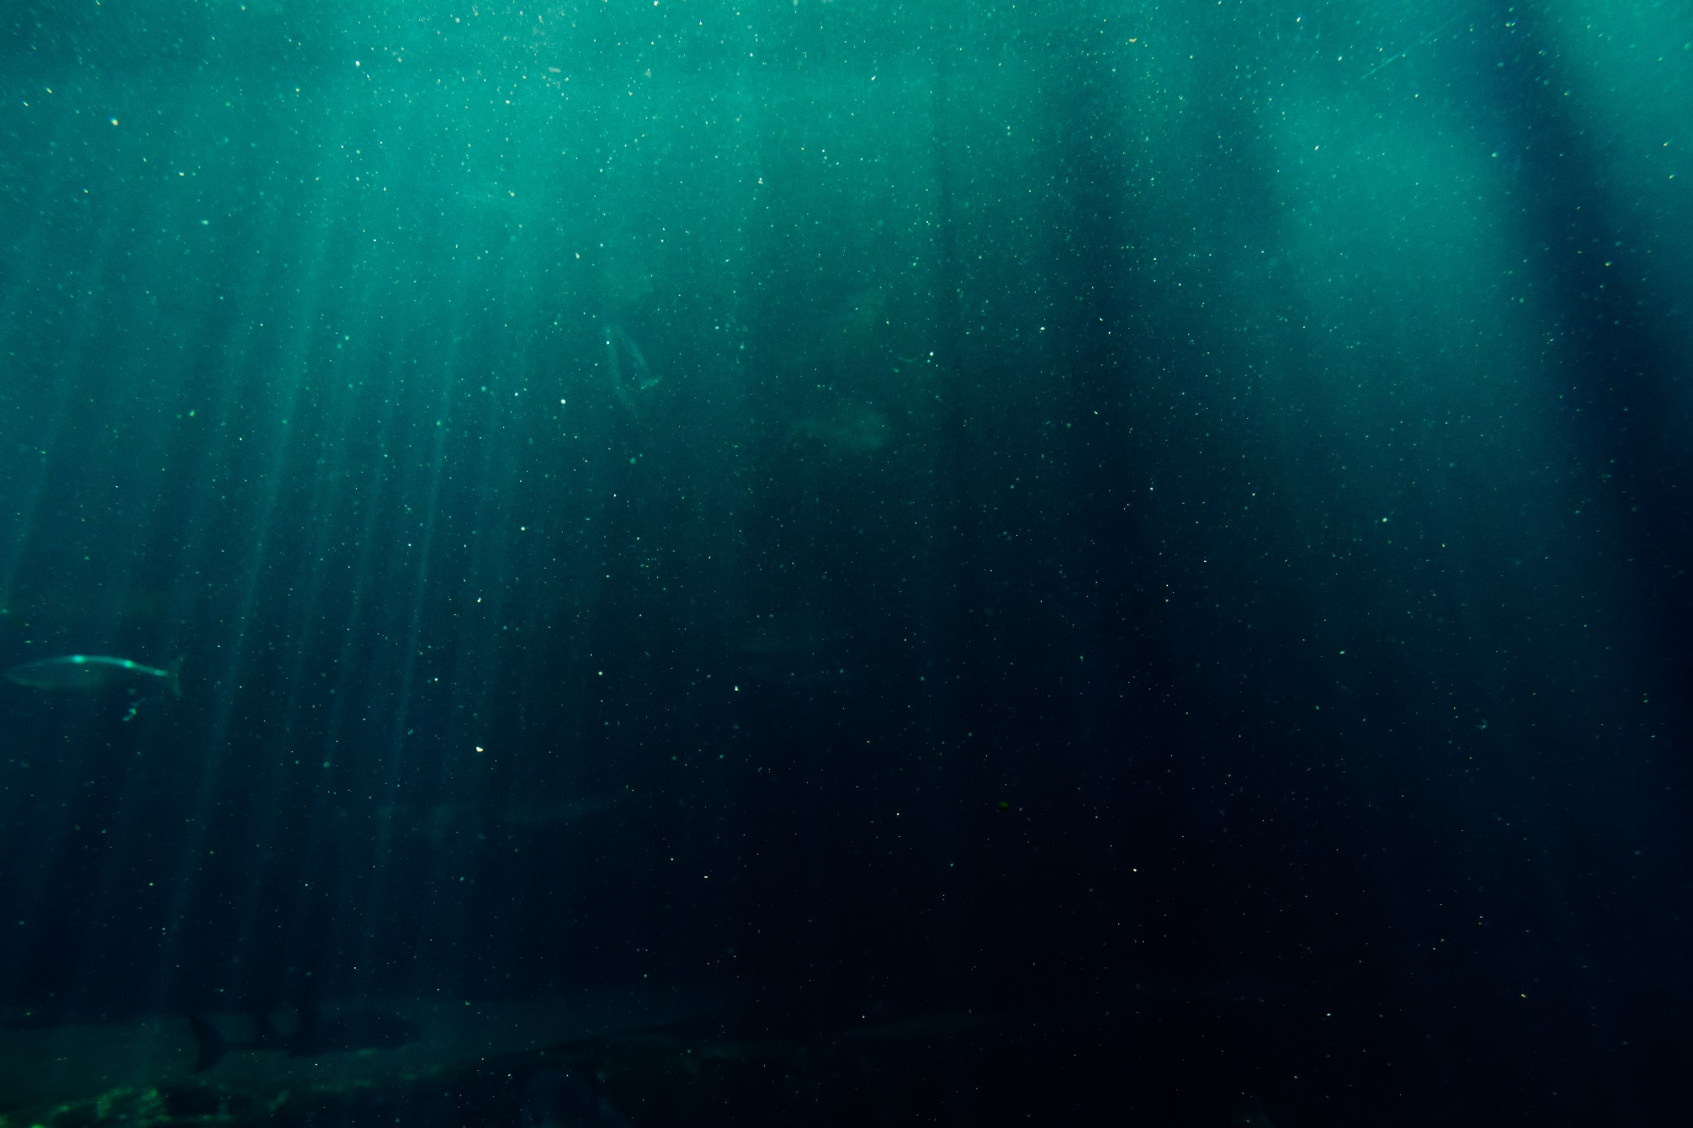

Day 1: Poetry
Building poems from a structure.
In the ocean of dreams I saw…
Three friendly dolphins
Playing in the sun.
In the ocean of dreams I saw…
Six sneaky starfish
Shuffling across the sea bed.
In the ocean of dreams I saw…
Four fishing trawlers
Dredging the frothy waves.
number
noun
Four
fishing
trawlers
adjective
Dredging the frothy waves
What is it doing?
Can you add your own verse to this poem?
Start with a number.
Then an adjective (e.g. Friendly).
Then a noun (dolphins, starfish, trawlers… what else would be in the ocean?)
Then explain what your noun is doing.

Slide 3
Day 2: Poetry
Based on ‘Playgrounds’ by Berlie Doherty.
LA Questions
What is the poem about?
Which question does the poet say 5 times?
What does ‘gobby’ mean?
What are the children doing in the playground?
Which words tell you that the playground is noisy?
MA/HA Questions
Describe the playground.
Why is a playground like a whirlwind?
The author repeats, ‘know what I mean?’ Why?
What does the word ‘kaleidoscope’ imply about the playground?
Why did the author choose to use a similar first line to each verse?
Poem can be found here.
Extra Challenge:
‘And playgrounds are such busy places…’
Try and write a verse that follows the same patterns that the authors uses, starting with this line.
Questions

Slide 4
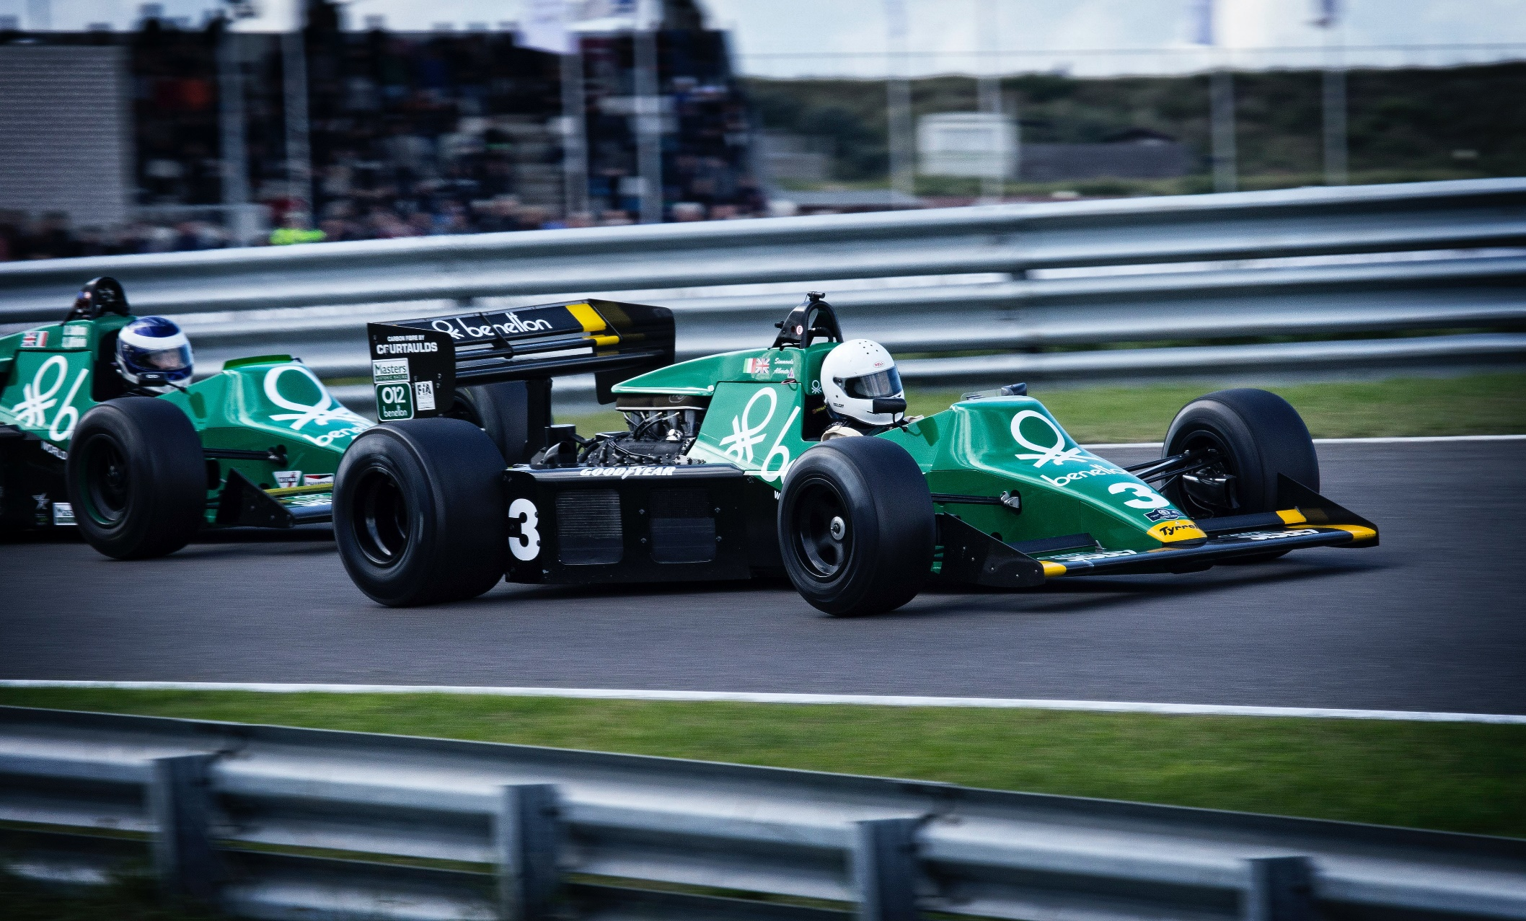
Day 3: Poetry
Building poems from a structure.
In the racetrack of champions I heard…
Three aggressive engines
Warming up at the start line.
In the racetrack of champions I heard…
Twelve sneaky tyres
Burning rubber marks on the track.
In the racetrack of champions I heard…
Thousands of cheering spectators
Engrossed in the rapid race.
noun
number
Thousands
cheering
spectators
What is it doing?
adjective
Engrossed in the rapid race.
Can you add your own verse to this poem?
Start with a number.
Then an adjective (e.g. Aggressive).
Then a noun (engines, tyres, drivers… what else would be on a race track?)
Then explain what your noun is doing.

Slide 5
Day 4: Poetry
Based on ‘Please do not feed the animals’ by Robert Hull.
LA Questions
What is the poem about?
What time of the year is it?
Have you ever seen a sign telling you not to do something? What did it say?
Choose your favourite part.
MA/HA Questions
Look up ‘disdain’ in the dictionary.
Why are the grapes and meringues not allowed?
What do you think could happen if the rattlesnakes ate fruit cakes?
Does the poet like animals? How do you know?
Which part of the poem impressed you the most? Explain why.
Poem can be found here.
Extra Challenge:
Can you find out more about Robert Hull?
Questions

Slide 6
Day 5: Poetry
Based on ‘Dawn meets the Queen’ by Chrissie Gittins.
LA Questions
What were the chandeliers like?
Who is the main character?
Who had taken Dawn to the Queen’s palace?
Who is like Dawn’s Nan?
MA/HA Questions
The author writes ‘THE QUEEN’ in capital letters. What does this tell you about how Dawn is feeling?
‘My mouth was as wide as Japan.’ What did the author mean by this?
Which words and phrases imply that the Queen’s palace was rich
or fancy?
Find the word in the poem that means ‘small’. Think of another word that means the same.
Poem can be found here.
Questions
Extra Challenge:
Imagine you were invited to meet the Queen. Choose 3 questions to ask her.

