Slide 1


Slide 3
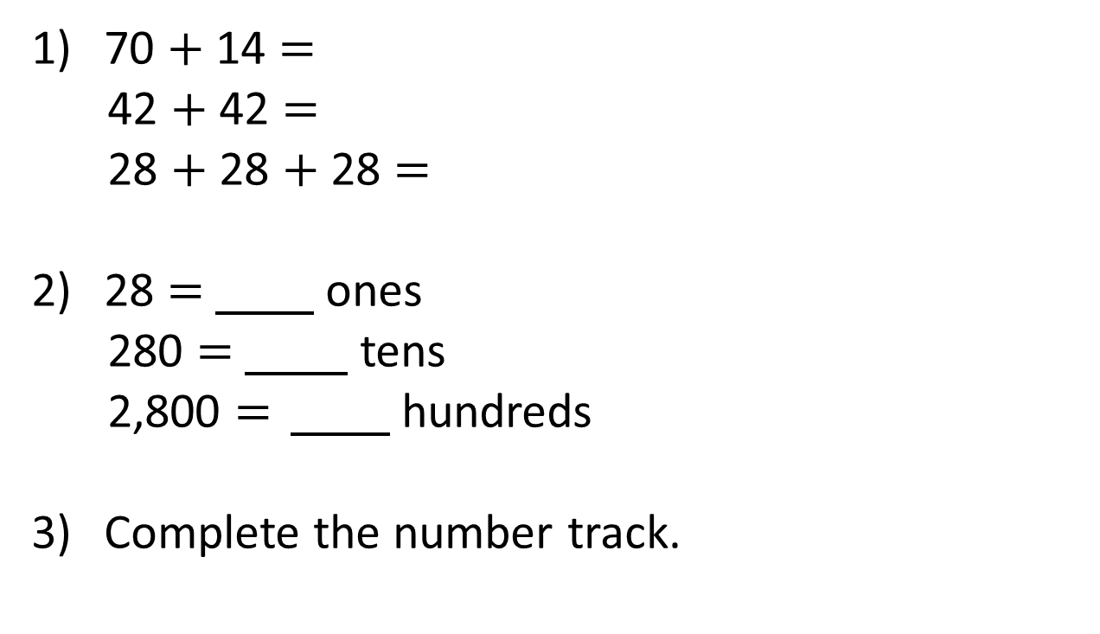
70 $+$ 14 $=$
42 $+$ 42 $=$
28 $+$ 28 $+$ 28 $=$
28 $=$ ones
280 $=$ tens
2,800 $=$ hundreds
Complete the number track.
6 | 12 |  | 24 |  | 36 | 42 |  |  | 60 |  | 72

Slide 4
70 $+$ 14 $=$
42 $+$ 42 $=$
28 $+$ 28 $+$ 28 $=$
28 $=$ ones
280 $=$ tens
2,800 $=$ hundreds
Complete the number track.
84
84
84
28
28
28
6 | 12 |  | 24 |  | 36 | 42 |  |  | 60 |  | 72
18
30
48
54
66

Slide 6



Complete the four number sentences using the number cards
7
56
8
$= ×$
56
7
8
$= ×$
56
8
7
$÷ =$
56
7
8
$÷ =$
56
8
7

Slide 7

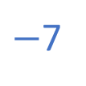
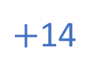
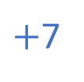



Have a think
$+$7
$−$7
$+$7
$+$7
$−$7
7 | 14 |  | 28 | 35 | 42 |  |  | 63 | 70 | 77 | 84
21
49
56
$+$14

Slide 8
Have a go at questions
1 – 5 on the worksheet

Slide 9

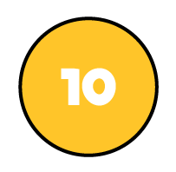

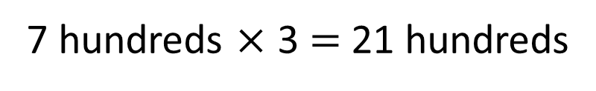
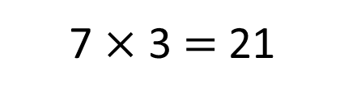
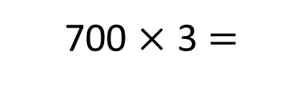

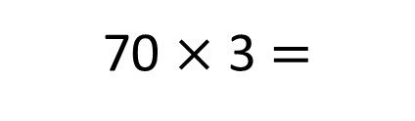

7 $×$ 3 $=$ 21
7 ones $×$ 3 $=$ 21 ones
70 $×$ 3 $=$
210
Have a think
7 tens $×$ 3 $=$ 21 tens
700 $×$ 3 $=$
2,100
7 hundreds $×$ 3 $=$ 21 hundreds

Slide 10
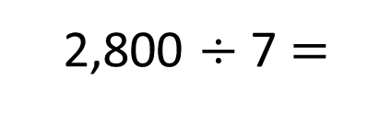
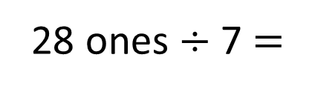
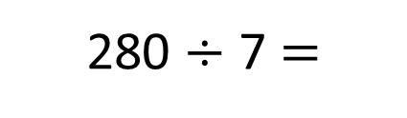
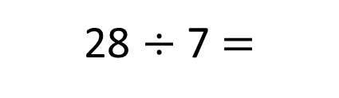

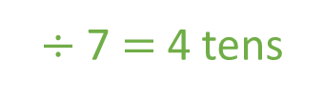
Have a think
280 $÷$ 7 $=$
2,800 $÷$ 7 $=$
40
400
28 tens
$÷$ 7 $=$ 4 tens
28 hundreds
$÷$ 7 $=$ 4 hundreds
28 $÷$ 7 $=$
4
28 ones $÷$ 7 $=$
4 ones

Slide 11



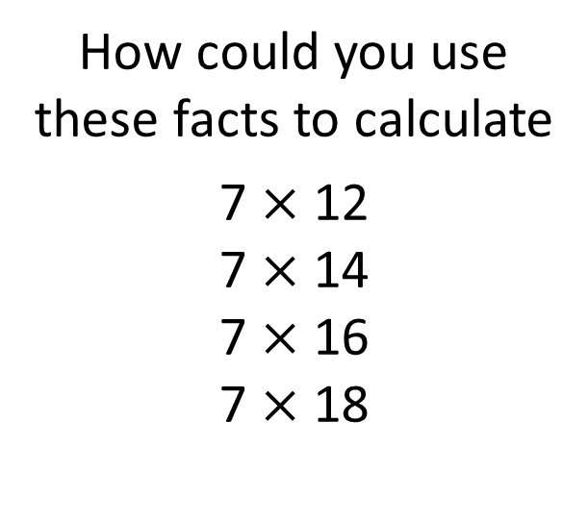
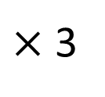

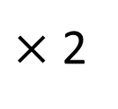







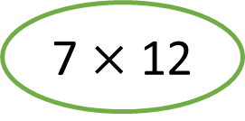
How could you use these facts to calculate
7 $×$ 12
7 $×$ 14
7 $×$ 16
7 $×$ 18
7 $×$ 6 $=$ 42
7 $×$ 1 $=$ 7
7 $×$ 6 $=$ 42
7 $×$ 2 $=$ 14
7 $×$ 7 $=$ 49
7 $×$ 2 $=$ 14
7 $×$ 3 $=$ 21
7 $×$ 8 $=$ 56
7 $×$ 3 $=$ 21
7 $×$ 4 $=$ 28
7 $×$ 9 $=$ 63
7 $×$ 4 $=$ 28
7 $×$ 10 $=$ 70
7 $×$ 5 $=$ 35
7 $×$ 10 $=$ 70
$$+$$
Have a think
7 $×$ 12
$×$ 2
$×$ 3

Slide 12
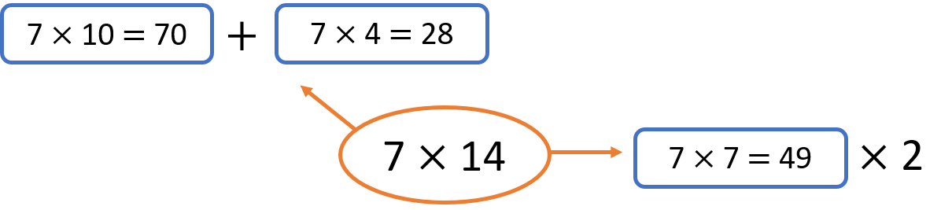
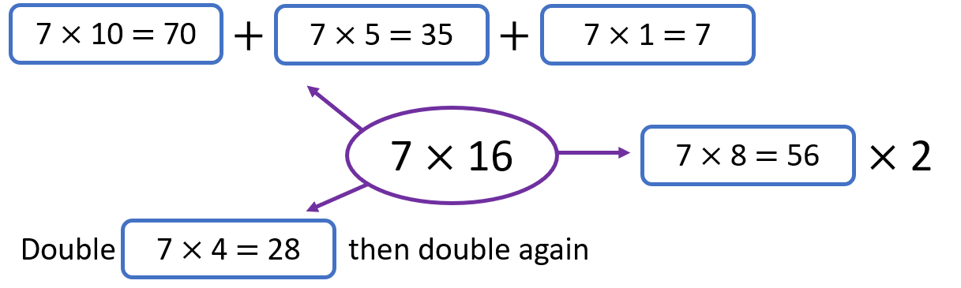
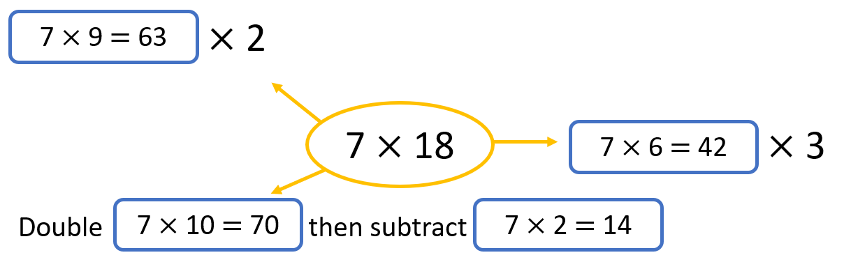

Slide 13
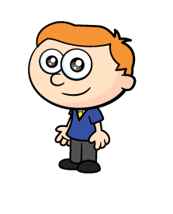
When a group of children are put into teams of 6 there are equal groups.
When the same group of children are put into teams of 7, there is one child not in a team.
There are less than 100 children.
How many children could there be?
Have a think

Slide 14
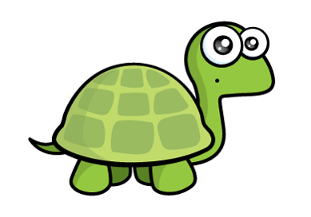
When the same group of children are put into teams of 7, there is one child not in a team.
When a group of children are put into teams of 6 there are equal groups.
6
12
18
24
30
36
42
48
54
60
66
72
78
84
90
96
7
8
14
21
28
35
42
49
56
63
70
77
84
91
98
15
22
29
36
Cannot be an odd number as all multiples of 6 are even
50
I think the next time this would happen is 120 children. Do you agree?
64
78
92

Slide 15
Have a go at the rest of the worksheet

