Slide 1
Mental health & well being
Parent Presentation 13th February 2019

Slide 2
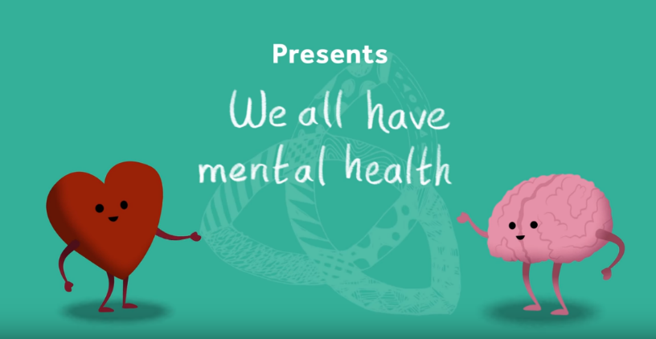
We all have mental health
(Schools in mind)
https://www.youtube.com/watch?time_continue=66&v=DxIDKZHW3-E

Slide 3
What is mental health first aid?
PHYSICAL FIRST AID (ABC) | MENTAL HEALTH FIRST AID (MHFA)
First aid is help given to an injured person before medical treatment can be obtained. The aims of any first aid are to: Preserve life Prevent deterioration of any injury or illness Promote healing and recovery Provide comfort to the ill or injured | MHFA is the help given to a person experiencing a mental health issue before professional help is obtained. The aims of MHFA are to: Preserve life where a young person may be a danger to themselves or others Provide help to prevent the emotional or mental health issue developing into a more serious state Promote the recovery of good mental health Provide comfort to a young person experiencing a mental health issue Raise awareness of mental health issues in the community Reduce stigma and discrimination.

Slide 4
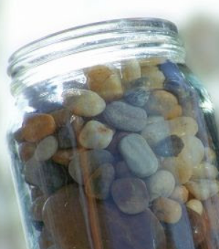
What is mental health?
The health of our brain
How we feel, think and behave
How we cope with ups and downs of everyday life
How we feel about ourselves and our lives
How we see ourselves and our future
How stress effects us
How we deal with negative things that happen in our life
Our self esteem and confidence
However…
You can’t see it and put a plaster on it!
https://www.annafreud.org/what-we-do/schools-in-mind/resources-for-schools/talking-mental-health-animation-teacher-toolkit/

Slide 5
Who is responsible?
We all are…
Last year there was 400,000 (yes…four hundred thousand) referrals to CHAMS
Their target was to see just one third of their referrals/caseload!
Therefore we must take this into our own hands

Slide 6
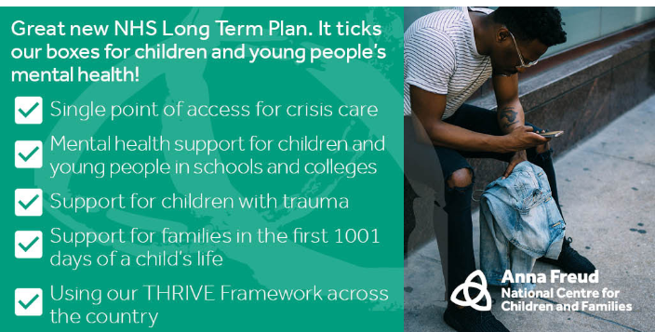
NHS January 2019

Slide 7
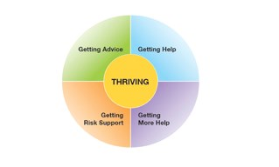
The Thrive Framework
https://www.annafreud.org/what-we-do/improving-help/thrive-framework/#Accept
The conceptual framework THRIVE has been translated into a model of care called 'i-THRIVE’, which is an integrated, person centred and needs led approach to delivering mental health services for children, young people and families.

Slide 8
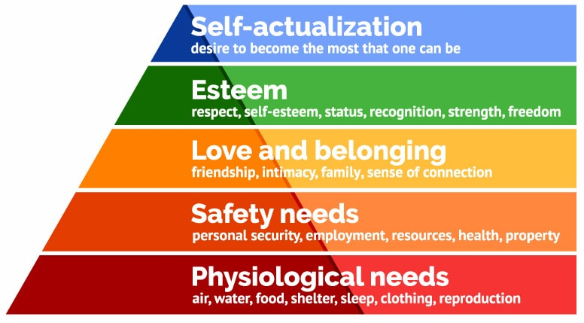
We need to manage children’s emotional state/well being before we focus on anything else.
We need to manage everyone's emotional state/well being before we focus on anything else.

Slide 9
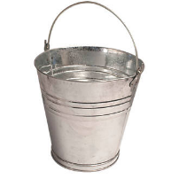
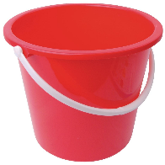

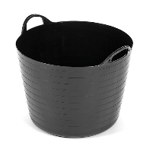
Stress bucket - Activity

Slide 10
Hand model of the brain
https://www.youtube.com/watch?v=gm9CIJ74Oxw

Slide 11
Types of mental health
Depression
Anxiety
Eating disorders
Suicide
OCD
Self Harm

Slide 12
anxiety
Anxiety is normal. Everyone experiences anxiety from time to time. It alerts us to threats, protects us from danger and helps us reach important goals. For example, it is normal to feel anxious when encountering a bear on a walk, or before taking an important exam.
Anxiety is not dangerous. Although anxiety feels uncomfortable, it is temporary and will eventually decrease. The sensations we experience in an anxious situation are designed to alert and activate us. They are normal and part of our body’s natural response mechanism. Our body is smart enough to know when to “ramp up” and when to “calm down.”
Anxiety is adaptive. Anxiety helps us prepare for real danger, such as crossing a busy street. It can also help us perform at our best, and motivate us to study for an exam or practice for a big game. When we experience anxiety, it triggers our "fight-flight-freeze" response, and prepares our body to react. For instance, our heart beats faster to pump blood to our muscles, so we have the energy to run away or fight off danger. Without it, we would not survive. We need some anxiety.
Anxiety is part of life. Trying to eliminate anxiety from your child's life is almost impossible, and even if it were possible, we are not sure you will have created a life worth living for your child. Since anxiety is everywhere, one of the greatest gifts you can give your anxious child or teen is the confidence and skill to tolerate anxiety whenever it occurs, and to continue living his/her life anyway!
Anxiety can become a problem. Small doses of anxiety in certain situations are useful. However, when your child is worrying much of the time, avoiding fun activities, if it is stopping them living their everyday life, or refusing to go to school because s/he is scared or worried, anxiety has become a problem. Think of anxiety like fog: if it covers everything, makes it hard to see, stops you from doing what you usually do, and generally gets in the way, then it has likely become a problem.

Slide 13
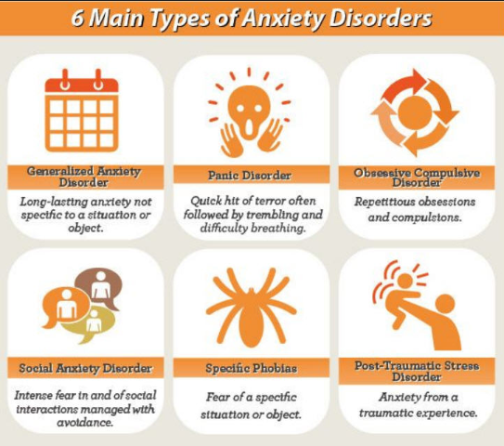
Types of anxiety

Slide 14
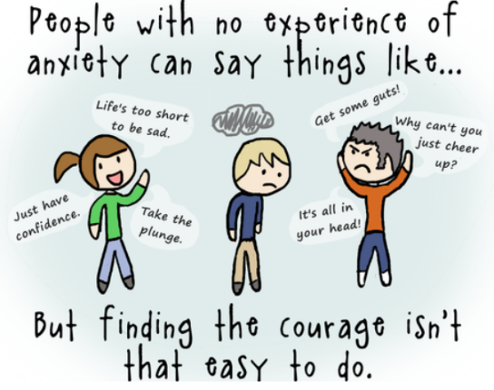
Anxiety

Slide 15
How to support an anxious child

Slide 16
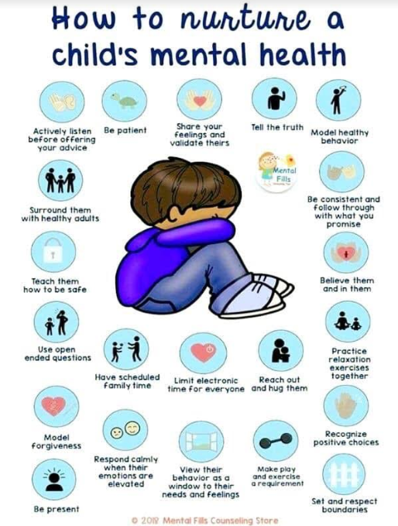

Slide 17
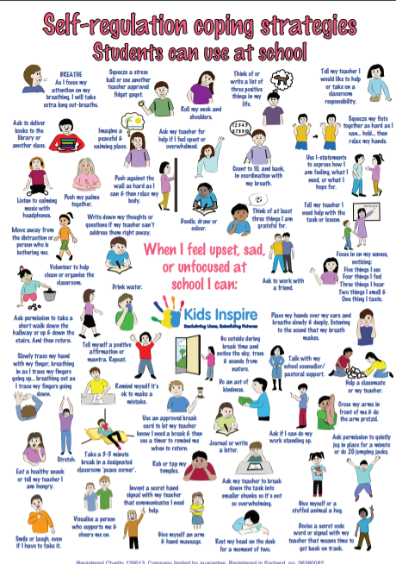

Slide 18
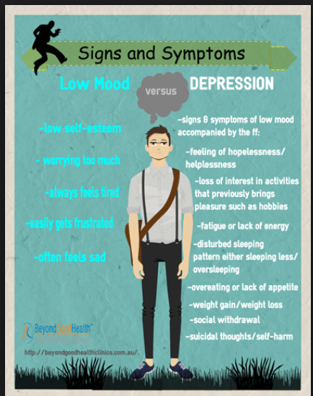
Low mood and depression
The difference between an low mood
and depression.

Slide 19
I have a black dog…
https://www.youtube.com/watch?v=XiCrniLQGYc

Slide 20
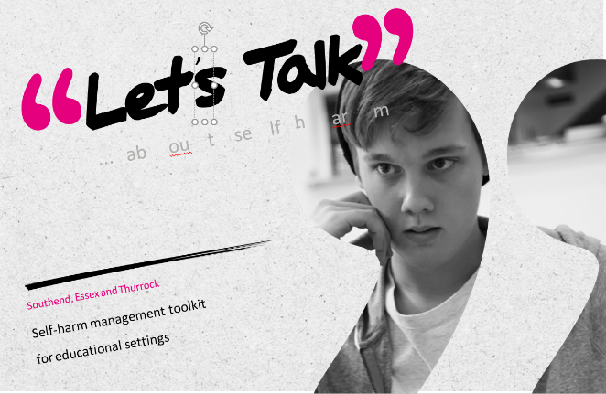
Self harm

Slide 21
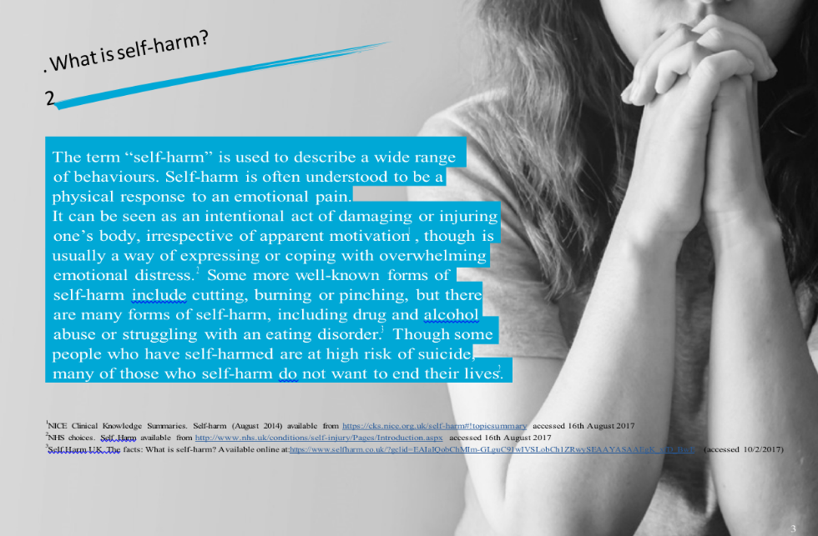

Slide 22
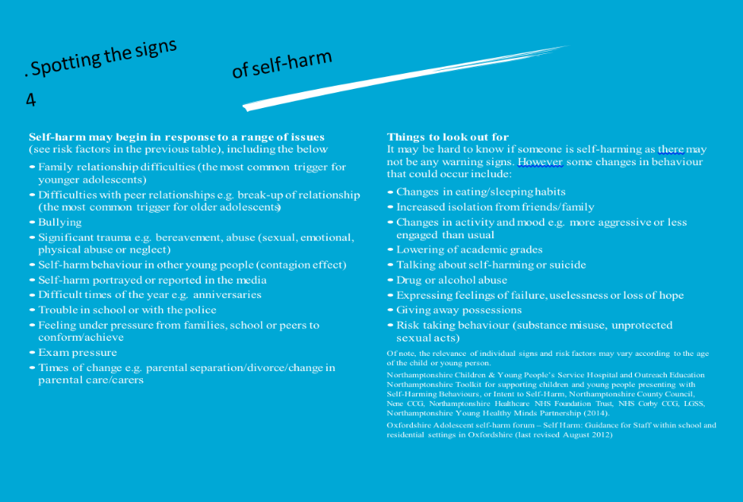

Slide 23
So what are we doing?
Raising awareness of Mental Health and Well Being within our school community.
Mental Health First Aid Champion
Talking to the children – in class and assemblies – questionnaires so we can gain a real insight into the children's feelings and emotions
14 members of staff have achieved a TQUK (NVQ) Level 2 Certificate in Understanding Children and Young People's Mental Health qualification.
Teachers and LSAs by July 2019 will have completed an online Educare (our schools training platform) course ‘Mental Wellbeing in Children and Young People’
Primary representative at the BAP (Behaviour and Pastoral) meetings - local schools group, from this trainers are coming into school from the CSS
ALGEE
GREAT DREAM
SHUSH - Non judgemental listening
Teach and build resilience
Mindefulness – headspace.com
Smilers

Slide 24
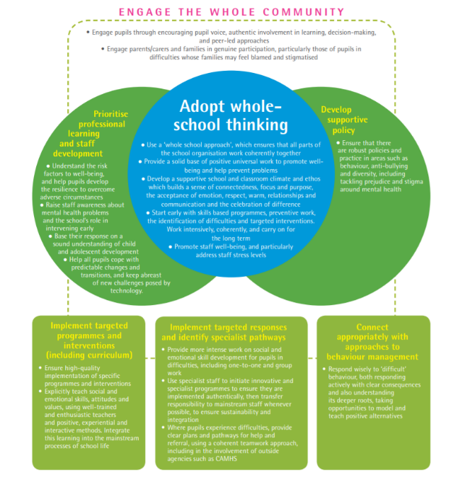

Slide 25
algee
A pproach
L isten and communicate
G ive support
E ncourage the young person
E ncourage others to support

Slide 26
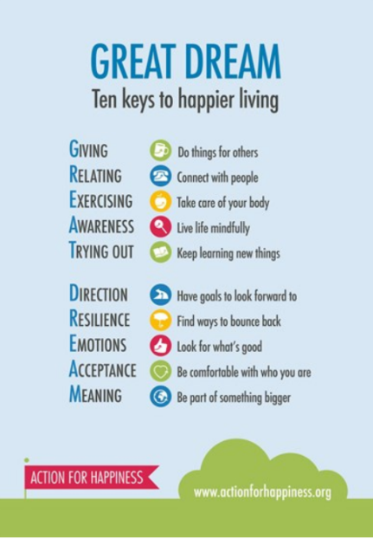
Great dream

Slide 27
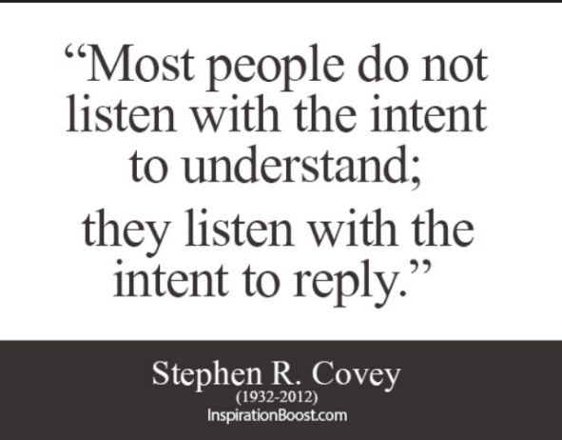
Shush - Non Judgemental listening
S how you care
H ave patience
U se open questions
S ay it back
H ave courage

Slide 28
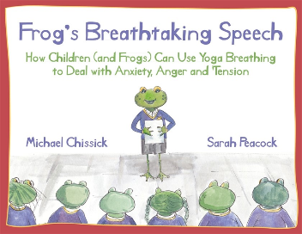

Building resilience
You are awesome book – Matthew Syed (Growth and Fixed Mind Set)
Frogs breath-taking speech

Slide 29

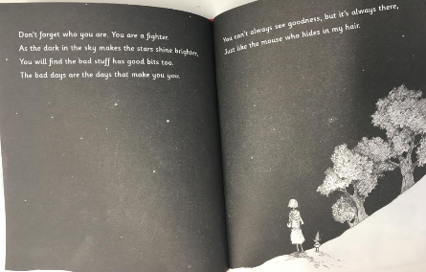
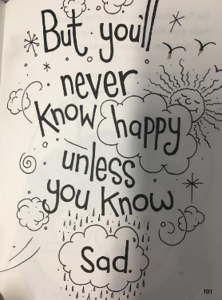
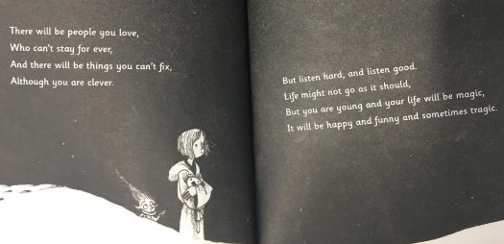
The truth pixie by matt haig

Slide 30
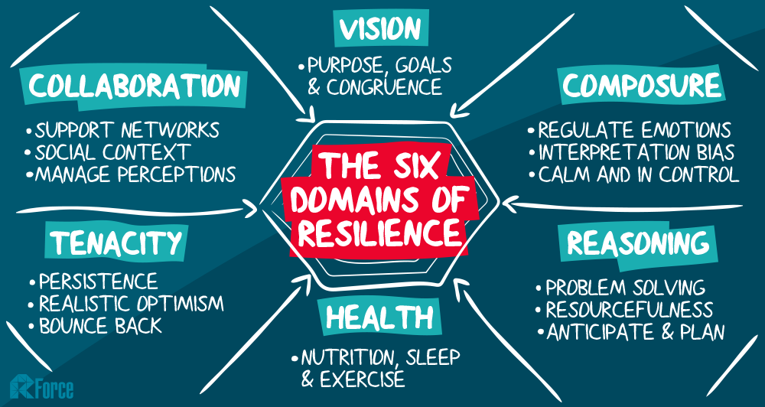

Slide 31
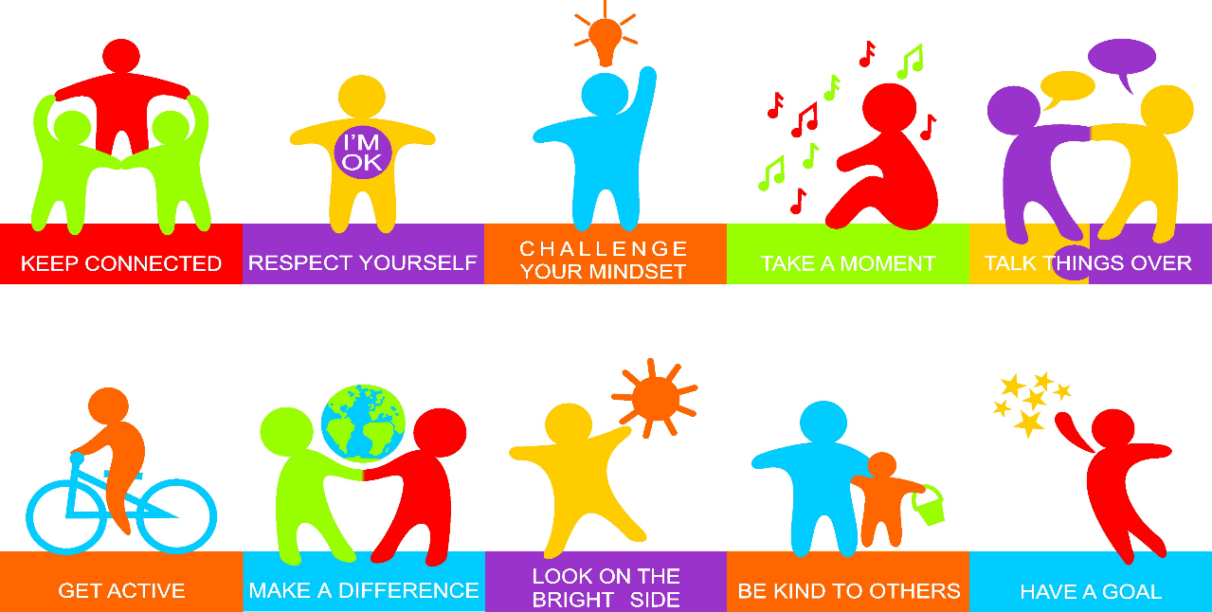

Slide 32
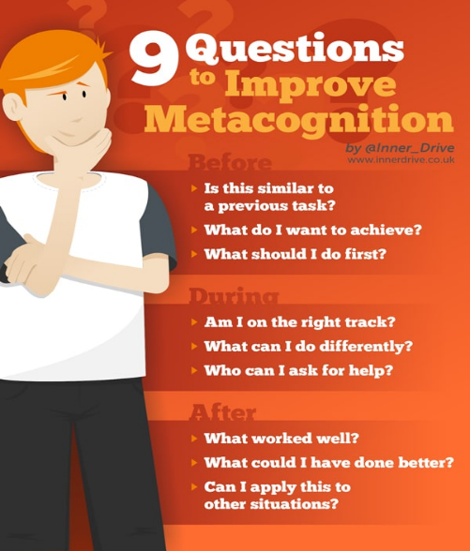
Metacognition

Slide 33
Mindfulness
Smiling minds
Head space https://www.headspace.com/

Slide 34

The recovery tree

Slide 35
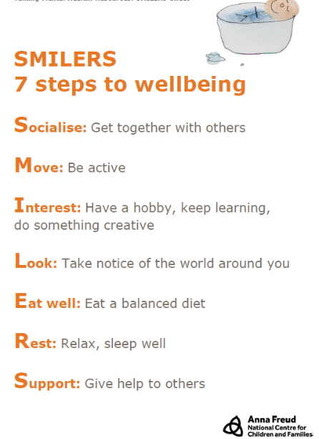

Slide 36
We are all supporting mental health first aid (Mhfa)
MHFA does not teach people to be therapists. However, it does teach people to:
Recognise the symptoms of mental health issues
Provide initial help
Enable a young person to access appropriate professional help.
https://www.annafreud.org/what-we-do/schools-in-mind/resources-for-schools/we-all-have-mental-health-animation-teacher-toolkit/

Slide 37
assemblies one for ks1 and ks2
https://www.annafreud.org/media/7207/05-talking-mental-health-assembly-powerpoint.pptx

Slide 38
Helpful resources
Anna Freud Centre www.annafreud.org
Young Minds www.youngminds.org.uk (experience with)
Child Line www.childline.org.uk
Kooth www.kooth.com (online support delivered via a chat based service)
STEM4 www.stem4.org.uk (teenage mental health)
Early Intervention Foundation www.eif.org.uk
Rethink Mental Illness www.rethink.org (severe mental illness recovery charity)
Samaritans www.Samaritans.org
Education Support Partnership (for people working in education) https://safeguardinginschools.us12.list-manage.com/track/click?u=efe032677d94ceba51dd39a7f&id=60913008b5&e=b825bf96be
MindEd www.minded.org.uk (MindEd for families – online advice, identifying early issues and how best to support your child
Mind www.mind.org.uk

Slide 39
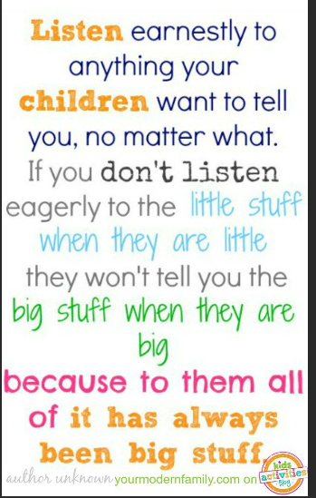
And finally…

