Slide 1


Come Dine With Me: Greek Style
By JK

Slide 2
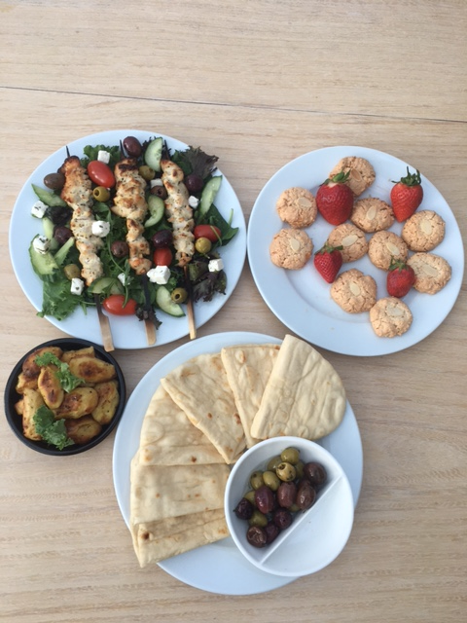
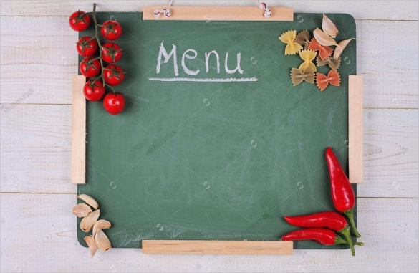
MENU
To Begin
Greek Style Roasted Potatoes
=====
Followed By
Chicken Souvlaki Skewers
Served on a bed of salad
Accompanied with olives and pitta bread
=====
To Finish
Greek Almond Ergolavi Cookies and Strawberries

Slide 3
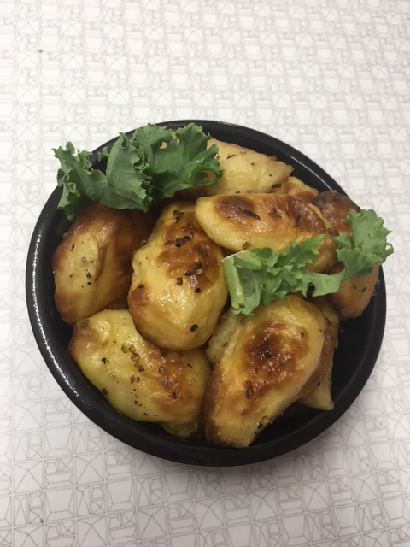
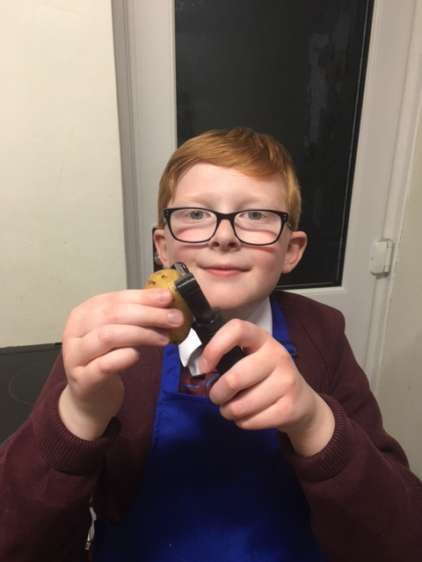
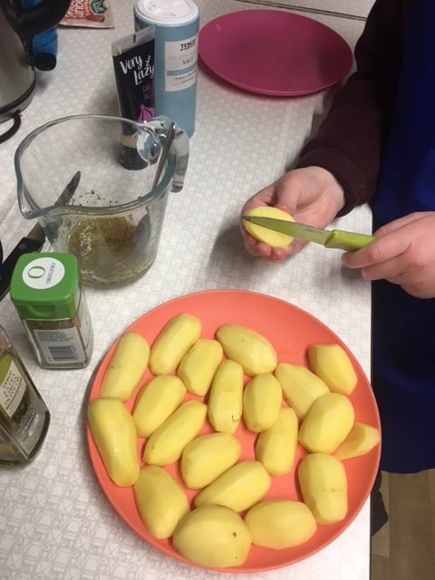
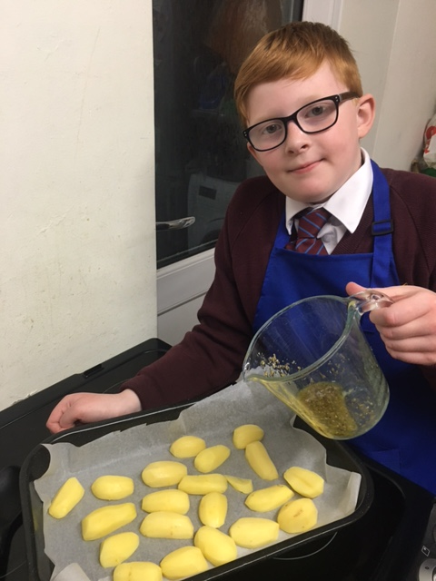
Greek Style Roasted Potatoes
Ingredients
2 teaspoons fresh lemon juice, 1 tablespoon olive oil, 2 tablespoons water, 1 teaspoon dried Greek oregano, small russet potatoes (peeled, cut in half), coarse salt and freshly cracked black pepper
Method
Preheat oven to 160 degrees Celsius.
Whisk lemon juice, olive oil, water and oregano in a small bowl to blend.
Toss potatoes with vinaigrette in a small roasting pan.
Season potatoes with salt and pepper.
Cover pan with foil and roast potatoes until tender and golden brown, turning occasionally, for about 45 minutes.
Using metal spatula, loosen potatoes from baking sheet to prevent sticking.
Serve.

Slide 4
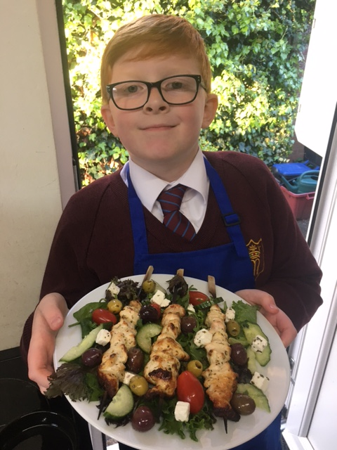
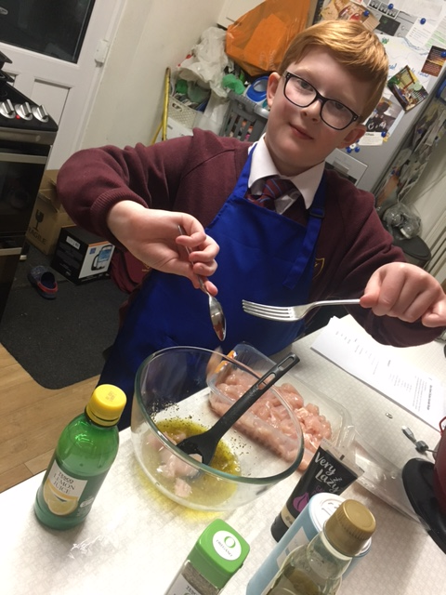
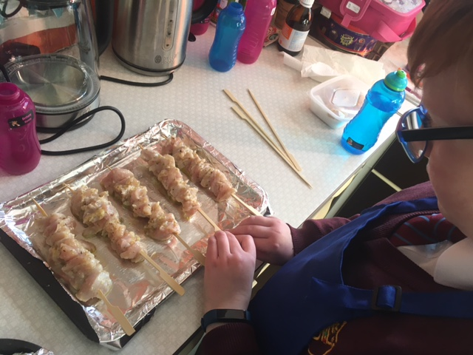
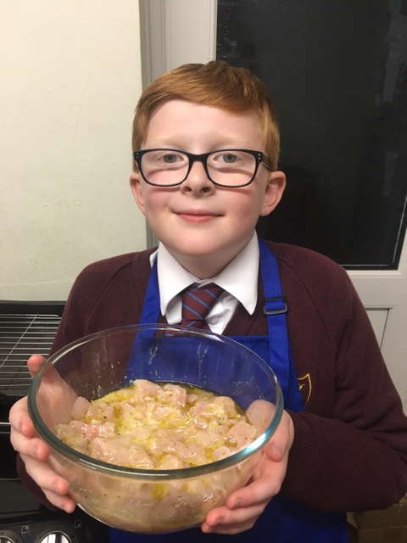
Chicken Souvlaki Skewers
Ingredients
700g chicken breast boneless and skinless, ¼ cup olive oil extra virgin, 2 lemons juice of,1 teaspoon salt, 2 teaspoon dried oregano and 8 cloves garlic minced.
Method
Cut the chicken breast into one inch cubes and set aside.
In a large bowl, mix olive oil, lemon juice, salt, dried oregano and minced garlic. Add the chicken cubes to the marinade and mix well.
Cover with a plastic wrap and marinate in the fridge for at least one hour or overnight.
Once ready to cook, heat a grill pan over medium high heat.
Thread the chicken pieces on wooden skewers. Do not crowd the skewers.
Place the skewers in the pan and grill them for 5 minutes on each side until fully cooked.
Once ready, serve.

Slide 5
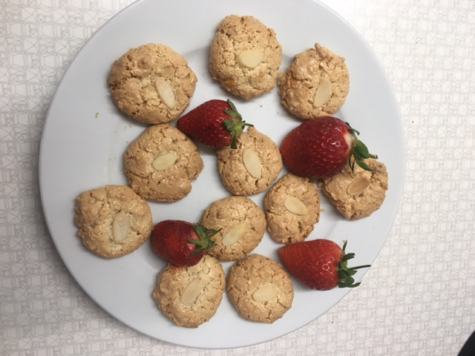
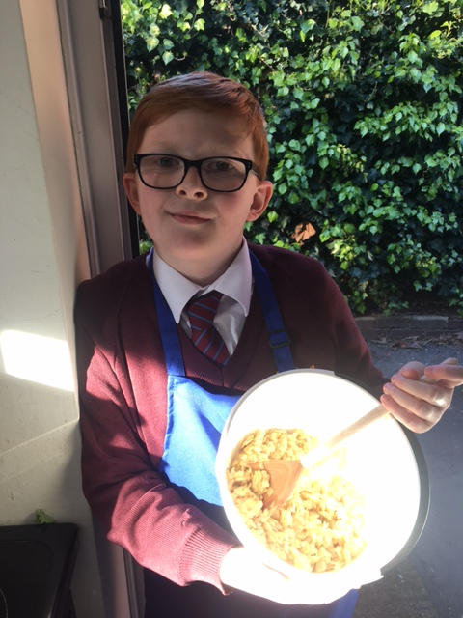
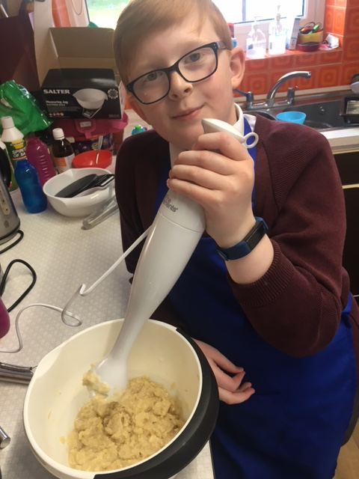
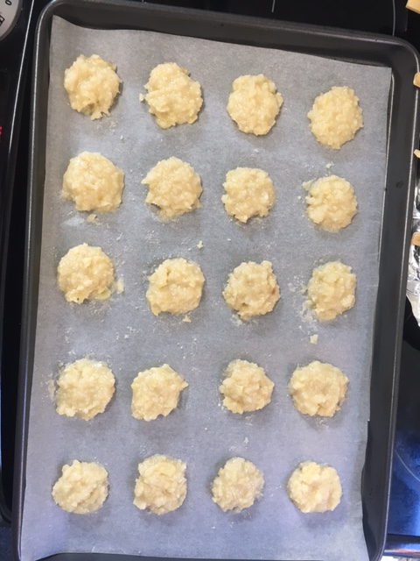
Greek Almond Ergolavi Cookies
Ingredients
250g sugar, 250g almonds, 3 egg whites and ½ teaspoon vanilla extract.
Method
Add the almonds and sugar in a food processor and blend until powdered. Add the egg whites and the vanilla extract and pulse, until the ingredients combine, forming a firm paste.
Layer the bottom of 2 baking trays with parchment paper and form the cookies. Take approximately 1 1/2 teaspoons of the paste and place on the baking tray; repeat with the rest. Garnish with almonds and wait for a while for the dough to spread on the tray.
Bake in preheated oven at 160C for 17-20 minutes, until light golden. Be careful not to over bake them. Enjoy hot from the oven with delicious strawberries.

Slide 6
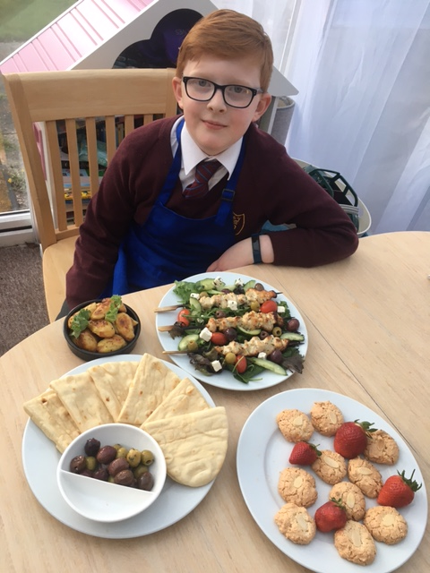
Family Review
Joshua
Potatoes 4.5/10 Too spicy for me!
Chicken Skewers 9.5/10 Delicious and delightful to eat.
Cookies 8.5/10 Good apart from the raw almond on top.
Mum
Potatoes 10/10 Cooked to perfection and incredibly tasty.
Chicken Skewers 8/10 Well seasoned and delicious.
Cookies 11/10 I loved the almond crunchiness with the gooey inside. They are very addictive!

