Slide 1
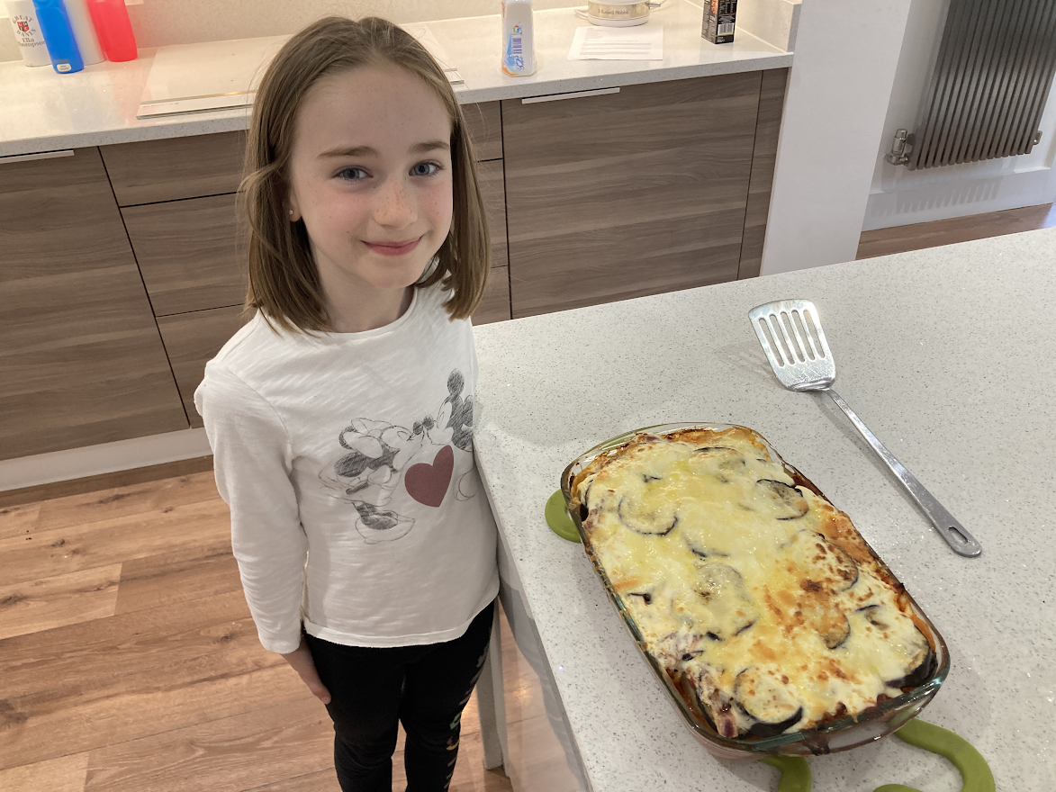
Why I chose
Moussaka

Slide 2
Why I chose Moussaka
I choose Moussaka because in class, Miss Michael told us some famous Greek meals and she said about Moussaka. She also showed us pictures.
Moussaka looked scrumptious and delicious. It looked a bit like my favourite meal, Lasagne.
I had to research the recipe. I found this on Google. It had new food that I’ve never tried, like aubergines. It was unique.

Slide 3
Ingredients
4 medium-sized potatoes
3 tbsp olive oil, plus extra for brushing
1 red onion, sliced
500g lamb mince
2 garlic cloves, crushed
1 tsp mixed spice
500g carton passata
2 aubergines, cut into slices
300ml tub crème fraîche
140g cheddar, grated

Slide 4
Method
STEP 1
Boil the potatoes whole for 20 mins or just until tender. Drain and allow to cool.
STEP 2
Return the pan to the heat and add 2 tbsp olive oil and the onion. Cook until softened, then add the lamb. Fry the mince for 5 mins or until cooked through and starting to char. Add the garlic and spice, and stir in the passata. Bring to a simmer, then season to taste, take off the heat and set aside until needed.
STEP 3
Heat oven to 220C/200C fan/gas 7. Warm a griddle pan over a high heat and brush a little oil over the aubergines. Grill for 2-3 mins each side or until char lines appear. You may have to do this in 3-4 batches.
STEP 4
Once cool enough to handle, cut the boiled potatoes into thick slices. Put 1 tbsp oil in the base of a deep ovenproof dish and start with a layer of potatoes, then aubergines, a sprinkling of seasoning, then a layer of the lamb mixture. Repeat until all the mixture is used up, ending with a layer of aubergines. Spread the crème fraîche over the top and scatter with the cheese. Put in the oven for 10 mins or until the cheese is golden.

Slide 5
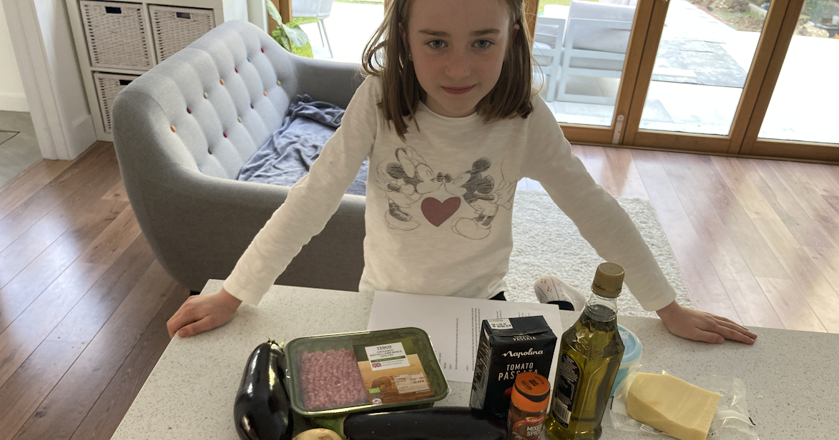
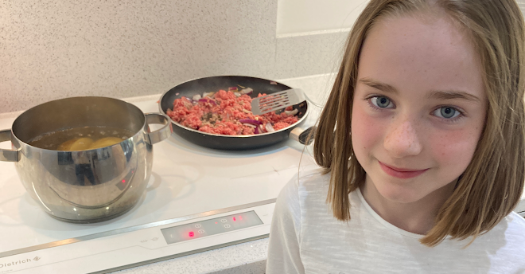
Preparing and Making
Getting all the ingredients ready
Cooking the potatoes and mince
We had to order quite a few things onto the online shopping. The crème fraiche didn’t arrive so we had to go to the shops anyway to get this. Apart from this, we had all the ingredients come in the shopping.
Rule 1 of preparation: WASH YOUR HANDS!!!

Slide 6
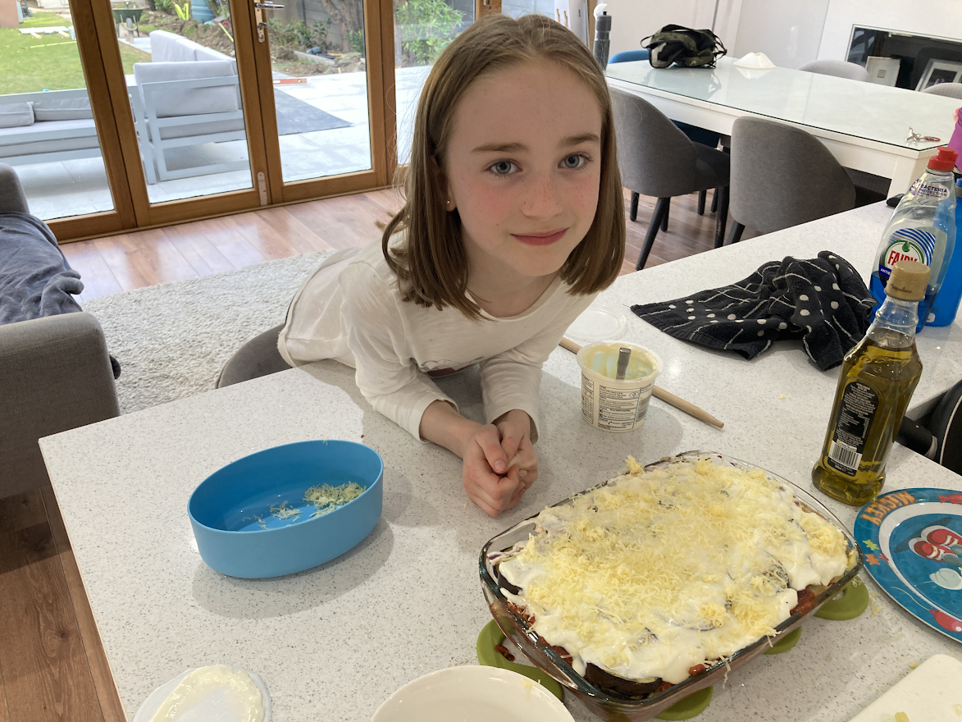
Preparing and Making
Once the ingredients were cooked, like lasagne, we had to layer it over and over. Then we put it into the oven.
Out of the oven, it looks delicious. Ready to serve!

Slide 7
Evaluation
My family liked it and I was fine I guess. I learnt not to choose food by the look ;-)
James (Big Brother):
  He rated it 8/10.
  He said doesn’t like the cinnamon in the spice and less potatoes.
Mum:
  She rated it 9/10.
  She said maybe less potatoes, but apart from that it was delicious and filling.
Dad:
  He rated 9/10 as well.
  He said it was scrumptious, that is all.
Me (Ella):
  I rate it a 6/10.
  I didn’t really like the aubergine, too many potatoes, garlic and cinnamon. I’m picky ;-;

Slide 8
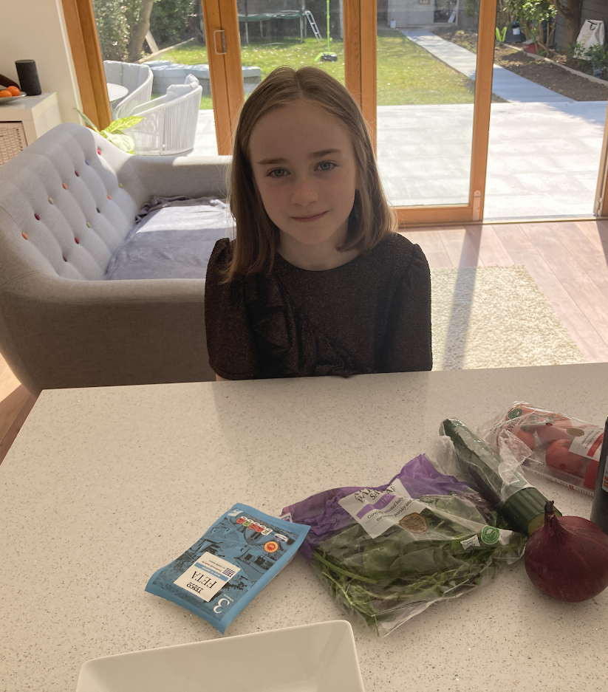
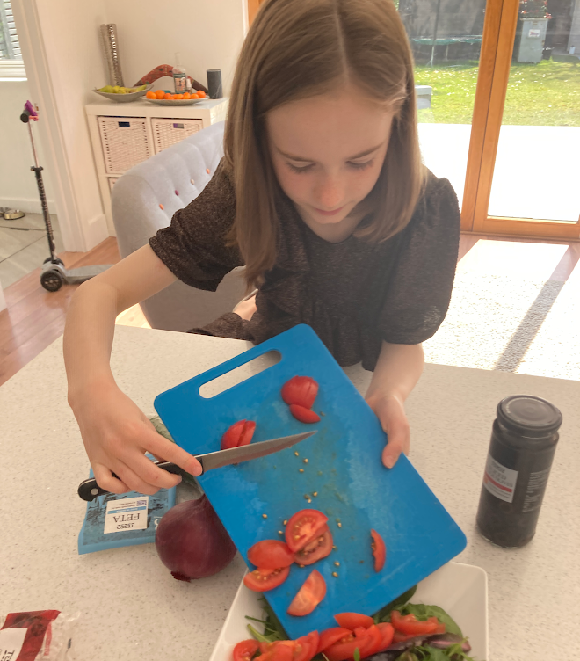
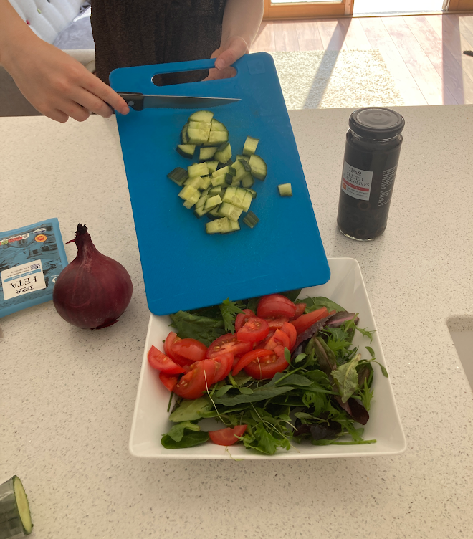
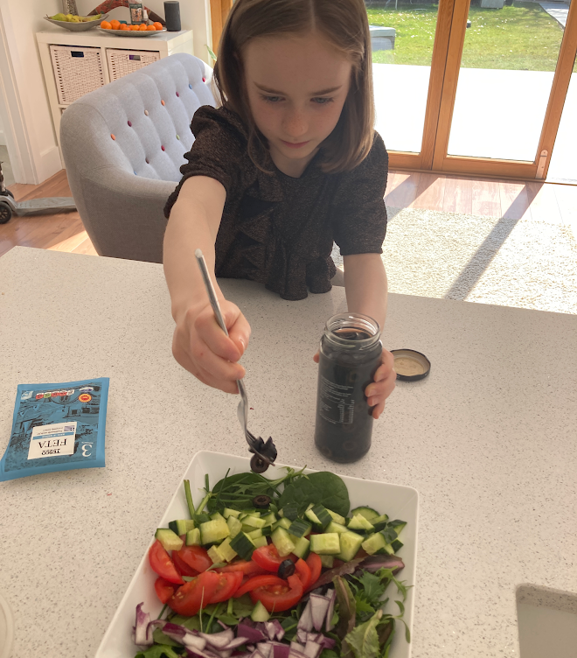
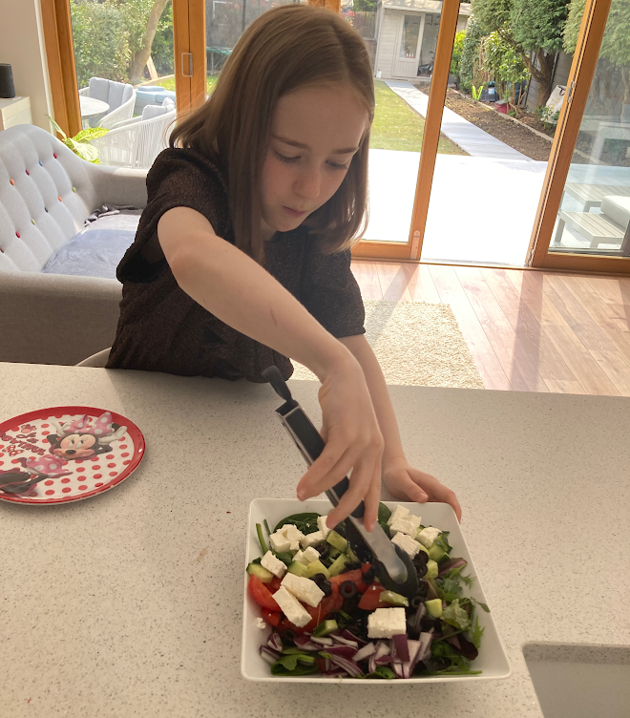
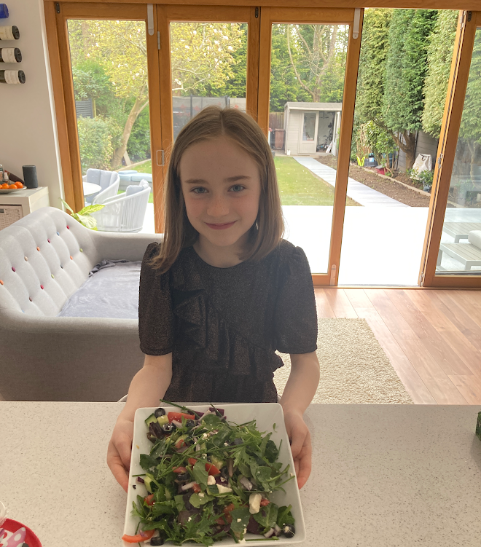
Greek Salad
I also wanted to make a Greek Salad for my mum’s birthday because she likes it. This was easy because you don’t have to do any cooking. You just mix the ingredients together.
Ingredients: red onion, cucumber, salad leaves, feta cheese (I don’t like this!), tomatoes and black olives.

