Slide 1

My Greek Meal
by OW, Merlin Class, Year 4

Slide 2
Designing my Menu
The first task I had to complete was deciding what I was going to make.
I asked my family what they would like and, since we were planning on having a barbeque anyway, I thought it would be good to make Greek lamb kebabs (known as Souvlaki).
I also wanted to make some side dishes to go with it, so I decided to make a home-made Tzatziki dip served with home-made flatbreads, olives and a feta cheese Greek salad.

Slide 3
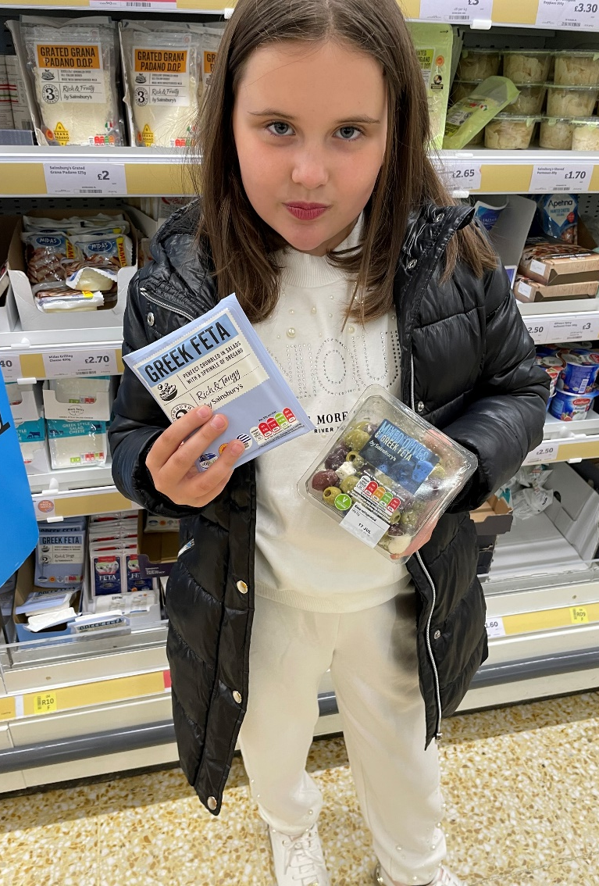
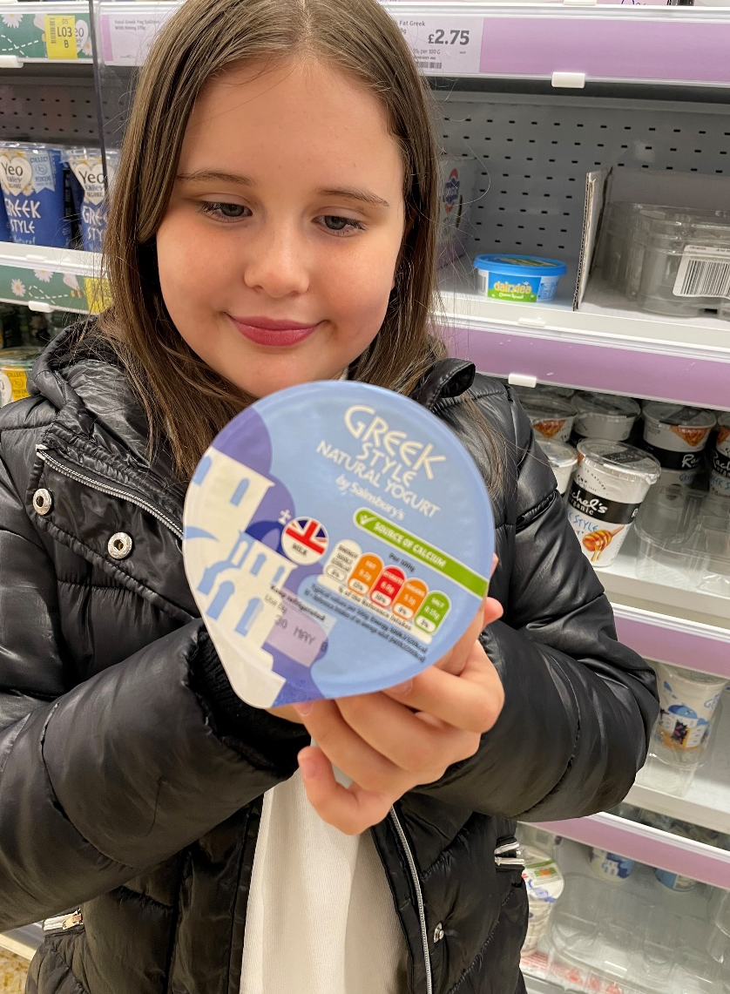
Purchasing my Ingredients
First I had to buy my ingredients
My Dad and I went to Sainsbury’s to get most of what we needed (we already had some items at home anyway)
We got the lamb for the Souvlaki from the butcher’s
Here are some photos of me getting what we needed

Slide 4
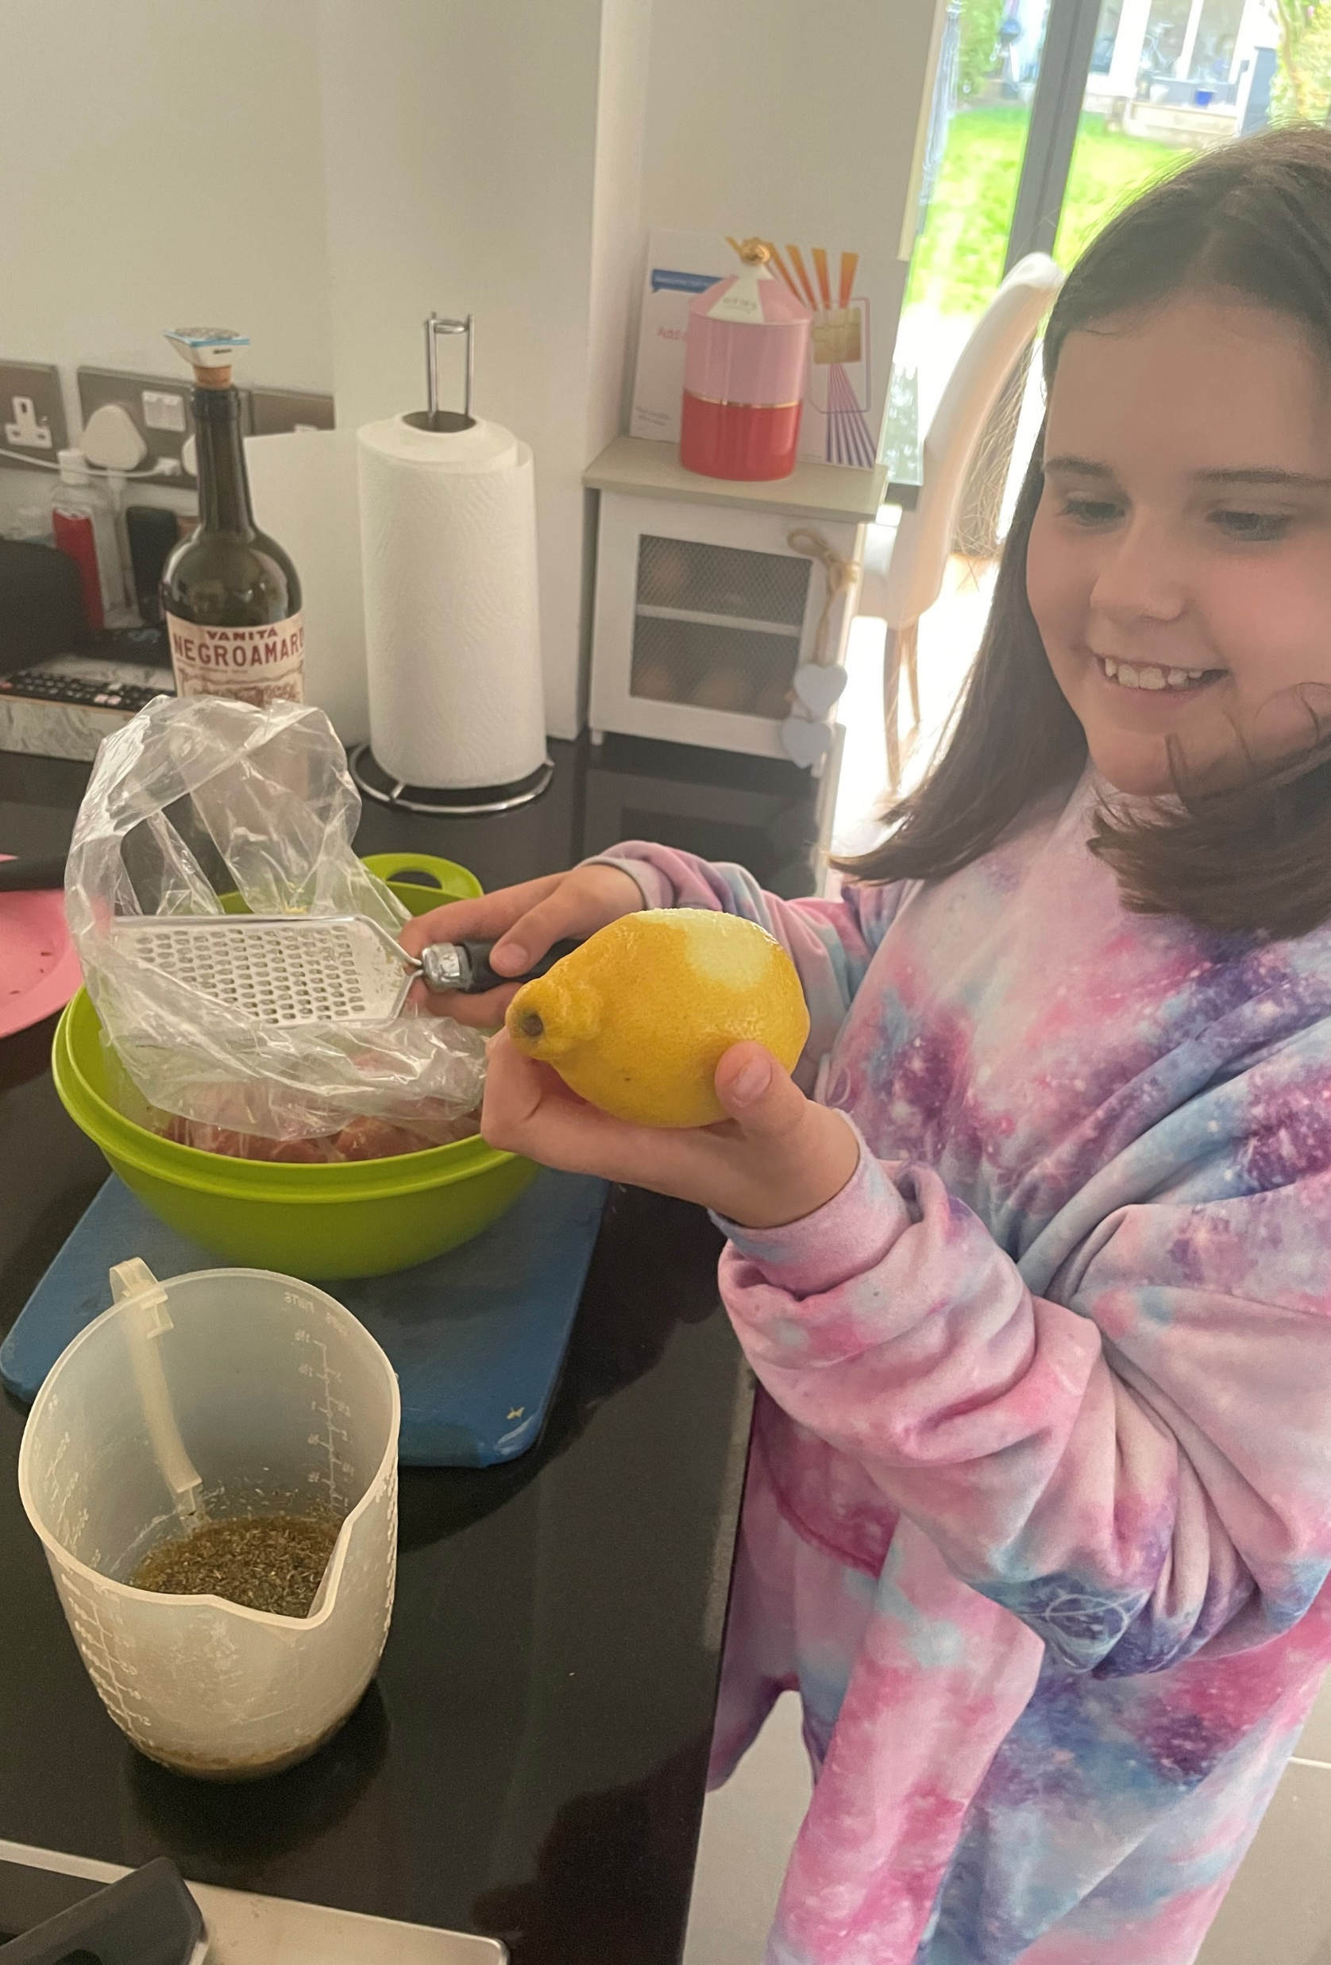
Making Lamb Souvlaki Skewers
Ingredients
1 ½kg lamb leg or shoulder (fat trimmed), cut into chunks
100ml olive oil
100ml red wine
2 tsp dried oregano
zest and juice 2 lemons
2 garlic cloves , crushed

Slide 5
Method
Put the lamb into a large bowl or strong food bag.
Add the olive oil, wine, oregano, lemon zest and juice, garlic and black pepper – don’t add salt yet.
Mix together so that all the lamb is completely coated, then chill and marinate for at least a few hours or overnight.
Lift the chunks of lamb out of the marinade and thread onto 10 metal skewers.
Season the meat with salt, then cook the skewers on a preheated barbeque for 10-12 mins, turning, until cooked to your liking. Serve tucked into warm flatbreads with salad and drizzle with chilli sauce and yoghurt.

Slide 6
Making the Tzatziki
Ingredients
½ cucumber, halved and deseeded
170g pot Greek yogurt
1 small garlic clove, crushed
handful mint leaves, chopped
Method
Coarsely grate the cucumber, sprinkle with a pinch of salt and squeeze out all the liquid. Tip into a bowl with the yogurt, garlic and mint, and mix well. Great served with slow roast lamb or as a dip.

Slide 7

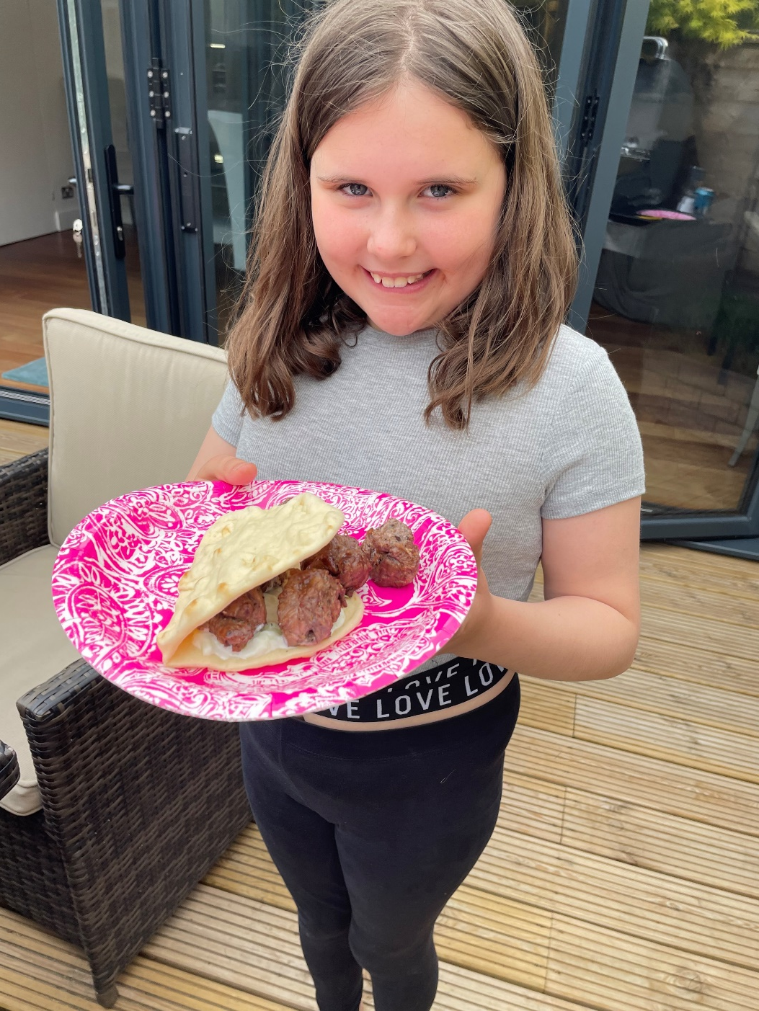
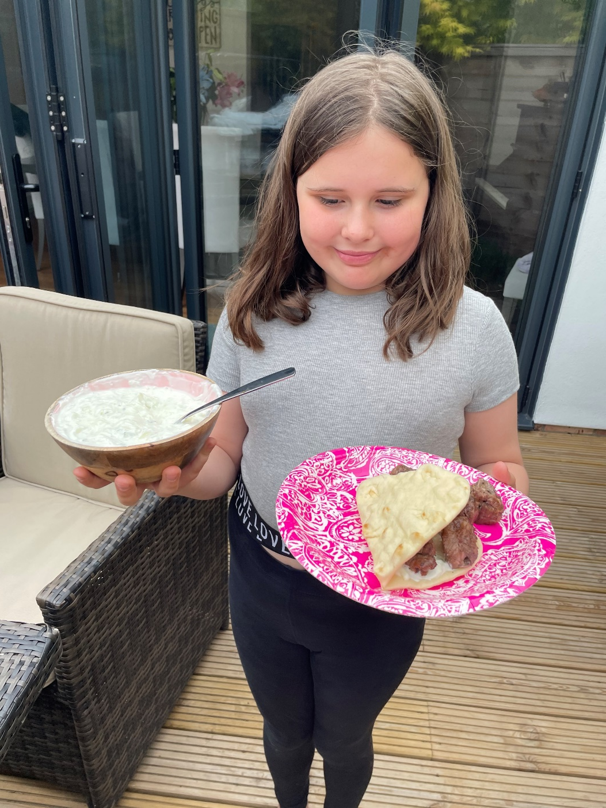
The Finished Article
The Souvlaki skewers were really tasty
The flatbreads were very easy to make
I wasn’t a fan of the Tzatziki as I don’t really like cucumber
The Tzatziki recipe made way too much and we ended up throwing most of it away!

Slide 8
Feedback
Dad
“The lamb kebabs were a bit over-cooked for my liking, but still very tasty”!
(Dad cooked them!)
7/10
Mum
“Whose idea was it to make this much Tzatziki?? We’ll NEVER eat all that!”
5/10
Me
“I thought you did a great job Olivia!” ☺
10/10
M
“Olives and Feta cheese are a winning combination!”
8/10

