Slide 1
BUTTERFLIES
Jamie Robinson, Summer 2023

Slide 2
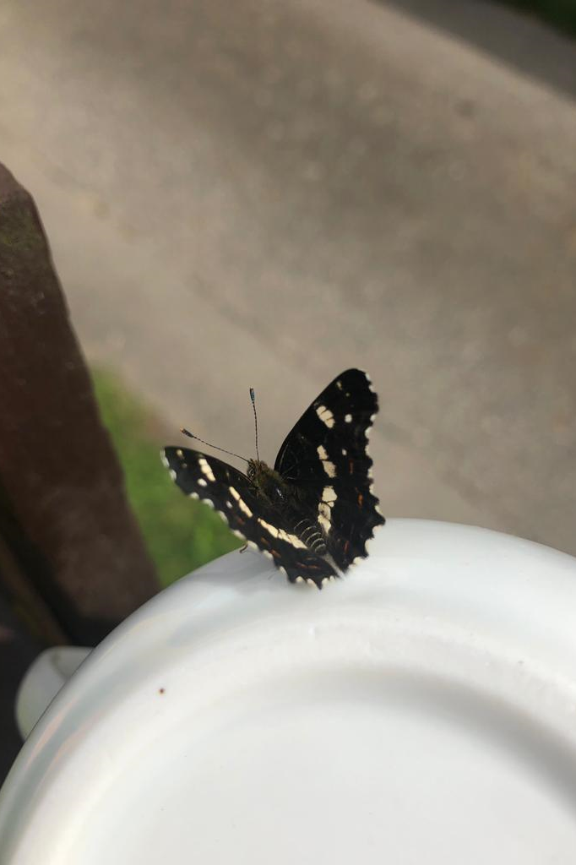

White admiral
ONE SEE IN CZECH REPUBLIC AUGUST 2023

Slide 3
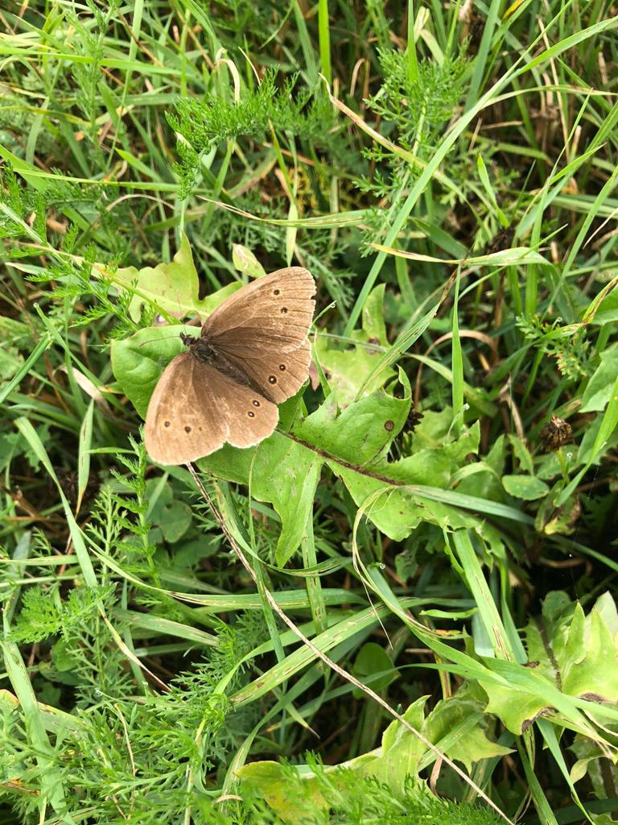

Ringlet seen in Czech republic – 29 July 2023

Slide 4
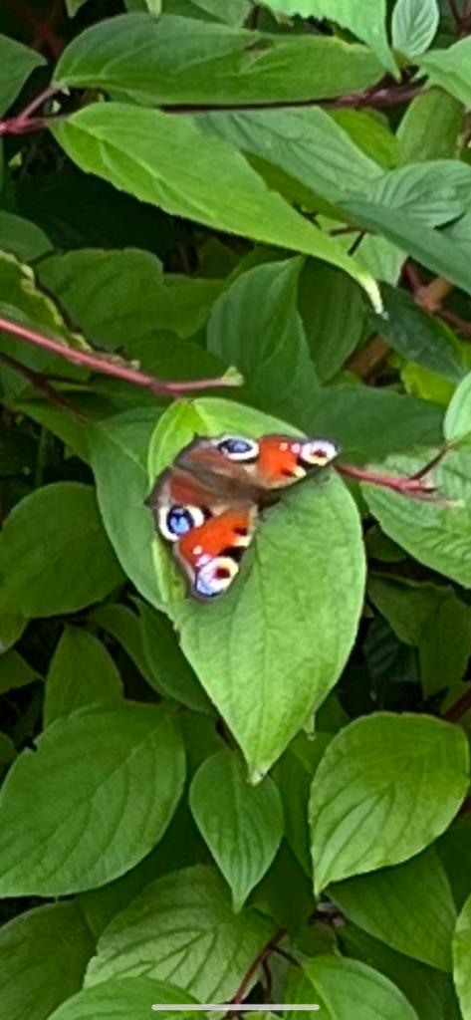

Peacock four seen in Shenfield July 2023

Slide 5

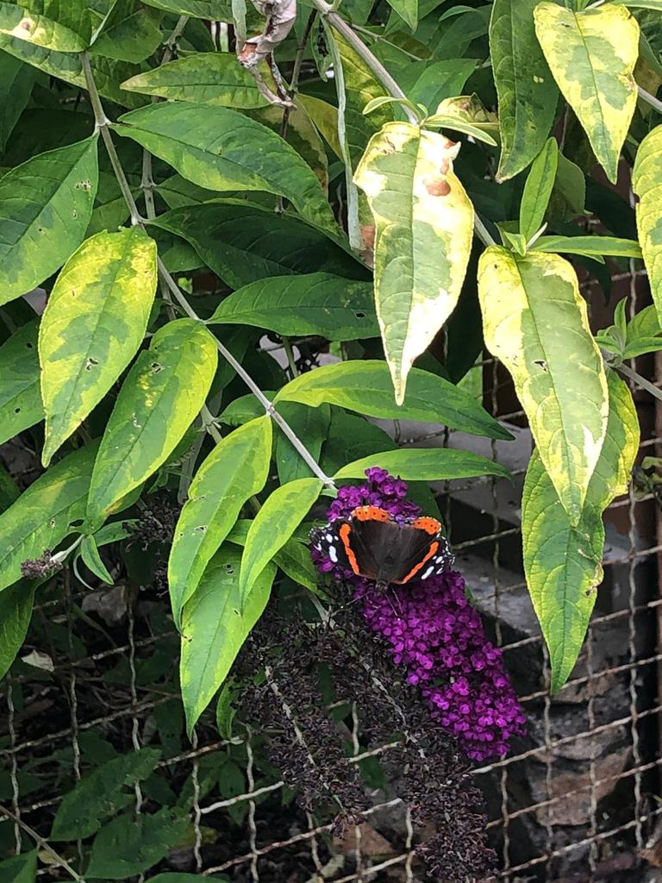
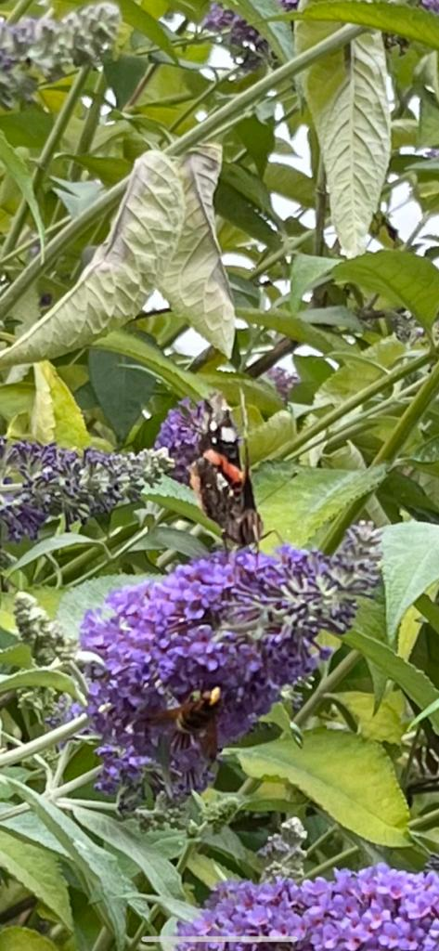
Red admiral
FIVE SEEN IN SHENFIELD JULY 2023

Slide 6
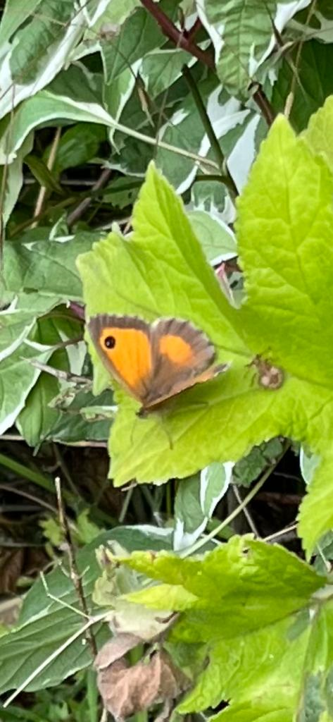
Gatekeeper two seen in Shenfield July 2023

Slide 7
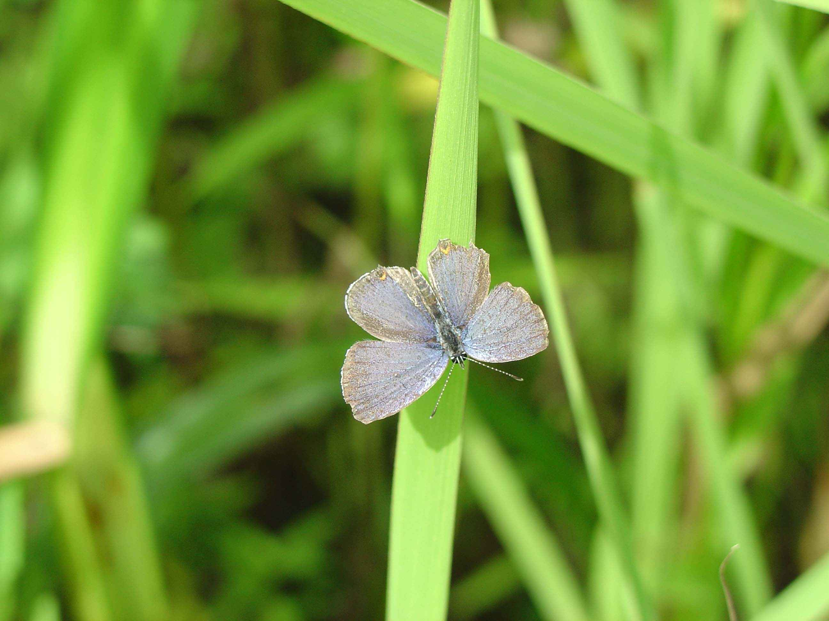
MEADOWBLUE
FOUR SEEN IN CZECH REPUBLIC AUGUST 2023

