Slide 1


Slide 2


cat

Slide 3

mat

Slide 4
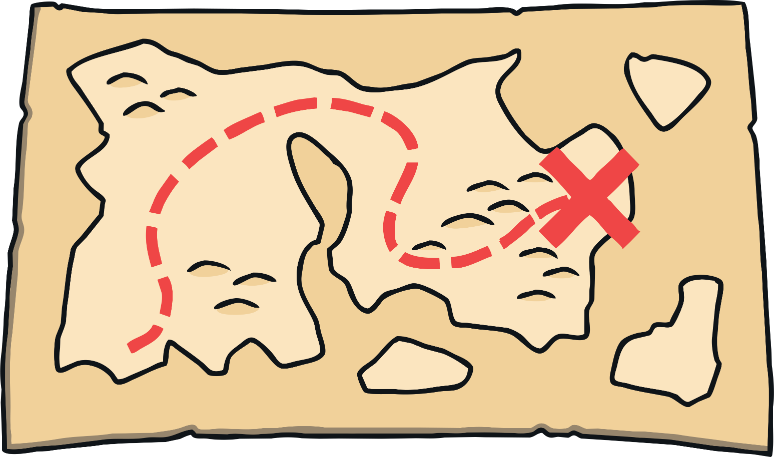
map

Slide 5
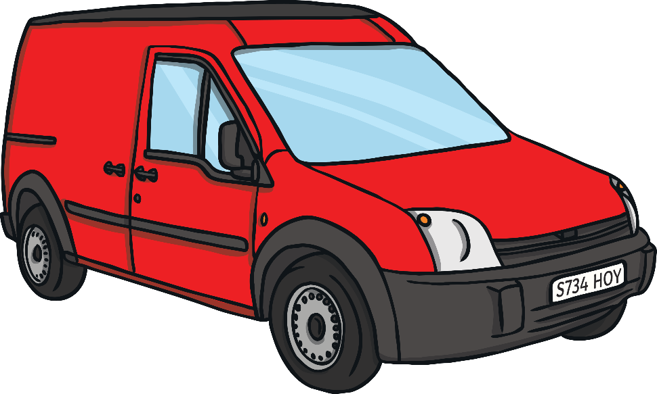
van

Slide 6

hat

Slide 7
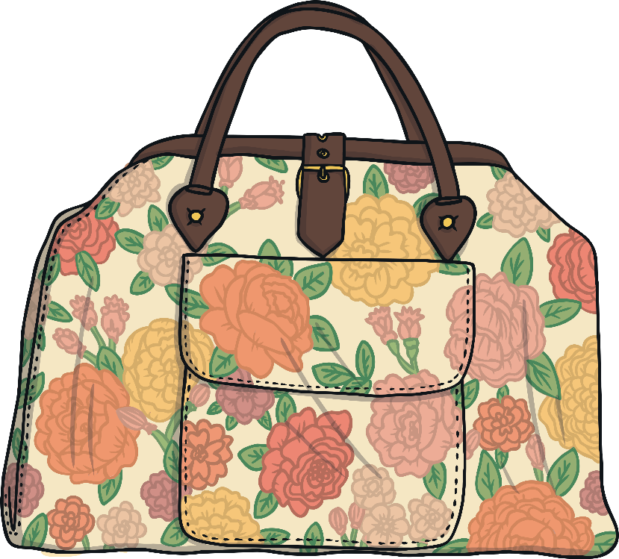
bag

Slide 8
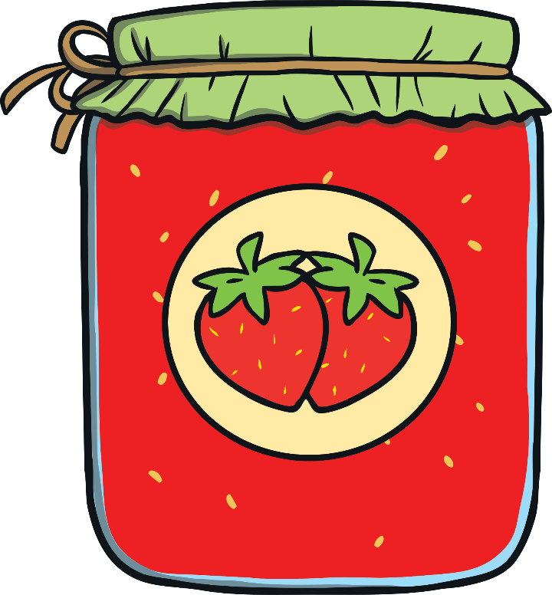
jam

Slide 9
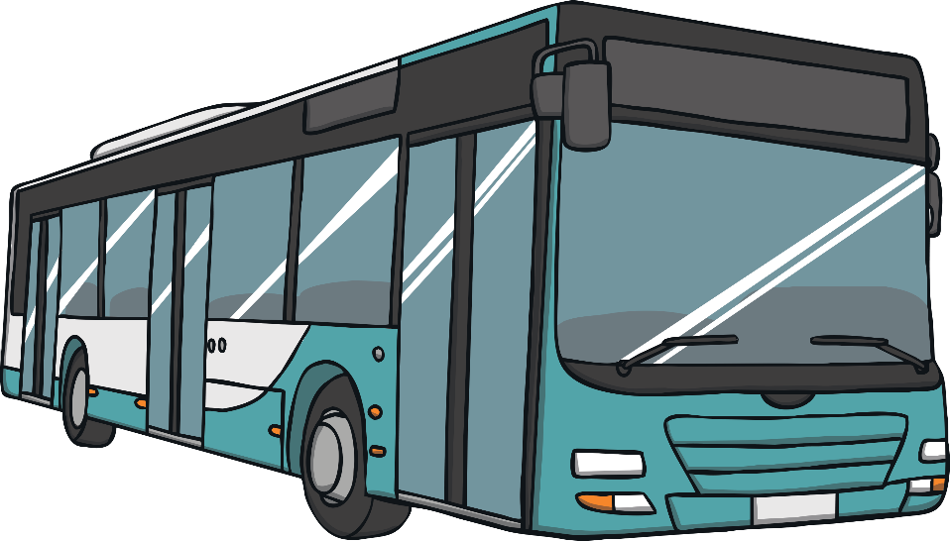
bus

Slide 10
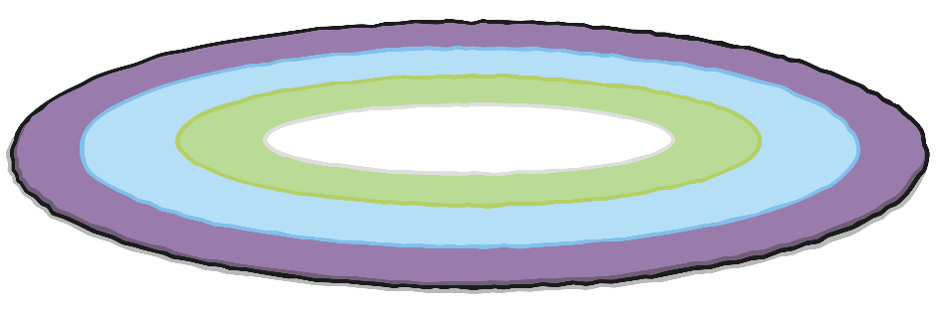
rug

Slide 11

sun

Slide 12

sum

Slide 13

jug

Slide 14
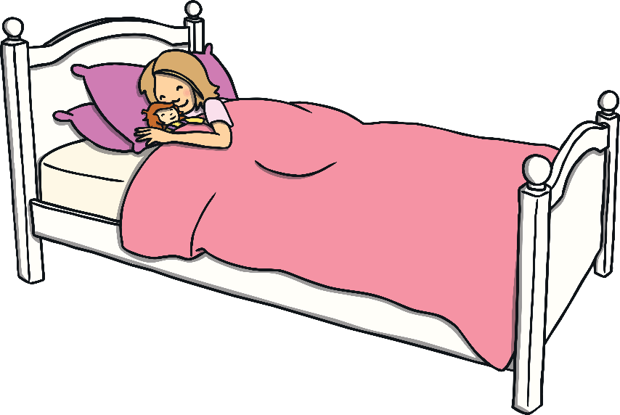
bed

Slide 15
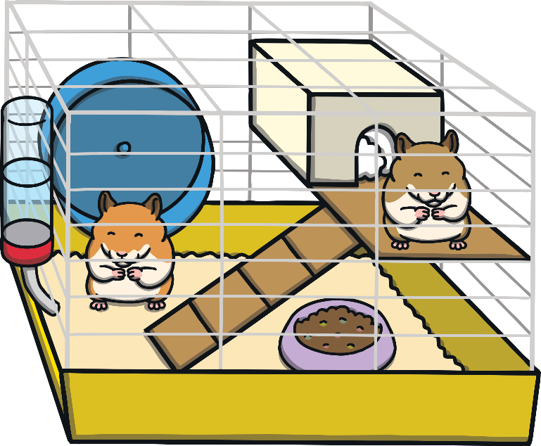
pet

Slide 16

pen

Slide 17

leg

Slide 18
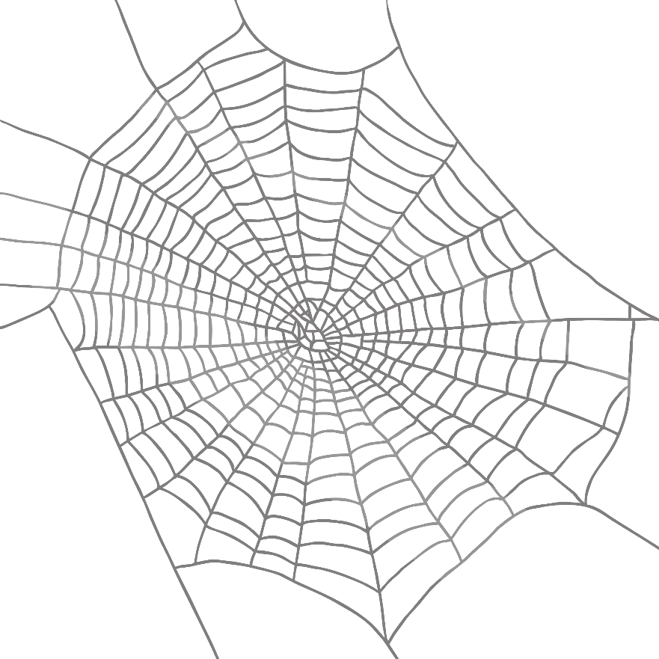
web

Slide 19

cob

Slide 20
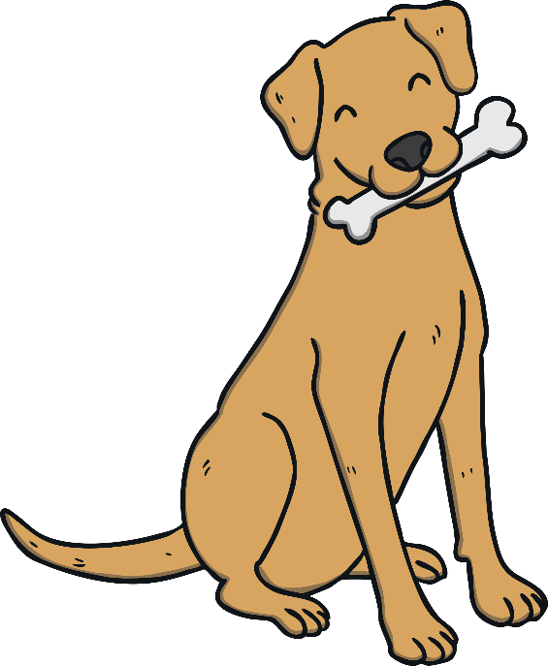
dog

Slide 21

hot

Slide 22

pop

Slide 23

box

Slide 24

jog

Slide 25

zip

Slide 26

can

Slide 27
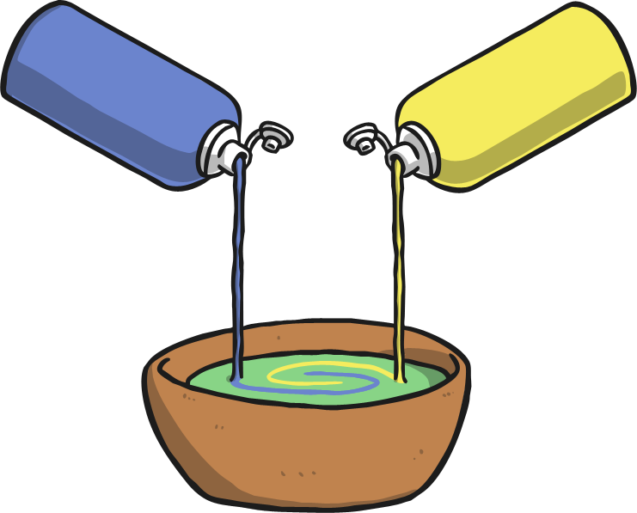
mix

Slide 28

pig

Slide 29

sit

Slide 30


