Slide 1
Can I understand the meaning of forgiveness?

Slide 2
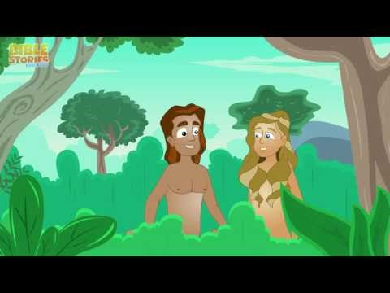
Adam and Eve – The Fall

Slide 3
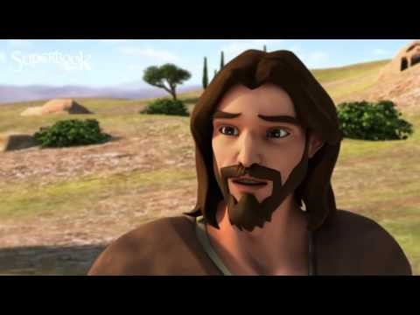
The Prodigal son

Slide 4

What is forgiveness?
In your own words, explain what forgiveness is,
what it isn’t and why it is important.

Slide 5
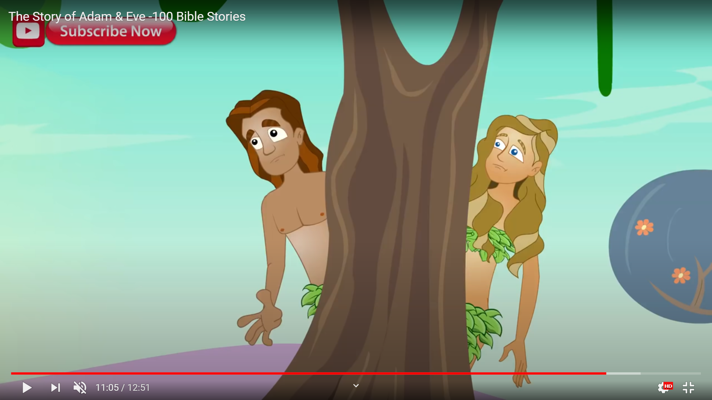
Why do you think Adam and Eve did not say sorry?

Slide 6
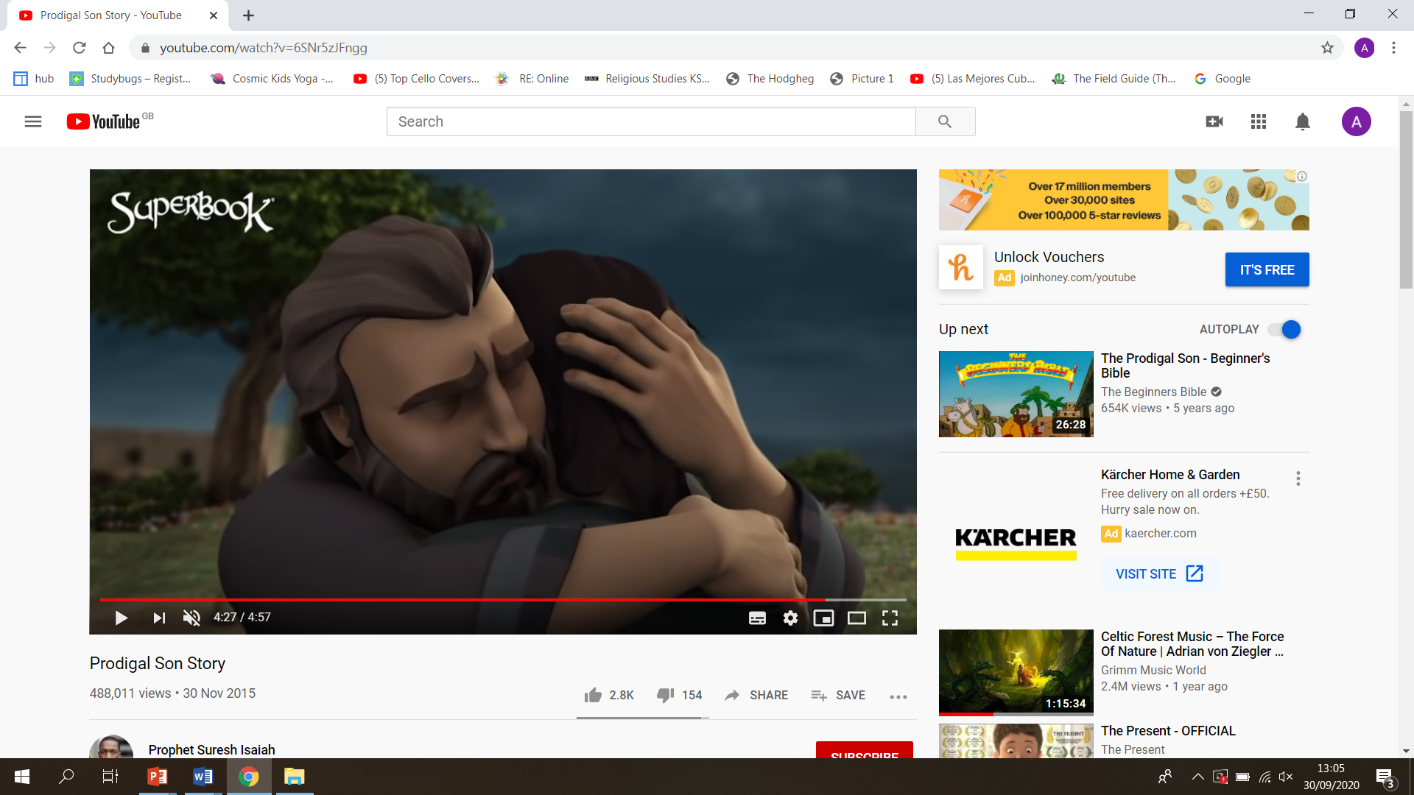
Why did the father forgive the son?

Slide 7
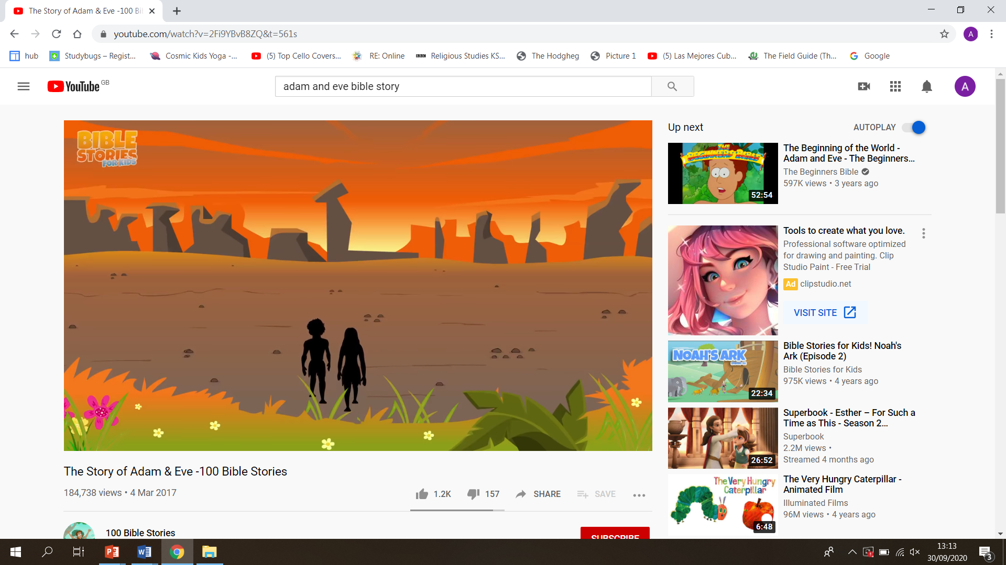
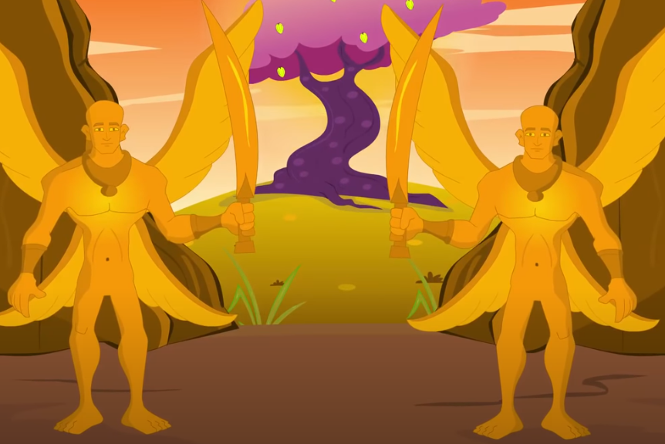
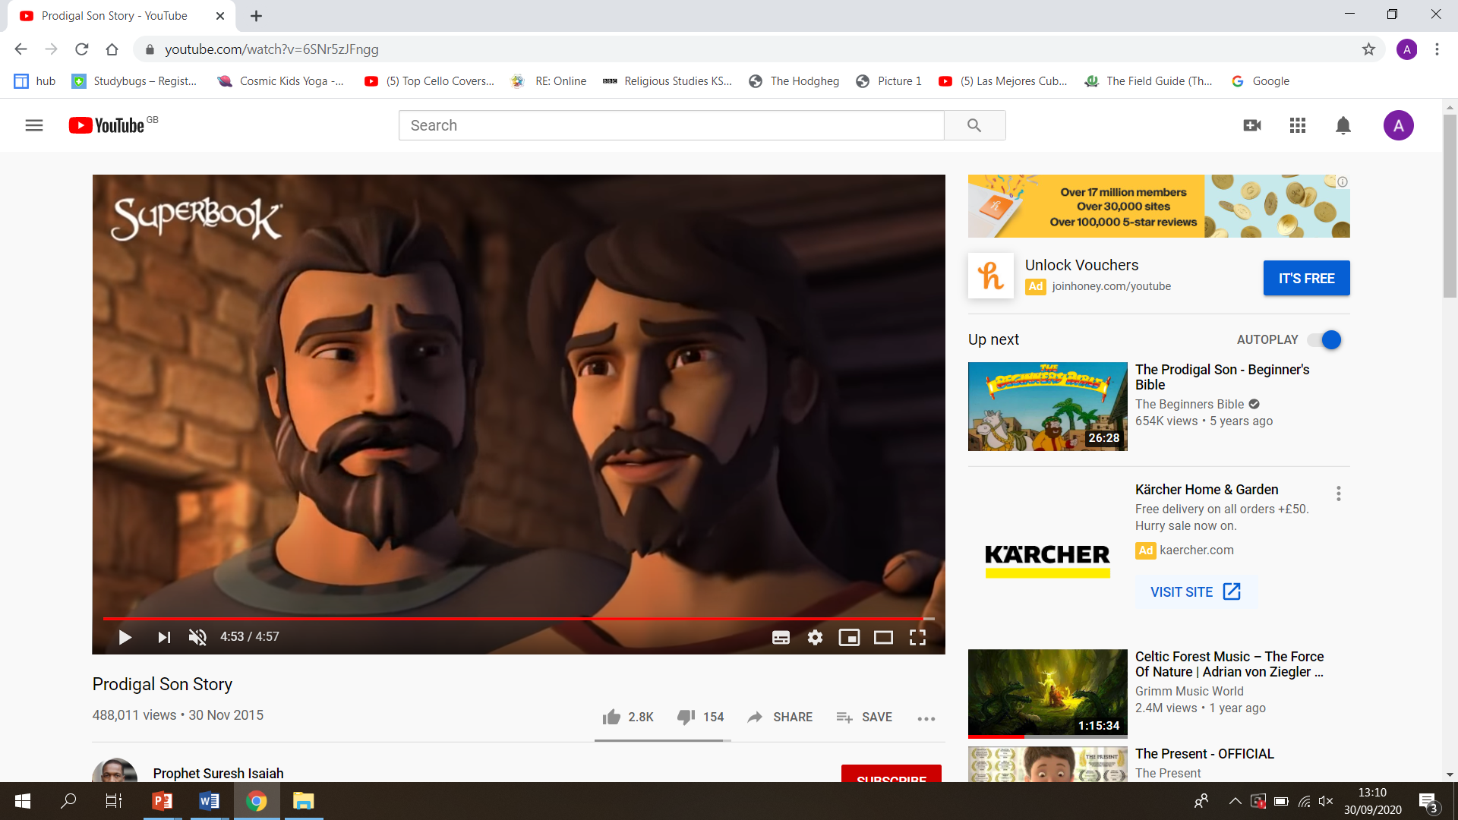
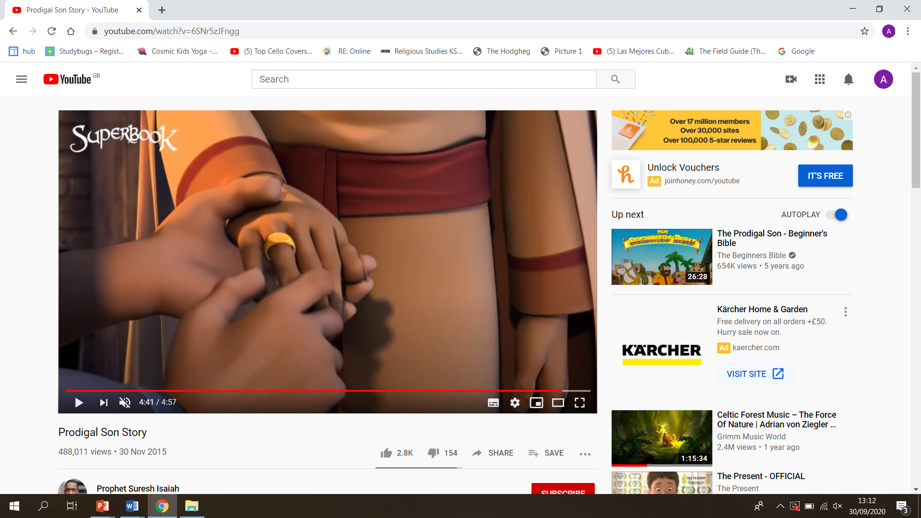
Second chances
Do you think Adam and Eve deserved a second chance?
Do you think the son deserved a second chance?

