Slide 1
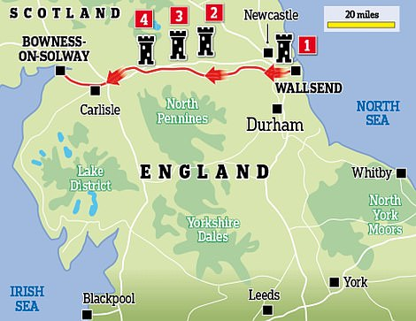
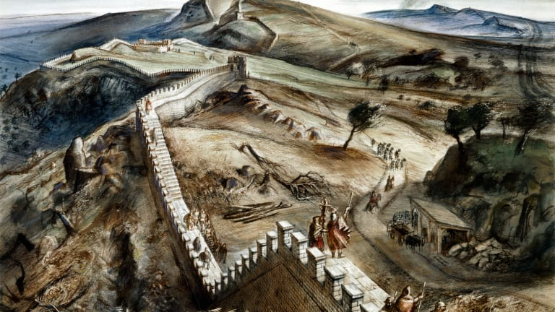
Hadrian’s Wall
I chose Hadrian’s Wall because it is in the UK
The wall is located at the border of England and Scotland. It runs from Wallsend and Newcastle to Bowness-on-Solway (73 miles).
The wall was mainly made from stone and it was 6m high.

Slide 2
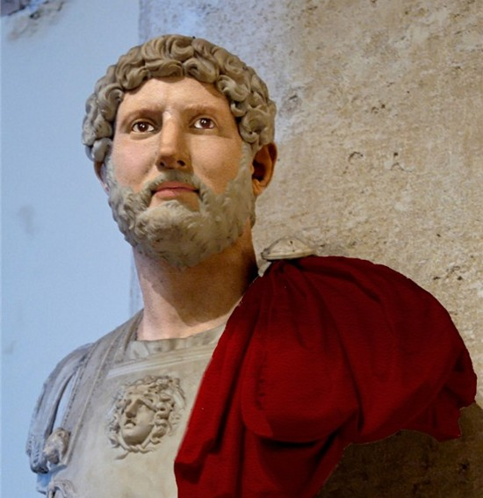
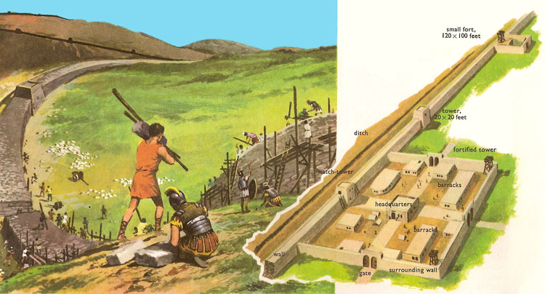
Who was Hadrian?
Hadrian was a Roman Emperor from 117 to 138 AD
Who built Hadrian’s Wall?
The wall was built by the army of Britain. It took 15,000 men.

Slide 3
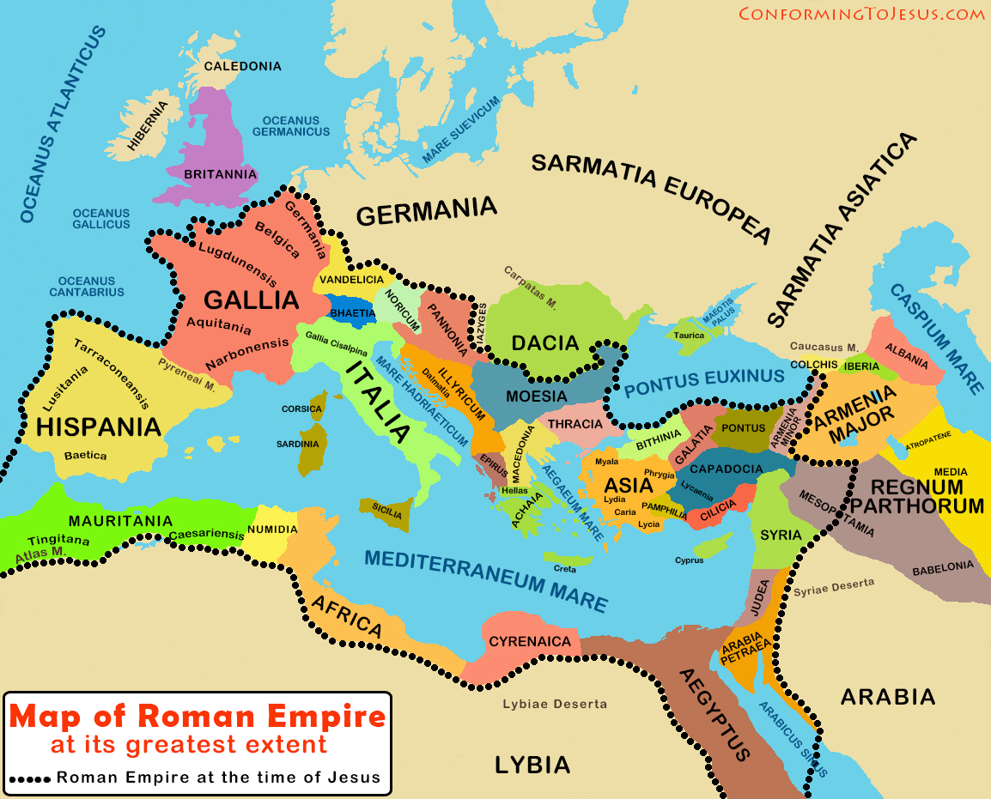
Why did they build Hadrian’s Wall?
The wall was built to secure the Roman Empire border in Britannia (Great Britain).
Hadrian’s Wall

Slide 4
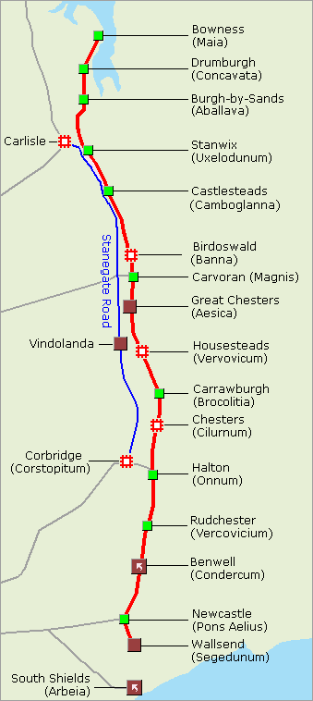
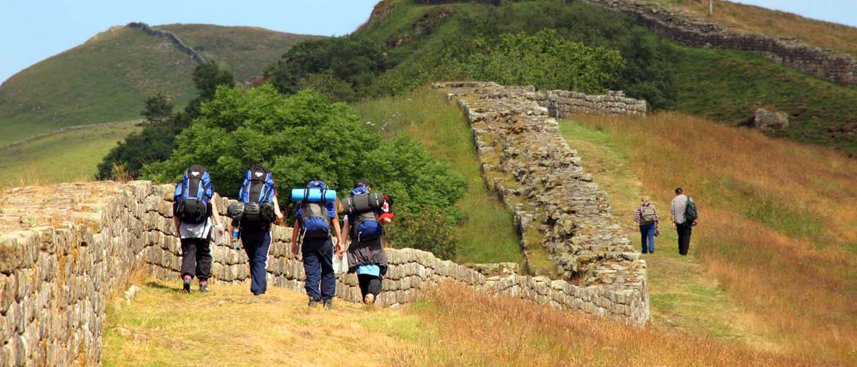
Can you visit it now?
Hadrian’s Wall is a World Heritage Site.
It is celebrating it’s 1900th anniversary in 2022.
You can walk along the wall for free or see the following places:
Segedunum
Chesters Roman Fort
Housesteads Roman Fort
Vindolanda Roman Fort
Birdoswald Roman Fort

