Slide 1
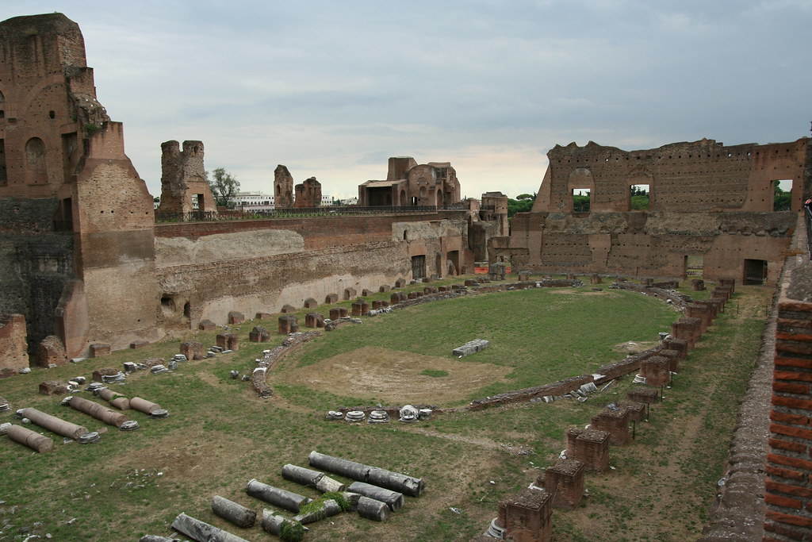
Circus Maximus
By
Charlie Tappin

Slide 2
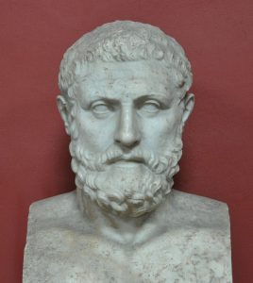
BACKGROUND
Circus Maximus was built by the 5th Roman king Lucius Tarquinius Priscus in Italy.
It is believed to have been built in late 7th or early 6th century BC.
It is an ancient Roman chariot racing stadium

Slide 3
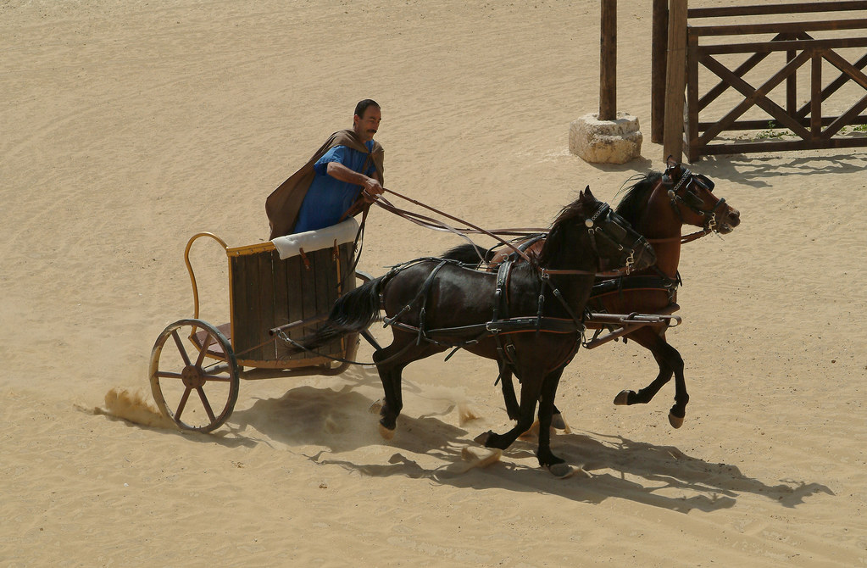
Uses and Facts
Circus Maximus was the largest stadium in the entire Roman Empire
It was used as a model for the construction of other stadiums across the Roman Empire.
The Circus was built mainly for entertainment purposes. The most popular event held at the site was the chariot race which was witnessed by a huge crowd.
The venue could fill up to
150,000 people.
Gladiators who fought were slaves
and prisoners

Slide 4
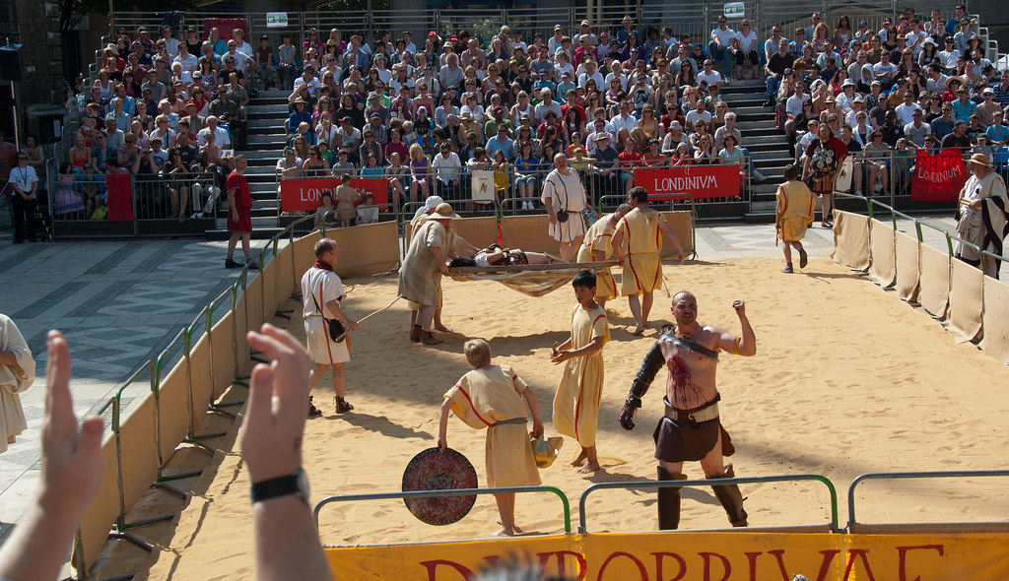
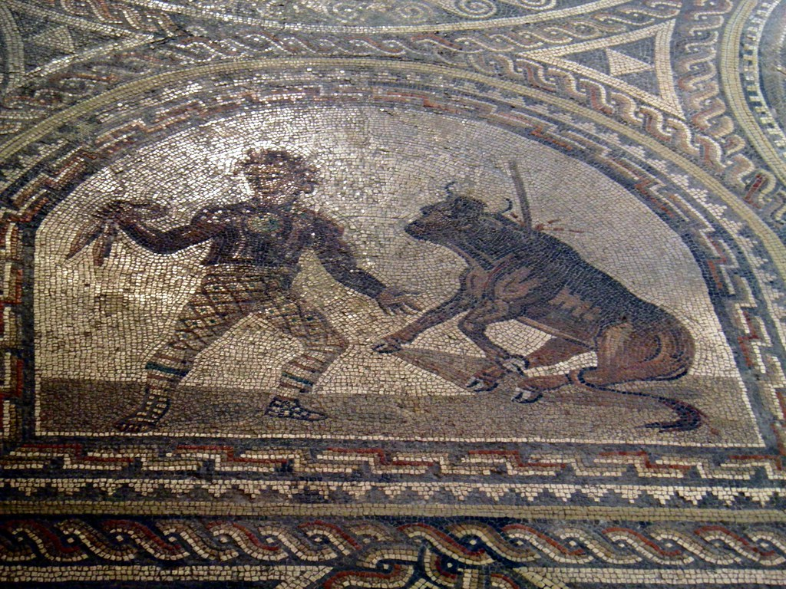
The stadium was also used for the celebration of religious events and holding public games during festivals.
Special games were also held to celebrate victory in wars.
Circus Maximus was still used for large scale animal hunting shows and Gladiator games

Slide 5
What happened to Circus Maximus and is it still used now?
After the 6th century AD, the stadium was no longer in use and started to suffer from decay and damage.
Thieves stole building material which damaged the structure greatly
As a result of flooding, lower tiers of seating gradually got buried and it is believed that the actual track remains buried under a layer of 6 meter thick soil.
The site is now used as a park area and is regularly used for holding music concerts
The stadium was also used as the venue for the victory celebration after Italy won the 2006 FIFA world cup in Germany. They also use it now for celebration events. People also use it for a playing games and having fun.

