Slide 1
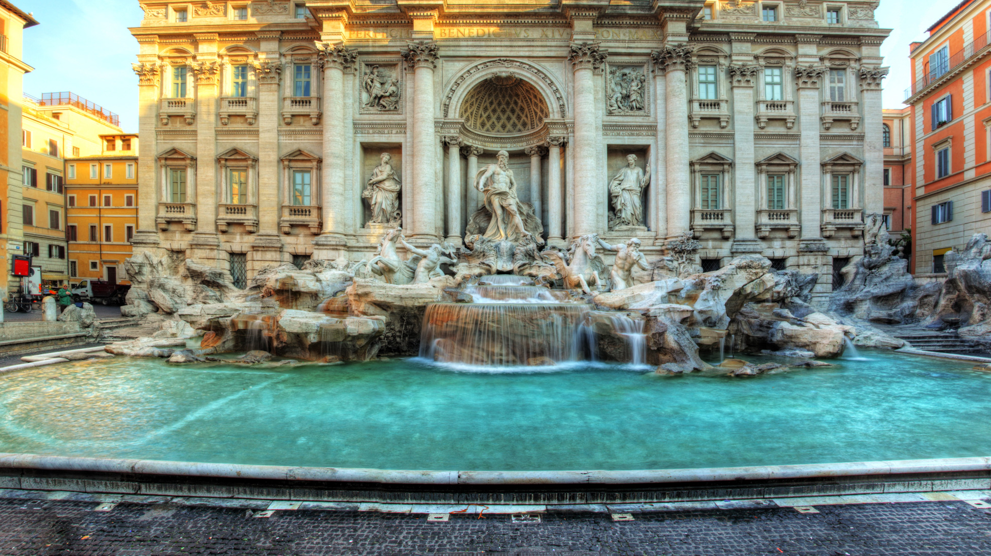
Trevi Fountain
By Chloe Thomson

Slide 2
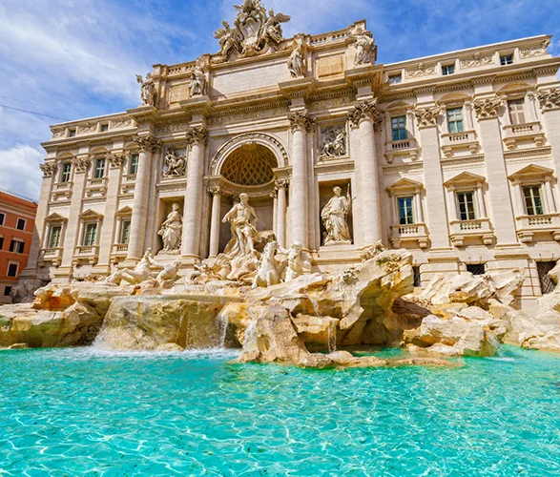
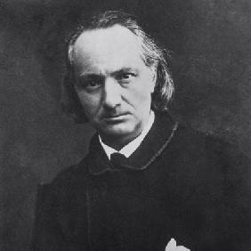
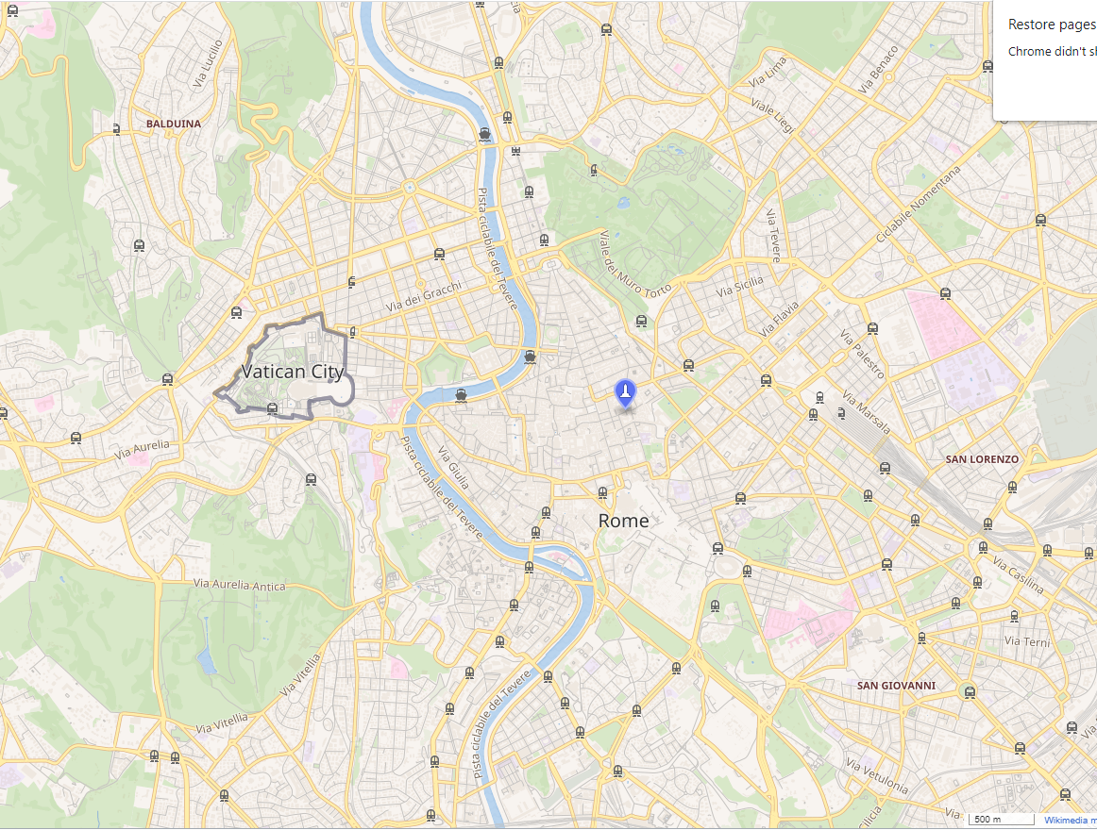
Background
The Trevi fountain is in the Trevi district in Rome, Italy.
The Trevi fountain was designed by architect called Nicola Salvi.
The Trevi fountain was opened in May 1762 by Pope Clement XIII.
The Trevi fountain name comes from the Latin word ‘Trivium’ meaning where three streets are connecting.

Slide 3
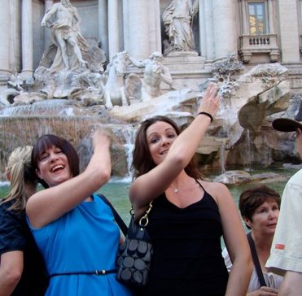
Coin Throwing
People throw coins into the Trevi Fountain
Throwing a coin into the Trevi fountain means “You will return to Rome someday”
The correct way to throw coins into the Trevi Fountain is to use your right hand over your left shoulder.
An estimated €3,000 are thrown into the fountain each day!!
The money is collected and used to support the poor people of Rome.

Slide 4
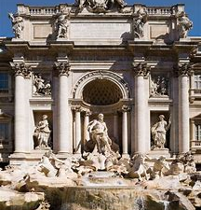
The Fountain
It is 26m tall
The fountain is 49m wide
It is decorated in the Baroque style
It is built on top of an ancient water source
The fountain is made up of statues and one of the statues is the god of water called Oceanus.

