Slide 1
The Rampaging Romans of Bath
By
Florrie Hart

Slide 2
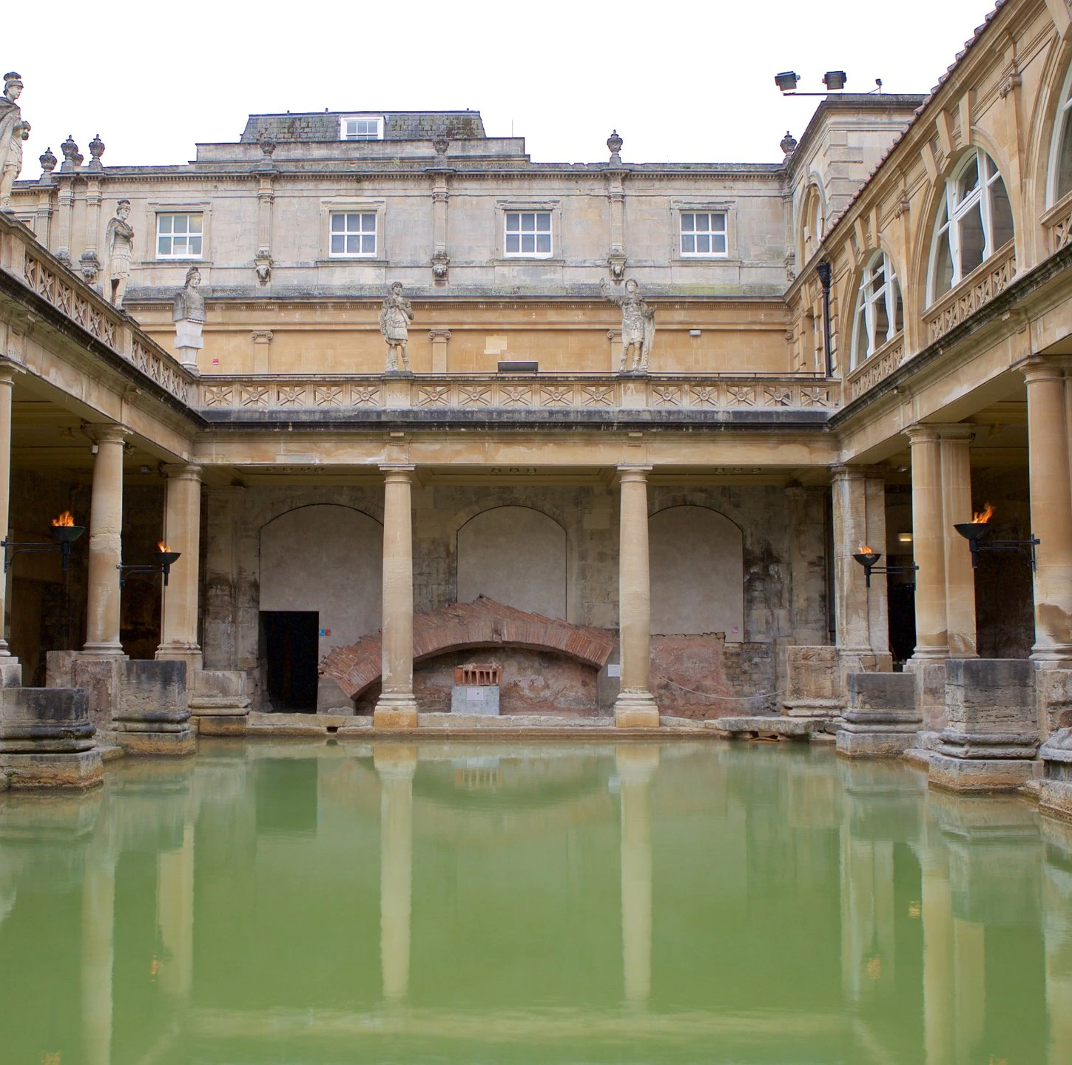
The Romans come to Bath
They arrived in 50 AD
The baths were discovered in 1880 AD

Slide 3
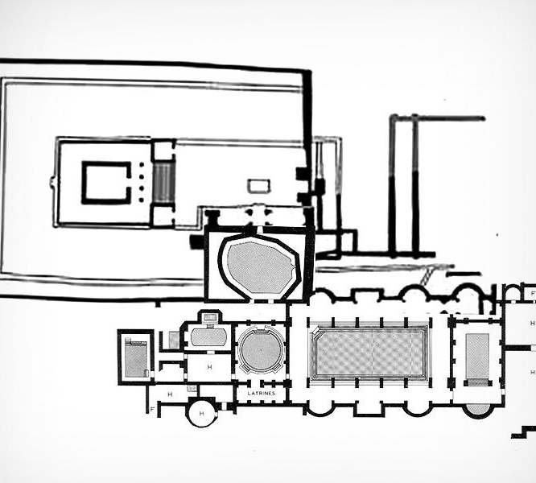
Floor plan
The temple in the courtyard is at the top left side.
The spring is in the middle of the site.
The bath house is at the bottom right .

Slide 4
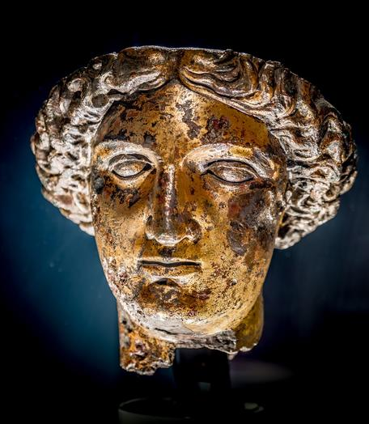
Sulis Minerva
Aquae Sulis (Bath) has 3 hot springs. The biggest spring is special to the goddess Sulis Minerva. She was worshipped here even before the Romans arrived. People travelled far to visit the spring, pray to her, and ask for her help. The water gushes up as a natural hot spring of 46C (hotter than my bath!)

Slide 5
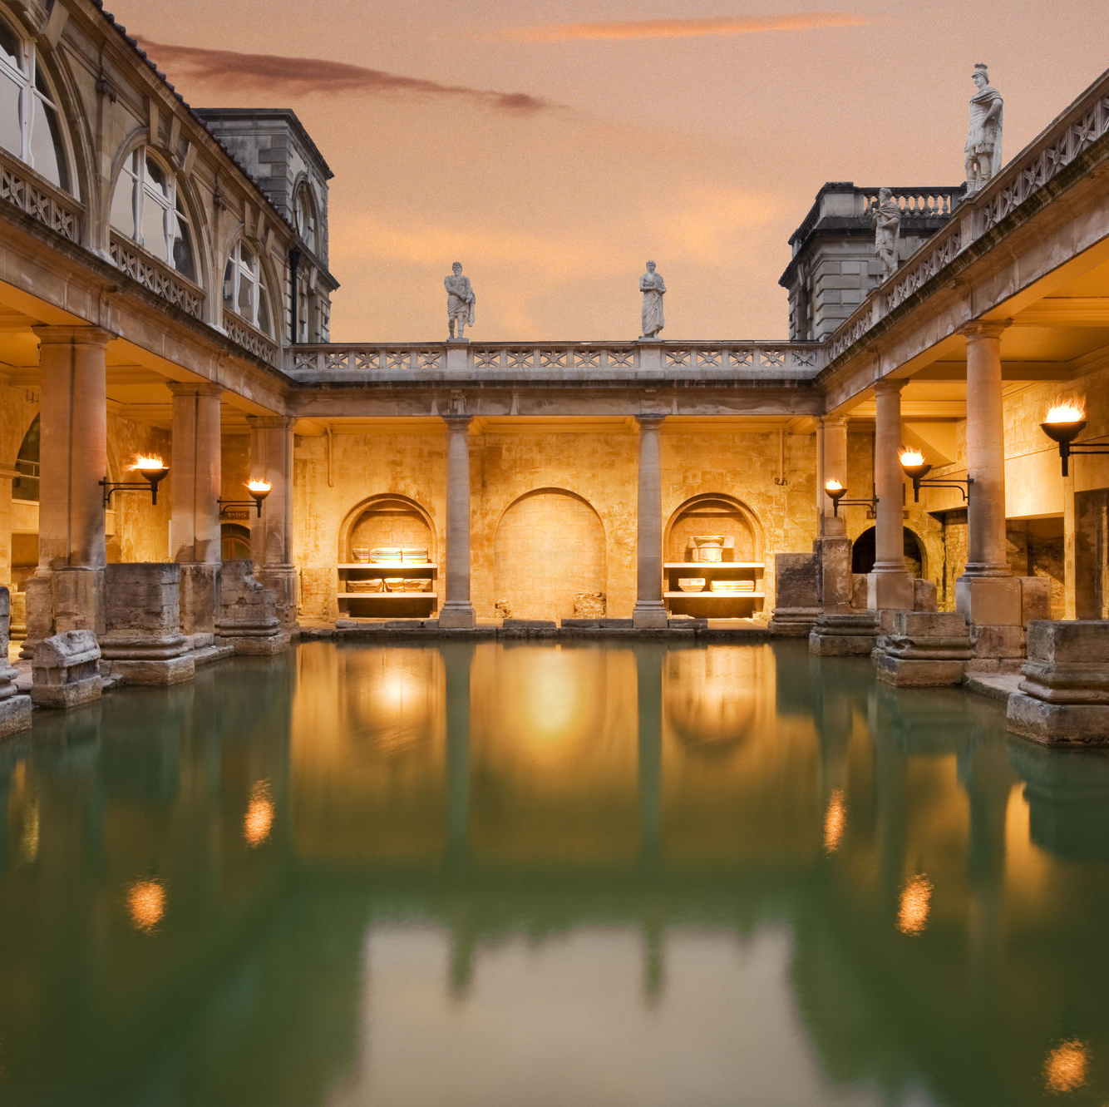
Roman Baths
Built throughout the Roman Empire.
Girls and boys weren’t allowed in the same bath.
The Roman baths were like public swimming pools.
Some baths were hot, others were cold.
Fires heated the water.

Slide 6
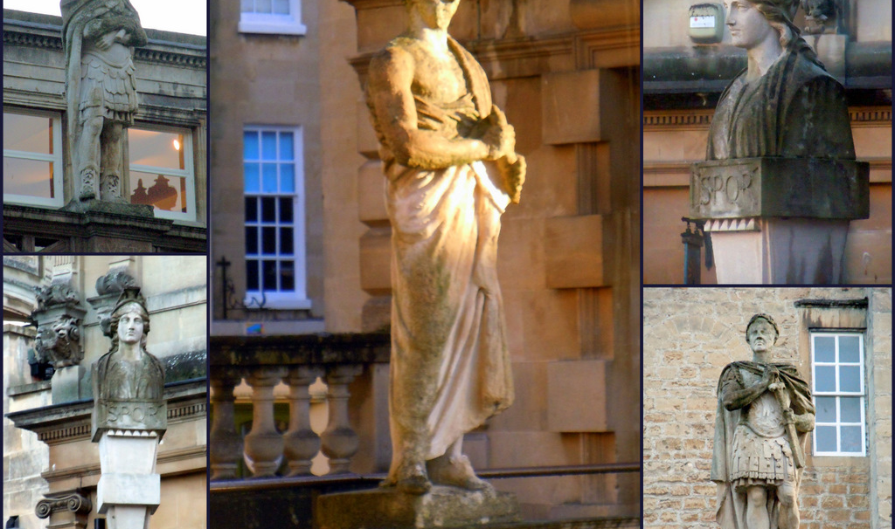
They built statues of gods, Emperors and other important people.

Slide 7
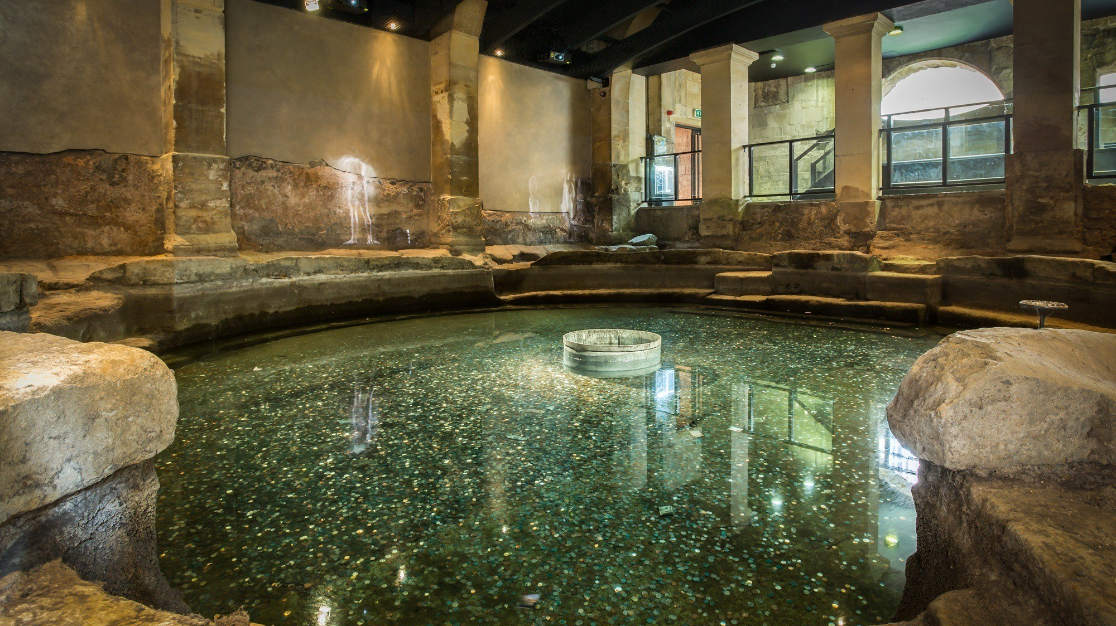
They threw coins into this bath for good luck
This bath is very cold.

Slide 8
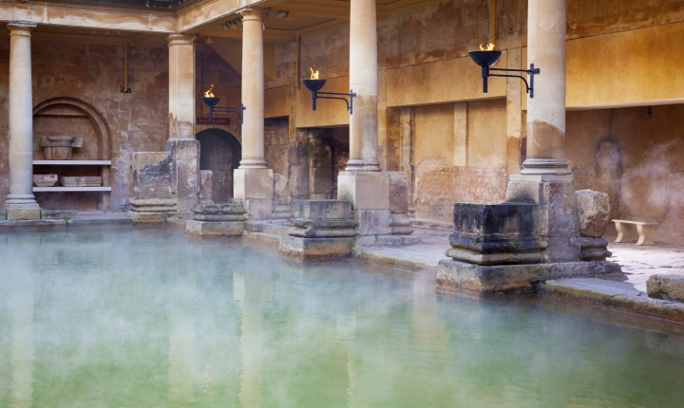
Bubbles and steam rose to the surface.

Slide 9
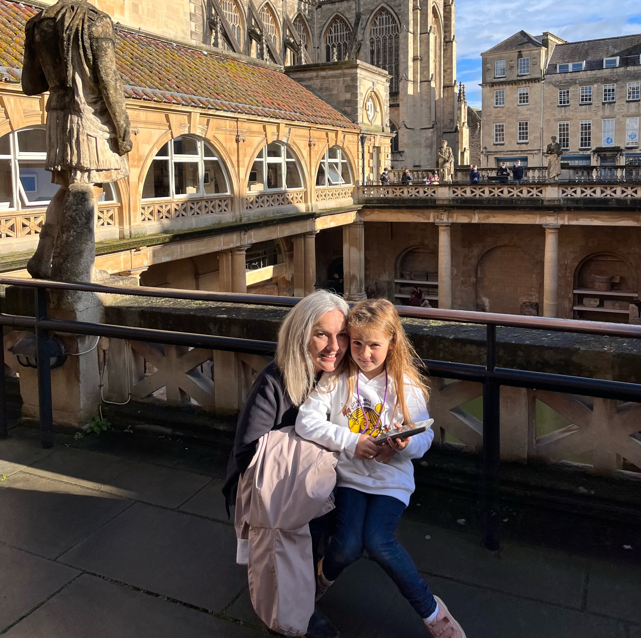
And I went there with my mum and dad!

