Slide 1
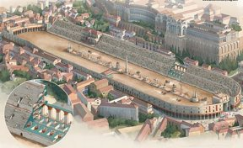
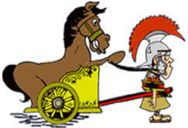
Roman Facts
Questions about Circus Maximus

Slide 2

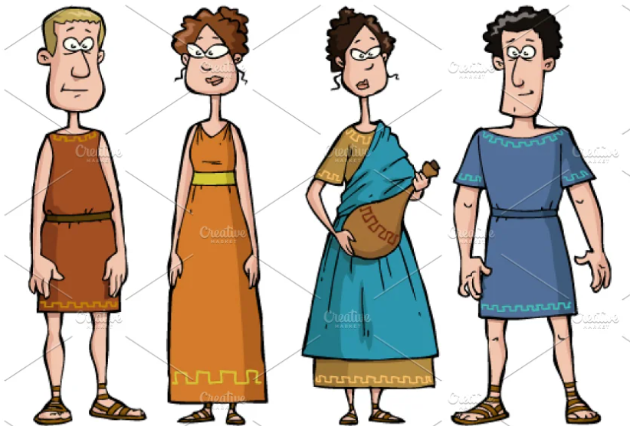
Question 1
How many people could fit into the Circus Maximus?
A) 100,000
B) 250,000
C) 300,000

Slide 3
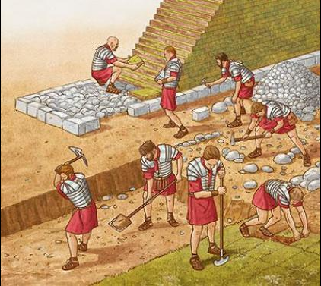
Question 2
When was the Circus Maximus built?
A) 6th century BC
B) 1st century BC
C) 8th century BC

Slide 4
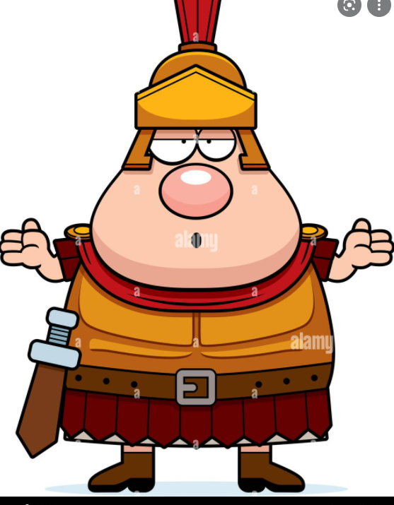
Question 3
How much did it cost to enter the Circus Maximum?
A) £5
B) Free
C) £2

Slide 5
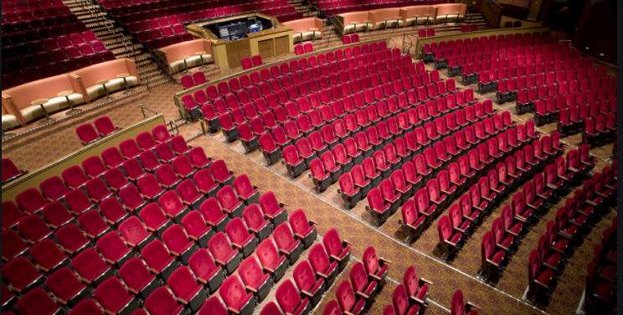
Question 4
Where were the rich seated in the Circus Maximum?
A) Top seats
B) Bottom seats
C) Middle seats

Slide 6
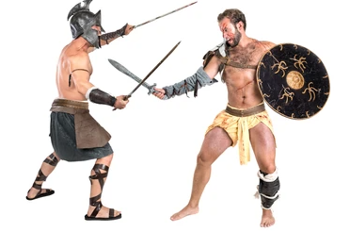
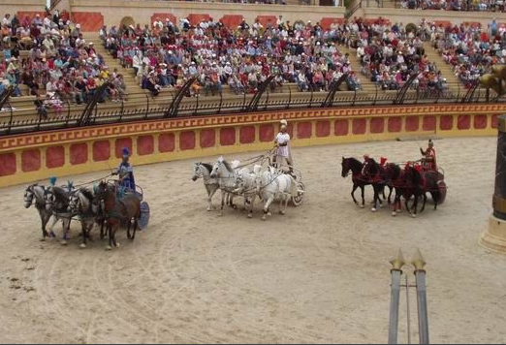

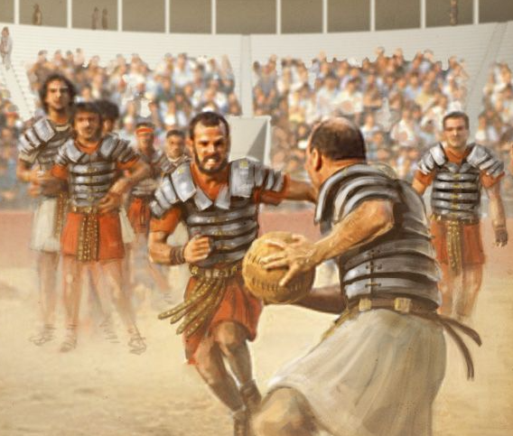
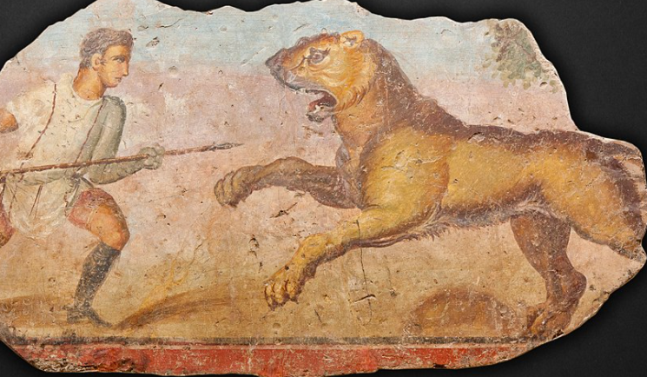
Question 5
Which of these events was NOT held in the Circus Maximus?
A) Gladiator combats
B) Chariot racing
C) Dancing on Ice
D) Animal hunts
E) Athletic events

